Slide 1
Quantization Error Analysis for CSI Report
Date: 2021-10-12
Authors:
Name | Affiliations | Address | Phone | email
Steve Shellhammer | Qualcomm |  |  | shellhammer@ieee.org

Slide 2
Background
In [1] several Quantization methods were described for the Sensing CSI Report
The two Quantization methods described were:
Rounding without Scaling
Low-Complexity Scaling and Quantization
Here we look at the quantization errors introduced by those two methods
[1] S. Shellhammer, et. al., “Low-Complexity Scaling and Quantization for CSI Report,” IEEE 802.11-21/1573r0, September 2021

Slide 3
Simulation
Simulated the following cases
80 MHz Channel Bandwidth
2x2 NLOS Channel Model D
5000 Channel Realizations
Ng = 2
$N_{b}∈\{4, 6, 8\}$
Considered the internal processing margin in the receiver CSI calculator (more details on the next slide)
Second Set of Simulations
Focused only on the Low-Complexity Scaling and Quantization approach
Included $N_{b}∈\{10, 12\}$
Notation
Complex element of 2x2 CSI complex matrix on a given tone is indicated by $z$
Quantized version of $z$ is indicated by $\hat{z}$

Slide 4
Receiver Calculator Margin
Receiver implementations require AGC and digital scaling in the calculation of the CSI
It is not possible for the receiver to know in advance exactly the effects of AGC and calculation of the CSI values, to scale the internal CSI values perfectly
Typical implementations include a margin of 1-3 bits of margin in the internal digital representation to avoid overflow
This is implementation dependent
A 1-bit margin corresponds to a 6 dB margin

Slide 5
Simulation of Internal Processing Margin
We specify the internal processing margin in dB
We consider three different values of processing margin
Internal Processing Margin (dB) | Description
0 | This is Gene receiver, where the largest CSI value is exactly equal to the largest value that can be represented by a $N_{p}$ word size ($N_{p}$ is the word size used in the internal PHY CSI value)
6 | This a 6 dB margin from the 0 dB case. This is equivalent to a 1-bit internal processing margin.
12 | This a 12 dB margin from the 0 dB case. This is equivalent to a 2-bit internal processing margin.

Slide 6
Quantization Error
For each element in the 2x2 CSI matrix we define the following normalized quantization error
$$e=20 Log\left( \frac{\left|z − \hat{z}\right|}{\left|z\right|}\right)=10 Log\left(\frac{{\left|z − \hat{z}\right|}^{2}}{{\left|z\right|}^{2}}\right)$$
Computing this error over every element in the CSI matrix, for each tone, and for each channel realization we have over a million complex values
The error is in dB
Analysis of Quantization Errors
Plotted CDF of quantization errors

Slide 7
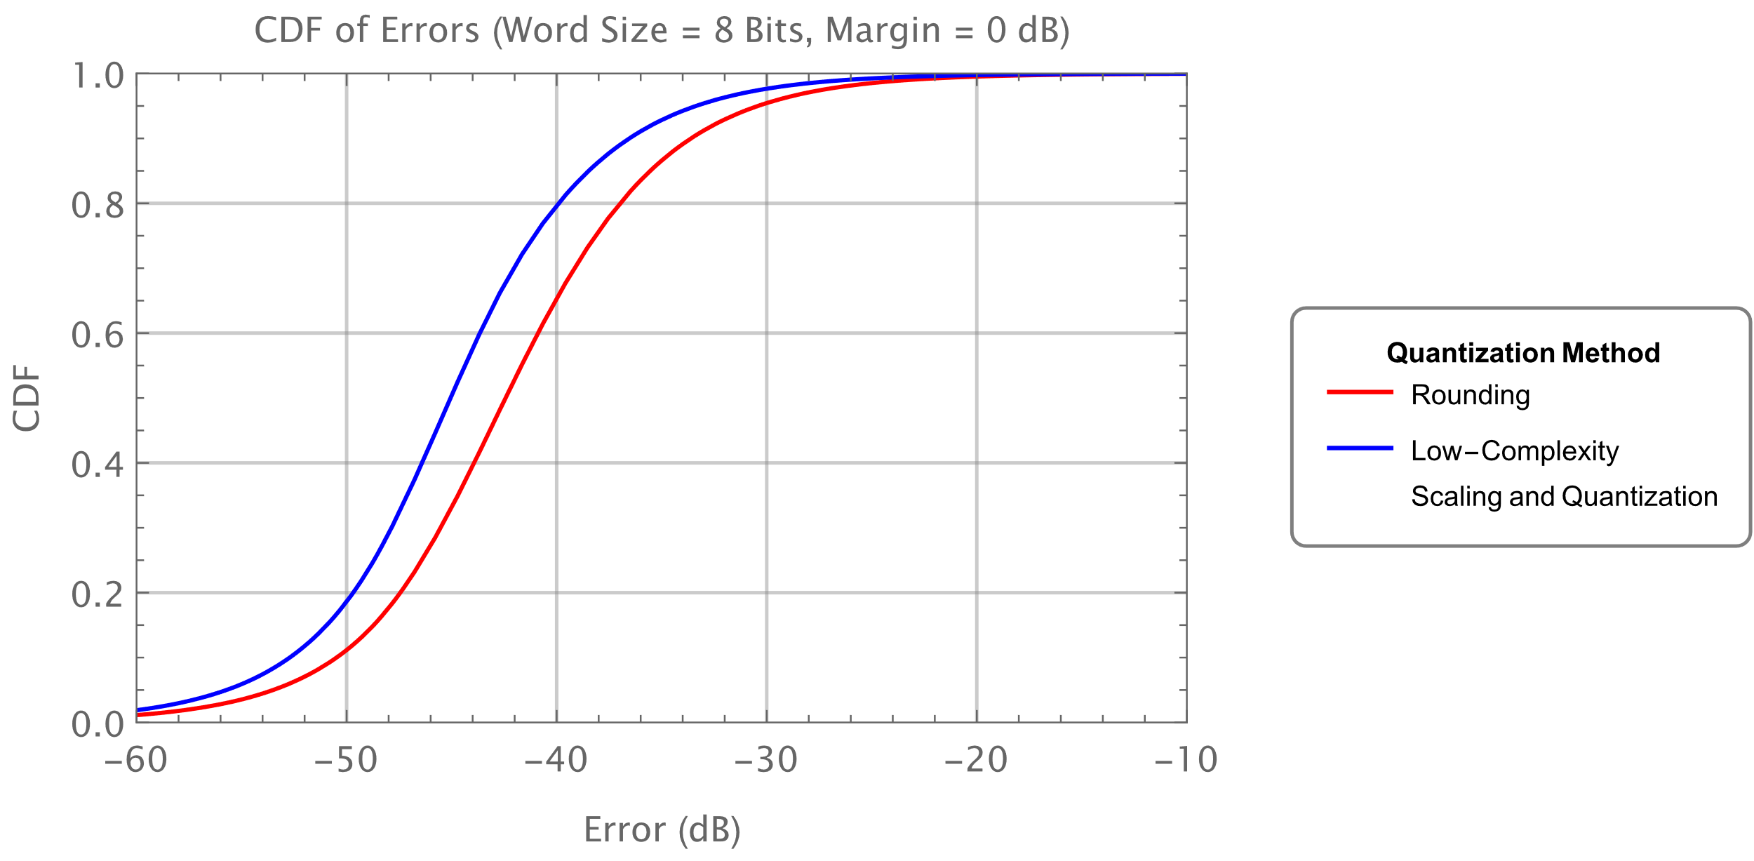
CDF ($N_{b}=8$, Margin = 0 dB)
Low-Complexity Scaling and Quantization has lower quantization errors than Rounding

Slide 8
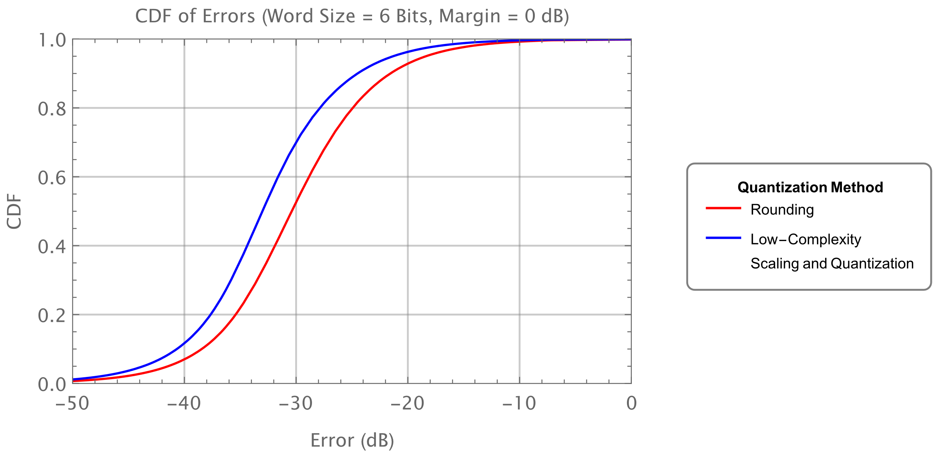
CDF ($N_{b}=6$, Margin = 0 dB)
Dropping from 8-bit to 6-bit increase the error by around 12 dB, as expected

Slide 9
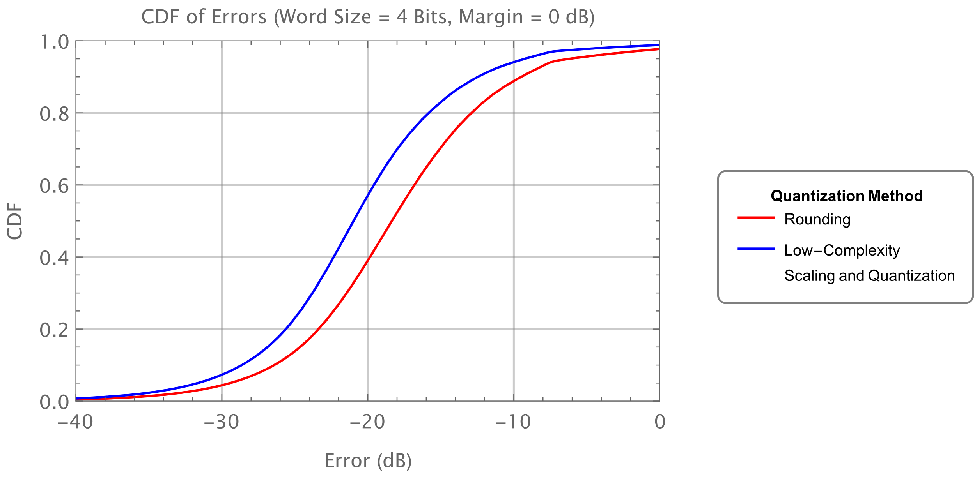
CDF ($N_{b}=$4, Margin = 0 dB)
As we drop to 4-bit the error becomes quite substantial, as expected

Slide 10
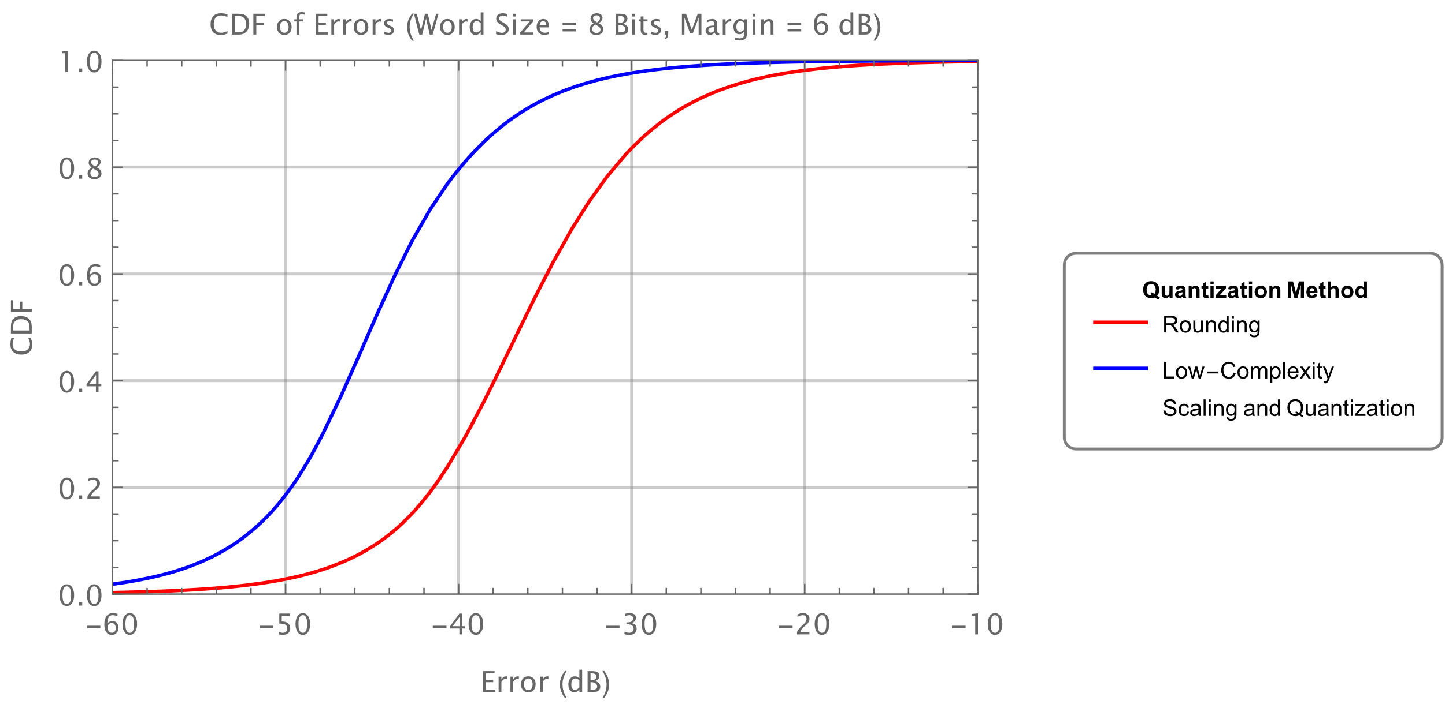
CDF ($N_{b}=8$, Margin = 6 dB)
With 6 dB margin we see an increase in the Rounding error, while the Low-Complexity Scaling and Quantization error is like the case with 0 dB margin

Slide 11
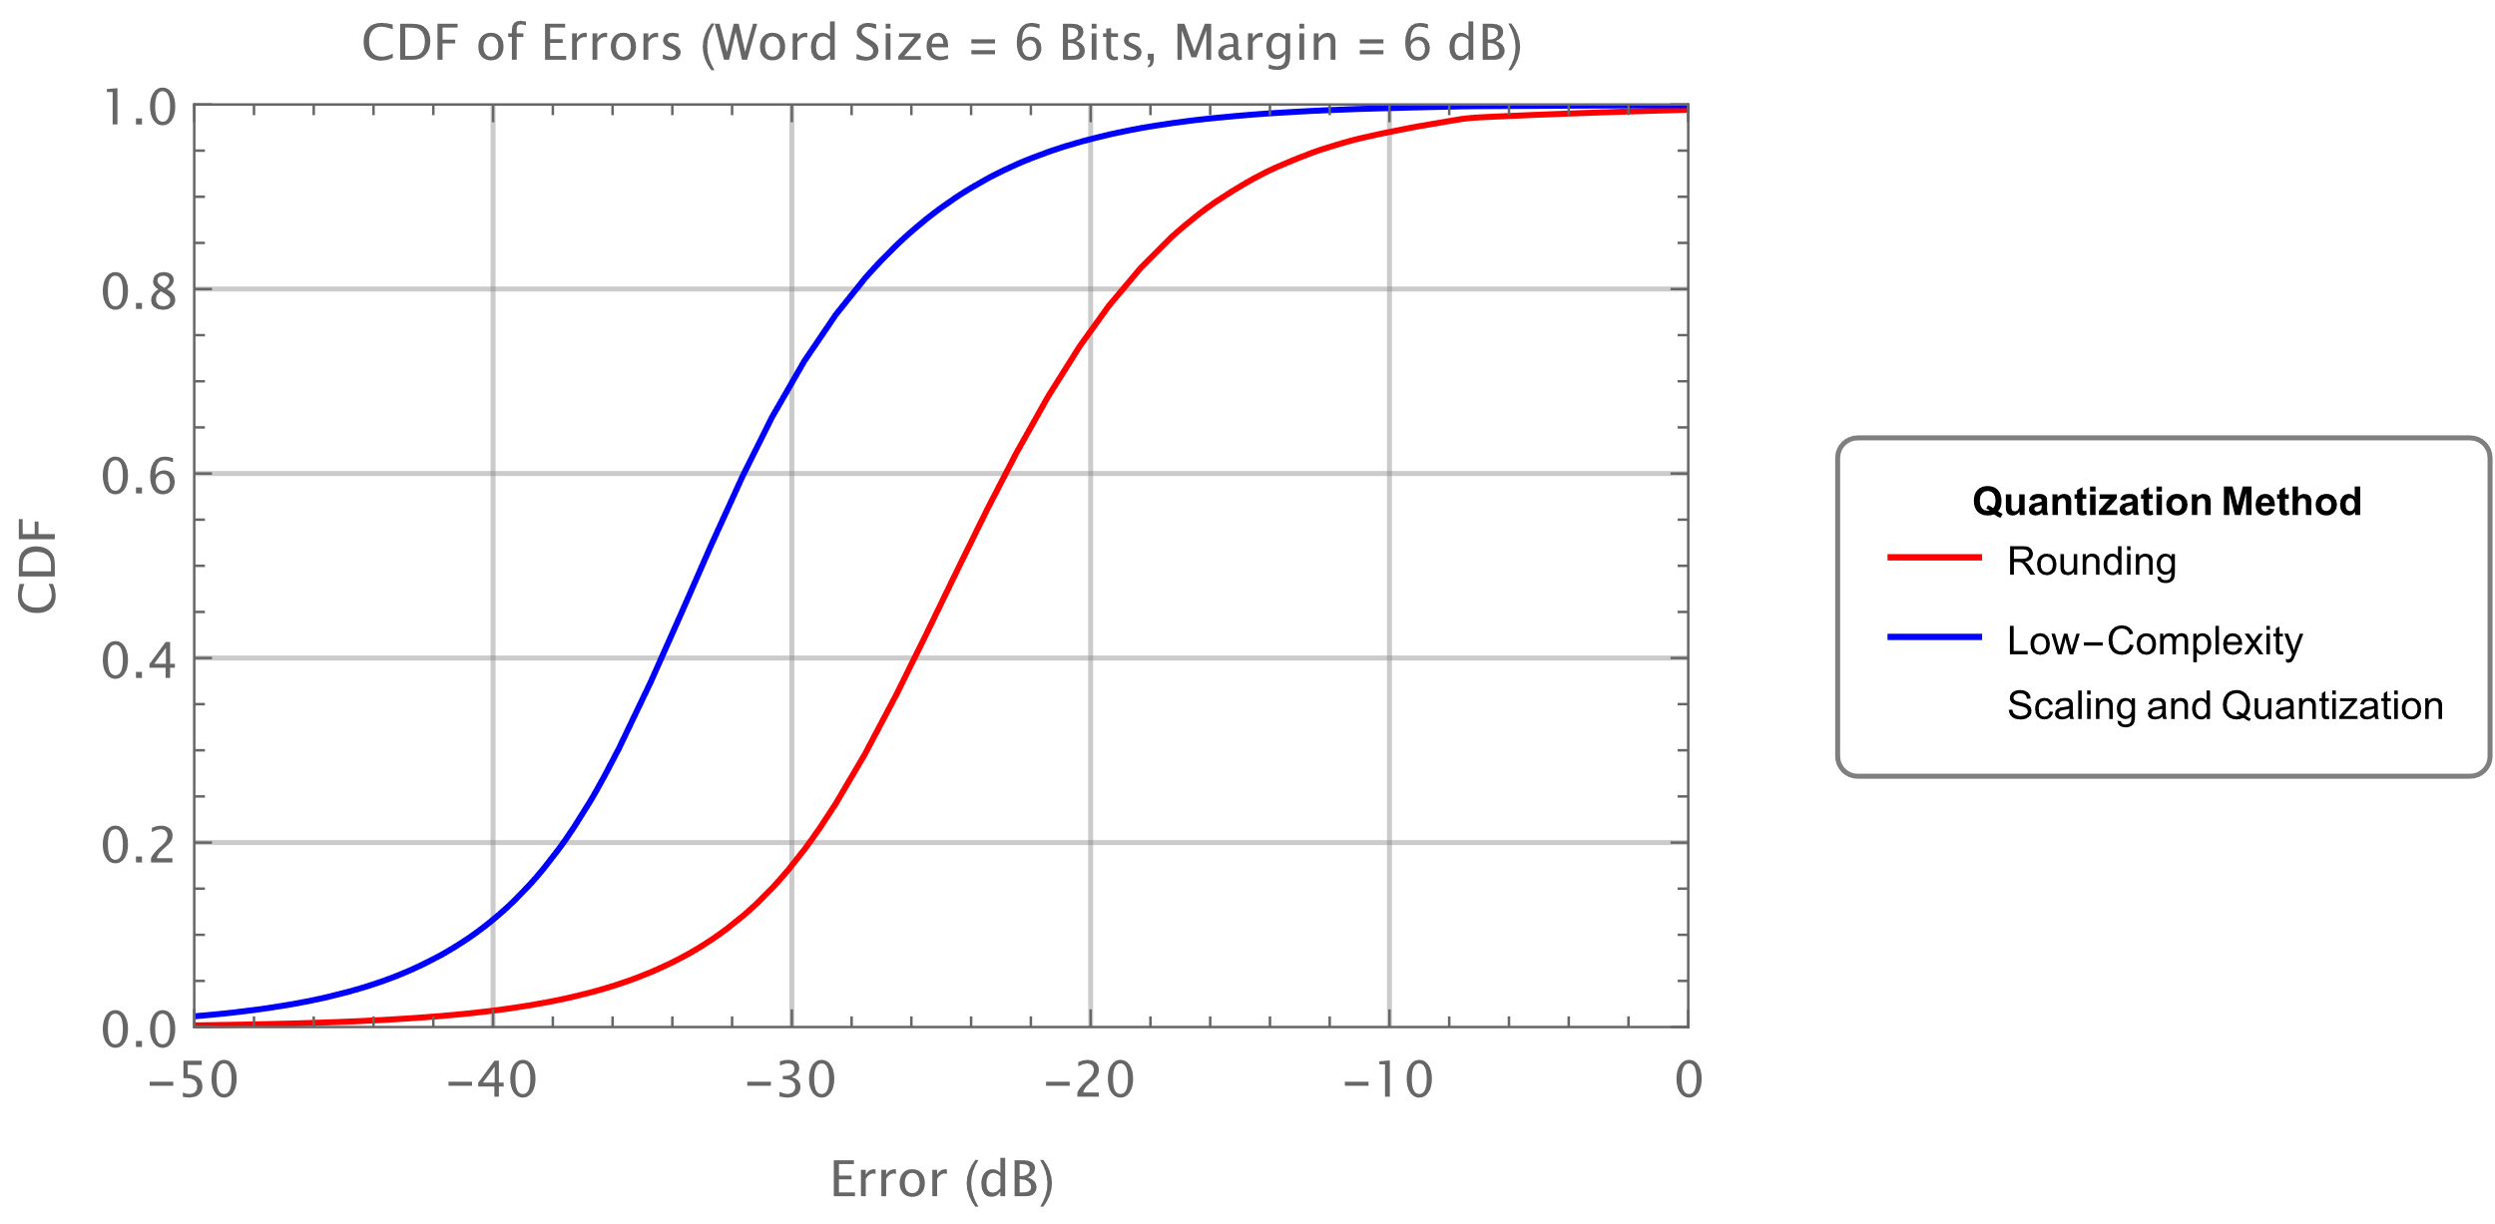
CDF ($N_{b}=6$, Margin = 6 dB)
Similar to previous case, but with higher error due to 6-bit word size

Slide 12
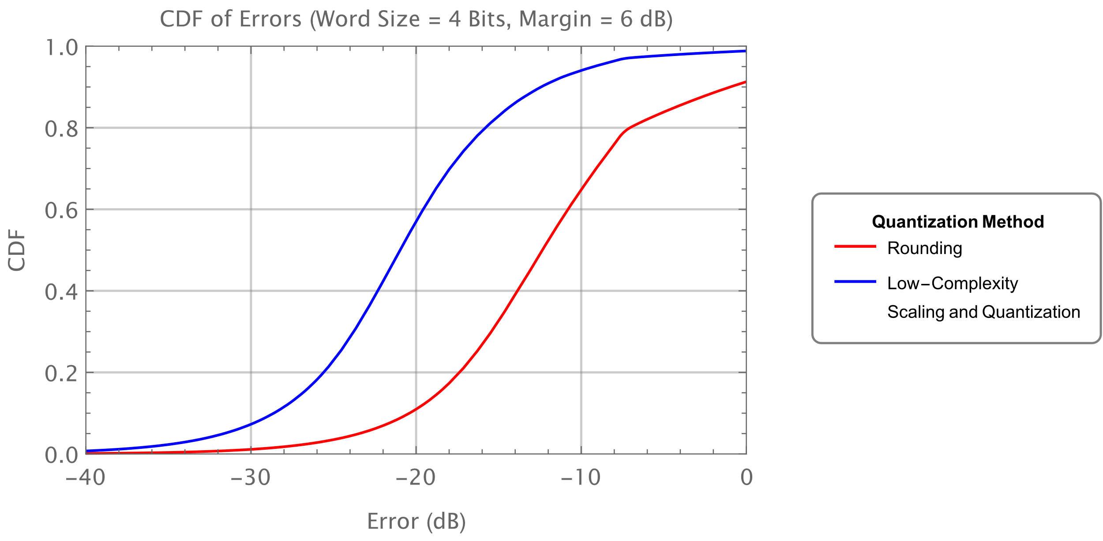
CDF ($N_{b}=$4, Margin = 6 dB)
Similar to previous case, but with higher error due to 4-bit word size

Slide 13
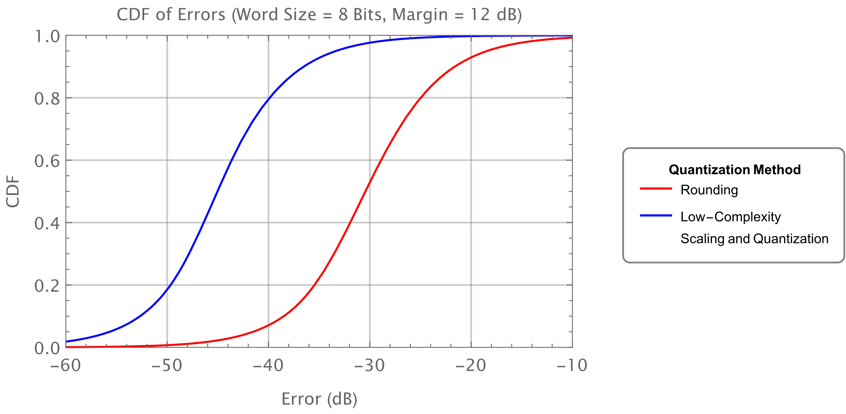
CDF ($N_{b}=8$, Margin = 12 dB)
Increase in Rounding error due to larger margin

Slide 14
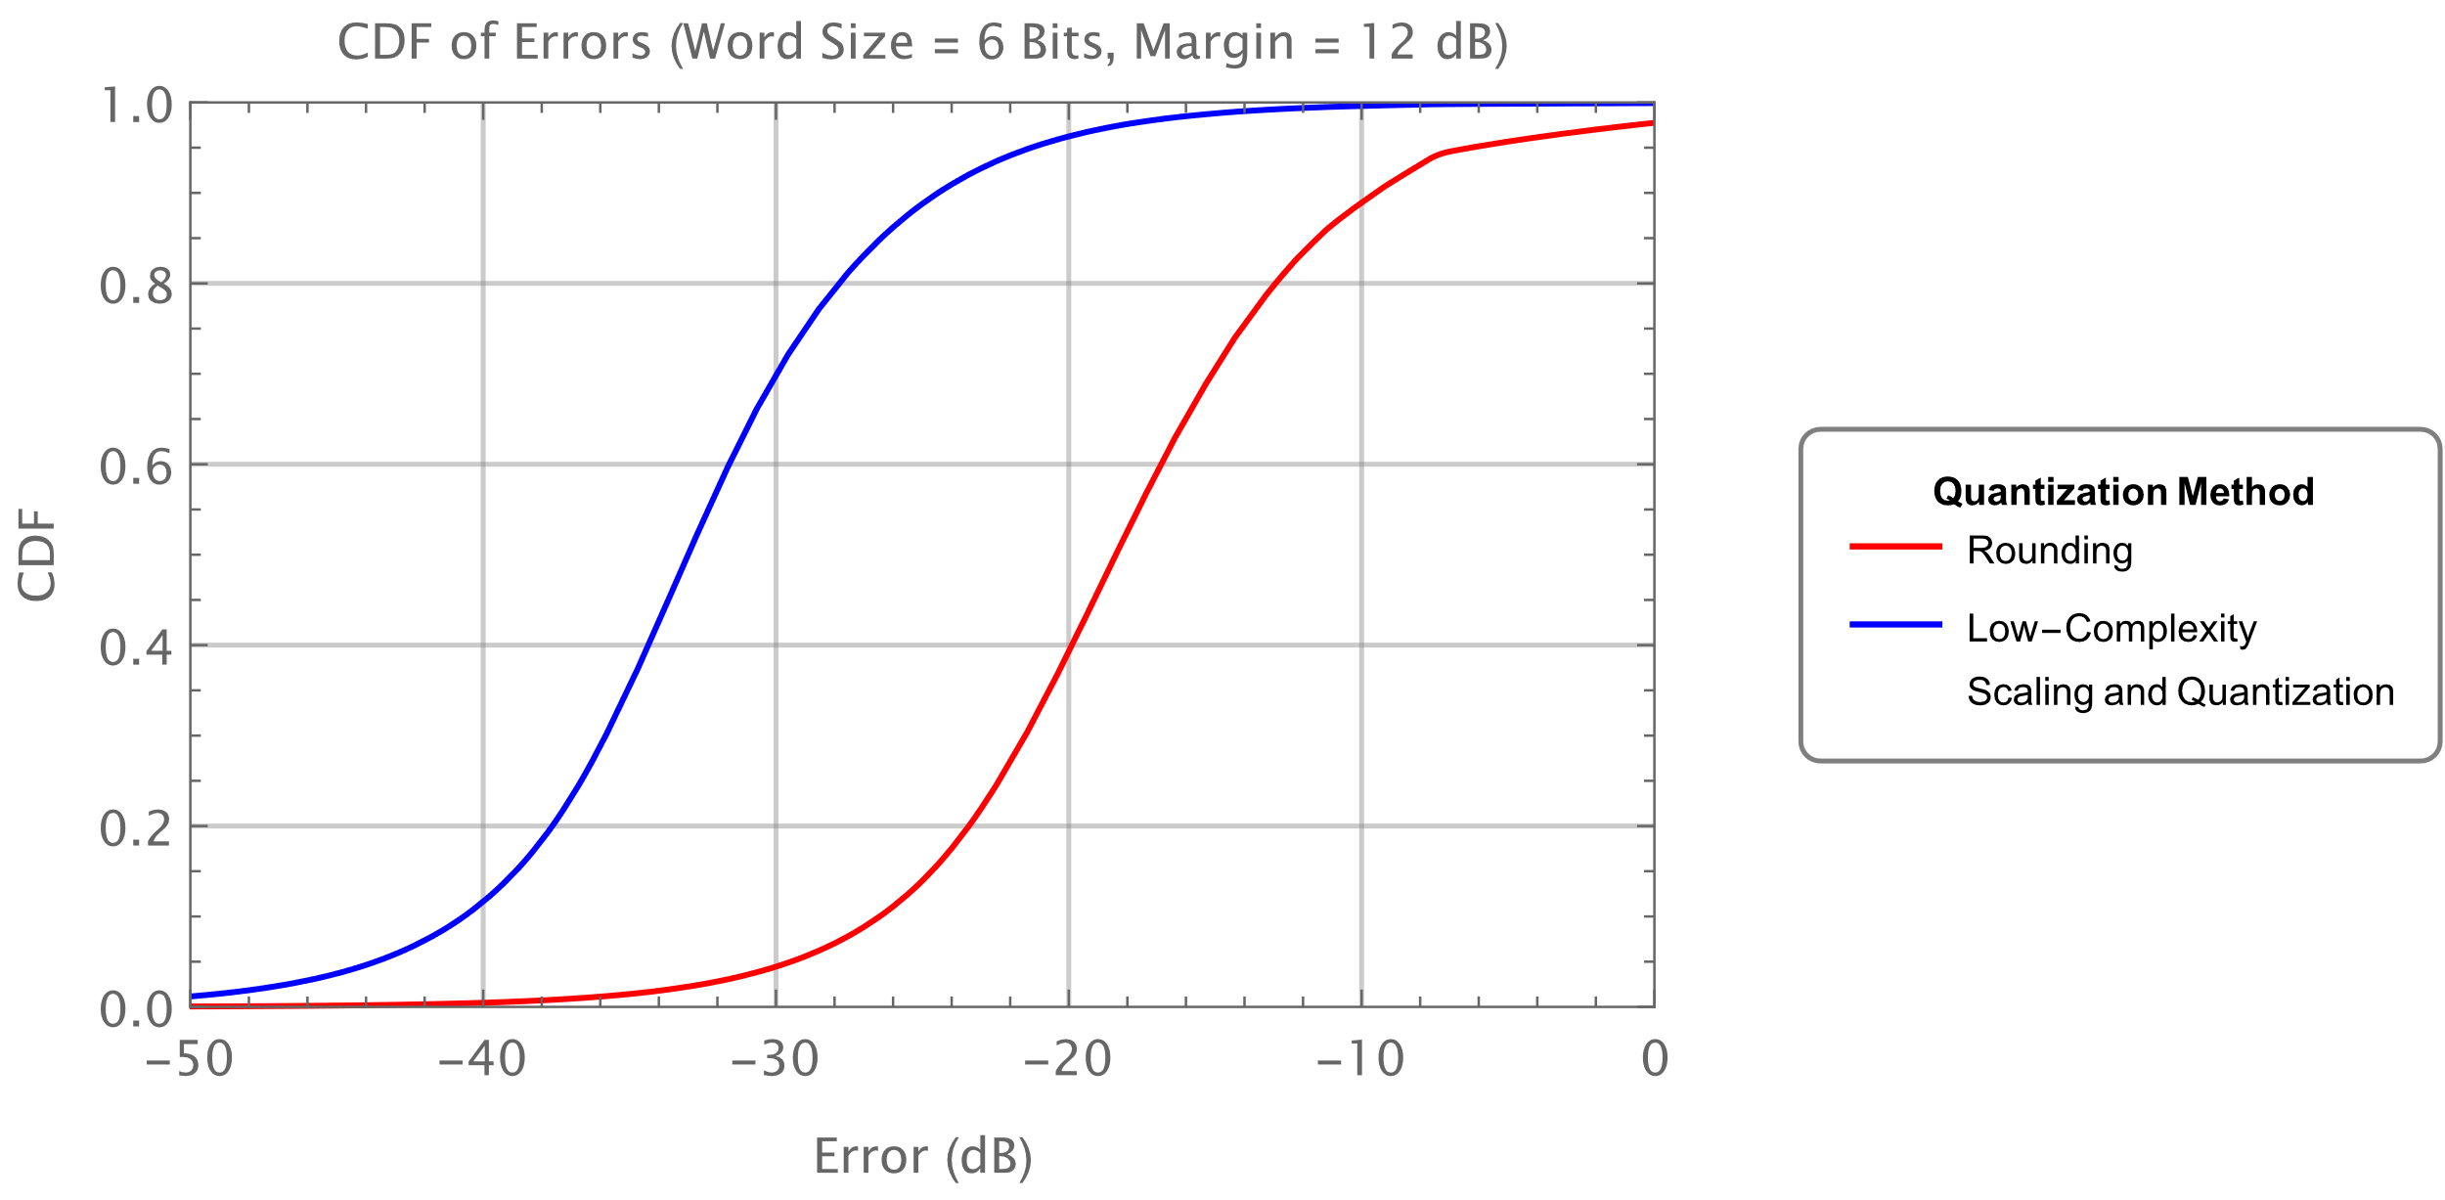
CDF ($N_{b}=6$, Margin = 12 dB)
Increase in Rounding error due to larger margin

Slide 15
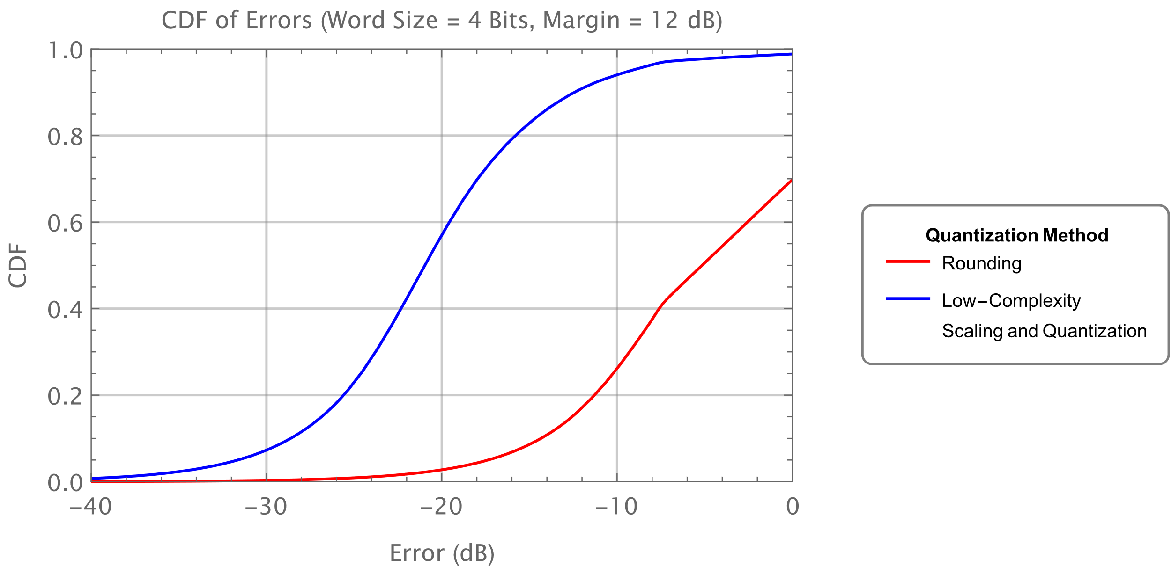
CDF ($N_{b}=$4, Margin = 12 dB)
Increase in Rounding due error to larger margin

Slide 16
Observations
Since many implementations include margin in their receiver CSI calculator, we need some form of scaling from internal CSI representations to the CSI representation in the Sensing CSI report
The low-complexity scaling and quantization scales CSI matrices on a tone-by-tone basis and as such we see in the simulations it provides consistent results even with implementation margin
As expected, the quantization error drops quickly with increased Word Size in the Sensing CSI Report
Of course, larger Word Size increase the size and duration of the Sensing CSI Report

Slide 17
Additional Simulations
Focus on the Low-Complexity Scaling and Quantization
Cover $N_{b}∈\{4, 6, 8,10, 12\}$
Provide Mean and 95-th Percentile
Fit Error Distribution to a Normal Distribution
Helpful, in any additional error analysis (e.g., selecting what values of $N_{b}$ to support)

Slide 18
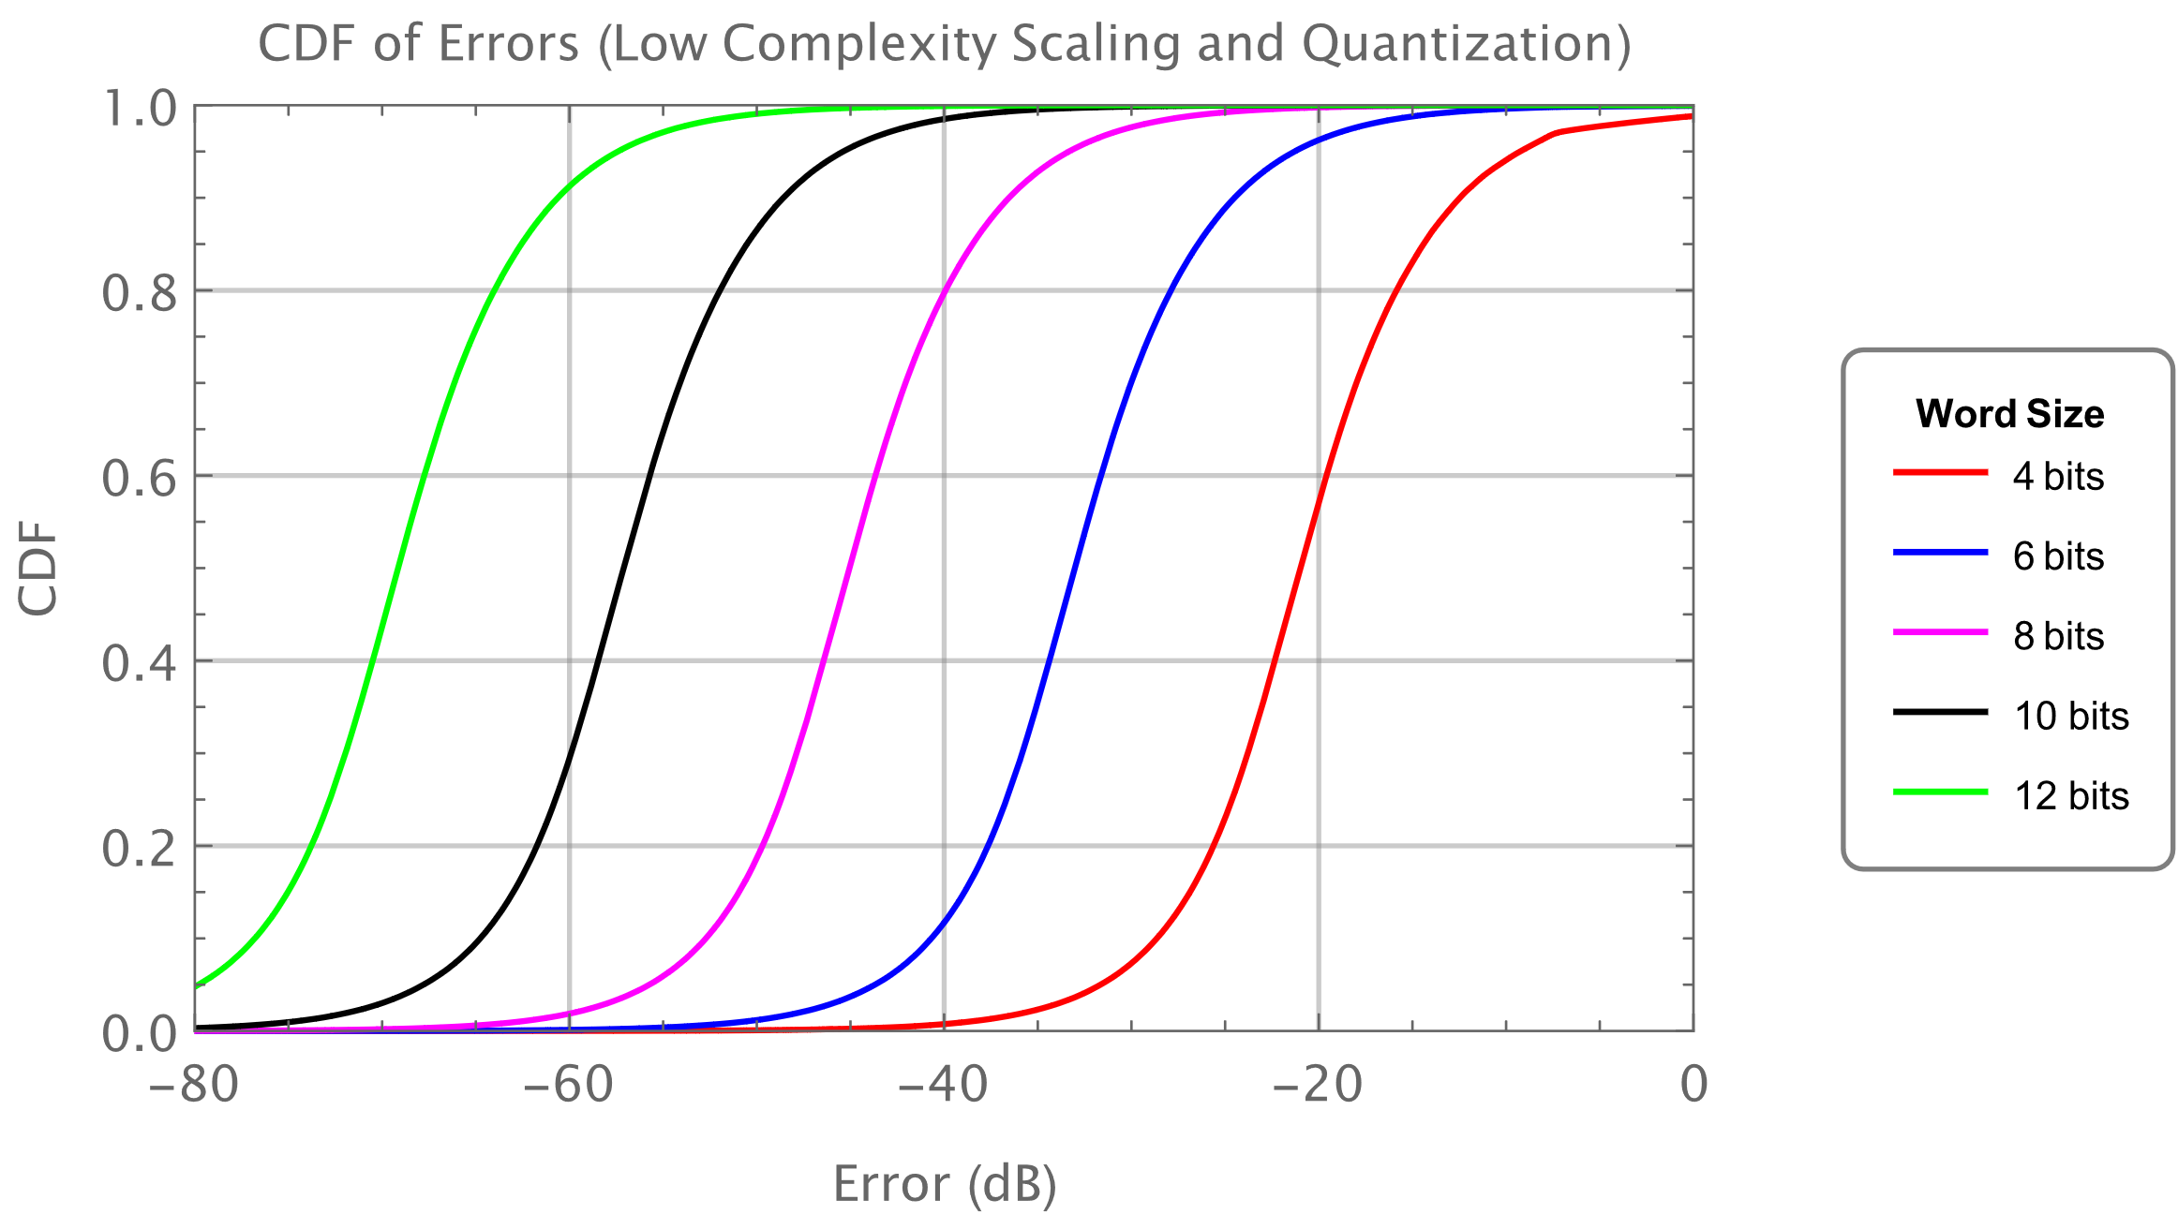
CDF of Errors (Low-Complexity Scaling and Quantization)

Slide 19
Table of Mean and 95-th Percentile (Low-Complexity Scaling and Quantization)
$$N_{b}$$ | Mean of Error (dB) | 95-Percentile (dB)
4 | -21 | -9
6 | -33 | -21
8 | -45 | -33
10 | -57 | -45
12 | -69 | -57

Slide 20
Fit Simulation Data to a Normal Distribution
For $N_{b}≥6$ bits, we can accurately fit a Normal Distribution to the simulation data
The Parameters of the Normal Distribution, $N\left(m, σ^{2}\right)$, that fits well to the simulation data is,
$$m=−6 N_{b}+3.3$$
$$σ=6.9$$

Slide 21
Summary
We have provided a detailed simulation study of the Low-Complexity Scaling and Quantization technique for use in the Sensing CSI Report

