Slide 1
Non-TB sensing measurement
Date: 2021-09-27
Authors:
Name | Affiliations | Address | Phone | Email
Cheng Chen | Intel |  |  | cheng.chen@intel.com
Dibakar Das |  |  |  | dibakar.das@intel.com
Carlos Cordeiro |  |  |  | carlos.cordeiro@intel.com
Notes:
September 2012

Slide 2
Motivation and background
11bf has defined the Trigger-based sensing measurement instance.
  It starts with the polling phase, where the AP polls STAs that are supposed to participate in the following TF sounding and/or NDPA sounding.
  So basically, this is mostly an AP-initiated measurement flow.
  TB sensing measurement instance works well in scenarios where:
    An AP is the initiator.
    A non-AP STA is the initiator, and the AP already knows all the sensing schedules and parameters, for example, through sensing negotiation with the STA initiator [1].
In [1], we also presented the Non-TB sensing measurement instance where the measurement instance is initiated by a non-AP STA.
  We propose the Non-TB sensing measurement to enable scenarios where a non-AP STA is the initiator, and sensing occurs in an on-demand manner between the non-AP STA initiator and the AP responder.
  Similar ideas were presented in [2][3].
In this contribution, we continue discussions on the Non-TB sensing measurement instance.

Slide 3
TB vs. Non-TB sensing measurement instance
The key difference between TB and Non-TB sensing measurement is who initiates the sensing measurement.
  In TB sensing measurement, the AP initiates the flow by polling the STAs to check the availability, which is necessary because:
    Some of the STAs may be unassociated, in which case the AP has no knowledge of the STAs and has to check the availability of them before the TF and/or NDPA sounding.
    Even if the STAs are associated to the AP, they may go to power save and therefore the AP still needs to check the availability of them before the TF and/or NDPA sounding.
  In Non-TB sensing measurement, the non-AP STA initiates the flow and directly goes into the sounding with the AP.
    The non-AP STA can safely assume the AP is there as long as it obtains a TXOP.

Slide 4
Assumptions
In this contribution, we make the following assumptions
  We assume the non-AP STA initiator is either associated to the AP or has already established security context with the AP in an unassociated state.
  We only consider the scenario where there is a single AP responder in one measurement instance
    Of course, the non-AP STA can always establish multiple sensing sessions with multiple AP responders, but generally it can only talk to one AP responder in one measurement instance.
    If there are additional non-AP STA responders in addition to the AP responder, we think the TB sensing measurement instance is a better fit because:
      A non-AP STA typically cannot support MU functionalities.
      The non-AP STA initiator will have to rely on the AP for the scheduling, synchronization etc. to coordinate multiple responders.
  We assume the non-AP STA and the AP has already finished the Session Setup and Sensing Measurement Setup.

Slide 5
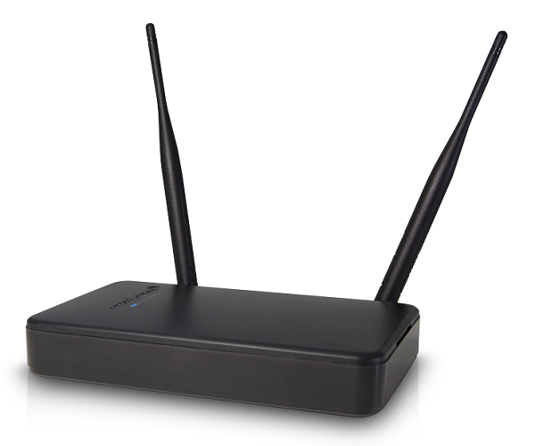

Possible scenarios
1)
AP
STA1
Bidirectional sensing
Sensing Responder
Sensing Transmitter & Receiver
Sensing Initiator
Sensing Receiver & Transmitter
Sensing PPDU transmission
2)
AP
STA1
Unidirectional UL sensing
Sensing Responder
Sensing Receiver
Sensing Initiator
Sensing Transmitter
3)
AP
STA1
Unidirectional DL sensing
Sensing Responder
Sensing Transmitter
Sensing Initiator
Sensing Receiver

Slide 6
Proposed Non-TB sensing measurement instance 1)
Sensing PPDU transmission
I2R sensing sounding
R2I sensing sounding
1)
AP
NDP
Sensing Feedback
AP
STA1
Sensing NDPA
NDP
SIFS
STA1
Sensing Responder
Sensing Transmitter & Receiver
Sensing Initiator
Sensing Receiver & Transmitter
SIFS
SIFS
Different from the scenarios where the initiator is an AP, whenever the non-AP STA obtains a TXOP,
it can safely assume the AP responder is always there. So it can directly go ahead and transmit the NDPA.
The sensing NDPA frame will include the Measurement Setup ID [4], which corresponds to the sensing
setup where STA1 and AP understand their roles, so they know both I2R NDP and R2I NDP are needed
following the Sensing NDPA frame.
We could also include a signaling in the NDPA to indicate that both I2R NDP and R2I NDP are needed
following the Sensing NDPA frame.
Sensing feedback for the I2R sounding could be sent to STA1 from the AP.

Slide 7
Proposed Non-TB sensing measurement instance 2)
Sensing PPDU transmission
2)
I2R sensing sounding
Sensing Feedback
AP
STA1
AP
Sensing NDPA
NDP
SIFS
STA1
Sensing Responder
Sensing Receiver
Sensing Initiator
Sensing Transmitter
SIFS
The sensing NDPA frame will include the Measurement Setup ID [4], which corresponds to the sensing
setup where STA1 and AP understand their roles, so they know only I2R NDP is needed following
the Sensing NDPA frame.
We could also include a signaling in the NDPA to indicate that only I2R NDP is needed following the
Sensing NDPA frame.
Sensing feedback for the I2R sounding could be sent to STA1 from the AP.

Slide 8
Two Options for Scenario 3)
Option 1:
R2I sensing sounding
Pros: We keep the existing flow of NDPA+NDP
from the same sender unchanged.
Cons: Redundant I2R NDP transmission. Additional
overhead.
AP
NDP
STA1
Sensing NDPA
NDP
Sensing PPDU transmission
SIFS
SIFS
3)
AP
STA1
Option 2:
R2I sensing sounding
AP
NDP
Sensing Responder
Sensing Transmitter
Sensing Initiator
Sensing Receiver
STA1
Sensing NDPA
SIFS
Pros: Most efficient flow.
Cons: New flow of NDPA + NDP, where the NDP
is SIFS after NDPA and is from the recipient
of the NDPA.
The sensing NDPA frame will include the Measurement Setup ID [4], which corresponds to the
sensing setup where STA1 and AP understand their roles, so they know only R2I NDP is needed
following the Sensing NDPA frame.
We could also include a signaling in the NDPA to indicate that only R2I NDP is needed following
the Sensing NDPA frame.
Since there is only R2I sensing sounding, there is no need for the AP to report sensing feedback.

Slide 9
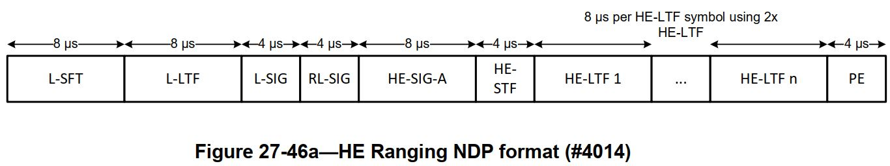
Overhead of the UL NDP
Assume we reuse the format of HE Ranging NDP for the Sensing NDP.
The number of HE-LTF symbols in an HE Ranging NDP depends on the number of space-time streams N_STS, the number of LTF repetitions LTF_REP, and, when Secure HE-LTFs with randomized LTF sequence are used, the number of users NUM_USERS.
  At least 48us minimum.

Slide 10
Option 1 vs. Option 2
Option 1 introduces redundant I2R NDP transmission, but we can always limit to be the minimum length whenever possible.
Option 2 introduces a new NDPA + NDP flow, where the NDP is coming from the recipient of the NDPA, instead of the transmitter of the NDPA.
  This change may cause implementation complexities.
Therefore, we think Option 1 is a better choice.

Slide 11
Conclusions
We propose a non-TB sensing measurement instance flow which works in scenarios where a non-AP STA is the initiator, and an AP is the responder.
  The proposed flow of non-TB sensing measurement instance reuses much of existing non-TB Ranging measurement flow and is able to address different scenarios.

Slide 12
References
[1] DCN0990r2, Discussions on sensing measurement flows
[2] DCN0842r0, A channel measurement procedure for WLAN sensing
[3] DCN1015r2, Non-TB and TB measurement procedure for WLAN sensing
[4] DCN0644r3, Sensing session and measurement exchange identification

