Slide 1
Random access using capture
Date: 2021-07-19
Authors:

Slide 2
Abstract
Random access can be improved outside of resource efficiency
It is also important to consider what random access is used for
In the case where random access is used for delivering BSR it is important to consider the delay
We propose a method that could improve the delay when using UORA to deliver BSR using capture and power ramping

Slide 3
Background
Random access for 11be has been discussed in several contributions
[1] considers improving UORA by utilizing spatial streams potentially increasing the number of resources by the number of spatial streams per RU
[2] considers reusing NFRP procedures borrowed from 11ax to increase the capacity to notify the AP that the STA needs to be scheduled
Both of the contributions considers the random access efficiency to be low
In order to improve random access, it should be considered how random access is used

Slide 4
Random access use case in 11be
One of the main use cases for 11ax UORA is to deliver Buffer Status Reports
This is particularly useful when there are many devices in the BSS whose data may arrive at any point and the AP uses OFDMA to schedule its users
The BSRP trigger frame may include a field that makes the BSR transmitted using UORA
This allows the AP to control the BSS to reduce contention, which allows for more efficient operations through AP control – this is key if there are a lot of devices
In this case not only UORA efficiency is important but also the uplink delay distribution caused of the scheduling cycle

Slide 5
Random access in 11be
In UORA there may be collisions between STAs
As the received power is controlled by the AP - if two devices collide it is likely that none of the UORA transmissions will be correctly decoded
This means that a collision will cause two failures
However if the received power levels from the two STAs would be different - “capture” might be possible
If the received power level are different it is likely that a collision would result in one failure and one success
Thus we suggest that UORA shall have the ability for devices to have different powers

Slide 6
Random access with capture and power ramping
Different received powers in UORA can be achieved through
Power ramping
Thus a STA starts at a lower transmitted power level and ramps it up successively until it succeeds
This can be done by for instance having a set of AP received power levels to use with each attempt
Randomly selecting powers
The powers can be from a set of AP received power levels
This should on average reduce the delay of random access as a collision may only cause one failure rather than two

Slide 7
System level simulation setup
Consider the use case of delivering BSR using UORA
Consider the following:
Single BSS scheduling using UORA
A set of sensor STAs with sensor traffic model
The STAs have sensor data arriving every 10 ms
In this traffic scenario, OFDMA usually outperfoms EDCA
The BSRP that triggers UORA is sent every 10 ms
We model the capturing of BSR UORA where if the RU resources are used by 2 or more STAs, a STA is succesful if the received SIR is larger than 3 dB
We thus look at the delay for the STA to deliver the uplink data packet

Slide 8
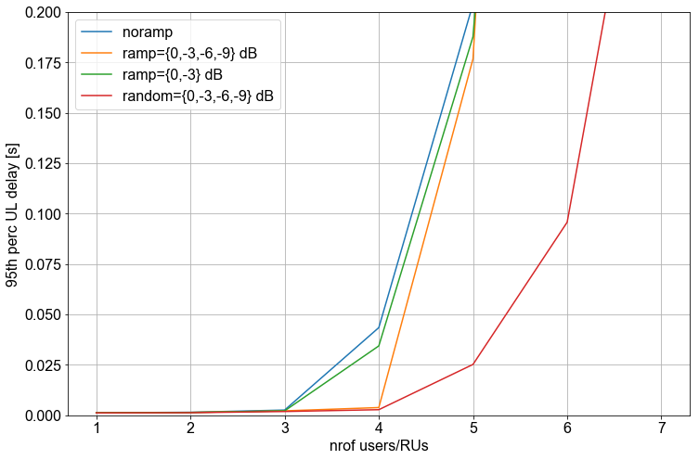
System level simulation results
We test the following:
No ramping nor capturing applied
Ramping 1: Ramping with 4 steps = {0, -3, -6, -9} dB
Ramping 2: Ramping with 2 steps = {0, -3} dB
Random 1: Random values selected from set of 4 values = {0, -3, -6, -9} dB
We look at the 50th and 95th percentile
We can see that 50th and 95th percentile UL delay is improved compared to no ramping

Slide 9
References
[1] 11/21-0400r0 Enhanced UORA, Yanyi Ding
[2] 11/20-1903r3 Random access for 11be, Stephane Baron

