Slide 1
Agenda for IEEE 802.11 Coexistence SC virtual meeting in July 2021
19 July 2021
Authors:
Name | Company | Phone | email
Andrew Myles | Cisco | +61 418 656587 | amyles@cisco.com

Slide 2
Welcome to the 7th virtual meeting of the Coex SC in July 2021
IEEE 802.11 PDED ad hoc
1 | Warsaw | Sep 2016
2 | San Antonio | Nov 2016
3 | Atlanta | Jan 2017
4 | Vancouver | Mar 2017
5 | Daejeon | May 2017
IEEE 802.11 Coexistence SC
9 | Bangkok | Nov 2018
10 | St Louis | Jan 2019
11 | Vancouver | Mar 2019
12 | Atlanta | May 2019
13 | Vienna | Jul 2019
14 | Hanoi | Sep 2019
15 | Hawaii | Nov 2019
16 | Irvine | Jan 2020
17 | Virtual 1 | Jul 2020
18 | Virtual 2 | Sep 2020
19 | Virtual 3 | Nov 2020
20 | Virtual 4 | Jan 2021
21 | Virtual 5 | Mar 2021
22 | Virtual 6 | May 2021
23 | Virtual 7 | Jul 2021
IEEE 802.11 Coexistence SC
1 | Berlin | July 2017
2 | Hawaii | Sep 2017
3 | Orlando | Nov 2017
4 | Irvine | Jan 2018
5 | Chicago | Mar 2018
6 | Warsaw | May 2018
7 | San Diego | July 2018
8 | Hawaii | Sep 2018

Slide 3
Registration is required for the July 802 electronic plenary session
  This meeting is part of the July 802 plenary session
  You must pay the registration fee in order to attend
  If you have not already done so:
    You can register here
    Or follow the registration link for this session here https://www.ieee802.org/11/Meetings/Meeting_Plan.html
  If you do not intend to register for this session:
    You must leave this meeting
    If you have logged attendance on IMAT, email the IEEE 802.11 WG Chair or Vice Chairs to have your attendance cancelled
  Please remember to register your attendance using IMAT
    https://imat.ieee.org/attendance

Slide 4
Coex SC minutes today will be kept by our permanent SC secretary
  It is important to keep proper minutes of all Coexistence SC meetings
  Fortunately, Guido Hiertz (Ericsson) agreed in Berlin (way back in July 2017 at a time when we actually saw each other F2F) to be appointed the IEEE 802.11 Coexistence SC’s permanent Secretary

Slide 5

The Coex SC will review the official IEEE-SA patent material for pre-PAR groups
Approved slide

Slide 6
Participant behavior in IEEE-SA activities is guided by the IEEE Codes of Ethics & Conduct
Approved slide
  All participants in IEEE-SA activities are expected to adhere to the core principles underlying the:
    IEEE Code of Ethics
    IEEE Code of Conduct
  The core principles of the IEEE Codes of Ethics & Conduct are to:
    Uphold the highest standards of integrity, responsible behavior, and ethical and professional conduct
    Treat people fairly and with respect, to not engage in harassment, discrimination, or retaliation, and to protect people's privacy.
    Avoid injuring others, their property, reputation, or employment by false or malicious action
  The most recent versions of these Codes are available at
    http://www.ieee.org/about/corporate/governance

Slide 7
Participants in the IEEE-SA “individual process” shall act independently of others, including employers
Approved slide
  The IEEE-SA Standards Board Bylaws require that “participants in the IEEE standards development individual process shall act based on their qualifications and experience”
  This means participants:
    Shall act & vote based on their personal & independent opinions derived from their expertise, knowledge, and qualifications
    Shall not act or vote based on any obligation to or any direction from any other person or organization, including an employer or client, regardless of any external commitments, agreements, contracts, or orders
    Shall not direct the actions or votes of other participants or retaliate against other participants for fulfilling their responsibility to act & vote based on their personal & independently developed opinions
  By participating in standards activities using the “individual process”, you are deemed to accept these requirements; if you are unable to satisfy these requirements then you shall immediately cease any participation

Slide 8
IEEE-SA standards activities shall allow the fair & equitable consideration of all viewpoints
Approved slide
  The IEEE-SA Standards Board Bylaws (clause 5.2.1.3) specifies that “the standards development process shall not be dominated by any single interest category, individual, or organization”
    This means no participant may exercise “authority, leadership, or influence by reason of superior leverage, strength, or representation to the exclusion of fair and equitable consideration of other viewpoints” or “to hinder the progress of the standards development activity”
  This rule applies equally to those participating in a standards development project and to that project’s leadership group
  Any person who reasonably suspects that dominance is occurring in a standards development project is encouraged to bring the issue to the attention of the Standards Committee or the project’s IEEE-SA Program Manager

Slide 9
IEEE SA Copyright Policy
Approved slide
  By participating in this activity, you agree to comply with the IEEE Code of Ethics, all applicable laws, and all IEEE policies and procedures including, but not limited to, the IEEE SA Copyright Policy.
    Previously Published material (copyright assertion indicated) shall not be presented/submitted to the Working Group nor incorporated into a Working Group draft unless permission is granted.
    Prior to presentation or submission, you shall notify the Working Group Chair of previously Published material and should assist the Chair in obtaining copyright permission acceptable to IEEE SA.
    For material that is not previously Published, IEEE is automatically granted a license to use any material that is presented or submitted.

Slide 10
IEEE SA Copyright Policy
Approved slide
  The IEEE SA Copyright Policy is described in the IEEE SA Standards Board Bylaws and IEEE SA Standards Board Operations Manual
    IEEE SA Copyright Policy, see:
      Clause 7 of the IEEE SA Standards Board Bylaws
      Clause 6.1 of the IEEE SA Standards Board Operations Manual
  IEEE SA Copyright Permission
  IEEE SA Copyright FAQs
  IEEE SA Best Practices for IEEE Standards Development
  Distribution of Draft Standards (see Clause 6.1.3 of the SASB Operations Manual)

Slide 11
The Coex SC will only meet once during the virtual IEEE 802 plenary meeting in July 2021
  Wednesday, 14 July 2021
  @ 4-6pm ET
  Webex details:
    https://ieeesa.webex.com/ieeesa/j.php?MTID=m962632c3dafea9c5d6f92634a1dbd6c2
    Meeting number: 173 042 3918
  Monday, 19 July 2021
  @ 4-6pm ET
  Webex details:
    https://ieeesa.webex.com/ieeesa/j.php?MTID=m5f37c64f58ce7088e86780cad6c53266
    Meeting number: 173 927 0443
Cancelled because:
We don’t have quite enough material for two sessions in July
The Wednesday session overlaps with TGme, whereas the Monday session does not

Slide 12
The Coex SC will consider a proposed agenda for its virtual meeting in July 2021
Approved Agenda
  Bureaucratic stuff
    Scope of IEEE 802.11 Coexistence SC (a reminder)
    Approve minutes
  What is happening this week? (in no particular order)
    Review of drivers of Coex SC work
      Announcement of plans by Uni of Chicago for further coex studies
    Review of ETSI BRAN activities
      EN 301 893 issues (5 GHz), incl.
        LS from ETSI BRAN
        Coexistence challenges for 802.11be
      EN 303 687 issues (6 GHz), incl.
        NB FH in 6 GHz
        Specification challenges for 802.11ax/be
    Discussion of 60 GHz coexistence issues
    Plans for next meeting

Slide 13
  Scope of IEEE 802.11 Coexistence SC

Slide 14
The Coex SC scope was revised in Sept 2020
IEEE 802.11 Coex SC Scope
  The Coex SC shall promote, within the 802.11 WG and externally, an environment that enables IEEE 802.11 technologies to have equitable access to unlicensed spectrum globally
  The Coex SC should focus particularly on coexistence of 802.11ax & 802.11be with LAA & NR-U in the 5 GHz & 6 GHz bands globally
  The Coex SC may consider coexistence with other technologies and in other bands as directed by the Chair of the 802.11 WG
IEEE 802.11 Coex SC close down criteria
  802.11 WG Chair has authority to close down SC

Slide 15
The scope of the Coex SC was expanded in March 2021 to include 60 GHz coexistence issues
  It was noted during the March 2021 plenary that ETSI BRAN is working on 60 GHz Harmonised Standards that may impact IEEE 802.11ay coexistence
  Subsequently, the 802.11 Chair directed the Coex SC to consider 60GHz coexistence within scope
    At today's WG11 Opening Plenary, the comment was made that ETSI BRAN is also considering operational and coexistence requirements related to 57-71 GHz (60GHz) spectrum, relevant of course to 802.11ad and 11ay
    The scope of the Coex SC focuses on, "coexistence of 802.11ax & 802.11be with LAA & NR-U in the 5 GHz & 6 GHz bands globally". However, it "may consider coexistence with other technologies and in other bands as directed by the Chair of the 802.11 WG". So the Coex SC can consider 60 GHz issues if directed by the WG Chair
    I have directed the Coex SC to additionally consider coexistence topics for 60GHz operation

Slide 16
  Minutes

Slide 17
The Coex SC will consider the approval of its virtual meeting minutes from May 2021
  The draft minutes for the Coex SC at the virtual meeting in May 2021 are available on Mentor:
    See 11-21-0973-00
  Proposed motion:
    The IEEE 802 Coex SC approves 11-21-0973-00 as the minutes of its virtual meeting in May 2021
    Moved:
    Seconded:
    Result:

Slide 18
Coex SC
Key messages for July 2021

Slide 19
There are few key message for the Coex SC that arise out of today’s session
Key messages from today’s session …
  Coexistence between Wi-Fi & LAA is already important … and coexistence with NR-U/MulteFire will become important soon
  Measurement & simulation evidence suggests Wi-Fi/LAA coexistence issues are not yet fully understood or resolved
  There is an agreement on 5 GHz coex in Europe … but it is not yet clear how 802.11be will need to respond to the agreement
  There is continuing resistance to allowing Wi-Fi to use 6 GHz
  There is an agreement on 6 GHz coex in Europe … except in relation to NB FH operation (and there is some 11ax/11be spec work to be done)
  We are still learning about 60 GHz radar coex issues
… you can leave if you are not interested in the details ☺

Slide 20
  Agenda items
  Unlicensed LTE deployment

Slide 21
We have tracked the use of 5G by SPs in unlicensed bands to highlight importance of coexistence work
Tech | Stage | GSMA¹ (July ‘18) | GSA² (Oct ‘18) | GSA³ (Jan ‘19) | GSA⁴ (Jul ‘19) | GSA⁵ (Nov ‘19) | GSA⁶ (Dec ‘19) | GSA⁷ (Mar ‘20) | GSA⁸ (Aug ‘20)
LAA | Trials/plans | 23 | 22 | 26 | 29 | 30 | 29 | 29 | 28
 | Deployed | 4 | 6 | 6 | 8 | 8 | 8 | 9 | 9
eLAA | Trials/plans | ? | 1 | 1 | 1 | 1 | ? | 0 | 1
 | Deployed | ? | 0 | 0 | 0 | 0 | ? | 1 | 0
LWA | Trials/plans | ? | 2 | 2 | 2 | 2 | 2 | 2 | 2
 | Deployed | ? | 1 | 1 | 1 | 1 | 1 | 1 | 1
LTE-U | Trials/plans | ? | 8 | 8 | 8 | 8 | 9 | 9 | 9
 | Deployed | ? | 3 | 3 | 3 | 3 | 3 | 3 | 3
GSMA (July 2018)
GSA: Evolution from LTE to 5G: Global Market Status (Nov 2018)
GSA: LTE in unlicensed and shared spectrum (Jan 2019)
GSA: Evolution from LTE to 5G: Global Market Status (Aug 2019)
GSA: LTE Unlicensed - LTE in Unlicensed and Shared Spectrum (Nov 2019
GSA: LTE and 5G Market Statistics (Dec 2019)
GSA: LTE in Unlicensed Spectrum and Shared Spectrum (Mar 2020)
GSA: LTE and 5G in Unlicensed Spectrum: Trials, Deployments & Devices (Aug 2020)

Slide 22
We are now also tracking support by 5G clients for unlicensed bands to highlight importance of coex work
Tech | Stage | GSA⁹ (Oct ’20) | GSA¹⁰ (Jan ’21) | GSA¹¹ (Feb ’21) | GSA^{12, 13} (Mar ’21) | GSA¹⁴ (Jun ’21)
LAA | Trials/plans | 27 | 27 | 27 | 27 | -
 | Deployed | 9 | 9 | 9 | 9 | -
 | Devices | - | - | - | 247 | 329
LWA | Trials/plans | 2 | 2 | 2 | 2 | -
 | Deployed | 1 | 1 | 1 | 1 | -
 | Devices | - | - | - | 16 | 16
LTE-U | Trials/plans | 9 | 9 | 9 | 9 | -
 | Deployed | 3 | 3 | 3 | 3 | -
 | Devices | - | - | - | 46 | 46
A new data series, focused on client devices rather than operators
GSA: LTE and 5G Market Statistics (Oct 2020)
GSA: LTE and 5G Market Statistics (Jan 2021)
GSA: Networks, Technologies & Spectrum Snapshot: LTE and 5G Market Statistics (Feb 2021)
GSA: LTE Ecosystem Status (Mar 2021)
GSA: LTE 5G Market Statistics (Mar 2021)
GSA: LTE Ecosystem Report (Status Update Jun 2021)

Slide 23
The number planned/testing & deployed LAA networks globally is currently steady

Slide 24
The number of devices supporting LAA globally is up by almost 200 in the last three months

Slide 25
There was a significant LAA deployment in Chicago as early as Jan 2020 …
Refined from Sept 2020
Chicago LAA deployment (Jan 2020)
  A study in Chicago in Jan 2020 shows a significant LAA deployment … that was expanding rapidly
    In Jan 2020, AT&T mostly used channel 149 & Verizon mostly used channel 36, avoiding intra-LAA coex issues
  See Measurement-based coexistence studies of LAA & Wi-Fi deployments in Chicago
    Vanlin Sathya, Muhammad Iqbal Rochman, & Monisha Ghosh (Uni of Chicago)
AT&T
Verizon
T-Mobile

Slide 26
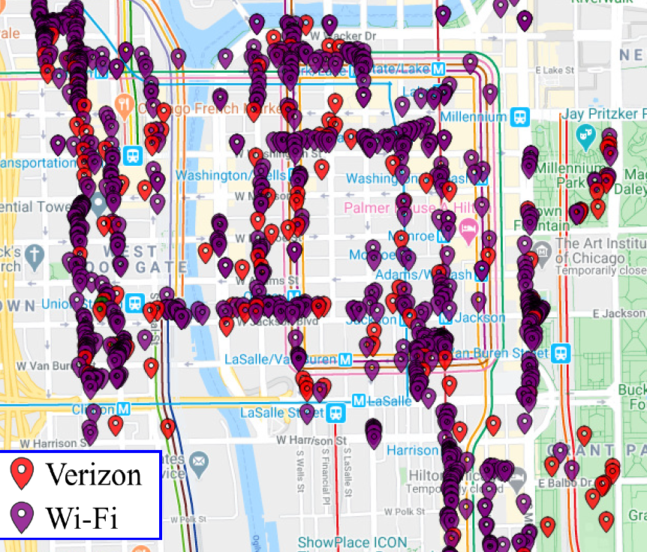
… and there is significant overlap between the LAA & Wi-Fi networks in Chicago
Refined from Sept 2020
  The study in Chicago showed a significant overlap between Wi-Fi & LAA networks
  The overlap is shown on the diagram is for channel 36 in Chicago area
    Wi-Fi using 20 MHz, 40 MHz & 80 MHz channels, from mostly indoor locations
    LAA mostly using 60 MHz channels, from mostly outdoor locations

Slide 27
  Agenda items
  MulteFire in 5 GHz

Slide 28
Nokia has announced that MulteFire will soon operate in the 5 GHz band …
  At the end of June 2021, Nokia announced the availability of a MulteFire solution operating in 4.9 GHz band
  An associated blog from Nokia suggested that MulteFire will also operate in the 5 GHz band …
    MulteFire now makes it possible to quickly set up and tear down a private LTE/4G network anywhere that Wi-Fi is allowed in 5.x GHz spectrum
  … with Nokia also claiming that MulteFire is better than Wi-Fi:
    MulteFire latency & throughput are stable with an increasing numbers of users, whereas with Wi-Fi throughput quickly decreases to a few Mbps
    MulteFire has range of 700m whereas Wi-Fi range is less than 200m
    MulteFire supports mobility, including high-speed mobility, whereas Wi-Fi cannot maintain connectivity during handovers between access points
    MulteFire offers inherent 3GPP-defined security features that are suitable for mission-critical networks, implying Wi-Fi does not

Slide 29
… suggesting the Coex SC probably needs to understand/evaluate MulteFire/Wi-Fi coexistence
  The Nokia blog mentions that MulteFire uses a 3GPP standards-based specification that would make LTE/4G compliant for use in 5 GHz unlicensed spectrum around the world, ensure coexistence with Wi-Fi, …
  The Nokia blog goes on to state that MulteFire uses an adaptive LBT mechanism for coexistence with Wi-Fi
    … an adaptive Listen Before Talk (LBT) procedure, which allows for transmission in the unlicensed spectrum for a known duration and opens channel access to ensure that MulteFire can coexist with neighboring Wi-Fi using the same channel
  This suggests some future questions of Coex SC consideration:
    Are MulteFire coexistence mechanisms the same as NR-U?
    If not, does MulteFire raise any additional coexistence issues?
  REQUEST: would anyone with knowledge of MulteFire coexistence mechanisms volunteer to lead a future discussion in the Coex SC?

Slide 30
  Agenda items
  Unlicensed LTE deployment
  Real measurements

Slide 31
The Coex SC heard about an LAA/Wi-Fi coexistence study in Chicago in Jan 2021
Refined from
Mar 2021
  One of concerns with many of the conclusions drawn in relation to coexistence is that they are based on simulation studies …
  … which have been used over the years to provide evidence for just about any conclusion one might want to draw
  A good complement to simulation studies is measurements of actual deployments …
  … recognising they also have limitations
  In early 2021, the Coex SC heard from one of the authors of the Chicago Wi-Fi deployment study noted in previous meetings
    See 11-20-1973

Slide 32
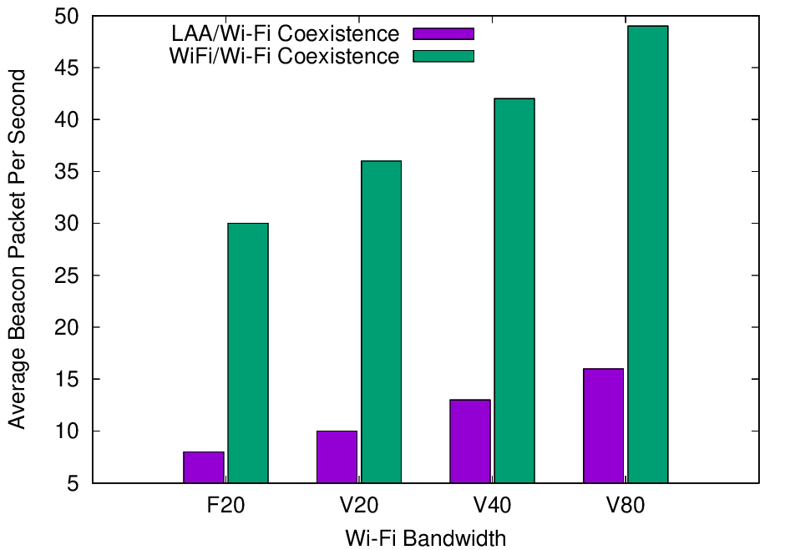
Experiments with deployed systems show LAA has a significant impact on Wi-Fi Beacon success
Refined from
Mar 2021
  The Uni of Chicago study investigated the effect of LAA on Wi-Fi operation in various typical configurations, including hidden nodes
  The work showed that LAA
  caused significant interference
  to Wi-Fi Beacons in the tested
  configuration
    Probably because LAA is:
      Using ED @ -72 dBm
      Rather than PD @ - 82 dBm
    Also because LAA typically uses
    long TxOPs (~8 ms)
Addition of a single LAA system to five Wi-Fi systems causes successful Beacon rate to reduce by > 75%
Pushing Wi-Fi APs into the same channel also causes successful Beacon rate to reduce, but by less than LAA

Slide 33
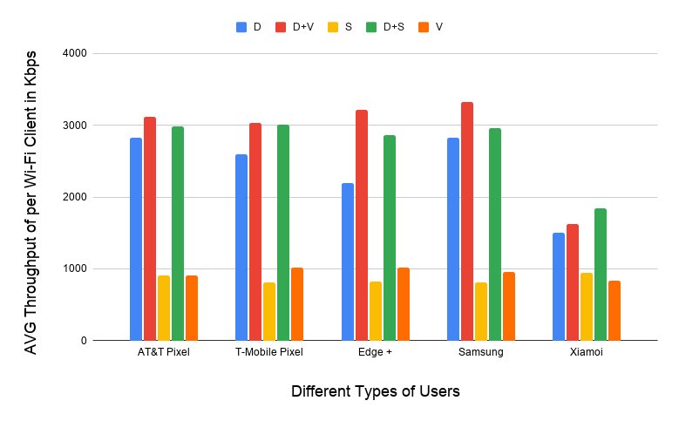
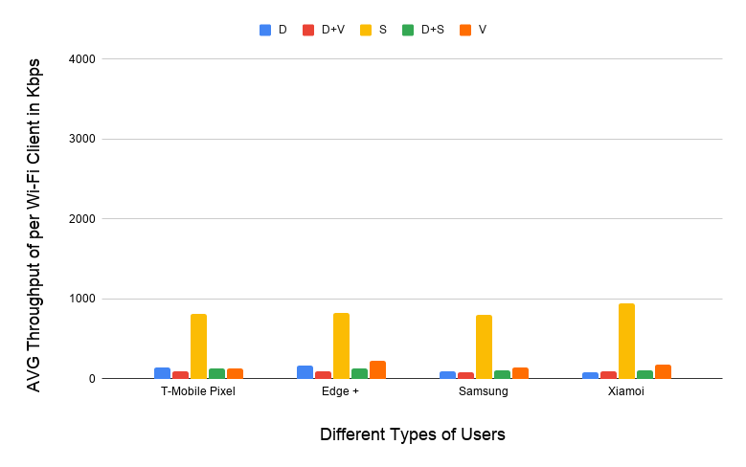
Experiments with deployed systems show LAA has a significant impact on Wi-Fi data success
Refined from
Mar 2021
  The work showed that LAA caused significant interference to data traffic in the tested configuration
    Probably because LAA is using ED @ -72 dBm rather than PD @ - 82 dBm
    Also because Wi-Fi’s hidden station mitigation mechanisms based on RTS/CTS have no effect on LAA
5 Wi-Fi APs on one channel, no LAA
5 Wi-Fi APs on one channel, one LAA
11-20-1973 slide 16
All client close
to Wi-Fi APs
Addition of LAA caused all Wi-Fi traffic to collapse …
… except streaming because LAA uses licensed for streaming

Slide 34
The previous discussions suggested a need to discuss the Uni of Chicago results in more detail
  There was some limited discussion about the Uni of Chicago results in January 2021
    There were questions & concerns about test setup & realism from some …
    … but others drew the conclusion that this is a typical scenario and Wi-Fi is significantly impacted by a single LAA (from minutes)
  There has not been much discussion since despite some agreement that these results are important …
    Do the results represent something of concern to Wi-Fi operators/users?
    Is there an understanding of the causes of these results?
    Are there additional testing/monitoring that should occur?
    Is there anything that should/could be done to mitigate the risk?

Slide 35
The Uni of Chicago is planning to undertake further measurements (and simulations)
  Monisha Ghosh (University of Chicago) has notified the Chair that they are continuing their Wi-Fi/LAA coexistence work and are expecting to be ready to report further results in September 2021
  The planned report in September 2021 is Coexistence of multiple LAA and Wi-Fi networks in 5 GHz
    Abstract: Our measurement campaign in the Chicago area revealed multiple areas where two operators have deployed LAA on the same channels in close proximity to each other. In order to study the coexistence behavior in such scenarios, we present new measurement results on Wi-Fi/LAA coexistence, using newer, more capable, enterprise access points, deployed LAA and a National Instrument SDR based LAA to study coexistence performance between Wi-Fi and two LAA deployments.

Slide 36
There has been some reporting and discussion of previous University of Chicago results
  The previous University of Chicago results were reported publicly here
  (7Jul 2021)
  There was some subsequent commentary in FierceWireless
  (16 July 2021)
    The reported response from Qualcomm used the 3GPP simulations from some years ago to claim that after years of testing and evaluation, the wireless industry and FCC determined the use of LAA has “no adverse impact” on Wi-Fi performance (see above article for full response)
    The reported response from the Wi-Fi Alliance stated they are ready to engage constructively with industry stakeholders to ensure that new technologies in unlicensed spectrum do not disadvantage Wi-Fi operation
  The question for the Coex SC is whether the University of Chicago measurement results represent a common scenario or an uncommon outlier?

Slide 37
  Agenda items
  ETSI BRAN issues

Slide 38
Note that ESTI BRAN documents are available to IEEE 802.11 WG members
  Today’s material references many ETSI BRAN documents
  They are (or should be) available in the IEEE 802.11 WG members area
    See http://www.ieee802.org/11/private/ETSI_documents/BRAN

Slide 39
  Agenda items
  ETSI BRAN 5 GHz

Slide 40
The stable draft of EN 301 893 (5 GHz) includes the adaptivity compromise & associated testing
Document status after BRAN#110 (June 2021)
  Draft EN 301 893 v.2.1.44 (stable draft) – 29 Jun 2021
Discussion during BRAN#110
  All ETSI BRAN agreements so far were approved in BRAN(21)110055, which was subsequently published as EN 301 893 v2.1.44
    Variety of editorial issues & other issues with less relevance to coexistence
    Compromise for adaptivity (and associated testing), as agreed at BRAN#109
      The adaptivity requirements most relevant to Wi-Fi equipment are the requirements in clause 4.2.7.3.2 (Load Based Equipment (LBE))
        … and sub-clauses
        … particularly 4.2.7.3.2.5 (Energy Detection Threshold (EDT) level)
      The associated testing procedures most relevant to Wi-Fi equipment are the procedures in clause 5.4.9.3.2 (Conducted measurements)
        … and sub-clauses

Slide 41
A LS from ETSI BRAN highlights recent progress related to adaptivity in EN 301 893 (5 GHz)
  ETSI BRAN recently sent IEEE 802.11 WG a LS that highlights recent progress related to adaptivity in EN 301 893 (5 GHz)
    See 11-21-1025-00
  ETSI BRAN’s LS was also sent to 3GPP RAN/RAN1/RAN4 & GSMA
    Interestingly, it was not sent to the WFA
  The LS has a few important elements
    It documents the agreed clause 4 text for the EDT, which is an important component of the adaptivity mechanism is EN 301 893
    It explains that the EDT text in EN 301 893 may be updated in the future
    It notes associated tests have also been accepted for inclusion into EN 301 893

Slide 42
ETSI BRAN’s LS highlights the key adaptivity text in EN 301 893 (5 GHz)
Text in EN 301 893 from ETSI BRAN’s LS
4.2.7.3.2.5 ED Threshold Level (Energy Detection Threshold Level)
An Operating Channel is an Occupied Channel as long as transmissions in that channel are present at a power level greater than the ED Threshold (EDT). The power level is determined by integrating the received power over the channel, and then normalized to per MHz power. The received power shall be measured at the interface between the device and the antenna assembly. If no transmissions are present at a power level greater than the ED Threshold (EDT), the Operating Channel is an Unoccupied Channel. Equipment may consist of one or more devices. A device shall operate according to one of the following categories. The EDT depends on the category of operation.
  Category 1: For a device operating only in conformance to IEEE 802.11ax/D8.0 [REF] clause 27, IEEE 802.11™2016 [9], clause 17, clause 19 or clause 21, or any combination of these clauses, independent of the device's maximum transmit power (P_{H}), the EDT shall be:
  EDT = −75 dBm/MHz (1)
  Category 2: Else, the EDT shall be proportional to the device's maximum transmit power (P_{H}):
  For P_{H} ≤ 13 dBm: EDT = −75 dBm/MHz
  For 13 dBm < P_{H} < 23 dBm: EDT = −85 dBm/MHz + (23 dBm − P_{H}) (2)
  For P_{H} ≥ 23 dBm: EDT = −85 dBm/MHz
A device capable of operating in either category, when changing operation from Category 2 to Category 1, shall not increase the EDT for a period of at least [60] s.
The EDT levels defined above are absolute levels that apply at all times independent of background noise of other signals being present in the channel.
Highlights EDT is used to determining if a channel is busy
Notes that equipment consists of multiple devices, each operating in one of following categories
Allows 802.11a/n/ac/ax to use EDT @ -62 dBm
Implicitly assumes use of PDT
@ -82 dBm, as specified in 802.11
Requires other devices to use EDT @ -72dBm (scaled with tx power)
Applies to LAA/NR-U, 802.11be, …
Avoids “game playing” by devices that frequently swap between categories

Slide 43
ETSI BRAN’s LS highlights that the key adaptivity text may be updated in the future
Text ETSI BRAN’s LS
EDT requirements may be further updated by ETSI TC BRAN in the future. It is the current understanding that such updates would most likely be considered in the context of a future work item. The following alternatives are among those that may be considered:
  Alt 1: common EDT = −85 dBm/MHz for all technologies, possibly as a function of PH.
  Alt 2: common EDT = −75 dBm/MHz for all technologies.
Highlights EDT requirements are not set in stone forever …
… but if updated, the update is unlikely to occur in the current EN 301 893 Work Item
The two potential updates highlighted are:
ED-only @ -62 dBm for all technologies
ED-only @ -72 dBm (scaled?) for all technologies
There is no mention of PD/ED for technologies beyond 802.11a/n/ac/ax; while such an option is technically not excluded, it is clear that it is somewhat unlikely unless an overwhelming case is made for it

Slide 44
Is there any need to reply to the LS wrt EN 301 893 from ETSI BRAN?
  ETSI BRAN’s LS does not request a reply
    The recipients of this Liaison Letter are respectfully requested to consider the provided information
  Do we want of provide any sort of reply?
    None has been prepared …
    … the Chair could put a short reply together for consideration by the IEEE 802.11 WG at the closing plenary

Slide 45
The EN 301 893 journey has been long & interesting, achieving good sharing but with future risks for 802.11be
V1.8.1
Standard
Mar 2015
802.11a/n/ac conformant devices use access mechanisms in 802.11 standard
Other devices followed weird rules with little connection to anything
Very 802.11 focused …
… as only game in town
… but not clear there is good sharing between Wi-Fi/LAA/…
V2.1.1
Standard
May 2017
EDCA based adaptivity
  802.11a/n/ac conformant devices use EDT at -62 dBm
  Other devices use EDT @ -72 dB (scaled)
Enabled good sharing, using LBT with exponential backoff …
… but a compromise, with different thresholds for Wi-Fi & LAA/NR-U
V2.1.8
Stable draft
Sep 2018
EDCA based adaptivity
  Any devices using 802.11 defined PD may use EDT at -62 dBm
  Otherwise use EDT @ -72 dB (scaled)
Enabled any technology to use either of the two options
Assisted placement of 802.11ax on market today
V2.1.44
Stable draft
Jun 2021
EDCA based adaptivity
  802.11a/n/ac/ax conformant devices use EDT at -62 dBm
  Other devices use EDT @ -72 dB (scaled)
Required compromise to make progress
Allows traditional Wi-Fi operation …
… but forces 802.11be to use ED-only
@ -72 dBm, with potential issues

Slide 46
The EN 301 893 journey will continue, with multiple options for consideration by the Coex SC
The future?
Option 1: status quo based on v.2.1.44
Option 2: ED-only
@ -62 dBm
Option 3: ED-only
@ -72 dB (scaled)
Option 4: Something else
Likely to be acceptable for next 2-3 years for reasonable coex between 802.11a/n/ac/ax & LAA/NR-U
Coex SC will need to evaluate coex between 802.11ax & 802.11be
Very simple and flexible
Aligned with US
Coex SC will need to evaluate:
  Effect on reuse vs interference
  Whether 802.11 should use PD/ED @ -82/-62 dBm or ED-only @ -62 dBm when coexisting with LAA/NR-U
Attractive in that it would establish similar rules in both 5 GHz & 6 GHz
Coex SC will need to evaluate:
  Impact on legacy
  Whether 802.11 should use PD/ED @ -82/-72 dBm or ED-only @ -72 dBm when coexisting with LAA/NR-U
What?
  Coex SC could make proposals
Similar discussions on options 2-4 could apply to 6 GHz coexistence

Slide 47
The Coex SC has started a process of evaluating the optimum path for 5 GHz (& 6 GHz) coexistence
  In May 2021, two submissions started the discussions about the optimum future path for coexistence in 5 GHz …
    11-21-0705-00
      Simulation and Evaluation of the Impact of Varying ED Thresholds
      Gaurav Patwardhan (HPE), Eldad Perahia (HPE), Stuart Strickland (HPE)
      Uniform use of EDT @ -72 dBm likely to have a positive impact on sharing
      EDT @ -72 dBm in 5 GHz will sometimes disadvantage 802.11be compared to legacy using EDT @ -62 dBm, with some mitigation from RTS/CTS
      Specification work is required in both TGme (for 802.11ax) and TGbe
    11-21-0851-00 (Word document)
      5 GHz ED Analysis
      Menzo Wentink (Qualcomm)
      EDT @ -72 dBm in 5 GHz will sometimes disadvantage 802.11be compared to legacy
      Use of EDT @ -72 dBm limits spectral reuse
      EDT of -62 dBm may be a better long-term approach
  … with no clear or agreed next steps (yet!)

Slide 48
The Coex SC may hear a brief proposal on next steps to help decide the best 5 GHz options for 802.11be
  Stuart Strickland (HPE) has submitted a discussion on possible next steps in relation to 5 GHz coexistence, especially in relation to the use of 802.11be
    See 11-21-1179-00
    Note: Stuart may not be available to present until the last 30 min of today’s session

Slide 49
  Agenda items
  6 GHz spectrum availability

Slide 50
Coexistence will become increasingly important as
6 GHz spectrum opens globally for unlicenced operation
6425-7125 MHz in Region 1 is undecided
Costa Rica
Guatemala
Honduras
Taiwan
1200 MHz
1200 MHz Consultation
500 MHz
500 MHz Consultation
TBD (early in process)
Jordan Qatar Oman

Slide 51
There is both good news & not so good news in terms of global 6 GHz availability
Good news in Europe
  The EC has formally released the lower 6 GHz band for unlicensed used by a formal announcement in the Official Journal of the European Union
    It is now binding for every EU member state to update their national frequency allocation plans before 1 Dec 2021
    Applies to VLP & LPI operation, without the standard power operation available in the US
Bad news globally
  GSMA are aggressively advocating for at least the upper 6 GHz band to be made available for licenced operation only
    GSMA with Ericsson, Huawei, Nokia & ZTE have published a joint statement advocating for licensed operation in some/all of 6 GHz
  GSMA are also urging governments to do nothing with
  6 GHz until at WRC-23
    See Vision 2030, Insights for Mid-band Spectrum Needs – GSMA - July 2021

Slide 52
  Agenda items
  ETSI BRAN 6 GHz issues

Slide 53
A stable draft of EN 303 687 includes the 6 GHz compromise for ED-only @ -72 dBm, but not NB FH
Document status after BRAN#110
  Draft EN 303 687 v0.0.13 (stable draft) – 24 Jun 2021
Discussion during BRAN#110
  All agreements are included in EN 303 687 v0.0.13, including:
    ED-only at -72 dBm (reflecting previously discussed compromise)
    Variety of editorial issues & issues with less relevance to coexistence
  The primary topic at BRAN#110 not included in EN 303 687 v0.0.13 is NB FH access
    Previous topics of contention (synchronous access, wideband access & LBT mechanisms) were not discussed at BRAN#110

Slide 54
  Coex SC
  ETSI BRAN 6 GHz issues
  NB FH update

Slide 55
Many believe NB FH systems represent a potential threat to coexistence in the 6 GHz band in Europe
Refined from
Jan 2021
  In Nov 2020, the Coex SC were made aware of two PSD limits being discussed for VLP devices in Europe:
    Default: 1 dBm/MHz
    Narrowband (NB) devices: 10 dBm/MHz with FH across at least 15 hops, with NB defined as a BW of less than 20 MHz
  Many in the Wi-Fi/NR-U/LAA industries were concerned that these NB FH systems could have an adverse affect on these systems
    ie, they will randomly “stomp” on Wi-Fi (and LAA/NR-U) systems without LBT leading to poor coexistence ☹

Slide 56
The ECC decision that allows NB FH requires ETSI BRAN to agree on a spectrum sharing mechanism
Table 2: Very Low Power (VLP) WAS/RLAN devices
(extract from ECC Decision (20)01)
Permissible operation | Indoors and outdoors
Category of device | The VLP device is a portable device
Frequency band | 5945-6425 MHz
Channel access and occupation rules | An adequate spectrum sharing mechanism shall be implemented.
Maximum mean e.i.r.p. for in-band emissions (note 1) | 14 dBm
Maximum mean e.i.r.p. density for in-band emissions (note 1) | 1 dBm/MHz
Narrowband usage maximum mean e.i.r.p. density for in-band emissions (note 1) (note 2) | 10 dBm/MHz
Note 2: Narrowband (NB) devices are devices that operate in channels bandwidths below 20 MHz. Narrowband devices also require a frequency hopping mechanism based on at least 15 hop channels to operate at a PSD value above 1 dBm/MHz.
Requires an ETSI BRAN defined spectrum sharing mechanism …
… without defining adequate spectrum sharing
Allows NB FH at 10 dBm/MHz

Slide 57
In May 2021, the Coex SC heard multiple submissions on the NB FH in 6 GHz issue
  The IEEE 802.11 WG should have an interest in how NB FH is specified by EN 303 687 for 6 GHz because it may have a significant impact on Wi-Fi operation in at least some circumstances
  However, this is a relatively new issue and so it is likely more investigation & education is required
  Several WG members interested in the coexistence issues between
  Wi-Fi & NB FH in 6 GHz provided contributions in May 2021:
    11-21-0814-00 – ETSI 6GHz Narrow Band Status - Stuart Thomas (Apple)
    11-21-0832-00 – Narrowband in 6 GHz - Menzo Wentink (Qualcomm)
  There were no conclusions or decisions at the time …

Slide 58
The next steps to a resolution of the NB FH 6 GHz questions were unclear after BRAN #110
  It is well understood in ETSI BRAN that EN 303 687 needs to enable NB FH in 6 GHz in some form … eventually
    Because ECC Decision (20)01 allows it
  However, the lack of consensus before BRAN#110 meant:
    The form was unknown
    The timing was uncertain
  There was further discussion at BRAN#110 but the conclusion after each presentation of each contribution was:
    This contribution is noted

Slide 59
In BRAN#1110 there was lots of discussion about NB FH … with no consensus
Submissions to BRAN#110 (Jun 2020)
  BRAN(21)110019 (Apple) - EN 303 687 NB Inputs
  BRAN(21)110045 (Qualcomm) - NB coexistence in 6 GHz – eDAA
  BRAN(21)110046 & BRAN(21)110047 (Facebook & HPE) - Proposal to approve EN 303 687 stable draft
Summary of presentations at BRAN#110
  Apple proposed the use of Adaptive Frequency Hopping using non-LBT based Enhanced-DAA (eDAA)
  Qualcomm asserted that eDAA causes latency issues with Wi-Fi and is inadequate for NB vs NB sharing too
    With very high latency spikes & unstable throughput
  Facebook suggested that the NB FH issue be delayed until a future WI

Slide 60
There is an ongoing debate within ETSI BRAN about the urgency of including NB FH in EN 303 687
A case has been made in ETSI BRAN that EN 303 687 should include NB FH requirements ASAP…
… with a counter case that the inclusion of NB FH requirements can wait for proper evaluations to complete
The concern is that ECC Decision (20)01 means Notified Bodies might approve product placements without the constraints of a Harmonised Standards
See BRAN (21)109e004r1 (Ericsson)
It is asserted the risk of Notified Bodies approving NB FH products is low given the issues highlighted already in ETSI BRAN
See BRAN(21)110045 (Qualcomm)
The answer?
Given the public debate on the question of whether (or not) NB FH uses an adequate spectrum sharing mechanism …
… it seems less likely that a Notified Body would authorise NB FH products at this time without strong evidence of adequate spectrum sharing
… but who knows?

Slide 61
A lack of understanding about intended NB FH use cases did not assist consensus at BRAN#110
  The NB FH concept was a surprise for many stakeholders when it was first disclosed in 2020
  One of the resulting issues for many stakeholders was that they did not understand the intended use cases …
  … which made it difficult to suggest appropriate for adequate spectrum sharing mechanisms
  There was some discussion during BRAN#110 about intended use cases but not much additional understanding
    Some mention was made about low latency voice in a small area, maybe for AR/VR type applications
  The proponents of NB FH may like to consider assisting the Coex SC about the intended use cases at a future session

Slide 62
The Coex SC will hear a submission about the adequacy of eDAA as a NB FH sharing mechanism
  Menzo Wentink (Qualcomm) will provide a summary of his latest eDAA simulations and findings
    See 11-21-1191-00 - NB Coexistence in 6 GHz – eDAA
    Its conclusions are:
      NB with eDAA may cause latency issues at Wi-Fi
      eDAA also appears inadequate for NB/NB sharing
      LBT shows no issues for either Wi-Fi/NB or NB/NB coexistence
      The eDAA coexistence issues pointed out in this analysis should make it unlikely that a notified body can certify 'no-LBT' NB equipment

Slide 63
  Coex SC
  Future ETSI BRAN meetings

Slide 64
ETSI BRAN will now meet virtually for the rest of 2021
Schedule for 2021
  NB FH in EN 303 687 ad hoc teleconferences
    BRAN#110c: 1 Sep 2021 (C2C)
    BRAN#110d: 2 Sep 2021 (NB FH)
    BRAN#110e: 6 Sep 2021 (NB FH)
  EN 301 893
  rapporteur's teleconferences
    None so far
  BRAN #111
    27 Sep 2021 – 1 Oct 2021
    Virtual
  BRAN #112
    13 Dec 2021 – 17 Dec 2021
    Virtual
A variety of additional ad hoc’s are also scheduled

Slide 65
ETSI BRAN has tentatively agreed its 2022 schedule based on F2F meetings
Meeting schedule for 2022
  BRAN #113
    4 Feb 2022 – 14 Feb 2022
    Sophia-Antipolis, France
  BRAN #114
    3 Jun 2022 - 10 Jun 2022
    Sophia-Antipolis, France
  BRAN #115
    29 Aug 2022 until 2 Sep 2022; OR
    5 Sep 2022 until 9 Sep 2022
  BRAN #116
    17 Oct 2022 until 21 Oct 2022
  BRAN #117
    5 Dec 2022 until 9 Dec 2022
A variety of additional ad hoc’s are also likely to be scheduled

Slide 66
  Agenda items
  60 GHz coexistence

Slide 67
The Coex SC will discuss coexistence with radars in 60 GHz, including possible actions
  At the Coex SC meeting in Mar 2021 a submission was presented that provided the status of 60 GHz work in ETSI BRAN
    See 11-21-0430-00 (Assaf Kasher (Qualcomm))
  In May 2021, the Coex SC heard about Coexistence between radars and communication systems in the 60 GHz band
    See 11-21-0796-00 (Alecsander Eitan (Qualcomm) et al)
  In July 2021,the Coex SC will hear about Coexistence between radars and communication systems in the 60GHz band – U.S. Update
    See 11-21-1089-00 (Alecsander Eitan (Qualcomm) et al)
    30 min requested
  What actions by the Coex SC are proposed?

Slide 68
  Coex SC
  Plans for next meeting

Slide 69
The Coex SC will continue its normal business in Sept 2021
Possible agenda items
  Review ETSI BRAN coex activities
    EN 301 893 (5 GHz)
    EN 303 687 (6 GHz)
      Main focus on NB FH?
  Review 60 GHz coex
    ETSI BRAN
    Regulatory aspects
  Review 3GPP related coexistence activities
    Any?
  802.11be coex with 802.11ax in 5 GHz
Submissions are requested!

Slide 70
The IEEE 802.11 Coexistence SC virtual meeting in July 2021 is adjourned!

