Slide 1
802.11ax Awards
Date: 2021-05-16
Authors:

Slide 2
Abstract
This presentation contains the list of awards for the P802.11ax project

Slide 3
Some Trivia
The TG resolved over 15000 comments
Perhaps the first amendment to be developed under 3 WG Chairs
Bruce Kraemer – SG and TG PAR approval
Adrian Stephens – development of the technical specification
Dorothy Stanley – Balloting and bringing it to the finish line

Slide 4
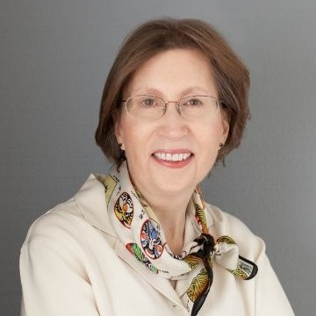
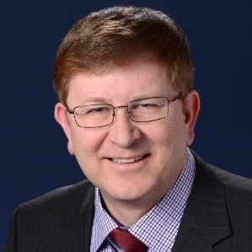
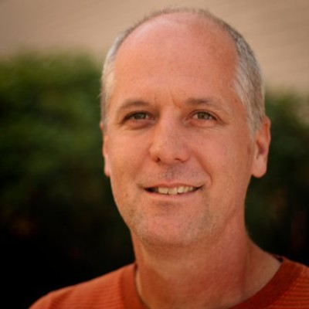
WG Officer Awards
Dorothy Stanley
(802.11 Chair)
Thanks for the support, for accommodating the requests for many time slots, and for teleconference Webex arrangement
Robert Stacey
(802.11 Vice Chair)
Jon Rosdahl
(802.11 Vice Chair)
Stephen McCann
(Secretary)

Slide 5
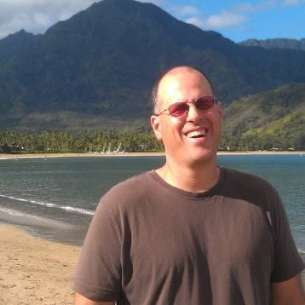
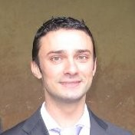
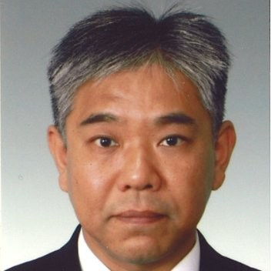
802.11ax TG Officers
Osama
Aboul-Magd
(TG Chair)
Simone
Merlin
(TG Vice Chair)
Alfred
Asterjadhi
(TG Vice Chair)
Yasuhiko
Inoue
(TG Secretary)
Ron Porat
(TG Vice Chair)
Robert Stacey
(TG Editor)
Thanks for being patient!!

Slide 6
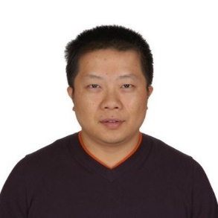
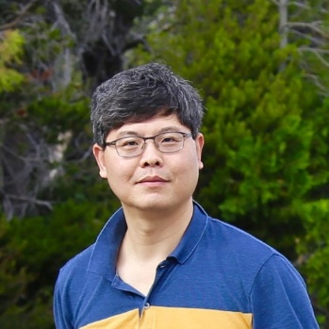
PHY Ad Hoc Chairs
Thanks for running very efficient meetings!!
Bo Sun
Bo Sun
Hongyuan
Zhang
Jianhan Liu
Yakun
Sun

Slide 7
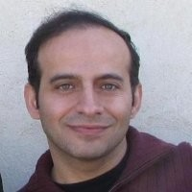
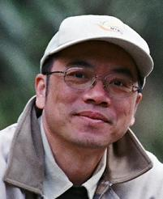
MAC Ad Hoc Chairs
Reza Hedayat
Where everyone had gone?!!
Brian Hart
Eric Wong
Chao-Chun
Wang

Slide 8
Spatial Reuse Ad Hoc Chairs
Thanks for handling contentious issues!!
Guido Hiertz
Jae Seung
Lee
Laurent
Cariou

Slide 9
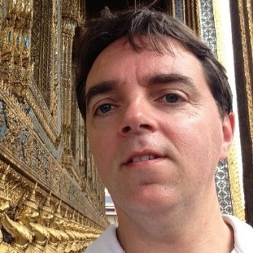
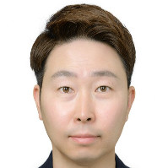
MU Ad Hoc Chairs
Sigurd Schelstraete
Thank You
Kaushik
Josiam
David Xun
Yang
Kiseon Ryu

Slide 10
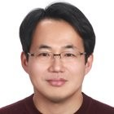
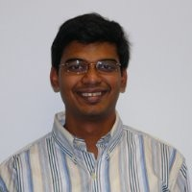
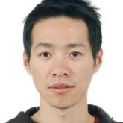
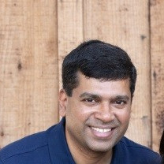
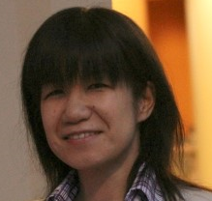
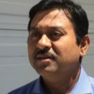
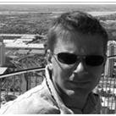
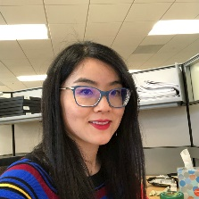
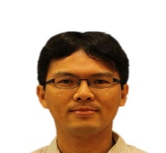
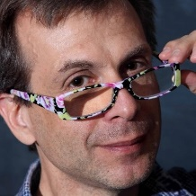
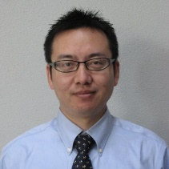
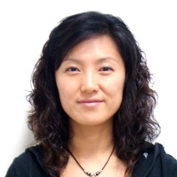
MAC and SR Comment Resolutions
Yongho
Seok
Abhishek
Patil
Ming
Gan
George
Cherian
Tomo
Adachi
Liwen
Chu
Chittabrata
Ghosh
Jarkko
Kneckt
Guoqing
Li
Po-Kai
Huang
Menzo
Wentink
Yunbo
Li
Matthew
Fischer
Zhou
Lan
Kaiying
Lu
Jeongki
Kim
James
Wang

Slide 11
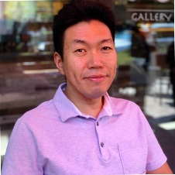
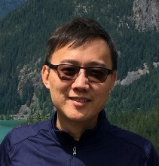
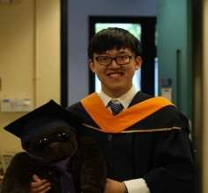
PHY Comment Resolution
Ross
Jian
Yu
Youhan
Kim
Tianyu
Wu
Bin
Tian
Sameer
Vermani
Jinsoo
Choi
Yan
Zhang
Xiaogang
Chen

Slide 12
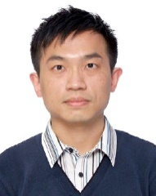
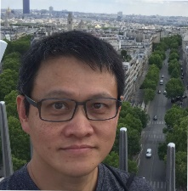
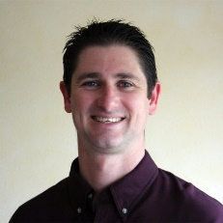
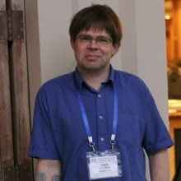
Other Comments
Edward
Au
James
Yee
PAR
Verification
Annex B and
Annex C
Suhwook
Kim
Frank
Hsu
Thomas
Derham
Eldad
Perahia
Mark
Rison
6 GHz
Comments
Coexistence
Assurance
Document
Many
Comments

Slide 13
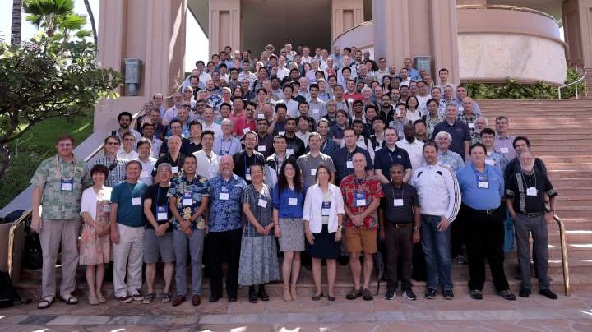
…. and the rest of 802.11 WG

Slide 14
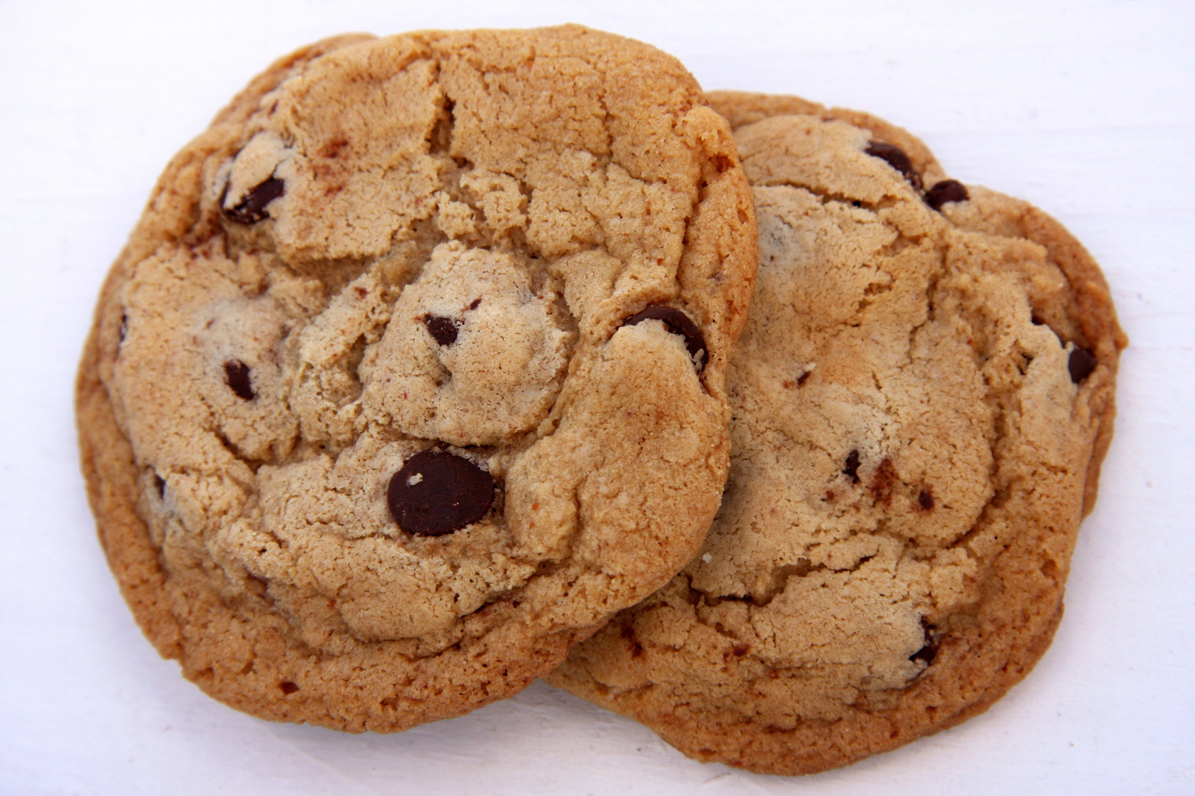
Quiz
How many cookies are consumed developing 802.11ax specification?
35 F2F meetings (not counting the virtual meetings)
Average number of 802.11ax attendance = 150
2 cookies per person
Over 10000 cookies – Thanks Jon

Slide 15
References

