Slide 1
Proactive Spectrum Planning
May 2021
Date: 2021-05-10
Authors:
Notes:
September 2012

Slide 2
Abstract
May 2021
Meeting spectrum needs is a complex and an excruciatingly time consuming process. This presentation explores how IEEE 802 could better manage the process by being proactive.
Notes:
September 2012
doc.: IEEE 802.11-09/0301r1
March 2009
Stephen McCann, RIM
Page 2

Slide 3
Problem Statement
May 2021
EXAMPLE: The 6 GHz band was recently added for IEEE 802.11
  The process has taken 4+ years and tremendous resources (so far)
  It is not (yet) globally harmonized
    5925 MHz to 7125 MHz in some regulatory domains, limited to 5925 MHz to 6425 MHz in others
    Very Low Power, Indoor only, geolocation restrictions, etc.
  Technology is ready, but rollout will be slow and torturous
    Many regulatory domains not available
    Different specifications based on locale
    Portability hampered by geolocation requirements
  We got a lot less than we hoped for
Can we do a better job to ensure the standards we create have the RF spectrum they need at the time of their ratification?

Slide 4
RF Spectrum Complexities
May 2021
Radio Frequency spectrum is poorly allocated
  Developed over the course of decades
    Frequency allocations were driven by technology limitations; not optimized for applications
    With no incentive to move, licensees continue in sub-optimal frequency bands
  Lack of accurate spectrum inventory leaves some spectrum unused or underused
    Expired licenses, obsolete applications, etc.
  Opportunities for spectrum sharing are limited
If we could start over…
  Short range devices best in highest frequency bands; long range in mid and low bands
  All allocations should have sharing provisions
…but we can’t

Slide 5
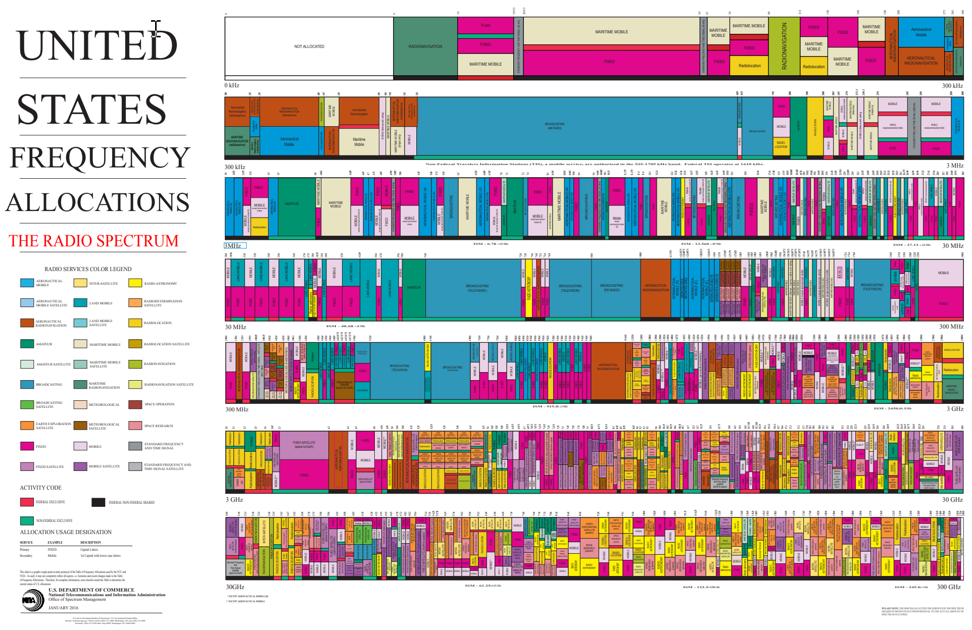
The Art of Spectrum Complexity
May 2021

Slide 6
Optimizing From Where We Are Today
May 2021
Comprehensive spectrum inventory is necessary
  We can only fix what we know for certain is broken
Regulators are required to be technology neutral
  Licensed and licensed-exempt (unlicensed) must have equal opportunities
  IEEE 802.11/15 have both proven that sharing is viable and valuable
  Biases hamper spectrum optimization
New or replacement allocations should be optimized
  Spectrum bands allocations should be selected based on application requirements
  Provision for sharing should be taken into account in any new allocations

Slide 7
What Can IEEE 802 Do?
May 2021
Proactivities
  Survey existing spectrum bands (low, mid, high) for potential sharing candidates
    Applications should drive band selections
  Set up a task force for spectrum discussions (802.18?)
    With the cellular industry
    With regulators
  Work with the cellular industry on sharing opportunities
    Can we avoid the competition that slows the process?
    Extol the successes of license-exempt/unlicensed wireless technologies and their value as part of cellular networks
  Build a coalition of industry leaders
    To lobby for spectrum inventory globally
    To work on changing the regulations

Slide 8
Next Steps
May 2021
Radio Regulatory TAG engagement
  Fine tune this proposal
  Begin surveying existing allocations for sharing opportunities generally
    Focus on recent sharing successes, e.g. 6 GHz
  Closely monitor both 802.11 and 802.15 WNG groups for potential new spectrum requirements

Slide 9
References
US FCC Table of Frequencies
  https://transition.fcc.gov/oet/spectrum/table/fcctable.docx
European Table of Frequency Allocations
  https://docdb.cept.org/download/2ca5fcbd-4090/attachments/2013_ERCRep025.pdf
  ECO Frequency Information System (cept.org)

