Slide 1
Discussion on Spatial Reuse Issues
Date: 2021-03-31
Authors:

Slide 2
Abstract
In this contribution, we follow up on discussions on spatial reuse for EHT STA.

Slide 3
Introduction
Spatial Reuse issues have been discussed in TGbe [1, 2, 4]
  Descriptions of two SR subfields in the U-SIG field of EHT TB PPDU were proposed in [2]
  Additional RPL normalization issues were discussed recently in [4]
Further changes are needed for some specifications due to 11be features

Slide 4

Recap - Current PSR Operation [3]
$TX_{PWR_{PSRT}}−10\log_{10}\left(\frac{PPDU_{BW}}{20MHz}\right)≤PSR−RPL$ [dBm] (1)
$TX_{PWR_{PSRT}} ≤ PSR−RPL^{∗}+10\log_{10}\left(\frac{PPDU_{BW}}{20MHz}\right)$ [dBm]
Tx power over
PSRT PPDU BW
Tx power upper bound
per 20MHz
Number of 20MHz channels in PSRT PPDU BW ➔ “20 MHz Subchannel Multiplier”
$RPL^{∗}$ is the normalized PRL to 20MHz [2]
Notes:
please

Slide 5
Recap - ESR Definition
There is consensus in [1,2] that normalizations of $TX_{PWR_{PSRT}}$, $PSR$ and $RPL$ are performed on 20MHz basis regardless of the BW field of the EHT TB PPDU
If the Bandwidth field indicates 80 MHz, then this field applies to each 20 MHz of the first 40 MHz subband of within the 80 MHz operating bandwidth.
If the Bandwidth field indicates 160 MHz, then this field applies to each 20 MHz of the first 80 MHz subband of within the 160 MHz operating bandwidth. [2]
If the Bandwidth field indicates 80 MHz, then this field applies to each 20 MHz of the second 40 MHz subband of within the 80 MHz operating band.
If the Bandwidth field indicates 160 MHz, then this field applies to each 20 MHz of the second 80 MHz subband of within the 160 MHz operating band. [2]
ESR1
ESR2
Spatial Reuse subfields in Special User Info field of EHT Trigger frame or U-SIG of TB-PPDU
In [1], it is proposed that RPL normalized to 20MHz is done by subtracting log10(PSRR_PPDU_BW/20MHz)
  Mismatch between PSRR-PPDU and STA operating BW was discussed recently in [4]

Slide 6
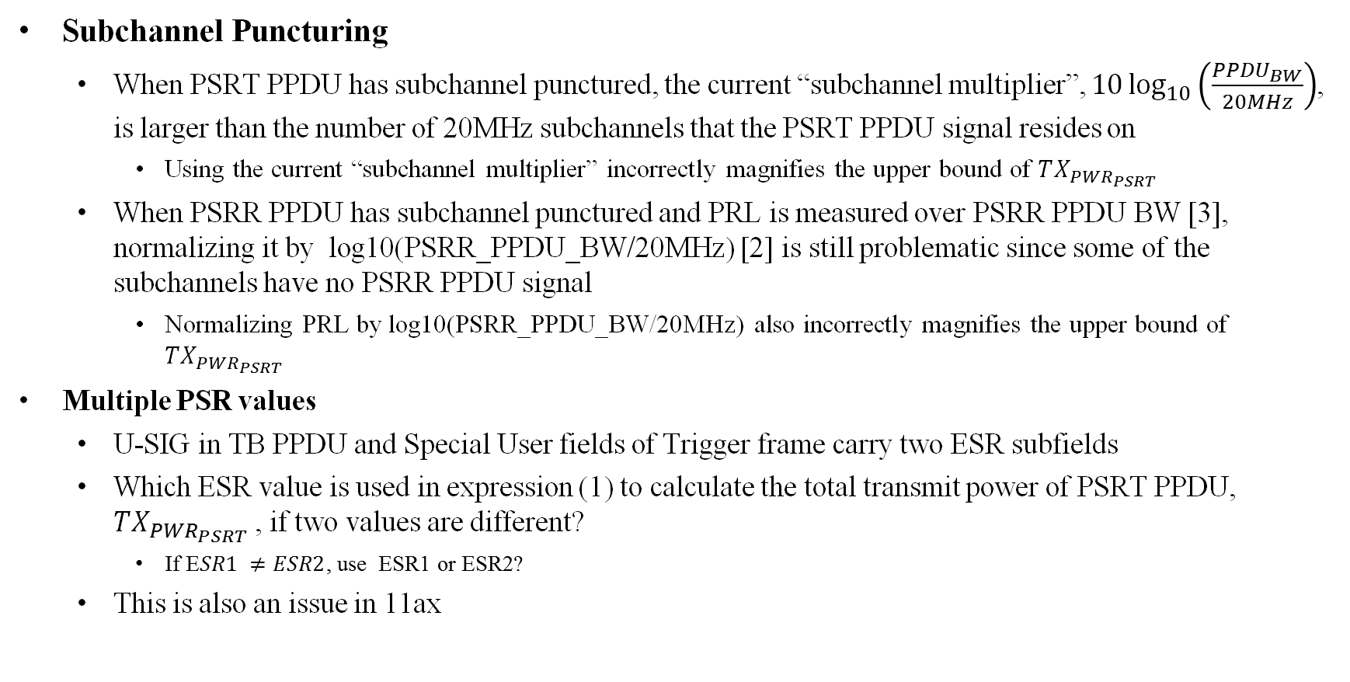
11be Features Impacting PSR Operation
Subchannel Puncturing
  When PSRT PPDU has subchannel punctured, the current “subchannel multiplier”, $10\log_{10}\left(\frac{PPDU_{BW}}{20MHz}\right)$, is larger than the number of 20MHz subchannels that the PSRT PPDU signal resides on
    Using the current “subchannel multiplier” incorrectly magnifies the upper bound of $TX_{PWR_{PSRT}}$
  When PSRR PPDU has subchannel punctured and PRL is measured over PSRR PPDU BW [3], normalizing it by log10(PSRR_PPDU_BW/20MHz) [2] is still problematic since some of the subchannels have no PSRR PPDU signal
    Normalizing PRL by log10(PSRR_PPDU_BW/20MHz) also incorrectly magnifies the upper bound of $TX_{PWR_{PSRT}}$
Multiple PSR values
  U-SIG in TB PPDU and Special User fields of Trigger frame carry two ESR subfields
  Which ESR value is used in expression (1) to calculate the total transmit power of PSRT PPDU, $TX_{PWR_{PSRT}}$, if two values are different?
    If E$SR1 ≠ESR2$, use ESR1 or ESR2?
  This is also an issue in 11ax

Slide 7
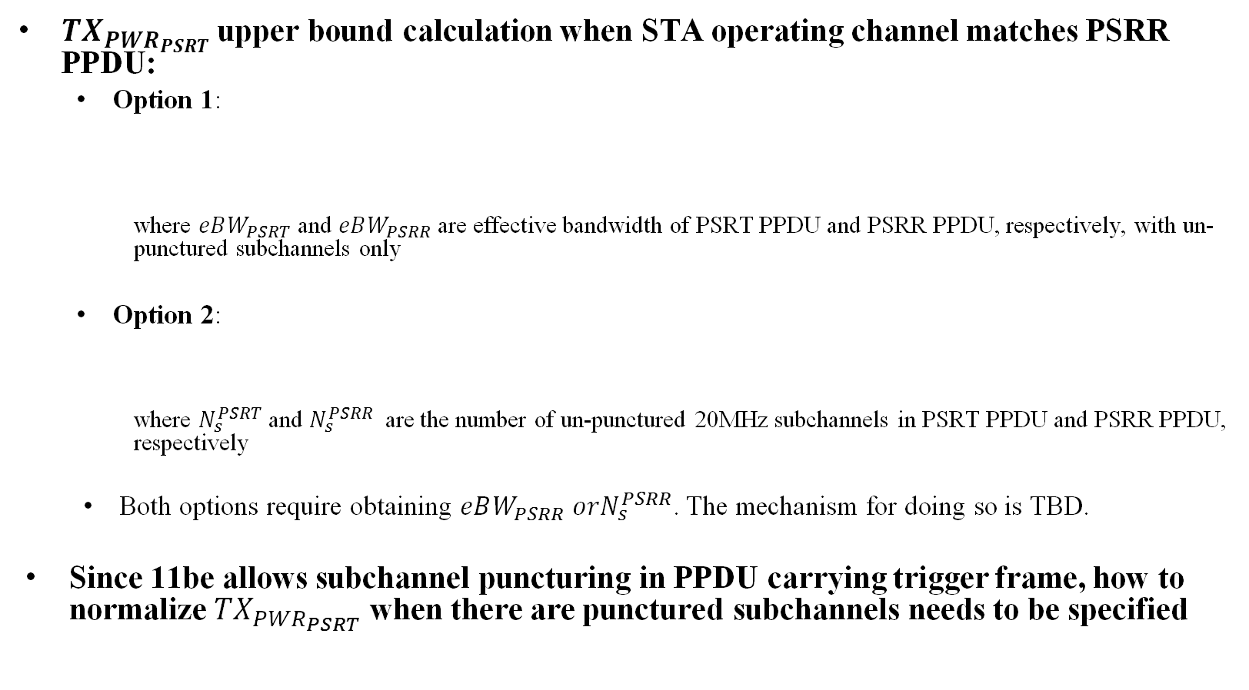
Potential Solutions (1/2)
${TX}_{PWR_{PSRT}}$upper bound calculation when STA operating channel matches PSRR PPDU:
  Option 1:
    where $eBW_{PSRT}$ and $eBW_{PSRR}$are effective bandwidth of PSRT PPDU and PSRR PPDU, respectively, with un-punctured subchannels only
  Option 2:
    where $N_{s}^{PSRT}$ and $N_{s}^{PSRR}$ are the number of un-punctured 20MHz subchannels in PSRT PPDU and PSRR PPDU, respectively
  Both options require obtaining $eBW_{PSRR} orN_{s}^{PSRR}$. The mechanism for doing so is TBD.
Since 11be allows subchannel puncturing in PPDU carrying trigger frame, how to normalize ${TX}_{PWR_{PSRT}}$ when there are punctured subchannels needs to be specified
$T{TX}_{PWR_{PSRT}}−10\log_{10}\left(\frac{eBW_{PSRT}}{20MHz}\right)≤\min\left(ESR1,ESR2\right)−(RPL_{PSRR}−10\log_{10}{(\frac{eBW_{PSRR}}{20MHz}))}$ [dBm] . (
$T{TX}_{PWR_{PSRT}}−10\log_{10}\left(N_{s}^{PSRT}\right)≤\min\left(ESR1,ESR2\right)−(RPL_{PSRR}−10\log_{10}{(N_{s}^{PSRR}))}$. ( [dBm]1

Slide 8








Examples – PSRT PPDU Operating Channel Matches PSRR PPDU Operating Channel
20MHz
20MHz
20MHz
20MHz
PSRR PPDU
$$eBW_{PSRR}=80MHz$$
$$N_{s}^{PSRR}=4$$
PSRT PPDU
$$eBW_{PSRT}=80MHz$$
$$N_{s}^{PSRT}=4$$
PSRR PPDU
Punctured
$$eBW_{PSRR}=60MHz$$
$$N_{s}^{PSRR}=3$$
PSRT PPDU
Punctured
Punctured
$$eBW_{PSRT}=40MHz$$
$$N_{s}^{PSRT}=2$$

Slide 9
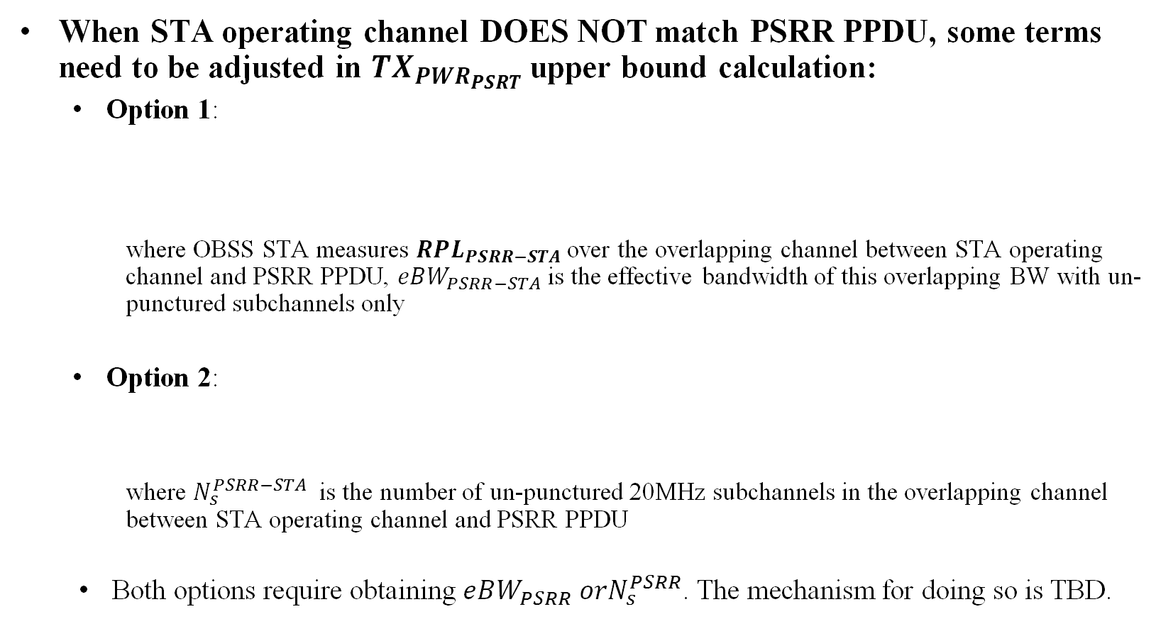
Potential Solutions (2/2)
When STA operating channel DOES NOT match PSRR PPDU, some terms need to be adjusted in ${TX}_{PWR_{PSRT}}$upper bound calculation:
  Option 1:
    where OBSS STA measures $RPL_{PSRR−STA}$over the overlapping channel between STA operating channel and PSRR PPDU, $eBW_{PSRR−STA}$is the effective bandwidth of this overlapping BW with un-punctured subchannels only
  Option 2:
    where $N_{s}^{PSRR−STA}$ is the number of un-punctured 20MHz subchannels in the overlapping channel between STA operating channel and PSRR PPDU
  Both options require obtaining $eBW_{PSRR} orN_{s}^{PSRR}$. The mechanism for doing so is TBD.
$T{TX}_{PWR_{PSRT}}−10\log_{10}\left(\frac{eBW_{PSRT}}{20MHz}\right)≤\min\left(ESR1,ESR2\right)−(RPL_{PSRR−STA}−10\log_{10}{(\frac{eBW_{PSRR−STA}}{20MHz}))}$ [dBm] . (
$T{TX}_{PWR_{PSRT}}−10\log_{10}\left(N_{s}^{PSRT}\right)≤\min\left(ESR1,ESR2\right)−(RPL_{PSRR−STA}−10\log_{10}{(N_{s}^{PSRR−STA}))}$. ( [dBm]1

Slide 10



Examples – PSRT PPDU Operating BW Mismatches PSRR PPDU Operating BW
20MHz
20MHz
20MHz
20MHz
PSRR PPDU
Punctured
$$eBW_{PSRR}=60MHz { N}_{s}^{PSRR}=3$$
PSRT PPDU
$eBW_{PSRT}=20MHz{ N}_{s}^{PSRR}=1$,,
$$eBW_{PSRR−STA}=20MHz N_{s}^{PSRR−STA}=1$$
20MHz
20MHz
20MHz
20MHz
PSRR PPDU
Punctured
$$eBW_{PSRR}=60MHz { N}_{s}^{PSRR}=3$$
PSRT PPDU
$$eBW_{PSRT}=140 MHz N_{s}^{PSRR}=7$$
$$eBW_{PSRR−STA}=60MHz N_{s}^{PSRR−STA}=3$$

Slide 11
Conclusions
In this contribution, we discuss two 11be features that may impact spatial reuse operations
Spatial reuse specification needs to be updated to address these issues
We discuss some potential solutions

Slide 12
References
[1] 802-11-21/0269r1 PSR-based SR Normalization Discussion
[2] 802-11-21/0440r2 PDT-EHT-PSR-based-SR
[3] 802.11ax D8.0
[4] 802-11-21/0673r2 PSR-Based SR Discussion Follow-up

Slide 13
Straw poll 1
Do you agree that the Tx_PWR_PSRT setting should consider subchannel puncturing in both PSRT PPDU and PSRR PPDU?
Y/N/Abs:

Slide 14
Straw poll 2
Which Option do you prefer to address the issue of Tx_Pwr_PPDU setting?
  Option 1 (as shown on slide 9)
  Option 2 (as shown on slide 9)
  Other option?
Option 1/Option 2/Other Option/Abs:

Slide 15
PPDU_BW determination

