Slide 1
Miscellaneous 11me/D0.0 issues
Date: 2021-03-11
Authors:

Slide 2
Abstract
This submission examines various miscellaneous points left over from REVmd.

Slide 3
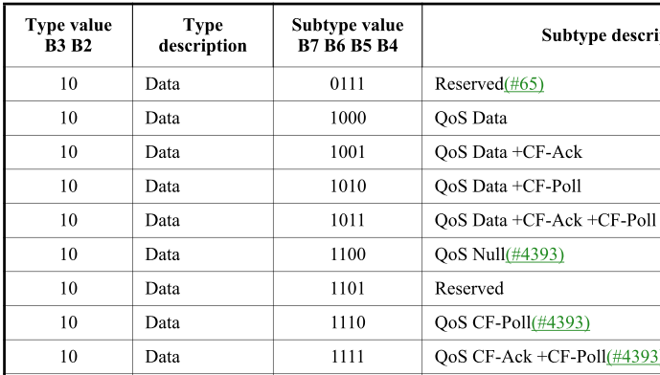
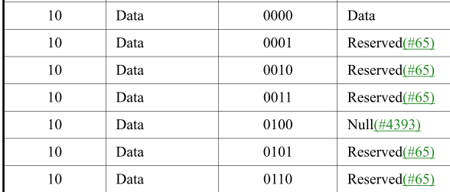
“QoS Data frame”
Per CID 4259 in REVmd:
"QoS Data frame" is ambiguous. It could mean Type = Data, Subtype has b7 set, or it could mean Type = Data, Subtype = QoS Data
In some parts of the spec, “QoS Data” clearly just refers to the specific subtype, because it’s in a context like “QoS Data or QoS Null frame”
On the other hand, in 802.11-2016 we had an explicit definition of “QoS Data frame” that meant it applied to all Data frames with b7 set in FC:
“Data frames with a 1 in the QoS subfield of the Subtype subfield are collectively referred to as QoS Data frames.”

Slide 4
“QoS Data frame”
We resolved CID 4259 so that 802.11-2020 would say:
Data frames with the QoS subfield of the Subtype subfield (see 9.2.4.1.3) set to 1 contain QoS in their names and contain a QoS Control field in the MAC header. Depending on the context, QoS Data frame either refers to any such frame, or refers specifically to the Data frame with subtype 1000. References nearby to other specific Data frames with QoS in their name (e.g. QoS Null or QoS Data +CF-Poll) typically suggest the latter interpretation.
“Depending on the context” and “typically suggest” heuristics are not ideal
Is there a better solution?
~185 instances of “QoS Data frame” in 802.11-2020

Slide 5
“beacon interval”
Per CID 2316 in REVmd:
References to "within a beacon interval" are not clear as to whether they mean "the nominal duration of one beacon period relative to a starting point that might not be a TBTT" or "the period of time between two consecutive TBTTs"
An example of the meaning being the former is “The Quiet Period field is set to the number of beacon intervals between the start of regularly scheduled quiet intervals defined by this Quiet element.” in 9.4.2.22
An example of the meaning being the latter is “The grpID 0 STAs are allowed to transmit within a beacon interval regardless of whether it is a sectorized beacon interval or not.” in 9.4.2.195, and 10.40.2 Access periods within a beacon interval. Probably also “The beacon interval within an IBSS is established by the STA at which the MLME-START.request primitive is performed to create the IBSS” in 11.1.3.5
Actually, there is a third possible interpretation, namely “the period of time between two beacons on the air”. Probably what is intended in “The STAs included in a page slice and indicated by the Page Slice element are served during the beacon intervals within a page period, starting from the Beacon frame that carries the Page Slice element for the page” in 9.4.2.192, and possibly also in 10.40.2

Slide 6
“beacon interval”
The wording “within an interval of time equal to one beacon interval” already appears in 10.2.3.2
Having said all this, there is a definition of “beacon interval”:
beacon interval: The time interval between two consecutive target beacon transmission times (TBTTs).
So anything that is referring to either the time between beacons on the air or the time to the next beacon or TBTT is using the wrong terminology

Slide 7
“beacon interval”
Consider the following timeline, for a BSS where the value in the Beacon Interval field of beacons is 100 (102.4 ms):
Is “a beacon interval”:
1) A to D only (anything happening from one TBTT to the next)
2) A to D, or C to F, etc. (anything happening over 102.4 ms)
3) B to E only (anything happening from the start of one beacon to the next, typically not exactly 102.4 ms)
4) B to D only (anything happening from the start of a beacon to the next TBTT)
5) Some combination of the above (e.g. 1 and 3, depending on context)
6) Something else

Slide 8
“beacon interval”
Some possible changes discussed in but punted from REVmd:
In 3.2, change the definition of “beacon interval” to:
beacon interval: An interval of time equal to the time interval between two consecutive target beacon transmission times (TBTTs).
NOTE—A beacon interval is a duration; it does not necessarily start at a TBTT.
In 10.2.3.2 change “within an interval of time equal to one beacon interval” to “within one beacon interval”
In 10.40.2 (first one) change “within a beacon interval” to “in the time interval between TBTTs” (or “within a beacon interval starting at a TBTT”?)
In 10.40.2 (others) change “within a beacon interval” to “within a beacon interval starting at a TBTT”
~800 instances of “beacon interval” in 802.11-2020
And ~120 “beacon period”

Slide 9
Non-QoS in a QBSS (Data)
Can a QSTA in a QBSS send data to another QSTA in a non-QoS Data frame?
My mental model was “no, except for broadcasts from a QAP when non-QSTAs are members of the QBSS”
However, I cannot find this clearly in the spec

Slide 10
Non-QoS in a QBSS (Data)
"A QoS STA shall use QoS Data frames for all MSDU transfers to another QoS STA."
… but that's in 10.23.3.5 HCCA transfer rules so probably doesn't apply in a QBSS that doesn't use HCCA
"In a QoS STA, the TID parameter of the MA-UNITDATA.request primitive results in a TID being specified for the transmitted MSDU.“
… implies use of QoS Control header and hence QoS frames?
… but doesn’t then allow non-QoS data broadcasts

Slide 11
Non-QoS in a QBSS (Data)
Bonus question: what replay counter is used for non-QoS Data frames (assuming there is more than one replay counter for the PTKSA or GTKSA, as appropriate)?

Slide 12
Non-QoS in a QBSS (Null)
Can a QSTA in a QBSS send a (non-QoS) Null to another QSTA?
e.g. for PM bit signalling
My mental model was “no, QSTAs in a QBSS use QoS frames (except for broadcasts from a QAP when non-QSTAs are members of the QBSS)”
However, I cannot find this clearly in the spec

Slide 13
Non-QoS in a QBSS (Null)
“A TXOP limit of 0 indicates that the TXOP holder may transmit or cause to be transmitted (as responses) the following within the current TXOP:
a) One of the following at any rate, subject to the rules in 10.6 (Multirate support)
1) One or more SU PPDUs carrying fragments of a single MSDU or MMPDU
2) An SU PPDU or a VHT MU PPDU carrying a single MSDU, a single MMPDU, a single A-MSDU, or a single A-MPDU
3) A VHT MU PPDU carrying A-MPDUs to different users (a single A-MPDU to each user) 4) A QoS Null frame or PS-Poll frame that is not an PS-Poll+BDT frame”
… but that’s a bit indirect (and doesn’t apply if the TXOP limit is non-zero, or in cases when a QoS Null is permitted in an A-MPDU)

Slide 14
References
802.11-2020
20/0435
19/0856

