Slide 1
Diversity Enhancement for DUP Mode
Date: 2021-03-03
Authors:
Name | Affiliation | Address | Phone | Email
Ali Tuğberk Doğukan | Vestel |  |  | adogukan18@ku.edu.tr
Başak Ak Özbakış |  |  |  | basak.ozbakis@vestel.com.tr
Ertuğrul Başar |  |  |  | ebasar@ku.edu.tr

Slide 2
Introduction
DUP mode, which duplicates the coded and modulated data symbols in the frequency domain, has been proposed for range extension in the 6 GHz band [1].
DUP mode is used only with MCS0+DCM and bandwidth 80/160/320 MHz.
PAPR reduction scheme is proposed for DUP mode in [2]. However, additional diversity scheme is TBD.
This contribution proposes a diversity enhancing technique to improve the performance of DUP mode.
A similar diversity enhancing method called ‘constellation rotation and cyclic Q delay’ is used in DVB-T2 standard [3].

Slide 3

Revisiting DUP Mode
In DUP mode, DCM signal is duplicated in frequency domain with PAPR reduction [2].
$x$: pre-DCM modulated symbols
$x_{DCM}$: symbols obtained by performing DCM on $x$
$x=\left[x_{L} x_{U}\right]$
$x_{L,DCM}$: symbols obtained by performing DCM on $x_{L}$
$x_{U,DCM}$: symbols obtained by performing DCM on $x_{U}$

Slide 4
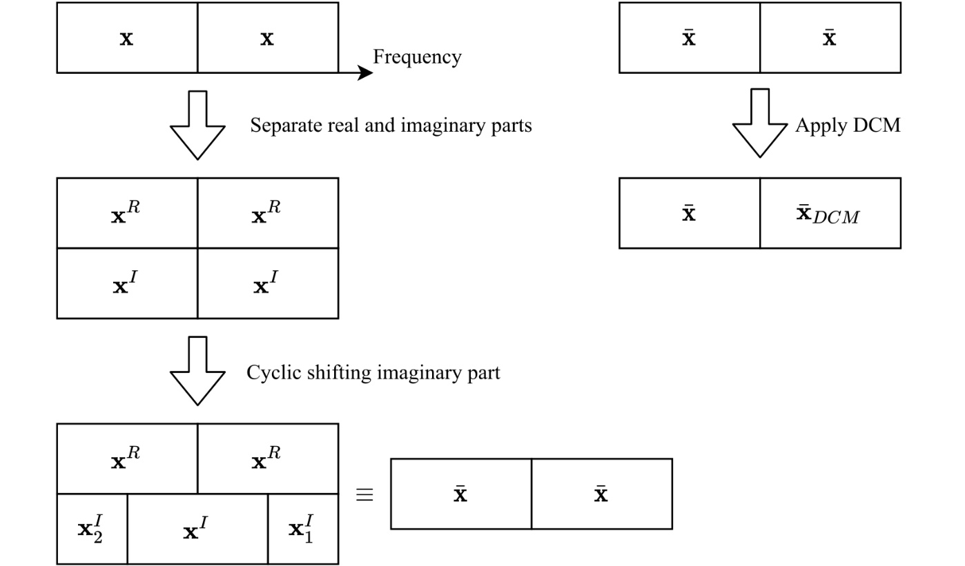
Proposed Method
In order to have imaginary and real parts, rotated BPSK can be used.
$x^{I}=\left[x_{1}^{I} x_{2}^{I}\right]$
After obtaining $y=\left[\overline{x} {\overline{x}}_{DCM}\right]$, DUP mode can be used with the PAPR reduction scheme in [2].

Slide 5
Comparison
Imaginary part is cyclicly shifted by $245$ elements.
DUP mode $→$ $x_{1}$ is transmitted over subcarriers with the indices $1$, $491$, $981$, and $1471$. ($4$ subcarriers)
Proposed method $→$ $x_{1}$ is transmitted over subcarriers with the indices $1$, $246$, $491$, $736$, $981$, $1226$, $1471$, and $1716$. ($8$ subcarriers)

Slide 6
Summary
We propose a diversity enhancing technique for DUP mode to further increase the transmission range and improve the error performance.

Slide 7
Reference
[1] Ron Porat, IEEE 802.11-20/965r4, 6 GHz LPI Range Extension.
[2] Ron Porat, et al, IEEE 802.11-20/1191r1, DUP mode PAPR reduction.
[3] “Frame structure channel coding and modulation for a second generation digital terrestrial television broadcasting system(DVB-T2),” ETSI EN 302 755 V1.1.1, Sep. 2009.

Slide 8
SP
Do you agree to add the proposed method with MCS14 to the 11be SFD?

