Slide 1
Agenda for IEEE 802.11 Coexistence SC virtual meeting in March 2021
10 March 2021
Authors:
Name | Company | Phone | email
Andrew Myles | Cisco | +61 418 656587 | amyles@cisco.com

Slide 2
Welcome to the 5th virtual plenary meeting of the Coex SC in Mar 2021
IEEE 802.11 PDED ad hoc
1 | Warsaw | Sep 2016
2 | San Antonio | Nov 2016
3 | Atlanta | Jan 2017
4 | Vancouver | Mar 2017
5 | Daejeon | May 2017
IEEE 802.11 Coexistence SC
7 | San Diego | July 2018
8 | Hawaii | Sep 2018
9 | Bangkok | Nov 2018
10 | St Louis | Jan 2019
11 | Vancouver | Mar 2019
12 | Atlanta | May 2019
13 | Vienna | Jul 2019
14 | Hanoi | Sep 2019
15 | Hawaii | Nov 2019
16 | Irvine | Jan 2020
17 | Virtual 1 | Jul 2020
18 | Virtual 2 | Sep 2020
19 | Virtual 3 | Nov 2020
20 | Virtual 4 | Jan 2020
21 | Virtual 5 | Mar 2020
IEEE 802.11 Coexistence SC
1 | Berlin | July 2017
2 | Hawaii | Sep 2017
3 | Orlando | Nov 2017
4 | Irvine | Jan 2018
5 | Chicago | Mar 2018
6 | Warsaw | May 2018
7 | San Diego | July 2018

Slide 3
Coex SC minutes today will be kept by our permanent SC secretary
  It is important to keep proper minutes of all Coexistence SC meetings
  Fortunately, Guido Hiertz (Ericsson) agreed in Berlin (in July 2017) to be appointed the IEEE 802.11 Coexistence SC’s permanent Secretary …
  … is Guido here today?

Slide 4
Meetings shall be conducted in compliance with all applicable laws, including antitrust & competition laws
Approved slide
  Don’t discuss the interpretation, validity, or essentiality of patents/patent claims
  Don’t discuss specific license rates, terms, or conditions
    Relative costs of different technical approaches that include relative costs of patent licensing terms may be discussed in standards development meetings
      Technical considerations remain the primary focus
  Don’t discuss or engage in the fixing of product prices, allocation of customers, or division of sales markets
  Don’t discuss the status or substance of ongoing or threatened litigation
  Don’t be silent if inappropriate topics are discussed … do formally object
  For more details, see IEEE-SA Standards Board Ops Man, 5.3.10 and Antitrust and Competition Policy: What You Need to Know available here
  If you have questions, contact the IEEE-SA Standards Board Patent Committee Administrator at patcom@ieee.org

Slide 5
Participant behavior in IEEE-SA activities is guided by the IEEE Codes of Ethics & Conduct
Approved slide
  All participants in IEEE-SA activities are expected to adhere to the core principles underlying the:
    IEEE Code of Ethics
    IEEE Code of Conduct
  The core principles of the IEEE Codes of Ethics & Conduct are to:
    Uphold the highest standards of integrity, responsible behavior, and ethical and professional conduct
    Treat people fairly and with respect, to not engage in harassment, discrimination, or retaliation, and to protect people's privacy.
    Avoid injuring others, their property, reputation, or employment by false or malicious action
  The most recent versions of these Codes are available at
    http://www.ieee.org/about/corporate/governance

Slide 6
Participants in the IEEE-SA “individual process” shall act independently of others, including employers
Approved slide
  The IEEE-SA Standards Board Bylaws require that “participants in the IEEE standards development individual process shall act based on their qualifications and experience”
  This means participants:
    Shall act & vote based on their personal & independent opinions derived from their expertise, knowledge, and qualifications
    Shall not act or vote based on any obligation to or any direction from any other person or organization, including an employer or client, regardless of any external commitments, agreements, contracts, or orders
    Shall not direct the actions or votes of other participants or retaliate against other participants for fulfilling their responsibility to act & vote based on their personal & independently developed opinions
  By participating in standards activities using the “individual process”, you are deemed to accept these requirements; if you are unable to satisfy these requirements then you shall immediately cease any participation

Slide 7
IEEE-SA standards activities shall allow the fair & equitable consideration of all viewpoints
Approved slide
  The IEEE-SA Standards Board Bylaws (clause 5.2.1.3) specifies that “the standards development process shall not be dominated by any single interest category, individual, or organization”
    This means no participant may exercise “authority, leadership, or influence by reason of superior leverage, strength, or representation to the exclusion of fair and equitable consideration of other viewpoints” or “to hinder the progress of the standards development activity”
  This rule applies equally to those participating in a standards development project and to that project’s leadership group
  Any person who reasonably suspects that dominance is occurring in a standards development project is encouraged to bring the issue to the attention of the Standards Committee or the project’s IEEE-SA Program Manager

Slide 8
IEEE SA Copyright Policy
Approved slide
  By participating in this activity, you agree to comply with the IEEE Code of Ethics, all applicable laws, and all IEEE policies and procedures including, but not limited to, the IEEE SA Copyright Policy.
    Previously Published material (copyright assertion indicated) shall not be presented/submitted to the Working Group nor incorporated into a Working Group draft unless permission is granted.
    Prior to presentation or submission, you shall notify the Working Group Chair of previously Published material and should assist the Chair in obtaining copyright permission acceptable to IEEE SA.
    For material that is not previously Published, IEEE is automatically granted a license to use any material that is presented or submitted.

Slide 9
IEEE SA Copyright Policy
Approved slide
  The IEEE SA Copyright Policy is described in the IEEE SA Standards Board Bylaws and IEEE SA Standards Board Operations Manual
    IEEE SA Copyright Policy, see:
      Clause 7 of the IEEE SA Standards Board Bylaws
      Clause 6.1 of the IEEE SA Standards Board Operations Manual
  IEEE SA Copyright Permission
  IEEE SA Copyright FAQs
  IEEE SA Best Practices for IEEE Standards Development
  Distribution of Draft Standards (see Clause 6.1.3 of the SASB Operations Manual)

Slide 10
The Coex SC will meet once during the virtual
IEEE 802.11 WG interim meeting in Mar 2021
IEEE 802.11 Coex teleconference
  Wednesday, 10 Mar 2021 @ 4-6pm ET
  Webex details:
    https://ieeesa.webex.com/ieeesa/j.php?MTID=m5bc9f1c807c106a293dc6ed0e3b3c31b
    Meeting number: 179 517 2313
    Meeting password: wireless

Slide 11
Today’s meeting of the Coexistence SC may be relatively short …
  Originally the plan was for
    ETSI BRAN to meet this week
    IEEE 802.11 WG to meet next week
  This schedule would have allowed the Coexistence SC agenda to include an update & discussion based on the ETSI BRAN results
  The schedule changed so now both ETSI BRAN & IEEE 802.11 WG are meeting this week
  This change caused at least two significant submissions to the Coex SC to be delayed … and means that there is less to discuss this week
  The IEEE 802.11 WG Chair suggested we still briefly meet for a status update … and it gives us an opportunity for open discussion

Slide 12
The Coex SC will consider a proposed agenda for its virtual meeting in Mar 2021
Proposed Agenda
  Bureaucratic stuff
    Scope of IEEE 802.11 Coexistence SC (a reminder)
      … and an expansion to include 60 GHz
    Approve minutes
  What is happening this week? (in no particular order)
    Review of ETSI BRAN activities
      EN 303 687 issues (6 GHz)
        Including a discussion of NB FH in 6 GHz
      EN 301 893 issues (5 GHz)
        Including status of proposed compromise on adaptivity
    5 GHz coexistence in China
    Plans for next meeting
    Other business

Slide 13
  Scope of IEEE 802.11 Coexistence SC

Slide 14
The Coex SC scope was revised in Sept 2020
IEEE 802.11 Coex SC Scope
  The Coex SC shall promote, within the 802.11 WG and externally, an environment that enables IEEE 802.11 technologies to have equitable access to unlicensed spectrum globally
  The Coex SC should focus particularly on coexistence of 802.11ax & 802.11be with LAA & NR-U in the 5 GHz & 6 GHz bands globally
  The Coex SC may consider coexistence with other technologies and in other bands as directed by the Chair of the 802.11 WG
IEEE 802.11 Coex SC close down criteria
  802.11 WG Chair has authority to close down SC

Slide 15
The scope of the Coex SC was expanded during the March 2021 plenary to include 60 GHz
  It was noted during the March 2021 plenary that ETSI BRAN is working on 60 GHz Harmonised Standards that may impact IEEE 802.11ay coexistence
  Subsequently, the 802.11 Chair directed the Coex SC to consider 60GHz coexistence within scope

Slide 16
The Coex SC Chair requests assistance in putting together 60 GHz material for a future meeting
  No 60 GHz material is included in this agenda because:
    None was provided
    The Coex SC Chair is still learning
  The two projects of relevance appear to be:
    EN 303 722: Wideband Data Transmission Systems (WDTS) for Fixed Networks in the 57 - 71 GHz band
      Sponsored by HPE, Nokia, Qualcomm, Intel, Facebook & Sony
    EN 303 753: Wideband Data Transmission Systems (WDTS) for Mobile and Fixed Equipment in the 57 - 71 GHz band
      Sponsored by Ericsson, Nokia, Qualcomm & Huawei
  The Coex SC Chair requests assistance in putting together material for a future meeting
    Volunteers?

Slide 17
  Minutes

Slide 18
The Coex SC will consider the approval of its virtual meeting minutes from Jan 2021
  The draft minutes for the Coex SC at the virtual meeting in Jan 2021 are available on Mentor:
    See 11-21-0178-00 (draft)
  Motion:
    The IEEE 802 Coex SC approves 11-21-0178-00 as the minutes of its virtual meeting in Jan 2021
    Moved:
    Seconded:
    Result:

Slide 19
Key messages

Slide 20
There are few key message for the Coex SC that arise out of today’s session
Key messages from today’s session …
  LAA is happening … and early deployment measurements suggest potential concerns
  EN 303 687 (6 GHz) is progressing well … although there are variety of potential outstanding issues
    NB FH is the most contentious in ETSI BRAN
    There is probably work to be done in the 802.11 WG to enable 802.11be operation & optimise 802.11ax/be operation in 6 GHz
  EN 301 893 (5 GHz) will be progressing very well … once agreement is reached on the proposed compromise
    Assuming there is consensus on the compromise, there is work to undertaken by Wi-Fi stakeholders to help determine any future refinements to EN 301 893
  There is a possible problem with 5 GHz operation in China
… you can leave if you are not interested in the details ☺

Slide 21
  Agenda items
  Unlicensed LTE deployment

Slide 22
The number planned/testing & deployed LAA networks globally is currently steady
Tech | Stage | GSMA¹ (July ‘18) | GSA² (Oct ‘18) | GSA³ (Jan ‘19) | GSA⁴ (Jul ‘19) | GSA⁵ (Nov ‘19) | GSA⁶ (Dec ‘19) | GSA⁷ (Mar ‘20) | GSA⁸ (Aug ‘20)
LAA | Trials/plans | 23 | 22 | 26 | 29 | 30 | 29 | 29 | 28
 | Deployed | 4 | 6 | 6 | 8 | 8 | 8 | 9 | 9
eLAA | Trials/plans | ? | 1 | 1 | 1 | 1 | ? | 0 | 1
 | Deployed | ? | 0 | 0 | 0 | 0 | ? | 1 | 0
LWA | Trials/plans | ? | 2 | 2 | 2 | 2 | 2 | 2 | 2
 | Deployed | ? | 1 | 1 | 1 | 1 | 1 | 1 | 1
LTE-U | Trials/plans | ? | 8 | 8 | 8 | 8 | 9 | 9 | 9
 | Deployed | ? | 3 | 3 | 3 | 3 | 3 | 3 | 3
GSMA (July 2018)
GSA: Evolution from LTE to 5G: Global Market Status (Nov 2018)
GSA: LTE in unlicensed and shared spectrum (Jan 2019)
GSA: Evolution from LTE to 5G: Global Market Status (Aug 2019)
GSA: LTE Unlicensed - LTE in Unlicensed and Shared Spectrum (Nov 2019
GSA: LTE and 5G Market Statistics (Dec 2019)
GSA: LTE in Unlicensed Spectrum and Shared Spectrum (Mar 2020)
GSA: LTE and 5G in Unlicensed Spectrum: Trials, Deployments & Devices (Aug 2020)

Slide 23
The number planned/testing & deployed LAA networks globally is currently steady
Tech | Stage | GSA¹⁰ (Oct ’20) | GSA¹¹ (Jan ’21) | GSA¹² (Feb ’21)
LAA | Trials/plans | 27 | 27 | 27
 | Deployed | 9 | 9 | 9
eLAA | Trials/plans | ? | ? | ?
 | Deployed | ? | ? | ?
LWA | Trials/plans | 2 | 2 | 2
 | Deployed | 1 | 1 | 1
LTE-U | Trials/plans | 9 | 9 | 9
 | Deployed | 3 | 3 | 3
GSA: LTE and 5G Market Statistics (Oct 2020)
GSA: LTE and 5G Market Statistics (Jan 2021)
GSA: Networks, Technologies & Spectrum Snapshot: LTE and 5G Market Statistics (Feb 2021)

Slide 24
The number planned/testing & deployed LAA networks globally is currently steady

Slide 25
In at least in Chicago, there is a significant LAA deployment …
No change from Sept 2020
Chicago LAA deployment (Jan 2020)
  A recent study in Chicago shows a significant LAA deployment, that is expanding rapidly
  In Jan 2020, AT&T mostly used channel 149 & Verizon mostly used channel 36
  See Measurement-based coexistence studies of LAA & Wi-Fi deployments in Chicago by Vanlin Sathya, Muhammad Iqbal Rochman, & Monisha Ghosh (Uni of Chicago)
AT&T
Verizon
T-Mobile

Slide 26
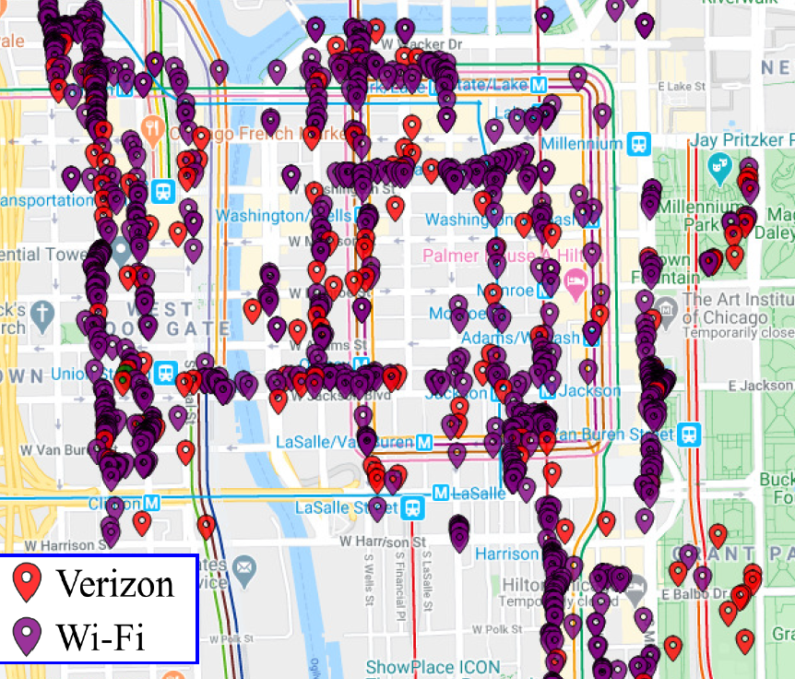
… suggesting that the need for coexistence between Wi-Fi & LAA is real … not just theoretical
No change from Sept 2020
  A recent study in Chicago shows a significant overlap between Wi-Fi & LAA
  The overlap is shown for channel 36
    Wi-Fi using 20 MHz, 40 MHz & 80 MHz channels, from mostly indoor locations
    LAA mostly using 60 MHz channels, from mostly outdoor locations

Slide 27
  Agenda items
  Unlicensed LTE deployment
  Real measurements

Slide 28
The Coex SC may briefly discuss the LAA/Wi-Fi coexistence study in Chicago reported in Jan 2021
  One of concerns with many of the conclusions drawn in relation to coexistence is that they are based on simulation studies …
  … which have been used over the years to provide evidence for just about any conclusion one might want to draw
  A good complement to simulation studies is measurements of actual deployments …
  … recognising they also have limitations
  In May 2021, the Coex SC heard from one of the authors of the Chicago Wi-Fi deployment study noted in previous meetings
    See 11-20-1973

Slide 29
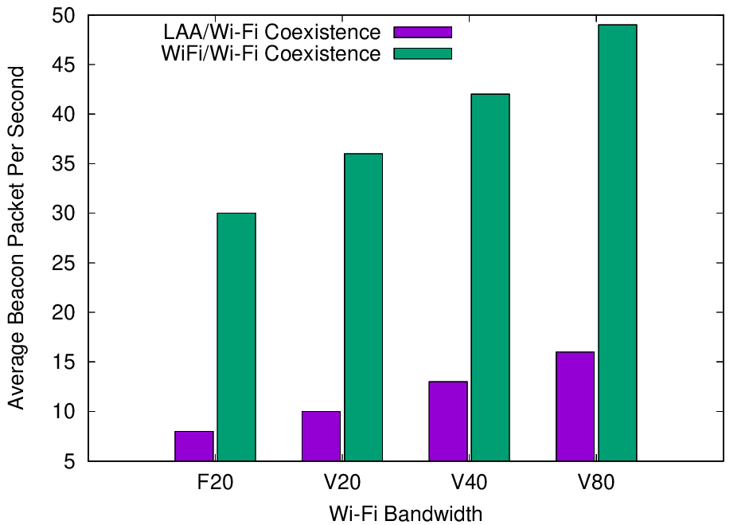
Experiments with deployed systems show LAA has a significant impact on Beacon success
  The University of Chicago study investigated the effect of LAA on Wi-Fi operation in various typical configurations, including hidden node
  The work showed that LAA
  caused significant interference
  to Beacons in the tested
  configuration
    Probably because LAA is:
      Using ED @ -72 dBm
      Rather than PD @ - 82 dBm
    Also because LAA typically uses
    long TxOPs (~8 ms)
Addition of a single LAA system to five Wi-Fi systems causes successful Beacon rate to reduce by > 75%
Pushing Wi-Fi APs into the same channel also causes successful Beacon rate to reduce, but by less than LAA

Slide 30
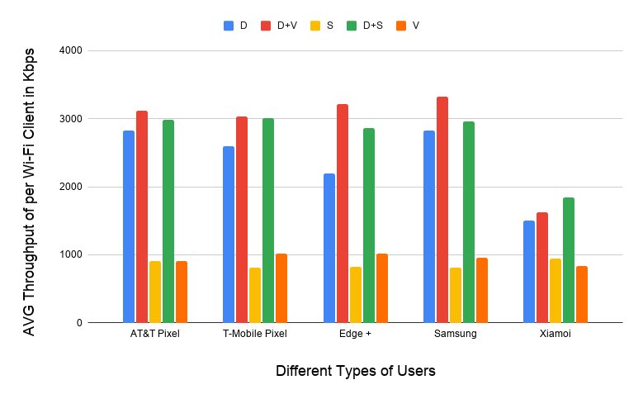
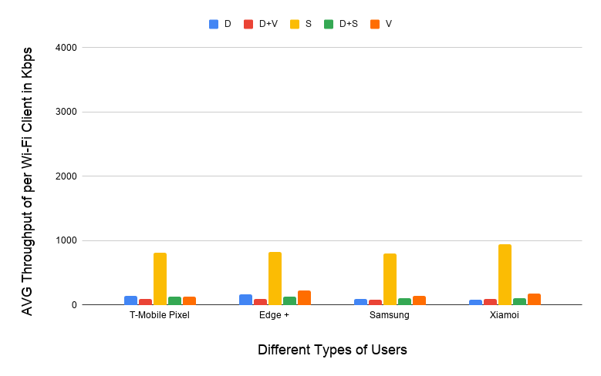
Experiments with deployed systems show LAA has a significant impact on data success
  The work showed that LAA caused significant interference to data traffic in the tested configuration
    Probably because LAA is:
      Using ED @ -72 dBm
      Rather than PD @ - 82 dBm
    Also because Wi-Fi’s hidden station mitigation mechanisms based on RTS/CTS have no effect on LAA
5 Wi-Fi APs on one channel, no LAA
5 Wi-Fi APs on one channel, one LAA
11-20-1973 slide 16
All client close
to Wi-Fi APs
Addition of LAA caused all Wi-Fi traffic to collapse …
… except streaming because LAA uses licensed for streaming

Slide 31
Today’s light agenda provides an opportunity to discuss the Uni of Chicago results in more detail
  There was some limited discussion on the Uni of Chicago results in January 2021 … but none since
  In January 2021 …
    There were questions & concerns about test setup & realism from some …
    … but others drew the conclusion that this a typical scenario and Wi-Fi is significantly impacted by a single LAA (from draft minutes)
  In March 2021 …
    Do the results represent something of concern to Wi-Fi operators/users?
    Is there an understanding of the causes of these results?
    Are there additional testing/monitoring that should occur?
    Is there anything that should/could be done to mitigate the risk?
    …
  Discuss!

Slide 32
  Agenda items
  ETSI BRAN issues

Slide 33
Note that ESTI BRAN documents are available to IEEE 802.11 WG members
  Today’s material references many ETSI BRAN documents
  They are (or should be) available in the IEEE 802.11 WG members area
    See http://www.ieee802.org/11/private/ETSI_documents/BRAN

Slide 34
  Agenda items
  ETSI BRAN 6 GHz issues

Slide 35
A stable draft of EN 303 687 includes the previously agreed 6 GHz compromise for ED-only @ -72 dBm
Document status as of BRAN#109
  Draft EN 303 687 v0.0.11 (stable draft)
Discussion as of BRAN#109
  All agreements are included in EN 303 687 v0.0.11, including:
    ED-only at -72 dBm (reflecting previously discussed compromise)
    Contention based FBE (tweaks are ongoing)
    Variety of editorial issues & issues with less relevance to coexistence
  A variety of issues without agreement after BRAN #108 are not incorporated into EN 303 687 v0.0.11, including:
    Synchronous access
    Wideband access
    LBT mechanisms
    NB FH access

Slide 36
  Agenda items
  ETSI BRAN 6 GHz unresolved issues
  (except NB FH)

Slide 37
There is unlikely to be any progress on the question of synchronous access at BRAN#109
  Access for Load Based Equipment (LBE) in EN 303 687 is based on using LBT for asynchronous access
  There has been discussion in ETSI BRAN about using LBT for synchronous access for a long time
    Qualcomm made the first proposal (BRAN(19)104018) in 2019
    Wi-Fi, as currently defined, does not make use of this mechanism … but it could
  In BRAN#108 there was a continuation of the discussion about synchronous access, but no consensus was reached
    Qualcomm claimed synchronous access had important benefits for VLP devices, and showed how it could be added to EN 303 687
    Intel claimed there is no clear benefit to synchronous access, and asserted it should not be incorporated into EN 303 687
  There do not appear to be any contributions to BRAN#109 related to synchronous access … and so progress is unlikely

Slide 38
There is unlikely to be any progress on the question of wideband LBT at BRAN#109
  It has previously been proposed to allow the use of a wideband EDT as an alternative to the current multi-channel mechanisms in EN 303 687
    eg Use EDT of -69 dBm for 40 MHz channel …
    … rather than -72 dB for 20 MHz in primary & secondary channels
  In BRAN#108, the discussion was inconclusive:
    Huawei asserted Wi-Fi/NR-U coexistence is not adversely affected
    Ericsson asserted is already allowed, but Qualcomm disagreed
    Cisco observed that Wi-Fi may need this to enable checking the secondary channels for PIFS … although it is a very complex part of the 802.11 spec
  In Jan 2021, the Coex SC was asked whether the Wi-Fi community would have an objection to enabling wideband EDT
    No reaction so far … does anyone have a perspective they could share?
  There do not appear to be any contributions to BRAN#109 related to wideband LBT … and so progress is unlikely

Slide 39
There is unlikely to be any progress at BRAN#109 on the proposed changes to LBT in EN 303 687
  In BRAN#108, Mediatek proposed that EN 303 687 (6 GHz) drop many of the adaptivity mechanisms from EN 301 893 (5 GHz) based on assertions they do not work, eg
    Traffic classes should be removed because there are no associated rules
    High priority should be removed because it blocks low priority completely
    CW_{max} is too low
    Broadcast should use Cw_{max}
    CW should not reset after successful tx
  There was very little support for these proposals, with opposition from Broadcom, Qualcomm, Cisco, Ruckus & Ericsson
  There do not appear to be any contributions to BRAN#109 related to Mediatek’s proposal … and so progress is unlikely
    Maybe the proposals are dead?

Slide 40
  Coex SC
  ETSI BRAN 6 GHz issues
  NB FH update

Slide 41
Many believe NB FH systems are a potential new threat to coexistence in the 6 GHz band in Europe
From
Jan 2021
  In Nov 2020, the Coex SC were made aware of two PSD limits being discussed for VLP devices in Europe:
    Default: 1 dBm/MHz
    Narrowband (NB) devices: 10 dBm/MHz with FH across at least 15 hops, with NB defined as a BW of less than 20 MHz
  Many in the Wi-Fi/NR-U/LAA industries were concerned that these NB FH systems could have an adverse affect on these systems
    ie, they will randomly “stomp” on Wi-Fi (and LAA/NR-U) systems without LBT leading to poor coexistence ☹
  A number of proposals were made in BRAN before BRAN#108 to incorporate these new rules …
  … but it was agreed that the LS documenting the request from the ECC to ETSI BRAN to implement the rules was required first

Slide 42
The ECC decision that allows NB FH also requires
ETSI BRAN to agree on a spectrum sharing mechanism
From
Jan 2021
Table 2: Very Low Power (VLP) WAS/RLAN devices
(extract from ECC Decision (20)01)
Permissible operation | Indoors and outdoors
Category of device | The VLP device is a portable device
Frequency band | 5945-6425 MHz
Channel access and occupation rules | An adequate spectrum sharing mechanism shall be implemented.
Maximum mean e.i.r.p. for in-band emissions (note 1) | 14 dBm
Maximum mean e.i.r.p. density for in-band emissions (note 1) | 1 dBm/MHz
Narrowband usage maximum mean e.i.r.p. density for in-band emissions (note 1) (note 2) | 10 dBm/MHz
Note 2: Narrowband (NB) devices are devices that operate in channels bandwidths below 20 MHz. Narrowband devices also require a frequency hopping mechanism based on at least 15 hop channels to operate at a PSD value above 1 dBm/MHz.
Requires an ETSI BRAN defined spectrum sharing mechanism
Maybe it will be based on LBT?
Allows NB FH at 10 dBm/MHz

Slide 43
In BRAN#108 there were two proposals on how to implement the ECC decision related to NB FH
Refined from
Jan 2021
Submissions to BRAN#108
  BRAN(20)108014: Initial Integration of NB requirements into EN 303 687 as per EC Regulation (Apple)
  BRAN(20)108038: 6GHz VLP Narrowband (Qualcomm et al)
  BRAN(20)108039 NB Analysis (Qualcomm)
Summary of presentations at BRAN#108
  BRAN(20)108014 from Apple copies the three FH mechanisms in EN 300 328 V2.2.2 (2.4 GHz) into EN 303 687 (6 GHz)
  BRAN(20)108038 from Qualcomm et al provided an alternative mechanism for including NB FH into EN 303 687 that requires a COT be obtained using LBE or FBE in the normal way before transmission
  BRAN(20)108039 from Qualcomm explains why the three FH mechanisms proposed by Apple lead to poor coexistence

Slide 44
There were many objections & some support for the NB FH proposal from Apple
Refined from
Jan 2021
Summary of presentations at BRAN#108
  There were many objections to the proposal from Apple
    Microsoft: lack of support studies; 6 GHz has a higher bar than 2.4 GHz (ISM); this new and unknown technology should not get a free pass
    Quorvo: use of EN 300 328 inappropriate in 6GHz; where are the studies?
    Facebook: concerned about coexistence, especially in wider channels
    Cisco: lack of supporting studies
    Qualcomm/Facebook: coex in 6 GHz between Wi-Fi/LAA/NR-U is result of many years of work; similar work is required for NB FH before it can be accepted
    OFCOM: 6 GHz is not like 2.4 GHz and some sort of LBT is probably needed
    Qualcomm/Facebook/Microsoft/Intel: – see BRAN(20)108038
  There was some support for the proposal from Apple
    Ericsson/BMWi: new technology deserves same access to the spectrum and it is natural to use 2.4 GHz based schemes; RLAN stakeholders need to prove a problem

Slide 45
There was agreement at BRAN#108 that there was an ECC decision but nothing more …
Refined from
Jan 2021
  There was agreement at BRAN#108 that BRAN had a task to perform based on the ECC decision allowing NB FH …
  … but there was no agreement on how to perform that task!
  One of the problems for many people is that this NB FH proposal by Apple came from nowhere (and does not seem to be based on any standard)

Slide 46
There have been numerous submissions to ETSO BRAN on NB FH in 6 GHz since BRAN#108
Submissions since BRAN#108
  BRAN(21)108a008, “EN 303 687 NB Discussion Points”, Apple
    Requested feedback on Apple’s proposal
  BRAN(21)108h003r1, “Proposed way forward for the introduction of VLP devices”, Nokia
    Adopt a “Adaptative Frequency Hopping using NB LBT” mechanism derived from EN 300 328 (2.4 GHz), while investigating other approaches in parallel
  BRAN(21)108h004, “NB Frequency Hopping in 6 GHz”, Ericsson
    No concerns about using EN 300 328 (2.4 GHz) as baseline
  BRAN(21)108h006, “Facebook comments to NB Frequency Hopping in 6 GHz”, Facebook
    Major concerns without proper studies

Slide 47
There have been numerous submissions to ETSO BRAN on NB FH in 6 GHz since BRAN#108
Submissions since BRAN#108
  BRAN(21)108h007, “Summary of Responses to BRAN(21)108a008”, Apple
    Summarized feedback on Apple’s proposal, suggesting no compromise yet
  BRAN(21)109025, “Non-Adaptive Frequency Hopping in 6 GHz”, Ericsson
    Suggests adopting non-adaptive frequency hopping as specified in EN 300 328 into EN 301 893 on basis that LBT does not work with hidden nodes
  BRAN(21)109036r1, “Comments on Narrowband VLP and document BRAN(21)109025”, Ruckus, HPE, Cisco
    Objects to suggestion in BRAN(21)109025 on basis risks have not yet been fully evaluated

Slide 48
The next steps to a resolution of the questions related to NB FH in EN 303 687 (6 GHz) are unclear
  EN 303 687 probably needs to enable NB FH in 6 GHz in some form eventually
    Because of the ECC Decision
  However, at this time, the lack of consensus within ETSI BRAN means:
    The form is unknown
    The timing is uncertain
  We will need to wait until after BRAN#109 to get a better read on the situation
  Submissions to the Coex SC on NB FH related topics are encouraged …

Slide 49
  Coex SC
  ETSI BRAN 6 GHz issues
  Future work for TGbe

Slide 50
There is work required to enable good coexistence in 6 GHz in the future (and 5 GHz)
  The adaptivity compromise in EN 303 687 means both 802.11ax & 802.11be will need to operate using ED-only at -72 dBm in 6 GHz
  However, the current 802.11 standard effectively specifies 802.11ax & 802.11be operate using PD/ED at -82/-72 dBm in 6 GHz (in Europe)
    Which may disadvantage 802.11ax & 802.11be when operating in the same
    6 GHz channel as LAA/NR-U
  TGbe might want to consider if & when 802.11ax & 802.11be should operate at ED-only at -72 dBm in 6 GHz
    A similar question could be applied to proposed 5 GHz operation
    We will discuss this issue wrt 5 GHz later today …
  TGbe may also need to propose revisions to for 6 GHz to enable 802.11be features not envisaged when EN 303 687 was developed
    Similar revisions will be required for 5 GHz operation under EN 301 893 too!
    Has anyone reviewed 802.11be operations under EN 303 687/EN 301 893?

Slide 51
  Agenda items
  ETSI BRAN 5 GHz issues

Slide 52
The stable draft of EN 301 893 (5 GHz) does not yet include a proposed adaptivity compromise
Document status as of BRAN#109
  Draft EN 301 893 v.2.1.41 (stable draft)
Discussion as of BRAN#109
  All agreements are included in EN 301 893 v2.1.41, including:
    Variety of editorial issues & issues with less relevance to coexistence
  Issues without agreement that are not incorporated into EN 301 893 v2.1.41 include:
    Compromise for adaptivity related to the treatment of IEEE 802.11be

Slide 53
  Agenda items
  ETSI BRAN 5 GHz issues
  Adaptivity compromise

Slide 54
ETSI BRAN agreed on compromise solutions for coexistence in 5 GHz in ~2016 & ~2018
Refined from
Jan 2021
A coex problem in Europe (& globally) was understood in ~2014
  How can different technologies detect each other and defer to each other in a way that enables equitable use of radio resources?
A compromise solution in ~2016 (EN 301 893 v2.1.1) enabled 802.11ac
  Use EDCA-like LBT, with detection using:
    PD/ED @ -82/-62 dBm for 802.11a/n/ac systems
    ED-only at -72 dBm (scaled) for any system
  Allowed 802.11ac to be placed on the European market
A new solution ~2018 (stable draft of EN 301 893) enabled 802.11ax
  Use EDCA-like LBT, with detection using:
    PD/ED @ -82/-62 dBm for any system
    ED-only at -72 dBm (scaled) for any system
  Allowed 802.11ax to be placed on the Euro market (using Notified Body)

Slide 55
In 2020, some stakeholders wanted to revisit the current 5 GHz compromise
From
Jan 2021
  During 2020, some NR-U/LAA stakeholders expressed strong opposition to the compromise documented in the stable draft of EN 301 893
  Reasons were varied … some legitimate to some extent, others not so much … it is complicated!
    Claims testing generalised versions of PD/ED is complex
    Discovery that some Wi-Fi gear does not operate as expected
      eg need for more than 802.11a preamble for PD
      eg changing PDT in some situations
    Assertions Wi-Fi gear has a “10 dB advantage”
    Assertions secondary channel access is “not fair”
    Claims ED-only at -62 dBm is better for all
    Assertions Wi-Fi stakeholders reneged on a promise that 802.11ac (or 802.11ax) would be last to use PD/ED
    …

Slide 56
A 5 GHz compromise that restricts 802.11be from using PD/ED @ -82/-62 dBm was proposed to BRAN#108
Refined from
Jan 2021
Submission to BRAN#108
  BRAN(20)108008r1: Compromise on 5 GHz channel access mechanism (HPE, Ericsson, Broadcom, CableLabs, Cisco, Huawei, Intel, Nokia & Ruckus)
Summary of discussion at BRAN #108
  In the interests of making timely progress, many ETSI BRAN participants proposed a new compromise to ETSI BRAN for EN 301 892
  It is proposed LBT mechanism in EN 301 893 will be based on operation by devices (with multiple logical devices in a physical piece of equipment) in two categories
    Devices operating in conformance with 802.11a/n/ac/ax (including the use of PD/ED @ -82/-62 dBm) may use ED-only @ -62 dBm (status quo)
    Any other devices use ED-only @ -72 dBm (scaled with tx power) in all channels

Slide 57
The proposed 5 GHz compromise was based on a few agreed principles
From
Jan 2021
Summary of discussion at BRAN #108
  The compromise is based on agreed principles that:
    The new status quo means that 802.11be devices will not be able to use the traditional PD/ED @ -82/-62 dBm category, and will instead have to use the ED-only @ -72 dBm category
    802.11a/n/ac/ax devices can switch between categories, with some limitations
    Any PD testing can be 802.11-specific & pragmatic, similar to the testing mechanism proposed in BRAN(20)106a003r1 by Broadcom
    Any device can choose to defer more often than required by EN 301 893 using whatever mechanism it chooses, including use of PD
    Multi-channel operations will continue to be based on the mechanisms currently defined in EN 301 893

Slide 58
Unfortunately, not all stakeholders agree with the proposed 5 GHz compromise
Refined from
Jan 2021
Summary of discussion at BRAN #108
  Generally, most stakeholders were happy that progress was being made towards a compromise … rather than the usual fights
  However, some (especially Qualcomm & Microsoft) were concerned that 802.11be devices will be unable to use an EDT at -62 dBm in 5 GHz
    Qualcomm asserted that 802.11be devices using ED-only @ -72 dBm or PD/ED @ -82/-72 dBm would suffer compared to 802.11ax devices using PD/ED
    @ -82/-62 dBm because most deferrals are based on an EDT @ -62 dBm
    In response, others noted one can’t claim it is fair for LAA/NR-U to use ED-only @ -72 dBm when coexisting with 802.11a/n/ac/ax but not for 802.11be
  These concerns were not resolved in BRAN#108 and so the compromise was not included in the stable draft EN 301 893 v2.1.41
    The stable draft still specifies any device can use PD/ED at -82/-62 dBm or
    ED-only at -72 dBm (tx scaled) … but with testing issues unresolved

Slide 59
There is only one submission to BRAN #109 in relation to adaptivity in 5 GHz …
Submissions to BRAN#109
  BRAN(21)109027: 5 GHz Channel Access (Nokia)
Summary of submissions to BRAN #109
  Nokia highlights various alternatives for EN 301 893
    ED-only @ -72 dBm (a function of tx power) – the compromise
      … with 802.11a/n/ac/ax conformant devices allowed to use an EDT @ -62 dBm
    ED-only @ -72 dBm (possibly a function of tx power)
      … with no exceptions
    ED-only @ -62 dBm
      … with no exceptions
    ED-only @ -72 dBm OR PD/ED @ -82/-62 – the status quo
      … with detailed PD testing based on 802.11a preamble
    ED-only @ -72 dBm OR PD/ED @ -82/-62
      … with simple PD testing based on technology specific preamble

Slide 60
… with Nokia advocating adoption of the previously proposed compromise (with an addition)
  Nokia advocates the adoption of the previously proposed compromise at a first step with the goal of breaking the current impasse
    ED-only at -72 dBm …
    … with an exception that allows IEEE 802.11a/n/ac/ax conformant devices to use EDT @ -62 dBm
    … but no exception for IEEE 802.11be conformant devices
  However, Nokia are also advocating a second step that allows other choices to be considered in a future Work Item in ETSI BRAN
    Nokia particularly suggest consideration of the ED-only @ -72 dBm & ED-only
    @ -62 dBm alternatives
    … given they don’t support any use of PD (either using a common preamble or a technology specific preamble)
    … with any considerations based on future experience/knowledge

Slide 61
The only agreement between Nokia & Wi-Fi industry is the “compromise” – it might be a good start
Alternative? | What? | Nokia perspective | Likely W-Fi industry view based on past discussions
ED-only @ -72 dBm … with 802.11a/n/ac/ax exception | The “compromise” | Acceptable 1st step | Acceptable 1st step
ED-only @ -72 dBm … with no exceptions allowed | Same as 6 GHz | Possible 2nd step | Not backward compatible with 802.11a/n/ac/ax (or 802.11be)
ED-only @ -62 dBm … with no exceptions needed | No restrictions! | Possible 2nd step | Known poor coexistence between LAA/NR-U & Wi-Fi
ED-only @ -72 dBm OR PD/ED @ -82/-62 dBm … with common 11a preamble | The “status quo” | Unacceptable | Acceptable as 1st/2nd step, but unlikely to be agreed by all stakeholders
ED-only @ -72 dBm OR PD/ED @ -82/-62 … with any preamble | Technology specific deferral | Unacceptable | Doesn’t support good inter-technology coexistence

Slide 62
Breaking news; there was no agreement on the proposed EN 301 893 compromise
Breaking news
  The compromise from BRAN#108 and Nokia’s proposal to BRAN#109 on how to make progress were discussed on Mon, 8 March 2021
  There was no consensus for acceptance of the compromise/Nokia proposal, with Qualcomm expressing concerns about 11be disadvantage
Alternative? | Qualcomm perspective | Nokia perspective | Others | General W-Fi perspective
The compromise: ED-only @ -72 dBm … with 802.11a/n/ac/ax exception | Unacceptable, want 11be in | Acceptable 1st step | Acceptable 1st step | Acceptable 1st step
ED-only @ -72 dBm … with no exceptions allowed | Unacceptable | Possible 2nd step | ? | Unacceptable
ED-only @ -62 dBm … with no exceptions needed | Acceptable | Possible 2nd step | ? | Unacceptable
ED-only @ -72 dBm OR PD/ED @ -82/-62 dBm … with common 11a preamble | Acceptable | Unacceptable | ? | Acceptable but unlikely
ED-only @ -72 dBm OR PD/ED @ -82/-62 … with any preamble | Acceptable | Unacceptable | ? | Unacceptable

Slide 63
The 802.11 WG needs to start thinking about a 2nd step for 802.11be operation in 5 GHz …
  At the time of writing, ETSI BRAN has not made a decision but …
  … let’s assume the compromise is eventually agreed as a 1st step (it’s probably the only viable short-term path to consensus)
  The question for the 802.11 WG is what 2nd step should be defined to support 802.11be operation in 5 GHz for when it is ready?
    What is a desirable 2nd step?
      Traditional PD/ED?
    What is an acceptable 2nd step?
      No restrictions?
      Technology specific deferral?
    Is a 2nd step even needed?
  The answer probably needs to be agreed by the whole 802.11 WG
    … not just the Coex SC or TGbe
    … although it is likely most of the discussion will occur in the Coex SC

Slide 64
… with a focus on coexistence between 802.11aax using PD/ED and 802.11be
  Additional data is probably required to determine the optimal 2nd step from a Wi-Fi perspective
    Or to even gain agreement on the compromise as a first step
  Suppose 802.11ax (using traditional PD/ED mechanisms) & 802.11be (subject to EDT @ -72 dBm) need to coexist in the 5 GHz band …
    … should 802.11be use ED-only @ -72 dBm?
      Compatible with the compromise, but probably requires a change to 802.11 standard
      Previous work on LAA/Wi-Fi coexistence suggests this should be acceptable, given we forced LAA/NR-U to use ED-only @ -72 dBm in this case (a point made by Nokia)
    … should 802.11be use PD/ED @ -82/-72 dBm?
      Compatible with the compromise, but may require a change to 802.11 standard
      Some preliminary work suggests this might result in better coexistence & spectrum use … for all! It is likely a submission will be made in May 2021; more welcome
    … should 802.11be use some other coexistence mechanism?
      Likely incompatible with the compromise, and with 802.11 standard
      Evidence is required! Please make a submission for our May 2021 meeting

Slide 65
The 5 GHz discussion about the use of ED-only vs PD/ED could be applied to 6 GHz
  The context of the task on the previous slide is 5 GHz operation
  However, there is a similar question applicable to 6 GHz operation
  Given 6 GHz in EN 303 687 is ED-only @ -72 dBm …
  … should 802.11ax/be use:
      ED-only @ -72 dBm; OR
      PD/ED @ -82/-72 dBm?
  Both answers are likely to require changes to the 802.11 standards
  Again, submissions are requested for future Coex SC meetings

Slide 66
  Coex SC
  Future ETSI BRAN meetings

Slide 67
ETSI BRAN will probably meet virtually for most of 2021 … or not
ETSI BRAN meeting schedule
  #BRAN109
    5 Mar 2021 – 12 Mar 2021
    Virtual (this week)
  #BRAN110
    18 Jun 2021 – 25 Jun 2021
    Virtual? (to be decided this week)
  BRAN #111
    27 Sep 2021 – 1 Oct 2021
    Virtual?
  BRAN #112
    5 Dec 2021 – 9 Dec 2021
    Virtual?
A variety of additional ad hoc’s are also likely to be scheduled

Slide 68
  Coex SC
  5 GHz Coexistence in China

Slide 69
China recently closed a consultation in relation to operation in 5 GHz
  A consultation recently closed in China wrt rules for operation in the 2.4 GHz & 5 GHz bands
    Only the 5 GHz aspects are within the scope of the Coex SC …
    … but the 2.4 GHz aspects also caused some discussion because of the
    -40dBm/MHz emissions requirements, which may have an adverse effect on Wi-Fi/BT/BLE band edge power
  It appears that the 5 GHz rules are based on a simplification of the ETSI rules in EN 301 893 for both FBE & LBE, with LBE rules:
    EDT @ -62 dBm/20MHz
    LBT with listening period of 27 µs (including secondary channel)
    No back off requirement, ie no adaptivity
    Max COT = 20 ms
  The Chinese rules are consistent with the more laisse faire approach taken to sharing & coexistence by the FCC, rather than the more rigorous European approach

Slide 70
The Chinese rules seem to impose at least one problematic constraint
  It appears that 802.11 can satisfy these proposed rules ... with one possible exception
  The specification of 27 µs of listening is potentially an issue because 802.11 gear often only listens for 25 µs (especially in the secondary channel)
  Is this of concern, noting the consultation has closed?

Slide 71
  Coex SC
  Plans for next meeting

Slide 72
The Coex SC will continue its normal business in May 2021
Possible agenda items
  Review ETSI BRAN coex activities
    EN 301 893 (5 GHz)
    EN 303 687 (6 GHz)
    60 GHz
  China regulations
  Review 3GPP coexistence activities
    Any?
  …
Submissions are requested!

Slide 73
The IEEE 802.11 Coexistence SC virtual meeting in March 2021 is adjourned!

