Slide 1
Simplified EHT PPE Thresholds Field
Date: 2021-02-05
Authors:
Name | Affiliations | Address | Phone | email
Mengshi Hu | Huawei |  |  | humengshi@huawei.com
Ross Jian Yu | Huawei |  |  | ross.yujian@huawei.com
Ming Gan | Huawei |  |  | ming.gan@huawei.com
Oded Redlich | Huawei |  |  | oded.redlich@huawei.com
Shimi Shilo | Huawei |  |  | Shimi.Shilo@huawei.com

Slide 2
EHT PPE Thresholds Field (1/2)
In [1] we have proposed two options for the design of EHT PPE Thresholds field.
Option 1: Add PPET20 subfields
Option 2: Still use PPET16/8 subfields to indicate 16/8/0 μs, and indicate a scope for 20 μs
In the following slides, we further reduce the overhead by simplifying the NSS subfield and RU Index Bitmask subfield.
 | NSS | RU Index Bitmask | PPE Thresholds Info | PPE Pad
Bits | 3 | 4 | 3 per each | 0-7
PPET16 NSS1 RUx | PPET8 NSS1 RUx | … | PPET16 NSSn RUm | PPET8 NSSn RUm | …
PPE Thresholds field in 11ax

Slide 3
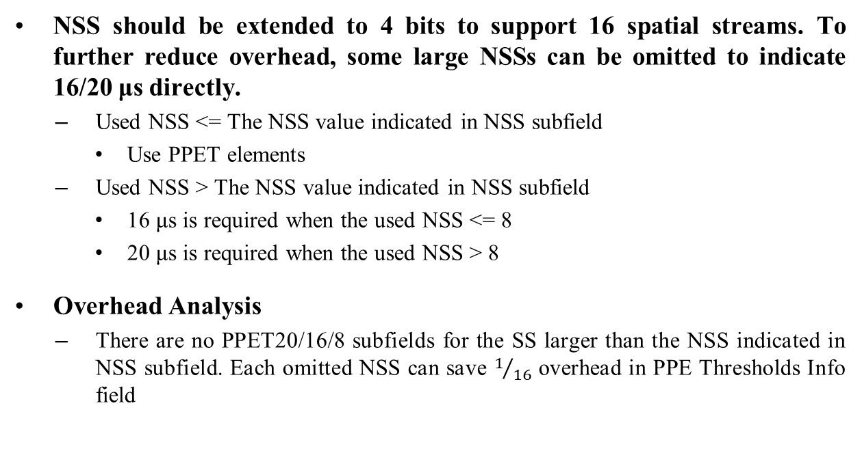
Simplification in NSS Subfield
NSS should be extended to 4 bits to support 16 spatial streams. To further reduce overhead, some large NSSs can be omitted to indicate 16/20 μs directly.
Used NSS <= The NSS value indicated in NSS subfield
Use PPET elements
Used NSS > The NSS value indicated in NSS subfield
16 μs is required when the used NSS <= 8
20 μs is required when the used NSS > 8
Overhead Analysis
There are no PPET20/16/8 subfields for the SS larger than the NSS indicated in NSS subfield. Each omitted NSS can save $1/{16}$ overhead in PPE Thresholds Info field

Slide 4
Simplification in RU Index Bitmask Subfield (1/2)
To support more RU/MRU sizes, RU Index Bitmask subfield shall be extended.
There is no need to give each large RU/MRU an RU allocation index. Some RUs/MRUs can share the same index. A 5-bit Bitmask is suggested with the meaning shown as follows:
RU allocation index | RU allocation size
0 | 242
1 | 484
2 | 484+242, 996
3 | 996+484, 996+484+242, 2×996
4 | 2×996+484, 3×996 3×996+484, 4×996

Slide 5
Simplification in RU Index Bitmask Subfield (2/2)
To save overhead, two cases of Zeros in the Bitmask sequence are used to carry more information.
Case 1: Zeros before the first 1 (e.g. [0 0 1 1 1])
Required nominal packet padding values = 0 for the corresponding RUs (the same as 11ax)
Case 2: Zeros between two 1s (e.g. [1 1 1 0 1])
PPETx NSTSn corresponding RU = PPETx NSTSn RUy, where y is the closest smaller allocation index with Bitmask value 1. (In other words, PE requirement for the missing RU shall be the same as the closest smaller RU with PPET defined)
Overhead analysis
In a 5-bit RU Index Bitmask, each 0 can save $1/5$ overhead in PPE Thresholds Info field.

Slide 6
Summary
4-bit NSS: 1 to 16 spatial streams
Simplification for the NSS > the NSS indicated in the 4-bit NSS subfield
Each omitted NSS can save $1/{16}$ overhead in PPE Thresholds Info field
5-bit RU Bitmap: [242, 484, 996, 996*2, 996*4]
Simplification for Bitmask value 0
Each 0 can save $1/5$ overhead in PPE Thresholds Info field.

Slide 7
Straw Poll #1
Do you agree with the following change in EHT PPE Thresholds field?
NSS subfield is extended to 4 bits to support 1-16 SS.
Y
N
A

Slide 8
Straw Poll #2
Do you agree with the following table of RU allocation index in EHT PPE Thresholds field?
RU allocation index | RU allocation size
0 | 242
1 | 484
2 | 242+484, 996
3 | 484+996, 242+484+996, 2×996
4 | 484+2×996, 3×996 484+3×996, 4×996
Y
N
A

Slide 9
Straw Poll #3
Do you agree that the following nominal packet padding value is used when the used NSS > the NSS indicated in NSS subfield?
16 μs for any RU/Constellation with the used NSS<=8
20 μs for any RU/Constellation with the used NSS>8 for R2
Y
N
A

Slide 10
Straw Poll #4
Do you agree to add the following meaning of the Zeros between two Ones in the Bitmask sequence in RU Index Bitmask subfield?
PE requirement for the missing RU (Bitmask value = 0) shall be the same as the closest smaller RU with PPET defined (Bitmask value = 1).
Y
N
A

Slide 11
References
[1] IEEE 11-21-0089r0 EHT PPE Thresholds Field Follow-up

