Slide 1
EHT PPE Thresholds Field Follow-up
Date: 2021-xx-xx
Authors:
Name | Affiliations | Address | Phone | email
Mengshi Hu | Huawei |  |  | humengshi@huawei.com
Ross Jian Yu | Huawei |  |  | ross.yujian@huawei.com
Ming Gan | Huawei |  |  | ming.gan@huawei.com
Oded Redlich | Huawei |  |  | oded.redlich@huawei.com
Shimi Shilo | Huawei |  |  | Shimi.Shilo@huawei.com

Slide 2
Background
Nominal Packet Padding value in 11ax
Nominal Packet Padding value along with Pre-FEC Padding Factor (a) determines the Nominal T_{PE} values for PE field.
The duration of the PE field, T_{PE}, may take values of 0, 4, 8, 12 or 16 µs, and should be equal to the Nominal T_{PE} to minimize the PE overhead.
Nominal T_{PE} values in 11ax
Nominal Packet Padding value
Pre-FEC Padding Factor (a) | TXVECTOR parameter NOMINAL_PACKET_PADDING (HE SU PPDU or HE ER SU PPDU) or NOMINAL_PACKET_PADDING[u] (HE MU PPDU)
 | 0 μs | 8 μs | 16 μs
1 | 0 μs | 0 μs | 4 μs
2 | 0 μs | 0 μs | 8 μs
3 | 0 μs | 4 μs | 12 μs
4 | 0 μs | 8 μs | 16 μs

Slide 3
Selection of Nominal Packet Padding Value
In 11ax, two methods can be used for the selection of Nominal Packet Padding value [1].
Method 1: If the PPE Thresholds Present subfield is equal to 0, the Nominal Packet Padding value is decided by the Nominal Packet Padding subfield. (A static method)
Method 2: If the PPE Thresholds Present subfield is equal to 1, the Nominal Packet Padding value is decided by the PPE Thresholds field. (A flexible method)
11be supports both of these methods.
The following SP on Method 2 has passed:

Slide 4
New Nominal Packet Padding Value in 11be
To provide more receive processing time, 11be has agreed to introduce a new Nominal Packet Padding value (20 µs) [1-2].
Change in Method 1: The value of Nominal Packet Padding subfield set to 3 indicates: The nominal packet padding is 16 µs for all modes with constellation<=1024-QAM, NSS<=8 and RU<=996*2, and 20 μs for all other modes the STA supports [2].
Change in Method 2: will be discussed in this contribution.

Slide 5
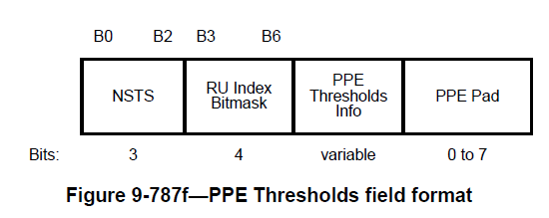
Recap: HE PPE Thresholds field (1/3)
In 11ax the PPE Thresholds field utilized in Method 2 has the following format:
The NSTS subfield and the RU Index Bitmask subfield together show the selected indication scope of the PPE Thresholds Info field.
Each PPET16/8 subfield in PPE Thresholds Info field indicates a modulation threshold (constellation index) for the corresponding NSTS and RU size.

Slide 6
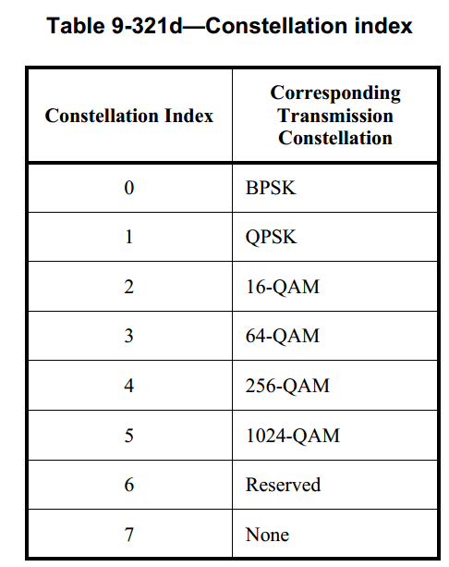
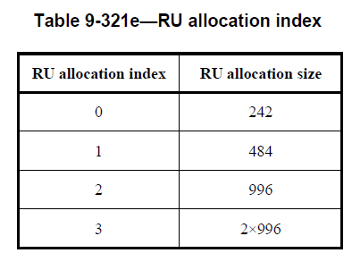
Recap: HE PPE Thresholds field (2/3)
NSTS subfield in 11ax
3 bits to indicate up to 8 STSs
RU Index Bitmask subfield in 11ax
Contains a 4-bit bitmask that indicates whether the PPE Thresholds Info field contains PPET16 and PPET8 for the following four possible RU sizes.
RU 242, 484, 996 and 2×996.
In the following, we show what the constellation index in each PPET16/8 subfield is used for.

Slide 7
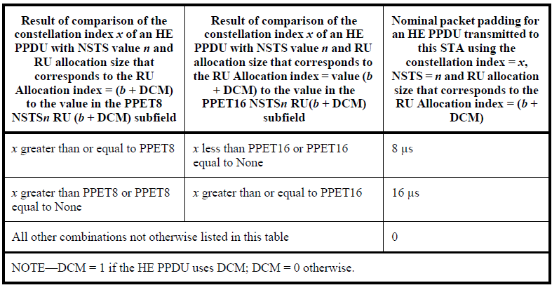
Recap: HE PPE Thresholds field (3/3)
The constellation index is used in the following table in 11ax:
Constellation Index
16μs
PPET16 NSTSn RU(b+DCM)
8μs
PPET8 NSTSn RU(b+DCM)
0μs
NSTS
RU
How to determine the Nominal Packet Padding value at a specific NSTS and RU size?
See the above table. If the two requirements in a row are both satisfied, the corresponding Nominal Packet Padding value is selected (8 or 16). Other combinations not otherwise listed indicate the Nominal Packet Padding value 0.
Note: "None" in the table indicates ignoring the corresponding requirement

Slide 8
Update EHT NSS Subfield
Both of the previous options need updates to support the indication of 16SS, 320MHz and 4096-QAM in 11be. Following the 11ax style, NSS subfield shall be extended to 4 bits to support 1-16 SS indication.
PPE Thresholds in 11be
 | NSS | RU Index Bitmask | PPE Thresholds Info | …
Bits | 4 | TBD | 3 per each

Slide 9
Update EHT RU Bitmask Subfield (1/2)
Considering 320MHz configuration, RU Index Bitmask subfield shall support the indication of more RU/MRUs
The RU allocation size 4×996 is needed for the indication of 320MHz. The size 3×996 can also be added to reduce the large gap between 2×996 and 4×996.
To save overhead, there is no need to give each large RU/MRU (484+996, 2×996+484, etc.) an RU allocation index. Some RUs/MRUs can share the same RU allocation index.
PPE Thresholds in 11be
 | NSS | RU Index Bitmask | PPE Thresholds Info | …
Bits | TBD | 6 | 3 per each
RU allocation index | RU allocation size
4 | 3×996
5 | 4×996
Note: In 11ax the nominal packet padding value is 0 for all RU less than 242 unless the RU size is 106 and DCM is enabled [3].

Slide 10
Update EHT RU Bitmask Subfield (2/2)
To notify constellation indices for more RUs/MRUs, we can add the following rules:
The constellation thresholds for the following RUs/MRUs can be the same:
242+484 and 996
484+996, 242+484+996 and 2×996
484+2×996 and 3×996
484+3×996 and 4×996
RU allocation index | RU allocation size
0 | 242
1 | 484
2 | 242+484, 996
3 | 484+996, 242+484+996, 2×996
4 | 484+2×996, 3×996
5 | 484+3×996, 4×996

Slide 11
Update EHT Constellation Index
4KQAM is supported in 11be.
Use Constellation Index = 6 to indicate 4096-QAM in EHT PPE Thresholds field.
4096-QAM

Slide 12
EHT PPE Thresholds Field Design (Opt. 1)
Opt. 1: As a straightforward extension to 11ax, we consider supporting the threshold notification for 20 μs similar to the designs for 16/8 μs.
Add PPET20 subfield
Constellation Index
20μs
PPET20 NSTSn RU(b+DCM)
 | NSS | RU Index Bitmask | PPE Thresholds Info | PPE Pad
Bits | TBD | TBD | 3 per each | 0-7
16μs
PPET16 NSTSn RU(b+DCM)
8μs
 | PPET20 NSS1 RUx | PPET16 NSS1 RUx | PPET8 NSS1 RUx | … | PPET20 NSSn RUm | PPET16 NSSn RUm | PPET8 NSSn RUm | …
PPET8 NSTSn RU(b+DCM)
0μs
NSTS
RU

Slide 13
EHT PPE Thresholds Field Design (Opt. 2)
Opt. 2: Scope indication for 20 μs
Value 1 indicates using 20 μs When 4096-QAM is used
Value 0 indicates not using 20 μs when 4096-QAM is used
 | NSS | RU Index Bitmask | PPE Thresholds Info | Constellation Indication | PPE Pad
Bits | TBD | TBD | 3 per each | 1 | 0-7
PPET16 NSS1 RUx | PPET8 NSS1 RUx | … | PPET16 NSSn RUm | PPET8 NSSn RUm | …
Only PPET16/8 subfields are needed (No PPET20 subfields).
When one of the following requirements is satisfied, 20 μs is used.
Used NSS > The NSS indicated in NSS subfield
Used RU allocation index > The largest RU allocation index with Bitmask value equal to 1
Used Constellation = 4096-QAM & Constellation Indication = 1

Slide 14
Analysis for Opt. 2
The previous three requirements show the application scope for 20μs in Opt. 2, which is shown in the following figure.
The nominal packet padding is 16 µs for all modes with constellation<=1024-QAM, NSS<=8 and RU<=996*2, and 20 μs for all other modes the STA supports [2] (Method 1).
Compared with Method 1, Opt. 2 in Method 2 provides a more flexible notification.
Flexible notification of 0, 8, 16 μs can be achieved inside the cube.
20 μs are used for the points outside the cube.
The cube size can be indicated by the NSS subfield, RU Index Bitmask subfield and Constellation indication.
There is no need to signal the PPET16/8 subfields for the points outside the cube (Provides lower overhead).
Constellation
1024-QAM
/4096-QAM
NSS
1024-QAM
Indicated SS
8 SS
2*996
Indicated RU
RU Size

Slide 15
Summary
Discussed some TBD issues related to EHT PPE Thresholds field:
NSS subfield: extended to 4 bits
RU Index Bitmask subfield: extended to 6 bits
Constellation Index: Consider 4096-QAM
Proposed two options for EHT PPE Thresholds field
Opt. 1: Add PPET20 subfield to PPE Thresholds field
Opt. 2: Scope indication for 20 μs

Slide 16
Straw Poll #1
Do you agree with the following change in EHT PPE Thresholds field?
NSS subfield is extended to 4 bits to support 1-16 SS.
Y
N
A

Slide 17
Straw Poll #2
Do you agree with the following table of RU allocation index in EHT PPE Thresholds field?
RU allocation index | RU allocation size
0 | 242
1 | 484
2 | 242+484, 996
3 | 484+996, 242+484+996, 2×996
4 | 484+2×996, 3×996
5 | 484+3×996, 4×996
Y
N
A

Slide 18
Straw Poll #3
Do you agree with the following change in EHT PPE Thresholds field?
Use Constellation Index = 6 to indicate 4096-QAM.
Y
N
A

Slide 19
Straw Poll #4
Do you agree that the nominal packet padding value 20 is used when one of the following requirements is satisfied?
Used NSS > The NSS indicated in NSS subfield
Used RU allocation index > The largest RU allocation index with Bitmask value equal to 1
Used Constellation = 4096-QAM & Constellation Indication = 1
Constellation Indication subfield is a newly added 1-bit subfield in EHT PPE Thresholds field. Value 1 indicates using 20 μs When 4096-QAM is used, and 0 indicates not using 20 μs when 4096-QAM is used.
Y
N
A

Slide 20
Straw Poll #5
Do you agree to add PPET20 subfield to EHT PPE Thresholds field?
The design of PPET20 subfield is similar to the design of PPET16/8 subfields.
Y
N
A

Slide 21
References
[1] IEEE 11-20-1847r0 EHT PPE Thresholds Field
[2] IEEE 11-20-1331r0 EHT pre-FEC padding and packet extension
[3] IEEE P802.11ax/D8.0

