Slide 1
Discussion on a Joint Communication and Sensing (JCS) Method
Date: 2021-01-11
Authors:
Name | Affiliation | Address | Phone | Email
Abdullah Haskou | InterDigital, Inc. | 975 Avenue des Champs Blancs, 35510 Cesson-Sévigné, France |  | abdullah.haskou@interdigital.com
Anthony Pesin
Ali Louzir
Rui Yang |  | 111 West 33rd Street Suite 1420 New York, NY 10120 |  | rui.yang@interdigital.com

Slide 2
Outline
Abstract
Introduction
  Stepped Frequency Continuous Wave (SFCW) Radar Principle
Joint Communication and Sensing (JCS) Method
Simulation Results
Summary
References
A. Haskou, et al. (InterDigital, Inc.)

Slide 3
Abstract
New waveform/sequence is potentially needed for WLAN sensing [1].
A Joint Communication and Sensing (JCS) method is proposed.
A. Haskou, et al. (InterDigital, Inc.)

Slide 4
Introduction
In most of the previous contributions, the different authors considered either passive sensing or active sensing using dedicated frequency/time resources for radar sensing.
In this contribution, we propose rather active sensing via a JCS method which allows performing simultaneous communications and radar sensing (ranging and localization) with very limited overhead.
This method explores the flexibility of frequency-time resource allocation in OFDMA system to generate a Stepped Frequency Continuous Wave (SFCW)-like radar waveform.
The proposed JCS method has the following advantages:
  Communication augmented with true radar functionality (i.e. ranging and localization)
  Low overhead (the radar waveform is also used for communications)
  Many of existing PHY and MAC parameters or protocols in 802.11 can be reused or extended
  Backward compatible
A. Haskou, et al. (InterDigital, Inc.)

Slide 5
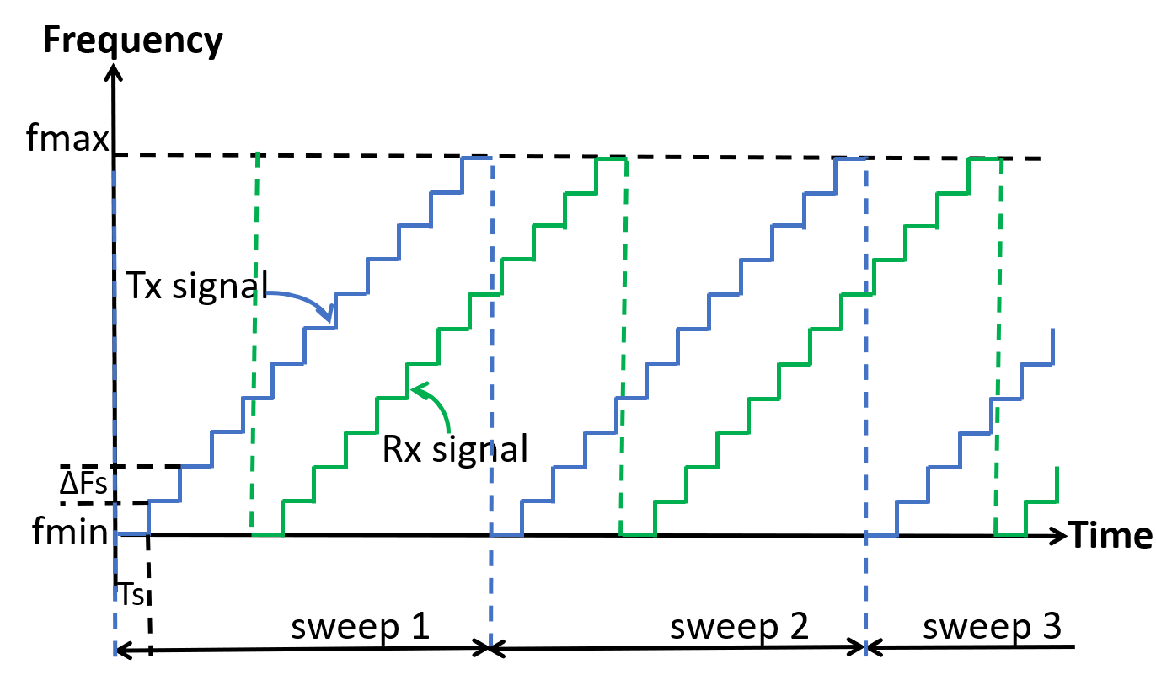
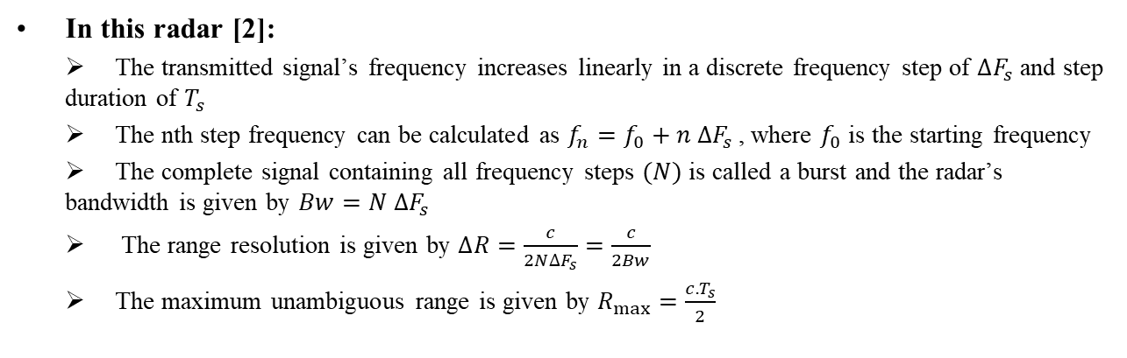
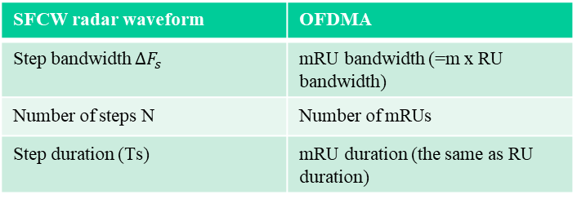
SFCW Radar Principle (1/2)
In this radar [2]:
The transmitted signal’s frequency increases linearly in a discrete frequency step of $∆F_{s}$ and step duration of $T_{s}$
The nth step frequency can be calculated as $f_{n}=f_{0}+n ∆F_{s}$, where $f_{0}$ is the starting frequency
The complete signal containing all frequency steps $(N)$is called a burst and the radar’s bandwidth is given by $Bw=N ∆F_{s}$
The range resolution is given by $∆R=\frac{c}{2N∆F_{s}}=\frac{c}{2Bw}$
The maximum unambiguous range is given by $R_{max}=\frac{c.T_{s}}{2}$
SFCW radar waveform | OFDMA
Step bandwidth $∆F_{s}$ | mRU bandwidth (=m x RU bandwidth)
Number of steps N | Number of mRUs
Step duration (Ts) | mRU duration (the same as RU duration)
A. Haskou, et al. (InterDigital, Inc.)

Slide 6
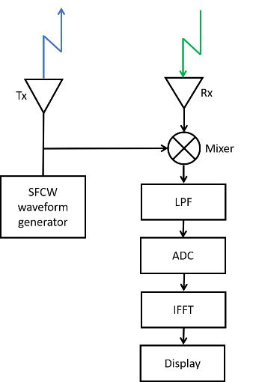
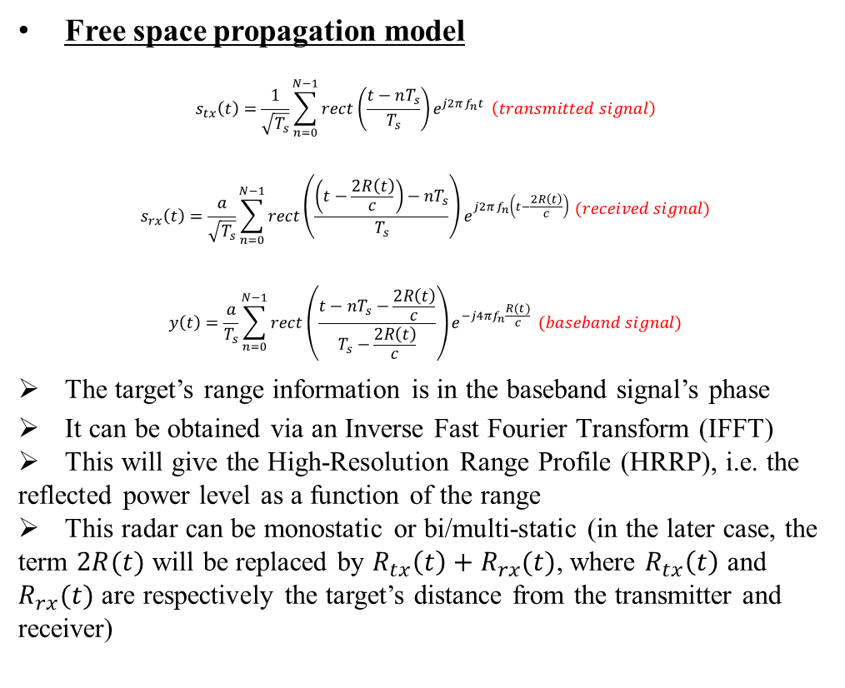
SFCW Radar Principle (2/2)
Free space propagation model
$$s_{tx}\left(t\right)=\frac{1}{\sqrt{T_{s}}}\sum_{n=0}^{N−1}{rect\left(\frac{t−nT_{s}}{T_{s}}\right)e^{j2πf_{n}t}} \left(transmitted signal\right)$$
$$\begin{aligned}s_{rx}\left(t\right)=\frac{a}{\sqrt{T_{s}}}\sum_{n=0}^{N−1}{rect\left(\frac{\left(t−\frac{2R\left(t\right)}{c}\right)−nT_{s}}{T_{s}}\right)e^{j2πf_{n}\left(t−\frac{2R\left(t\right)}{c}\right)}}\end{aligned} (received signal)$$
$$y\left(t\right)=\frac{a}{T_{s}}\sum_{n=0}^{N−1}{{rect\left(\frac{t−nT_{s}−\frac{2R\left(t\right)}{c}}{T_{s}−\frac{2R\left(t\right)}{c}}\right)e}^{−j4πf_{n}\frac{R(t)}{c}}} (baseband signal)$$
The target’s range information is in the baseband signal’s phase
It can be obtained via an Inverse Fast Fourier Transform (IFFT)
This will give the High-Resolution Range Profile (HRRP), i.e. the reflected power level as a function of the range
This radar can be monostatic or bi/multi-static (in the later case, the term $2R(t)$ will be replaced by $R_{tx}\left(t\right)+R_{rx}(t)$, where $R_{tx}\left(t\right)$ and $R_{rx}(t)$ are respectively the target’s distance from the transmitter and receiver)
A. Haskou, et al. (InterDigital, Inc.)

Slide 7
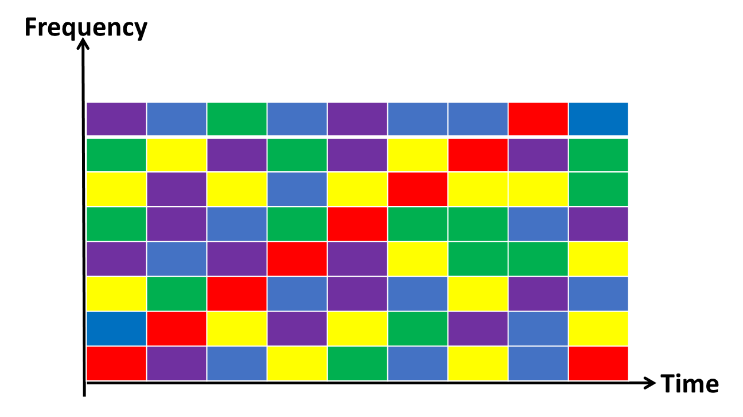
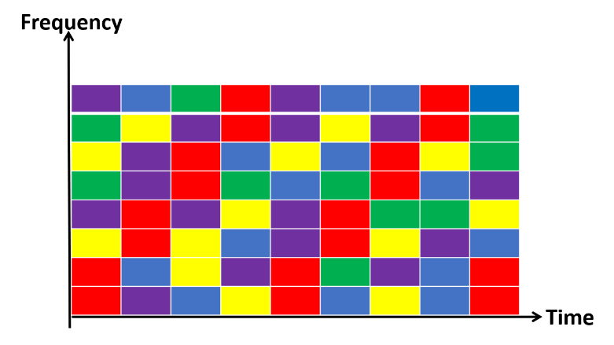
JCS Method (1/3)
Exploit the flexibility of OFDMA in resources allocation
Generate an SFCW-like waveform at the transmitter side (the RUs used for sensing can be populated with any data symbols)
Normal SFCW radar signal processing at the receiver side (with a minimum SNR of around -25dB [3])
Only in the case of a bistatic radar, an excellent synchronization (around 80ns for a maximum range error of 0.5m) between Tx and Rx is required. The Rx locally generates a SFCW-like waveform synchronized with the transmitted one (for radar signal processing).
Every colored block represents a Resource Unit (RU)
Different users’ RUs are given in different colors
The red RUs are used for JCS using SFCW -like waveform
1 RU/Ts (long sweeping time) 2 RUs/ Ts (shorter sweeping time)
A. Haskou, et al. (InterDigital, Inc.)

Slide 8
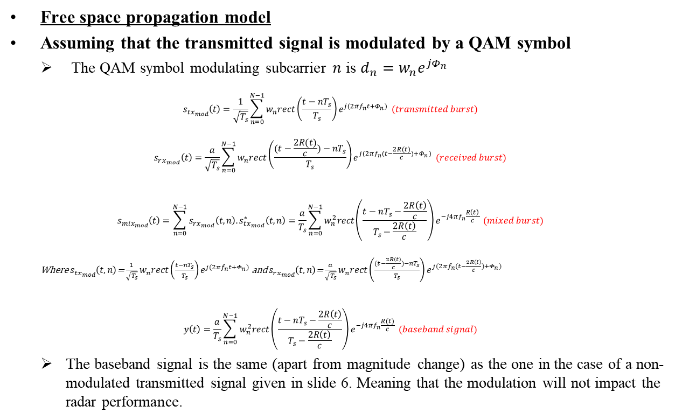
JCS Method (2/3)/ Modulation Impact
Free space propagation model
Assuming that the transmitted signal is modulated by a QAM symbol
The QAM symbol modulating subcarrier $n$ is $d_{n}=w_{n}e^{jΦ_{n}}$
$$s_{tx_{mod}}\left(t\right)=\frac{1}{\sqrt{T_{s}}}\sum_{n=0}^{N−1}{w_{n}rect\left(\frac{t−nT_{s}}{T_{s}}\right)e^{j(2πf_{n}t+Φ_{n})}} (transmitted burst)$$
$$s_{rx_{mod}}\left(t\right)=\frac{a}{\sqrt{T_{s}}}\sum_{n=0}^{N−1}{w_{n}rect\left(\frac{(t−\frac{2R(t)}{c})−nT_{s}}{T_{s}}\right)e^{j(2πf_{n}(t−\frac{2R(t)}{c})+Φ_{n})}} (received burst)$$
$$s_{{mix}_{mod}}\left(t\right)=\sum_{n=0}^{N−1}{s_{rx_{mod}}\left(t,n\right).s_{tx_{mod}}^{∗}\left(t,n\right)}=\frac{a}{T_{s}}\sum_{n=0}^{N−1}{w_{n}^{2}rect\left(\frac{t−nT_{s}−\frac{2R\left(t\right)}{c}}{T_{s}−\frac{2R\left(t\right)}{c}}\right)e^{−j4πf_{n}\frac{R\left(t\right)}{c}}} (mixed burst)$$
Where $s_{tx_{mod}}\left(t,n\right)$= $\frac{1}{\sqrt{T_{s}}}$ $w_{n}rect\left(\frac{t−nT_{s}}{T_{s}}\right)e^{j(2πf_{n}t+Φ_{n})}$ and $s_{rx_{mod}}\left(t,n\right)$= $\frac{a}{\sqrt{T_{s}}}$ $w_{n}rect\left(\frac{(t−\frac{2R(t)}{c})−nT_{s}}{T_{s}}\right)e^{j(2πf_{n}(t−\frac{2R(t)}{c})+Φ_{n})}$
$$y\left(t\right)=\frac{a}{T_{s}}\sum_{n=0}^{N−1}{w_{n}^{2}rect\left(\frac{t−nT_{s}−\frac{2R\left(t\right)}{c}}{T_{s}−\frac{2R\left(t\right)}{c}}\right)e^{−j4πf_{n}\frac{R(t)}{c}}} (baseband signal)$$
The baseband signal is the same (apart from magnitude change) as the one in the case of a non-modulated transmitted signal given in slide 6. Meaning that the modulation will not impact the radar performance.
A. Haskou, et al. (InterDigital, Inc.)

Slide 9
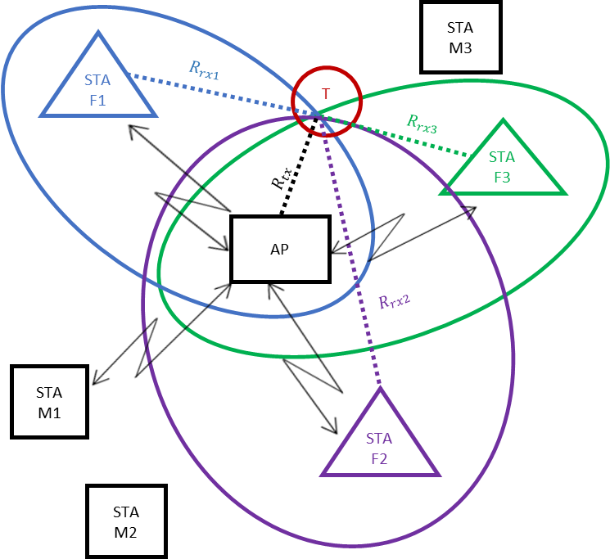
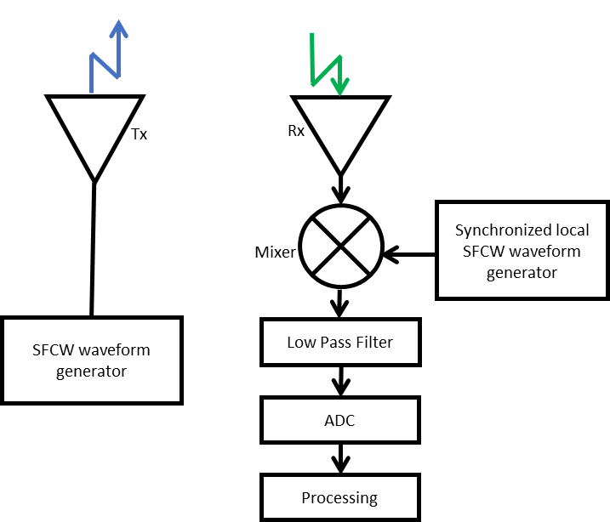
JCS Method (3/3)/ Localization
Collaborative multi-static localization method
The AP generates a single SFCW-like waveform
Every Rx (STA Fi) uses the reflected waveform and the synchronization information to calculate its HRRP
Every Rx sends its HRRP to the AP
The AP uses known fixed equipment’s location and range to localize the different targets
M → mobile equipment
F → fixed equipment
T→ target
A. Haskou, et al. (InterDigital, Inc.)

Slide 10
Simulation Results/ Configuration
1 transmitter (Tx), 4 receivers (Rx) and 4 static targets (Tg)
  Multistatic radar with perfect synchronization
  The four targets have the same Radar Cross-Section (RCS) of 1 m2 (typical RCS of human body, assumed isotropic, in the 1-10GHz frequency band [4])
The simulated scenario
A. Haskou, et al. (InterDigital, Inc.)

Slide 11
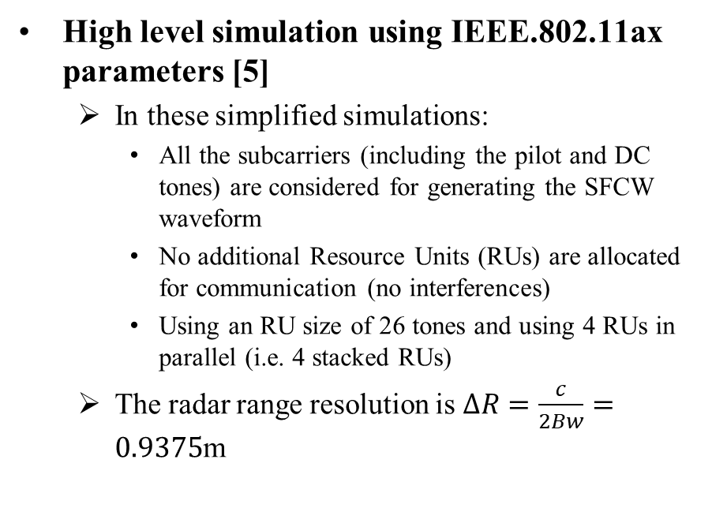
Simulation Results/ IEEE 802.11ax (1/2)
Parameter | Value
Lowest frequency | 5.17 GHz
Bandwidth | 160 MHz
Number of subcarriers | 1960
Transmitted power | 0.2 Watts
Tx antenna gain | 2.3 dBi
Rx antenna gain | 2.3 dBi
Noise power spectral density | -203.86 dB/Hz
Receiver’s Noise Figure (NF) | 3 dB
Modulation scheme | 16-QAM
High level simulation using IEEE.802.11ax parameters [5]
  In these simplified simulations:
    All the subcarriers (including the pilot and DC tones) are considered for generating the SFCW waveform
    No additional Resource Units (RUs) are allocated for communication (no interferences)
    Using an RU size of 26 tones and using 4 RUs in parallel (i.e. 4 stacked RUs)
  The radar range resolution is $∆R=\frac{c}{2Bw}=0.9375$m
A. Haskou, et al. (InterDigital, Inc.)

Slide 12
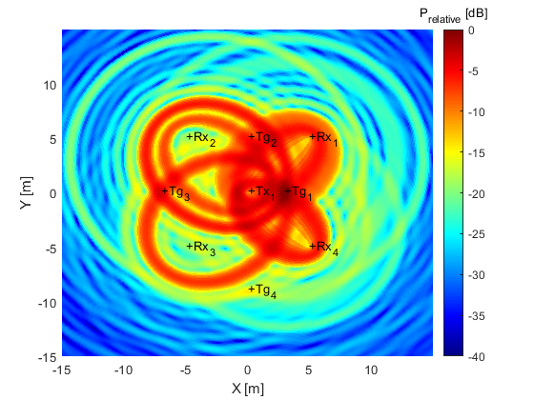
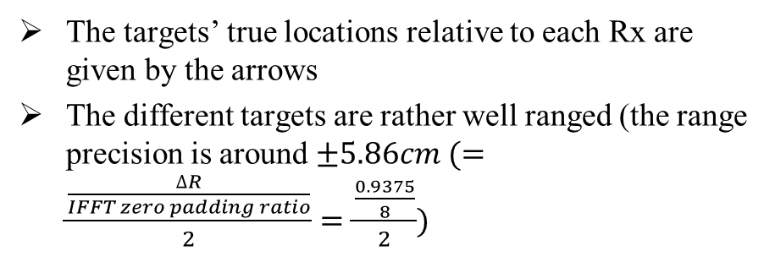
Simulation Results/ IEEE 802.11ax (2/2)
The targets’ true locations relative to each Rx are given by the arrows
The different targets are rather well ranged (the range precision is around $±5.86cm (=\frac{\frac{∆R}{IFFT zero padding ratio}}{2}=\frac{\frac{0.9375}{8}}{2})$
Generated waveform (sweep time=0.23ms) localization heatmap obtained HRRP for the different Rxs
A. Haskou, et al. (InterDigital, Inc.)

Slide 13
Summary
In this presentation, a Joint Communication and sensing (JCS) method was proposed.
High level simulations of the proposed method were presented showing a promising performance.
We are currently considering the effect of using the other resources for communication (communication-SFCW radar interference), doppler-shift, and removing DC and pilot tones on the radar performance. This study’s results will be presented in future contributions.
A. Haskou, et al. (InterDigital, Inc.)

Slide 14
References
[1] 11-19-1500-00-0wng-wi-fi-sensing-follow-up.pptx
[2] A. Mngandi, “Design of a System View Simulation of a Stepped Frequency Continuous Wave Ground Penetrating Radar”, Thesis, 2004.
[3] A. Nadira-Asanti Traille, “Flexible Monolithic Ultra-Portable Ground Penetrating Radar Using Inkjet Printing Technology”, Thesis, 2014.
[4] E. Piuzzi, S. Pisa, P. D'Atanasio and A. Zambotti, “Radar cross section measurements of the human body for UWB radar applications”, IEEE International Instrumentation and Measurement Technology Conference, pp. 1290-1293, Graz, 2012.
[5] CISCO, Technical white paper, “IEEE 802.11ax The Sixth generation of Wi-Fi”, 2018.
A. Haskou, et al. (InterDigital, Inc.)

Slide 15
SP
Do you agree to consider this Joint Communication and Sensing (JCS) method for WLAN sensing?
Yes:
No:
Abstain:
A. Haskou, et al. (InterDigital, Inc.)

