Slide 1
Frame Format of Modified MU-RTS for SU PPDU
Date: 2021-01-10
Authors:
Name | Affiliations | Address | Phone | Email
Yunbo Li | Huawei | Shenzhen, China |  | liyunbo@Huawei.com
Yuchen Guo
Ming Gan
Guogang Huang
Yiqing Li
Rob Sun
Zhenguo Du
Notes:
September 2012

Slide 2
Background
A modified MU-RTS will be used by AP for allocating time to a target STA to do SU PPDU transmission.
In R1, 802.11be shall define a mechanism for an AP to transmit a modified MU-RTS Trigger frame that allocates time within a TXOP for transmitting one or more non-TB PPDUs.
The time allocation starts after the end of transmission of the MU-RTS frame.
It is TBD whether the AP can optionally not solicit CTS.
This is an optional mechanism for non-AP and AP STAs.
NOTE – The non-TB PPDUs may be transmitted by the non-AP STA to AP or to a peer of a peer-to-peer link.
[Motion 146, #SP354, [30] and [158]]
The frame format of this modified MU-RTS will be discussed.

Slide 3
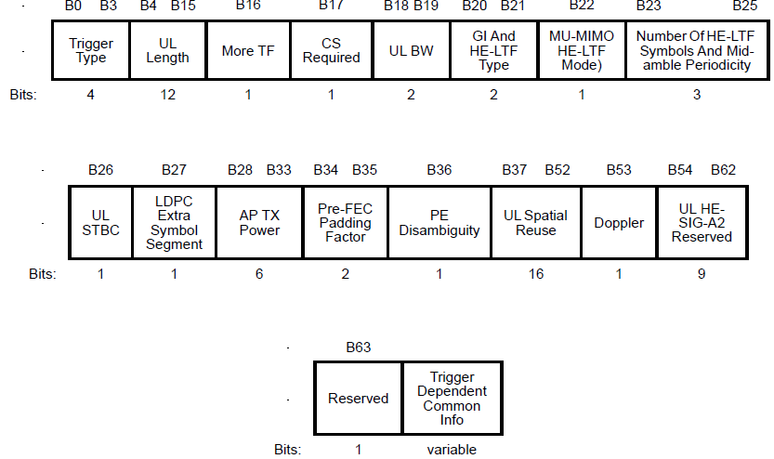
Frame Format of MU-RTS
The subfields in the red boxes are reserved or not present.

Slide 4
Discussion for Modified MU-RTS
AID12 in User Info field is not needed anymore
Modified MU-RTS is send to single STA, RA field can be used to carry the MAC address of the target STA
RU Allocation subfield in User Info field is not needed anymore
The following CTS (if it is required) shall set to the same bandwidth as MU-RTS, and the bandwidth info can obtained from UL BW subfield in Common Info field
In that case, no User Info field is needed for Modified MU-RTS. In MU-RTS, at lease one User Info filed is needed (usually multiple User Info fields are needed for multiple target STAs). So we can distinguish Modified MU-RTS from MU-RTS from the number of User Info field;
UL Length subfield is reserved in MU-RTS, it can be reused to indicate the allocated time period for target STA in Modified MU-RTS;
MU-RTS is allowed to transmitted on preamble puncture mode, similar rule should applied for modified MU-RTS. There are a lot of reserved bits in Common Info field. Some of reserved bits (e.g. B20-B35) can be used to indicate the preamble puncture BW mode for modified MU-RTS.

Slide 5
Frame Format of Modified MU-RTS
When the Trigger Type field is set to 3 (MU-RTS), and no User Info field present, it is a modified MU-RTS.
Target STA’s MAC addr
Set to 3 (MU-RTS)
Preamble puncture BW mode indication
Time period allocated to tarter STA. Starting from the ending of modified MU-RTS
Reserved

Slide 6
Summary
The frame format of Modified MU-RTS is proposed
When the Trigger Type field is set to 3 (MU-RTS), and no User Info field present, it is a modified MU-RTS;
UL Length subfield is used to indicate the allocated time period for target STA;
Some reserved bits (e.g. B20-B35) in Common Info field is used to indicate the preamble puncture BW mode of Modified MU-RTS

Slide 7
Straw Poll 1
Do you support to add following into the TGbe spec in next revision?
When the Trigger Type field of a Trigger frame is set to 3 (MU-RTS), and no User Info field present, this Trigger frame is a modified MU-RTS Trigger frame.

Slide 8
Straw Poll 2
Do you support to add following into the TGbe spec in next revision?
UL Length subfield in Modified MU-RTS Trigger frame is used to indicate the allocated time period for target STA.

Slide 9
Straw Poll 3
Do you support to add following into the TGbe spec in next revision?
B20-B35 in Common Info field of Modified MU-RTS Trigger frame is used to indicate the preamble puncture status of subchannels that used to transmit this Modified MU-RTS Trigger frame.

Slide 10
Reference
[1] 11-20-1312-08-00be-triggered-su-ppdu-for-11ber1

