Slide 1
Group Addressed Frame Delivery Methods for MLO
Date: 2021-1-19
Authors:
Name | Affiliations | Address | Phone | Email
Qi Wang Yong Liu Jarkko Kneckt Jinjing Jiang Tianyu Wu SK Yong | Apple Inc. |  |  | qi_wang2@apple.com
Matthew Fischer | Broadcom |  |  | matthew.fischer@broadcom.com
Srinivas Kandala | Samsung |  |  | srini.k1@samsung.com

Slide 2
Overview
Per 11be SFD [1], groupcast frames (GCFs) are transmitted independently over multiple links of MLD, and a non-AP MLD needs to select one link to receive GCFs.
As a result, a non-AP MLD can receive undetectable duplicated GCFs when switching link.
We propose group addressed frame delivery methods to enable duplicate detection .
We also propose to use a single GTK, PN space for group addressed frame delivery for MLO.

Slide 3
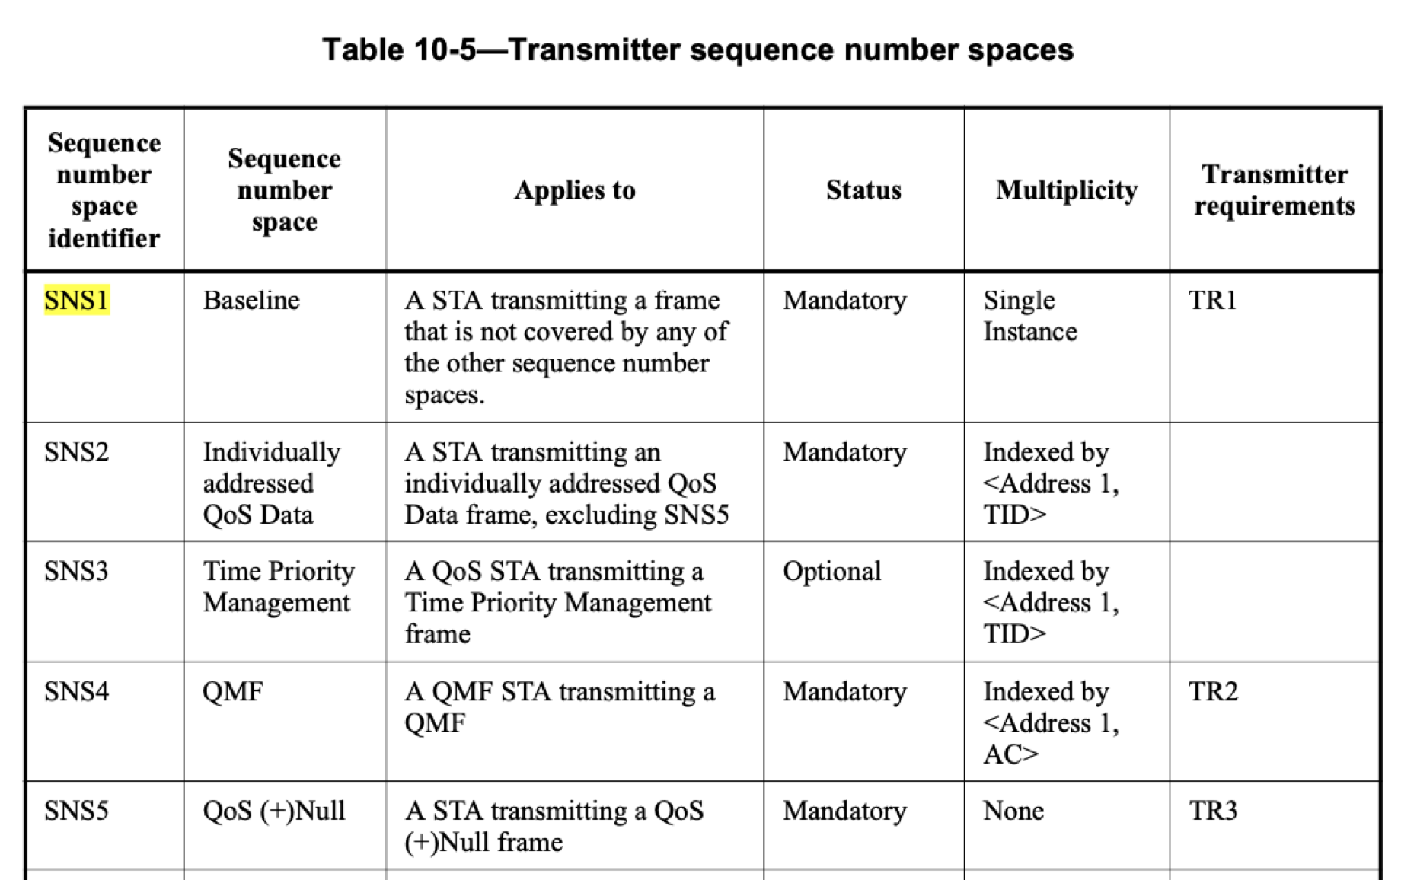
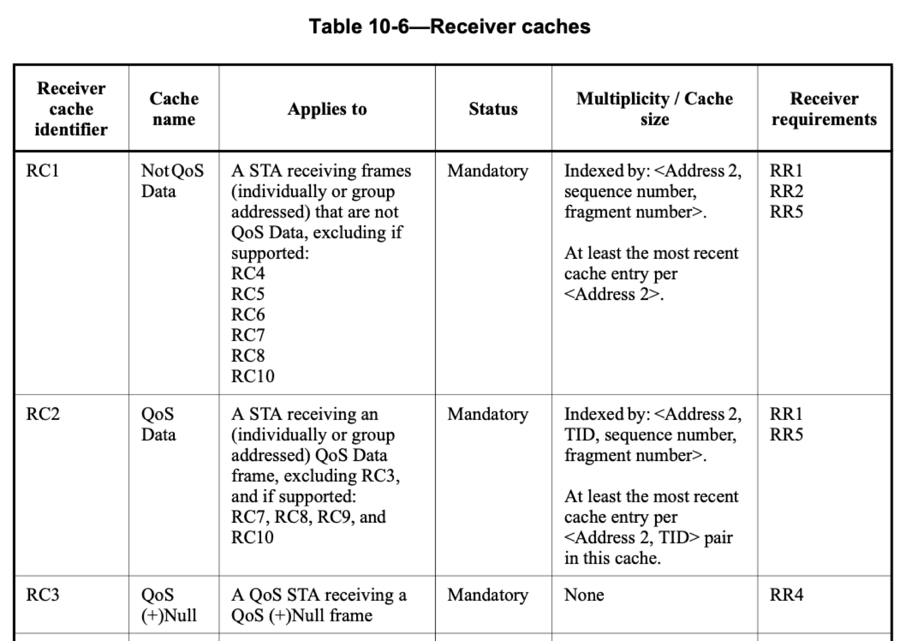
SNS 1 defined in 802.11 (Pre-11be)
SNS1 is used by:
-- Groupcast data (QoS, non-QoS);
-- Groupcast management frames.
-- Unicast data (Non-QoS);
-- Unicast management frames.

Slide 4
Problem of Duplicate Detection
A GCF is transmitted independently on all links, with its SN assigned by the per link SNS1 independently.
When a STA switches link, it might receive undetectable duplicated GCFs.
STAs may need to switch link at any time. Selective timing for link switch to avoid undetected duplicates, as proposed in [2], is not workable.
GC-Data frame
AP1
SNS1_1
AP2
SNS1_2
AP3
SNS1_3
GC-Data frame (SN = n1)
GC-Data frame (SN = n2)
Link 1
Link 2
Link 3
STA1
STA2
STA3
Undetected duplicate with link switch
(false negative)

Slide 5
Significant Limitation On Link Switch (1)
Case 1: With NO incoming GCFs between DTIM Beacon 1 and DTIM Beacon 2
DTIM Indication
G-BU_link 1= 1
G-BU_link 2 =1
DTIM Indication
G-BU_link 1 = 0
G-BU_link 2 = 0
Condition for link switch to avoid duplicates
DTIM
Beacon 1
DTIM
Beacon 2
Link 1
Wait time for link switch
Intended link switch time
Actual link switch time
DTIM Indication
G-BU_link 1 = 0
G-BU_link 2 = 1
DTIM Indication
G-BU_link 1
G-BU_link 2 = 0
Link 2
Wait time for link switch can be one DTIM Beacon Interval

Slide 6
Significant Limitation On Link Switch (2)
Case 2: With incoming GCFs
DTIM Indication
G-BU_link 1= 1
G-BU_link 2 =1
DTIM Indication
G-BU_link 1 = 1
G-BU_link 2 = 1
DTIM Indication
G-BU_link 1 = 1
G-BU_link 2 = 1
DTIM
Beacon 1
GCFs
GCFs
GCFs
DTIM
Beacon 3
GCFs
DTIM
Beacon 2
Link 1
Wait time for link switch
Intended link switch time
DTIM Indication
G-BU_link 1 = 1
G-BU_link 2 = 1
DTIM Indication
G-BU_link 1 = 1
G-BU_link 2 = 1
DTIM Indication
G-BU_link 1 = 1
G-BU_link 2 = 1
GCFs
GCFs
GCFs
GCFs
Link 2
Wait time for link switch can be indefinite!

Slide 7
Proposal: New SNS Design (1)
Create a new SNS that is shared across all links, SNS_new_shared, used by:
Groupcast data (QoS, non-QoS) frames
Groupcast management frames
Unicast management frames (ML) (i.e., generated at the ML level)
Note: SNS_new_shared may have multiplicity distinguished by Address 1, TID, frame type, etc.
AP MLD
SNS_new_shared:
GC-data, GC-Mgmt, UC-Mgmt (ML)
AP1
SNS1_1:
UC-data (non-QoS)
UC-Mgmt (Local)
AP2
SNS1_2:
UC-data (non-QoS)
UC-Mgmt (Local)
AP3
SNS1_3:
UC-data (non-QoS)
UC-Mgmt (Local)
Link 1
Link 2
Link 3
STA1
STA2
STA3
The existing per link SNS1 remains to be used by:
Unicast data (non-QoS)
Unicast management frames (local) (i.e., generated at the local AP level)

Slide 8
Proposal: New SNS Design (2)
Alternatively, unicast management frames (local) with recipient to be non-AP MLD can use SNS_new_shared instead of per link SNS1.
A non-AP MLDs uses <address 1= group address, sequence number (SN) > for duplicate GCF detection.

Slide 9
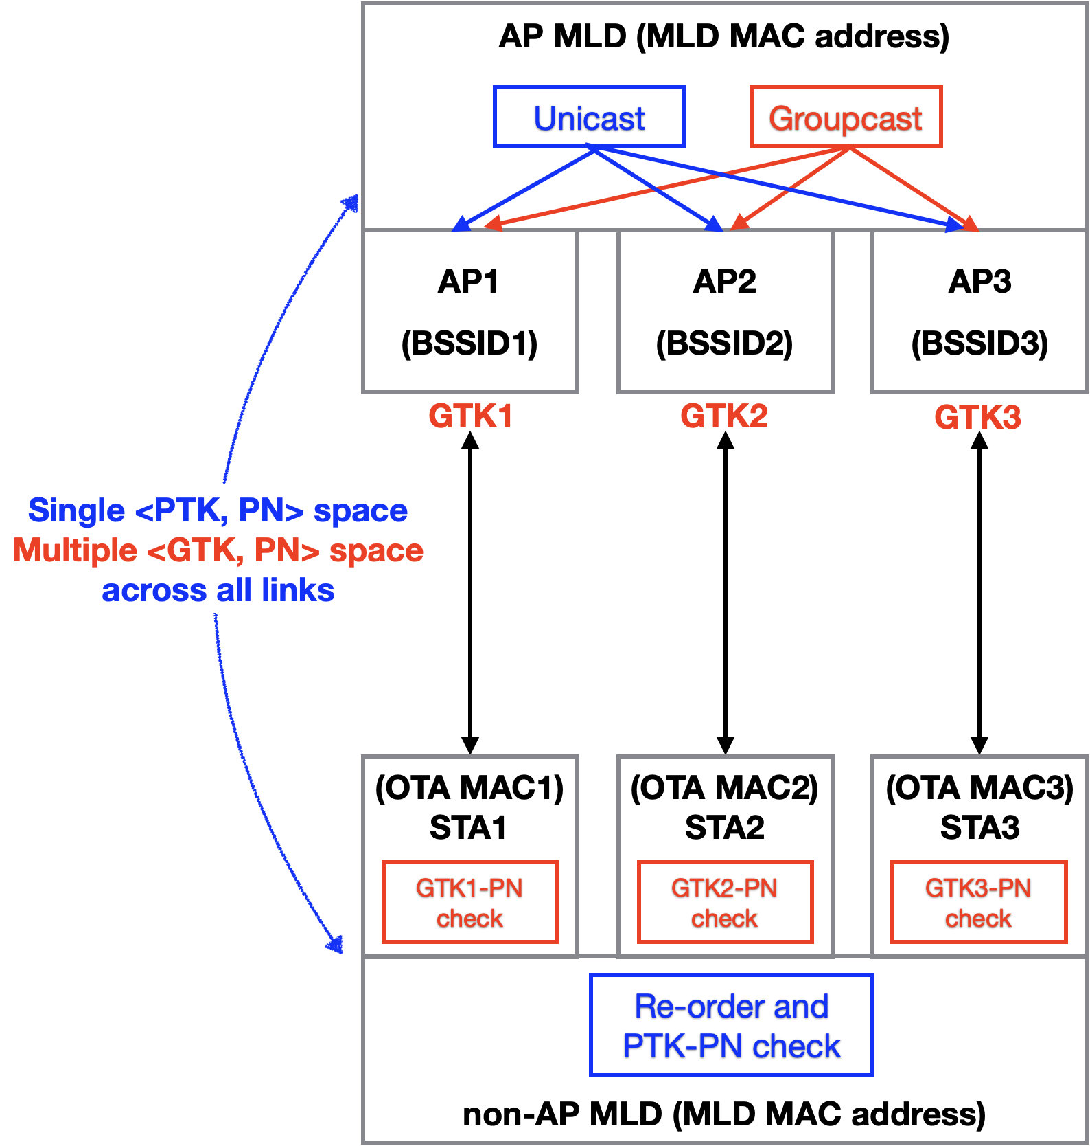
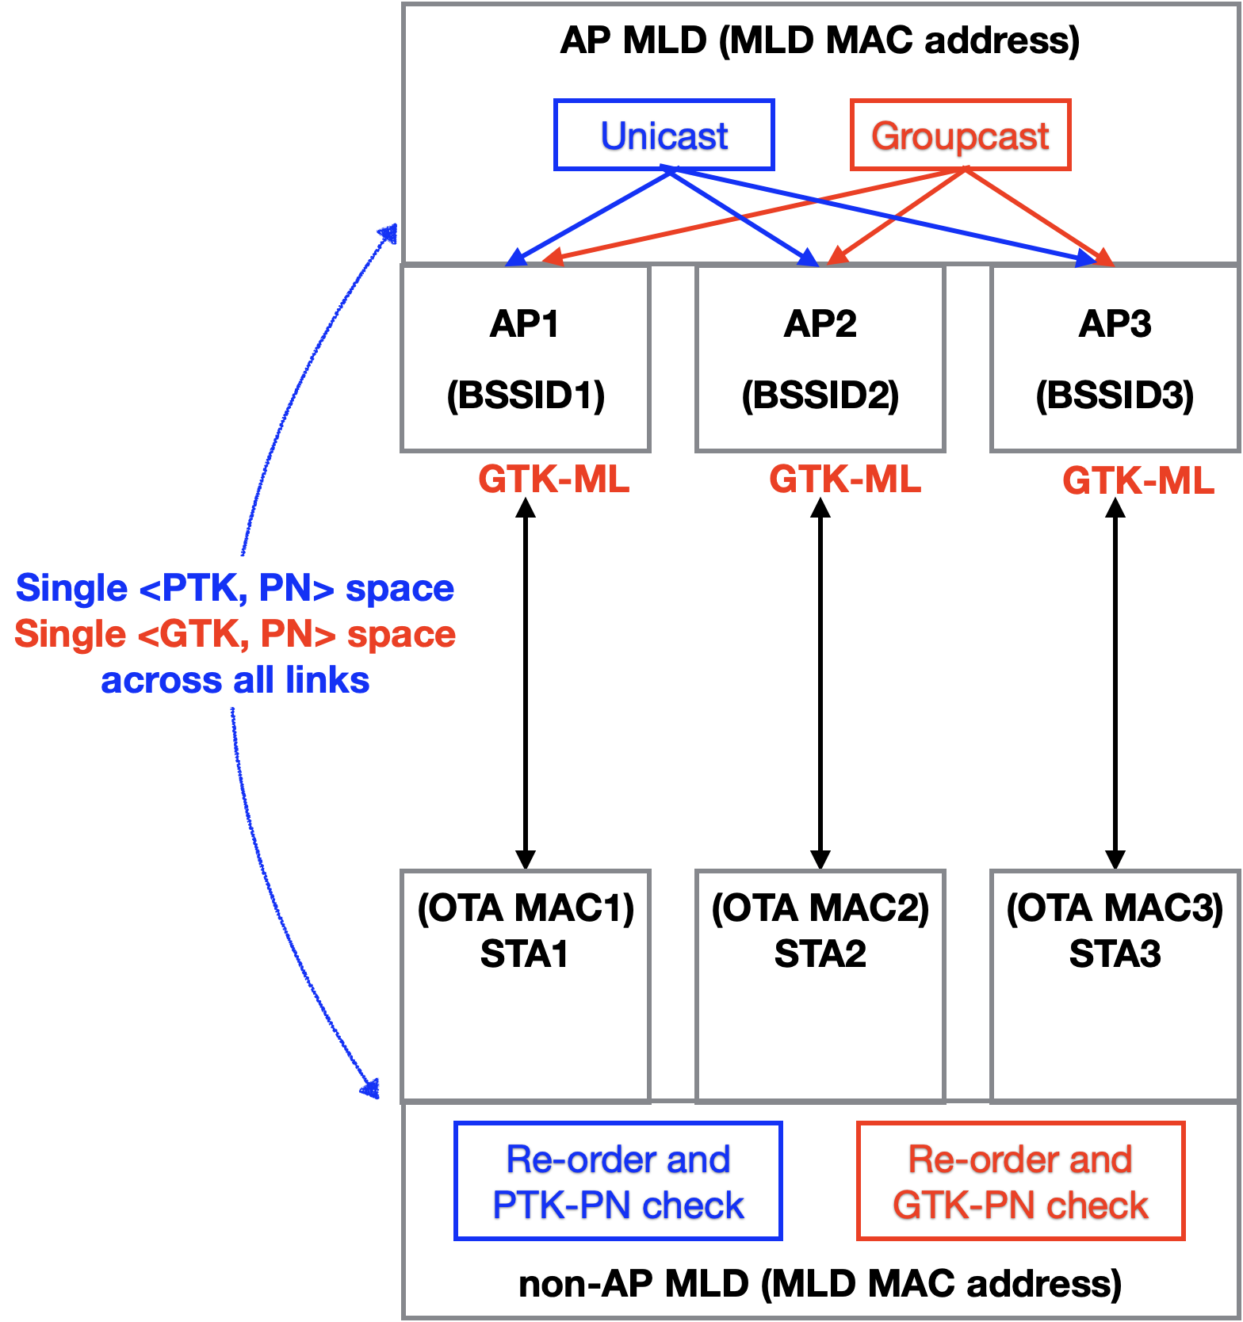
Proposal: Single GTK and PN Space for GCF Delivery for MLO (1)
11be SFD:
Proposal (unified unicast and groupcast approach):

Slide 10
Summary
The group addressed frame delivery method described in 11be SFD can cause undetected duplicates at non-AP MLDs.
We have proposed to use a new shared SNS to enable duplicate detection of group addressed frames by non-AP STAs.
We have also proposed to use a single and common GTK, PN space for group addressed frame delivery on all links.

Slide 11
Reference
[1] IEEE 802.11-19/1262r22, “Specification framework for 11be”, Edward Au, Huawei
[2] IEEE 802.11-20/0903r10, “Multi-link group addressed data frame delivery follow up”, Po-Kai Huang, et al., Intel

Slide 12
SP1
Do you support to use a common SNS shared across all links of MLD for the transmission of:
Group addressed data (QoS, non-QoS) frames
Group addressed management frames

Slide 13
SP2
Do you support to use a common SNS shared across all links of MLD for the transmission of:
Unicast management frames (ML) (i.e., generated at the ML level)
Optionally, unicast management frames (Local) (i.e., generated at the local AP level) whose recipients are a STA affiliated with a non-AP MLD

Slide 14
SP3
Do you support to use a single and common GTK and PN space for group addressed frame delivery on all links of MLD?

Slide 15
Appendix

Slide 16
Problem with Using SNS_new_shared
The use of SNS_new_shared alone can create false positive duplicate declaration by legacy STAs.
A corner case? Should this be addressed by the spec?
Alternatively, we propose the method shown on next slide as its solution.
AP MLD
SNS_new_shared:
GC-data, GC-Mgmt, UC-Mgmt (ML)
AP1
SNS1_1:
UC-data (non-QoS)
UC-Mgmt (Local)
AP2
SNS1_2:
UC-data (non-QoS)
UC-Mgmt (Local)
AP3
SNS1_3:
UC-data (non-QoS)
UC-Mgmt (Local)
Retransmitted
UC-Mgmt frame (SN = n1)
Failed
UC-Mgmt frame (SN = n1)
GC-Data frame (SN = n1)
Link 1
Link 2
Link 3
Incorrectly declared duplicate
(false positive)
Legacy STA
STA2
STA3

Slide 17
Solution to False Positive Problem
Derive a single GTK-ML, and create a new PN_gc space.
Transmit an additional copy of GCFs with MLD Address as TA.
Transmission:
 | Link(s) transmitted | Encryption Key | SNS_new_shared
GCF with TA = MLD_add | All links | GTK-ML | A single SNS shared across all links for the GCF
GCF with TA = AP_i_add | Link_i | GTK_i or GTK-ML | Transmission on link_i uses its own SNS1_i space, as defined in the 802.11 base spec.
Reception:
 | Legacy_STA | MLD_STA
GCF with TA = MLD_address | Filter out/discard (based on TA) | Receive and perform duplicate detection using SN
GCF with TA= AP_i_address | Receive | Filter out/discard (based on TA)

