Slide 1
Analysis of Secure LTF Frequency Windows
Date: 2021-01-06
Authors:

Slide 2
PHY Security
Attacker tries to modify the measured range
  Make STA appear closer to AP to fake proximity detection
  Spoof time-stamps t2 or t4 to achieve that
Focus on physical layer attack
  Assume that MAC level is authenticated/encrypted
  Includes time-stamps t1/t4 feedback to initiator

Slide 3
Integrity Attack Scenario
First line security
  Use secure LTF (sequence unknown to attacker)
  Replace Cyclic Prefix (CP) with zero-padded Guard Interval (to reduce structure)
Attack types
  Frequency Domain/ Computational attack: attacker observes fraction of symbol and predicts the rest to attack the later part
  Time Domain/MMSE Attack: attacker continuously observes and attacks using low pass nature of baseband signal

Slide 4
Frequency Domain/Computational Attack
Steps
  Attacker will listen to first half portion of LTF
  Then try to estimate the full time-domain LTF waveform (typically by estimating frequency QAM symbols)
  Change measured t2 or t4 by transmitting the last (estimated) quarter of time-domain LTF waveform with timing advance
Advantages:
  High received SNR (listen only)
  Processing delay of 100 ns okay
Disadvantages
  Attack correlation limited by attack duration
  Receiver will notice poor SINR if boost power
6.4 µs
Waveform for channel measurement
First half
Timing advance
Waveform transmitted by attacker
Last quarter

Slide 5
Time Domain/MMSE Attack
Attack here
Steps
  Attacker will try to predict the waveform sample-by-sample
  Use finite bandwidth of signal and pulse shape/sidelobes
  Subtract out predicted symbols
  Start tx attack, while rx more data
Advantages
  Can attack large part of symbol
  Does not depend on finite constellation
Disadvantages
  Needs full duplex, limits receive SNR
  Needs to account for inter-symbol-interference
  Can only change RTT by prediction time (less proc. Delay)
Maximum RTT
effect
Measure here

Slide 6
Attack Example 20 MHz - Rectangle
Vulnerability depends on anti-causal part of pulse
Caused by frequency domain “interpolation”
Attacker can observe energy up to
Processing delay (30-60 ns)
Attack ToA time (30 ns)
If attack both RTT ToAs with 30 ns, can make distance seem 9 meters shorter
Attack by
30 ns
Processing delay
of 45 ns
Observe pulse energy here

Slide 7
Attack Example 80 MHz - Rectangle
When changing bandwidth attacker capabilities stay the same
Higher bandwidth systems are inherently more secure against time domain attack
Tx Window Design
Minimize pulse energy that can be used to attack
Suggest a mask that minimizes energy more than 60ns before main pulse
Attack by
30 ns
Processing delay
of 45 ns
Observe pulse energy here

Slide 8
Window Design 40 MHz – Rectangle
HE40 2x Subcarriers
No Window (rectangular, β=0)
Time domain
Equivalent “Pulse shaper”
Below 0.1
before 60 ns
Below 0.04
before 160 ns

Slide 9
Window Design 40 MHz – Raised Cosine
HE40 2x Subcarriers
Raised cosine (β=0.3)
Easily meets spec
Below 0.1
before 60 ns
Below 0.04
before 160 ns

Slide 10
Window Design 40 MHz – Flattop
HE40 2x Subcarriers
Flattop window (truncated at 0.5)
Time domain
Equivalent “Pulse shaper”

Slide 11
Window Design 40 MHz – Trimmed Raised Cosine
HE40 2x Subcarriers
Raised cosine (β=0.3), cut at 0.5
Time domain
Equivalent “Pulse shaper”

Slide 12
Window Design 80 MHz – Rectangle
HE80 2x Subcarriers
No Window (rectangular, β=0)
No Tx window needed
Below 0.1
before 60 ns
Below 0.04
before 160 ns

Slide 13
Window Design 20 MHz – Rectangle
HE20 2x Subcarriers
No Window (rectangular, β=0)
Tx window needed very much
Below 0.1
before 60 ns
Below 0.04
before 160 ns

Slide 14
Window Design 20 MHz – Raised Cosine
HE20 2x Subcarriers
Raised cosine (β=0.6)
Not enough to meet spec

Slide 15
Window Design 20 MHz – Flattop
HE20 2x Subcarriers
Flattop window (truncated at 0.5)
Not enough to meet spec

Slide 16
Window Design 20 MHz – Kaiser Window
HE20 2x Subcarriers
Kaiser window (β=3)
Aggressive enough to meet spec

Slide 17
Window Design 20 MHz – Chebyshev Window
HE20 2x Subcarriers
Chebyshev Window (sidelobes at -30 dB)
For small window size and not aggressive sidelobes, has peaks at boundary
Peak at boundary

Slide 18
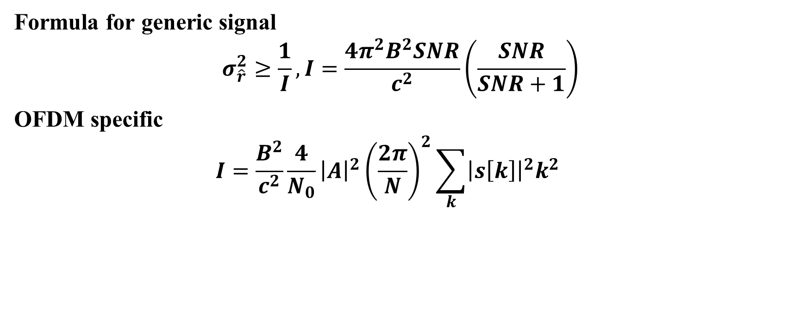
Cramer-Rao Lower Bound
Formula for generic signal
$$σ_{\hat{r}}^{2}≥\frac{1}{I},I=\frac{4π^{2}B^{2}SNR}{c^{2}}\left(\frac{SNR}{SNR+1}\right)$$
OFDM specific
$$I=\frac{B^{2}}{c^{2}}\frac{4}{N_{0}}{\left|A\right|}^{2}{\left(\frac{2π}{N}\right)}^{2}\sum_{k}{{\left|s\left[k\right]\right|}^{2}k^{2}}$$

Slide 19
CRLB Evaluation – 80 MHz
Can add more paths to reflect multipath
HE80 2x LTF – 512 FFT size
498 subcarriers, 3 DC, no pilots
OFDM+multipath
OFDM signal
generic signal

Slide 20
CRLB Evaluation Raised-Cosine – 80 MHz
Some degradation due to reduced effective bandwidth
Renormalize to keep power constant
OFDM+multipath
OFDM signal
Rectangle OFDM

Slide 21
CRLB Evaluation Flattop – 80 MHz
Similar degradation, slightly better in multipath
Window is cut at 0.5
OFDM+multipath
OFDM signal

Slide 22
CRLB Evaluation Trimmed Raised-Cosine – 80 MHz
Slightly better than Flattop
Similar to Flattop, cut at 0.5
OFDM+multipath
OFDM signal

Slide 23
Tx Window Comparison – 40 MHz
Some performance degradation
Flattop worse than rectangle
Trimmed raised-cosine has less loss than flattop
flattop
rectangle
Trimmed
Raised-cosine

Slide 24
Tx Window Comparison – 20 MHz
Some performance degradation
Flattop worse than rectangle
Kaiser even more aggressive than flattop – and more loss
Kaiser
rectangle
flattop

Slide 25
Conclusion
Higher bandwidth signals are more secure
  80 and 160 MHz LTFs don’t need Tx windows
  40 MHz can be easily addressed, choice of options
  20 MHz needs aggressive window, with further degradation of performance

