Slide 1
Reducing Feedback Overhead in Multicast Transmissions
Date: 2020-12-25
Authors:
Name | Affiliations | Address | Email
Boyce Bo Yang | Huawei | Nanjing, China | yangbo59@huawei.com
Guangji Chen |  | Nanjing, China | chenguangji1@huawei.com
Chenhe Ji |  | Nanjing, China | jichenhe@huawei.com
Notes:
September 2012

Slide 2
This doc is proposed to solve LB 252 CID 1096
CID | Commenter | LB | Draft | Comment | Proposed Change | Resolution
1096 | Bo Yang | 252 | 1 | 802.11bc amendment shall provide a mechanism for an AP to solicit acknowledgment feedbacks from a large number of group-cast recipients more efficiently. | Add a mechanism as proposed in 1976r0

Slide 3
Recall[1] 802.11 multicast properties
Multicast / broadcast traffic is generally not retransmitted, because there is no acknowledgement
Multicast / broadcast traffic is generally sent at a “lowest common denominator” rate, known as a basic rate. This might be as low as 6 Mbps, when unicast links are operating at 600 Mbps.
Lower rate ⇒ larger frame, less airtime for everything else.
There are options to improve multicast reliability
  GroupCast with Retries (GCR)
  Directed Multicast Service (DMS)

Slide 4
Efficiency of multicast to large number of recipients is low
DMS(Direct Multicast Service) converts multicast to unicast, which is not efficient when the number of group recipients is large.
GCR(Group Cast Retry) defines two polices for the transmission of group addressed frames
  GCR Block ACK
    Initiates BA agreement with each group member. Transmitting AP
    regularly sends BAR to the STAs
    Suited to small to medium number of group members
  GCR unsolicited retry
    Retransmit MSDU one or more times without soliciting uplink feedbacks to increase probability of success
    Suited to large number of group members
    The selection of MCS or retransmission times is arbitrary and unreliable

Slide 5
GCR MU-BAR in 11ax
GCR MU-BAR mechanism is defined in 11ax, taking advantage of OFDMA access. However, it’s still not able to deal with the case of transmission to a large group of recipients.
  For a typical implementation of 40MHz BW, there are up to 18 RUs. 4 MU-BAR Triggers are needed to solicit BAs from each group transmission, if there are 60 recipients.
AP
Groupcast PPDU
MU BAR
MU BAR
MU BAR
MU BAR
STA 1
BA
STA 20
BA
STA 40
BA
STA 60
BA
Notes:
It’s still a large feedback overhead

Slide 6
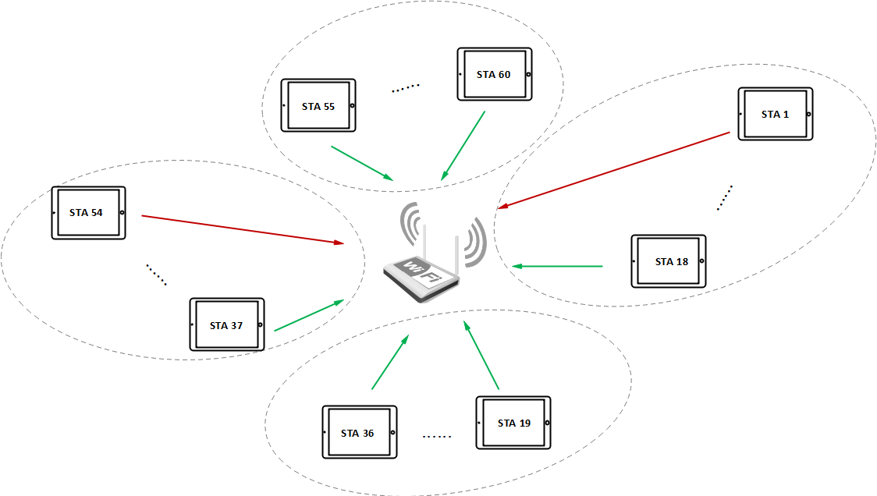
Observations on feedbacks of Multicast
When an AP commences a group transmission, most of recipients can decode the multicast A-MSDU/MSDUs correctly, and a few can’t.
  If the recipients decode every MSDU correctly, that is only one bit info.
  If the recipient doesn’t decode every MSDU correctly, there are many possible error patterns, so a feedback bitmap is necessary for AP’s scheduling(retransmission, link adaptation, etc)
MU-BAR Trigger 4
MU-BAR Trigger 1
MU-BAR Trigger 3
BA bitmap with all 1s
BA bitmap with at least one 0
MU-BAR Trigger 2

Slide 7
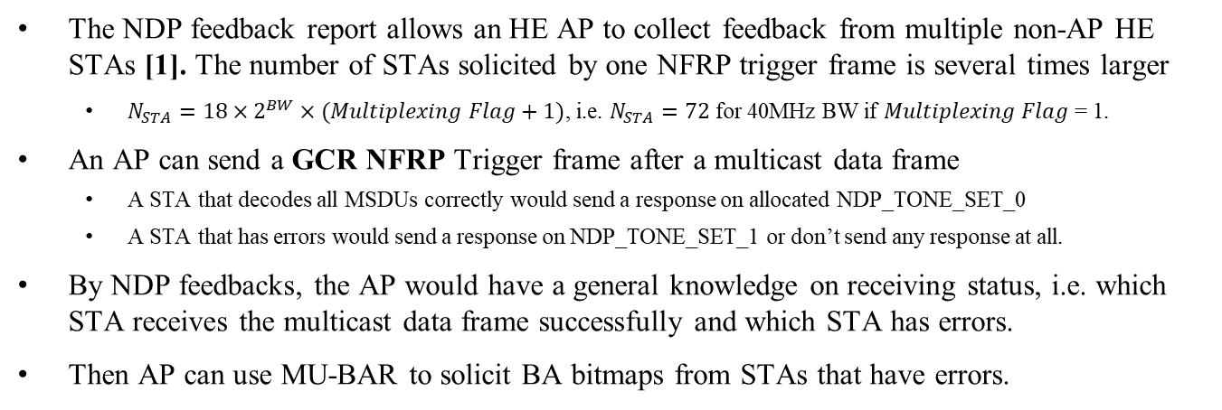
NDP Feedback can help reducing the number of BA responses
The NDP feedback report allows an HE AP to collect feedback from multiple non-AP HE STAs [1]. The number of STAs solicited by one NFRP trigger frame is several times larger
  $N_{STA}=18×2^{BW}×(Multiplexing Flag+1)$, i.e. $N_{STA}=72$ for 40MHz BW if $Multiplexing Flag$ = 1.
An AP can send a GCR NFRP Trigger frame after a multicast data frame
  A STA that decodes all MSDUs correctly would send a response on allocated NDP_TONE_SET_0
  A STA that has errors would send a response on NDP_TONE_SET_1 or don’t send any response at all.
By NDP feedbacks, the AP would have a general knowledge on receiving status, i.e. which STA receives the multicast data frame successfully and which STA has errors.
Then AP can use MU-BAR to solicit BA bitmaps from STAs that have errors.
AP
multicast PPDU
GCR
NFRP
MU BAR
STAs 1
NDP
STA 20
NDP
BA
STA 40
NDP
STA 60
NDP
BA

Slide 8
Evaluation on BA feedback overheads
Simulation setup
BW: 40MHz
Num of STAs with decoding errors: <=18
MCS for Trigger/BA: 4
Observations:
As shown in the figures, the gain is significant if there are more than 40 recipients
(us）
MF = 1
(us）
MF = 0
Number of Recipients
Number of Recipients

Slide 9
Minor changes to NFRP Trigger
Use one of the reserved values in Feedback Type field to indicate a GRC acknowledgement request
The starting sequence number and ending sequence number may also be needed in the modified NFRP Trigger frame
  Recipients that fail to decode the whole AMPDU may not know the first/latest sequence number that the AP has transmitted.
User info of NFRP variant Trigger
Feedback Type
UL Target Receive Power
Multiplexing Flag
GCR ACK Starting Sequence Control
GCR ACK Sequence Span
Starting AID
Reserved
Reserved
Bits:
12
9
4
7
7
1
16
8
Table 9-31k—Feedback Type subfield encoding
Table 9-31k—Feedback Type subfield encoding
Value | Description
0 | Resource request
1 | GCR acknowledgement request
2-15 | Reserved
Value | Description
0 | Resource request
1-15 | Reserved

Slide 10
Proposed changes to spec text(1)
9.3.1.22.9 NFRP Trigger frame format
Change Figure 9-64l as follows
Insert a new row in Table 9-31k (Feedback Type subfield encoding) as follows and update the Reserved row as appropriate
Insert the following paragraphs at the end of this subclause
The GCR ACK Starting Sequence subfield and the GCR ACK Ending Sequence subfield are optionally present if the value of the Feedback Type subfield is 1. The Starting Sequence Number subfield of the GCR Starting Sequence Control subfield contains the sequence number of the first MSDU or A-MSDU for which this NFRP frame is sent. The Fragment Number subfield of the GCR Starting Sequence Control subfield is set to 0. The GCR Sequence Span subfield indicates the number of MSDU/A-MSDUs that needs to be acknowledged, starting from the MADU/AMSDU with sequence number as indicated in GCR ACK Starting Sequence subfield.
Feedback Type
UL Target Receive Power
Multiplexing Flag
GCR ACK Starting Sequence Control
GCR ACK Sequence Span
Starting AID
Reserved
Reserved
Bits:
12
9
4
7
7
1
16
8
Table 9-31k—Feedback Type subfield encoding
Value | Description
1 | GCR acknowledgement request

Slide 11
Proposed changes to spec text(2)
26.5.7 NDP feedback report procedure
Inset new subclause following 26.5.7.4 NDP feedback report for a resource request as follows
26.5.7.5 NDP feedback report for a GCR acknowledgement request
If the Feedback Type subfield in the User Info field of the NFRP Trigger frame is 1, a STA that is scheduled shall send an NDP feedback report response in order to signal to the AP that it is in the awake state and that it received all frames as indicated in NFRP Trigger frame.
Each STA that is scheduled is assigned a STARTING_STS_NUM and an RU_TONE_SET_INDEX to transmit a FEEDBACK_STATUS bit.
The meaning of the FEEDBACK_STATUS bit is defined in Table 26-3a (FEEDBACK_STATUS description):
Table 26-3a—FEEDBACK_STATUS description
FEEDBACK_STATUS | Condition
0 | The STA is in the awake state and reports acknowledgements of all frames as indicated in NFRP Trigger frame.
1 | The STA is in the awake state and reports that at least one of the frames as indicated in NFRP Trigger frame is not correctly received.

Slide 12
Proposed changes to spec text(3)
9.4.2.248.2 HE MAC Capabilities Information field
Change the corresponding part of Figure 9-788b as follows
Insert a new row in Table 9-322a (Subfields of the HE MAC Capabilities Information field) as follows
B24
B25
B26
B27
B28
B29
B30
B31
B32
Reserved
GCR NDP feedback Report Support
Maximum
A-MPDU Length Exponent Extension
Flexible TWT Schedule Support
OM Control Support
OFDMA RA Support
A-MSDU Fragmentation Support
Rx Control Frame To MultiBSS
BSRP BQRP A-MPDU Aggregation
Bits:
1
1
1
2
1
1
1
1
Table 9-322a—Subfields of the HE MAC Capabilities Information field
Subfield | Definition | Encoding
GCR NDP Feedback Report Support | For an AP, indicates support for the GCR NDP feedback report procedure. For a non-AP STA, indicates support for responding to an NFRP Trigger frame with feedback type equals to GCR acknowledgement request. | Set to 1 if supported. Set to 0 otherwise

Slide 13
Proposed changes to spec text(4)
9.4.2.248.2 HE MAC Capabilities Information field
Change the following row in Table 9-322a (Subfields of the HE MAC Capabilities Information field)
Table 9-322a—Subfields of the HE MAC Capabilities Information field
Subfield | Definition | Encoding
NDP Feedback Report Support | For an AP, indicates support for the NDP feedback report procedure. For a non-AP STA, indicates support for responding to an NFRP Trigger frame with feedback type equals to Resource request. | Set to 1 if supported. Set to 0 otherwise.

Slide 14
Summary
We propose a method to reduce feedback overheads in case of high density multicast transmissions
An AP uses modified NFRP trigger to solicit one bit info(whether all MSDUs are decoded successfully).
Then the AP allocates RUs for STAs with decoding errors, the number of which would be much less.

Slide 15
Straw Poll 1
Do you support adding the proposed text on slide 10-13 to 802.11bc Draft.
Y/N/A

Slide 16
Reference
[1] IEEE 802.11-15/1261r2
[2] Draft P802.11ax_D7.0

Slide 17
Proposed changes to spec text(1)
9.3.1.22.9 NFRP Trigger frame format
Change Figure 9-64l as follows
Insert a new row in Table 9-31k (Feedback Type subfield encoding) as follows and update the Reserved row as appropriate
Insert the following paragraphs at the end of this subclause
The GCR ACK Starting Sequence subfield and the GCR ACK Ending Sequence subfield are optionally present if the value of the Feedback Type subfield is 1. The Starting Sequence Number subfield of the GCR Starting Sequence Control subfield contains the sequence number of the first MSDU or A-MSDU for which this NFRP frame is sent. The Fragment Number subfield of the GCR Starting Sequence Control subfield is set to 0. The Ending Sequence Number subfield of the GCR Ending Sequence Control subfield contains the sequence number of the last MSDU or A-MSDU for which this NFRP frame is sent. The Fragment Number subfield of the GCR Ending Sequence Control subfield is set to 0.
Starting AID
Feedback Type
UL Target Receive Power
Multiplexing Flag
GCR ACK Starting Sequence
GCR ACK Ending Sequence
Reserved
Reserved
Bits:
12
9
4
7
7
1
16
16
Table 9-31k—Feedback Type subfield encoding
Value | Description
1 | GCR acknowledgement request
Notes:
We have two options here
1, we can add a GCR ACK Ending Sequence, which would have the same format as the Starting sequence subfield.
2, we can also add a GCR ACK Sequence span/range, which indicates the number of MSDUs between the starting and ending Sequence number. For option 2, only 8 bits are needed, since the largest BA bitmap is 256

