Slide 1
Versioning for PHY Security
Date: 2021-02-15
Authors:
Name | Affiliations | Phone | Email
Roy Want | Google Inc. |  | roywant@google.com
Mingguang Xu | Google Inc. |  | mingguangxu@google.com
Raymond Hayes | Google Inc. |  | hayesr@google.cm
Jonathan Segev | Intel Corporation |  | Jonathan.segev@intel.com
Ali Raissinia | Qualcomm |  | alirezar@qti.qualcomm.com
Nehru Bhandaru | Broadcom |  | nehru.bhandaru@broadcom.com

Slide 2
Abstract
The Secure LTF protocol is a potential target for a future as yet unknown attack, and may need to be upgraded if one comes to light.
By planning for this possibility, and using a Secure LTF versioning mechanism, we can smoothly upgrade the protocol, make the right decisions in the field, and provide users with feedback about their security options; whether to proceed with caution, or not.
Outline
Background
Problem Statement
Versioning of PHY Security
Summary
Strawpoll
Changes relative to : TGaz_Draft D3.0

Slide 3
Background
We have been discussing 11az PHY Security options from 2016-2020, and there is still no unanimous consensus on the best approach for a Secure LTF protocol, (although we have agreed on a compromise).
Randomized 8PSK[6], 64QAM[2], 64QAM + 4PSK [5], 1024QAM[1,3], DFT Pre-coded OFDM [4]
Attacker methods include using a Viterbi decoder, Sphere decoder in the frequency domain, MMSE sample-by-sample in the time domain.
Attacks don’t need to be perfect, and can take advantage of probabilistic weaknesses in the coding and modulation, and then after several attempts may succeed.

Slide 4
Problem Statement
After the 11az standard is productized, it’s possible we may find other attacks that need to be addressed with a new, or improved, variant of the Secure PHY protocol (it would become a priority).
As a result, there may be new and old variants of the protocol in the field.
For PHY Security versions, especially for key/lock applications, for a suitable user experiences we would need a coexistence mechanism:
Negotiation for the highest level of LTF security protocol solution.
Enable a user setting to define/override the LTF security policy level.

Slide 5
Previous Comments Addressed
Versioning might be better addressed at the application level
What kind of user experience would be enabled?
Consider adding a new version subelement rather than overload an existing field
We could address versioning if/when a vulnerability is found in the future.
Are version numbers ordered by improving security robustness?

Slide 6
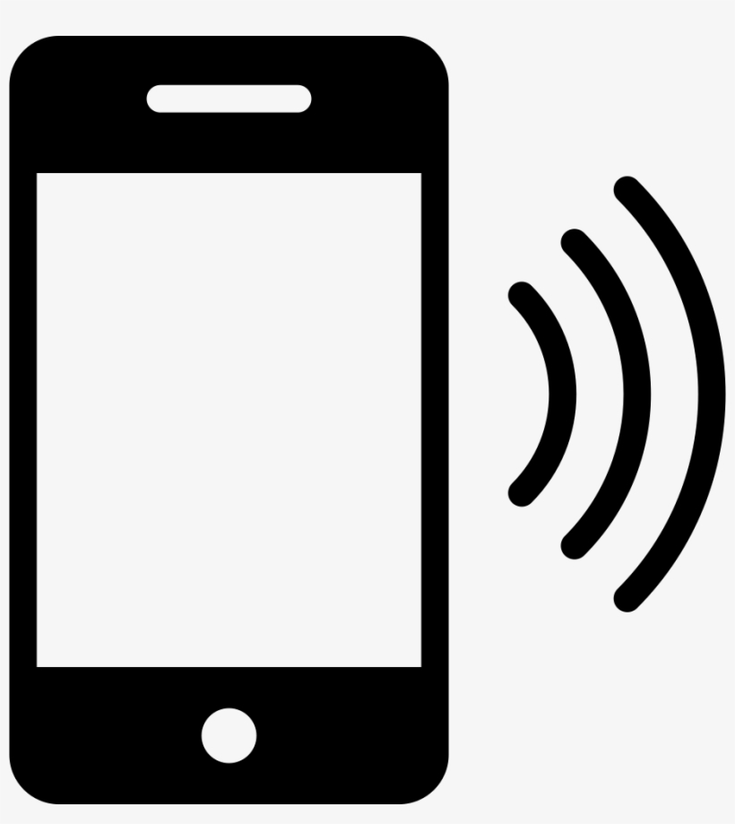
EXAMPLE using the Secure LTF version during FTM Request negotiation
ISTA: Key App Security Menu
User Selects:
Car security level must match the key’s level, or block (terminate)
n/a
Allow phone to use a lower security level set by car (less safe – warn user, display version used)
RSTA: Car Lock Security Menu
(available through dash console)
User Selects:
Key security level must match the car’s level, or block (terminate)
Permit Key with a lower (older) security level to open car. (less safe – warn user, display version used)
n/a
ISTA
RSTA
=
<
>

Slide 7
Secure LTF protocol version subelement
Insertions: addition of description of ‘Secure LTF protocol versioning subelement’ at the end of section 9.4.2.298 (Ranging Parameters element) and update Table 9-322h23fd (Ranging Subelement IDs for Ranging Parameters), with a new entry for subelement 2, formally reserved; and 11.21.6.3.4 (Negotiation for Secure LTF in the TB and Non-TB Ranging measurement exchange)
Figure 9-788edm1– Secure LTF protocol version subelement
The Secure LTF protocol version subelement may be included in the Ranging Element of the FTMR and the initial FTM frame, to indicate the Secure LTF protocol version number proposed. This represents a negotiation for the version proposed from ISTA to RSTA, and the response from RSTA to ISTA.
If it is not included, this is equivalent to proposing version 0.
The version number will be incremented by the IEEE for each new Secure LTF protocol supported by the standard, and will be reflected by the inclusion of this subelement with that version number during negotiation.
If the versions differ, each STA can then decide if it wishes to proceed with, or terminate, the ranging request. This decision can be made based on a security policy established a priori by the user at the application level. The policy at the RSTA may chose to accept the requested version from the ISTA, downgrade it, or terminate. Likewise the policy at the ISTA may chose to accept the RSTA’s equal, or downgraded version, or terminate.
 | B0 B7 | B8 B15 | B16
 | Subelement ID (2) | Length | Secure LTF Protocol Version
Bits: | 8 | 8 | 8

Slide 8
Summary
PROs
Secure LTF versioning allows devices to negotiate the Secure LTF protocol used
Versioning enables user policies and feedback describing the security problem.
- It can indicate a phone upgrade is required; from a Marketing perspective this is a good thing.
It provides an upgrade path for 11az PHY Security
(This is not unusual given the history of Wi-Fi WEP, WPA, WPA2, WPA3 and Bluetooth security)
CONs
Secure LTF version bits may tell the market TGaz is unsure about the PHY security solution.
COUNTER POINT: We have lots of public documents that already indicate this uncertainty. However, it also shows we are committed to maintain the highest-level of security possible.

Slide 9
References
[1] 802.11-20/0836r0 11az Secure LTF Design
[2] 802.11-20/0964r0 Attacks to Fully Random 64QAM Sounding Signal
[3] 802.11-20/1373r0 Attacks to Fully Random OFDM Sounding Signal
[4] 802.11-20/1097r1 Secure LTF using DFT Pre-coded OFDM
[5] 802.11-20/1855r0 Further updates on 11az Secure LTF design
[6] TGaz Draft D3.0 (members area)

Slide 10
Strawpoll (1/6/2021)
We support developing amendment text to enable Secure LTF versioning in the FTM Request negotiation.
(Y/N/A: 20 / 8 / 12)

Slide 11
Strawpoll (2/17/2021)
We support developing amendment text to enable Secure LTF versioning in the FTM Request negotiation as depicted by the protocol additions in 11-20/1972r1.
(Y/N/A: / / )

Slide 12
Back-up and Alternates

Slide 13
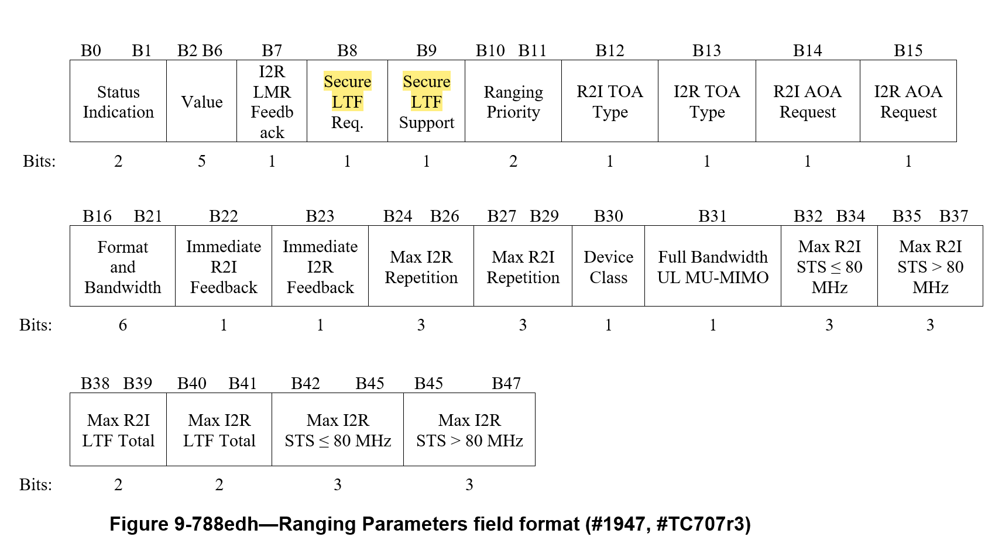
Proposed Versioned PHY Security Negotiation
Use for Secure LTF version in FTMR and
IFTM status 1, 2
For simplicity, leaving “Secure LTF Support” as is, qualified by the version.

Slide 14
Option: Status Indication & Value Field
Old Value Field | New Value Field
Reserved | Reserved
Reserved | Version of Secure LTF supported
Reserved | Version of Secure LTF supported
Time in Seconds for retry | Time in Seconds before retry
Value field supports 32 values (5-bits) and is largely unused (reserved in FTMR)
Proposal:
For 1) ISTAs FTMR and
2) RSTA’s IFTM Status Indication set to 1 or 2
The Value field would indicate the version number from 0-31 (only a few needed)

Slide 15
How a Secure LTF version would be used.
ISTA
RSTA
ISTA negotiates using Secure LTF required, with version X supported in FTMR
RSTA responds with Secure LTF version Y supported in IFTM
If (X == Y) { Ranging Protocol with Secure LTF continues }
If (X < Y) { If (ISTA only supports rev X which is older than Y)
{RSTA rejects assignment and indicates minimum required Secure LTF Rev Y;
User Feedback – ISTA Does not meet Secure LTF requirements} OR {RSTA proceeds with ranging}
If (X > Y) { If (RSTA only supports rev Y which is older than rev X)
{ISTA Terminates, User feedback – RSTA does not meet Secure LTF requirements. } OR
{ISTA decides to accept lower Secure LTF requirement with Y (with user in loop) and proceeds}

Slide 16
Secure LTF protocol version subelement
TGaz editor: Insert the following field updating Figure 9-788edn in section 9.4.2.299 (Secure LTF Parameters element) and insert the following text describing the field after the Element ID Extension field description.
Figure 9-788edn—Secure LTF Parameters element format
The Element ID, Length and Element ID Extension fields are defined in 9.4.2.1 (General).
The Secure LTF Protocol Version field provides an indication of the Secure LTF protocol version number supported from I2R and R2I. If these versions differ, each of the STAs can decide if it wishes to proceed with, or terminate, the ranging request. This decision can be made based on a security policy established by the user at the application level. The starting value of this field is zero, and will be incremented for each improvement of the Secure LTF protocol that may extend this standard in the future.
 | B0 – B7 | B8 – B15 | B16 – B23 | B24 - B31 | B32 – B79 | B80 – B95 | B96 – B111 | B112 – B119
 | Element ID | Length | Element ID Extension | Secure LTF Protocol Version | Secure LTF Counter | LTF Generation SAC | Ranging Management SAC | Measurement Result LTF Offset
Octets: | 1 | 1 | 1 | 1 | 6 | 2 | 2 | 1

