Slide 1
Versioning for PHY Security
Date: 2021-01-05
Authors:
Name | Affiliations | Phone | Email
Roy Want | Google Inc. |  | roywant@google.com
Mingguang Xu | Google Inc. |  | mingguangxu@google.com
Raymond Hayes | Google Inc. |  | hayesr@google.cm

Slide 2
Abstract
The Secure LTF protocol is a potential target for a future as yet unknown attack, and may need to be upgraded if one comes to light.
By planning for this possibility with a Secure LTF version mechanism, we can smoothly upgrade the protocol, make the right decisions in the field, and provide users with feedback about the security options they have; whether to proceed with caution, or not.
Outline
Background
Problem Statement
Versioning of PHY Security
Summary
Strawpoll

Slide 3
Background
We have been discussing 11az PHY Security options from 2016-2020, and there is still no unanimous consensus on the best approach for a Secure LTF protocol, (although we are close to an agreement on how to proceed).
Randomized 8PSK[6], 64QAM[2], 64QAM + 4PSK [5], 1024QAM[1,3], DFT Pre-coded OFDM [4]
Attacker methods include using a Viterbi decoder, Sphere decoder in the frequency domain, MMSE sample-by-sample in the time domain.
Attacks don’t need to be perfect, and can take advantage of probabilistic weaknesses in the coding and modulation, and then after several attempts may succeed.

Slide 4
Problem Statement
After the 11az standard is productized, it’s possible we may find other attacks that need to be addressed with a new, or improved, variant of the Secure PHY protocol (it would become a priority).
As a result, there may be new and old variants of the protocol in the field.
For PHY Security versions, especially for key/lock applications, we would need a coexistence mechanism:
Negotiation for the highest level of security solution.
Provide user feedback about why a PHY security negotiation does not proceed OR if the user chooses, let them know the risks of continuing.

Slide 5
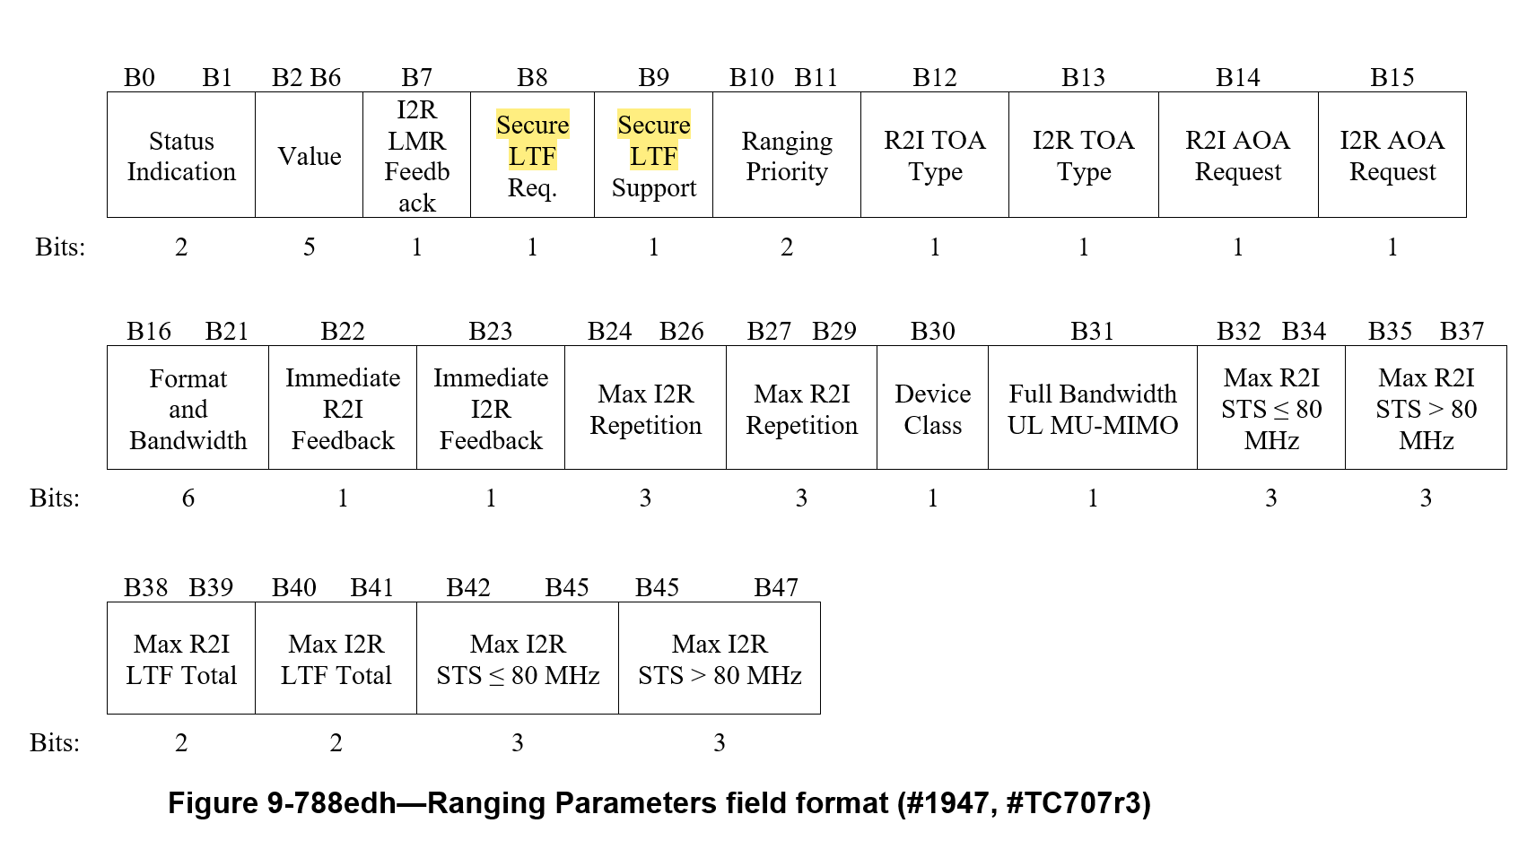
Current Boolean PHY Security Negotiation
This field is in the FTMR/IFTM request/response
The Secure LTF Required field is 1-bit, and Secure LTF Support is 1-bit.
Versioning would require a few additional bits

Slide 6
Option: Status Indication & Value Field
Old Value Field | New Value Field
Reserved | Reserved
Reserved | Version of Secure LTF supported
Reserved | Version of Secure LTF supported
Time in Seconds for retry | Time in Seconds before retry
Value field supports 32 values (5-bits) and is largely unused (reserved in FTMR)
Proposal:
For 1) ISTAs FTMR and
2) RSTA’s IFTM Status Indication set to 1 or 2
The Value field would indicate the version number from 0-31 (only a few needed)

Slide 7
Proposed Versioned PHY Security Negotiation
Use for Secure LTF version in FTMR and
IFTM status 1, 2
For simplicity, leaving “Secure LTF Support” as is, qualified by the version.

Slide 8
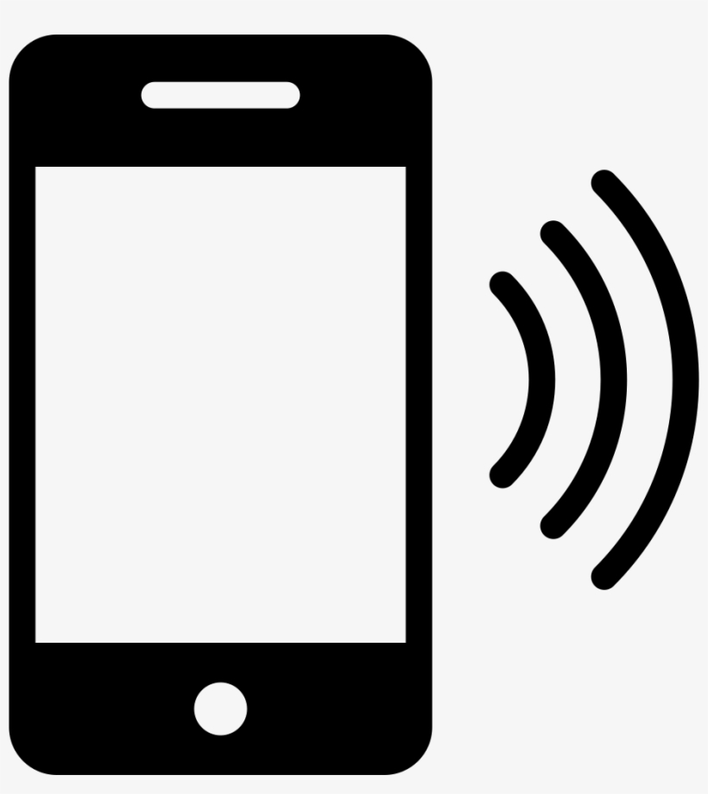
How a Secure LTF version would be used.
ISTA
RSTA
ISTA negotiates using Secure LTF required, with version X supported in FTMR
RSTA responds with Secure LTF version Y supported in IFTM
If (X == Y) { Ranging Protocol with Secure LTF continues }
If (X < Y) { If (ISTA only supports rev X which is older than Y)
{RSTA rejects assignment and indicates minimum required Secure LTF Rev Y;
User Feedback – ISTA Does not meet Secure LTF requirements} OR {RSTA proceeds with ranging}
If (X > Y) { If (RSTA only supports rev Y which is older than rev X)
{ISTA Terminates, User feedback – RSTA does not meet Secure LTF requirements. } OR
{ISTA decides to accept lower Secure LTF requirement with Y (with user in loop) and proceeds}

Slide 9
Summary
PROs
Secure LTF versioning allows for devices to negotiate the Secure LTF protocol used
Versioning enables user feedback describing the security problem.
- It can indicate a phone upgrade is required; from a Marketing perspective this is a good thing.
It provides an upgrade path for 11az PHY Security
(This is not unusual given the history of Wi-Fi WEP, WPA, WPA2, WPA3 and Bluetooth security)
CONs
Secure LTF version bits may indicate to the market TGaz is unsure about the PHY security solution.
COUNTER POINT: We have lots of public documents that already indicate this uncertainty. However, it also shows we are committed to maintain the highest-level of security possible.

Slide 10
References
[1] 802.11-20/0836r0 11az Secure LTF Design
[2] 802.11-20/0964r0 Attacks to Fully Random 64QAM Sounding Signal
[3] 802.11-20/1373r0 Attacks to Fully Random OFDM Sounding Signal
[4] 802.11-20/1097r1 Secure LTF using DFT Precoded OFDM
[5] 802.11-20/1855r0 Further updates on 11az Secure LTF design
[6] TGaz Draft D2.6 (members area)

Slide 11
Strawpoll
We support developing amendment text to enable Secure LTF versioning in the FTM Request negotiation.
(Y/N/A: / / )

