Slide 1
Relayed CCA mechanism for TGbb
Date: 2020-12
Authors:
Notes:
September 2012

Slide 2
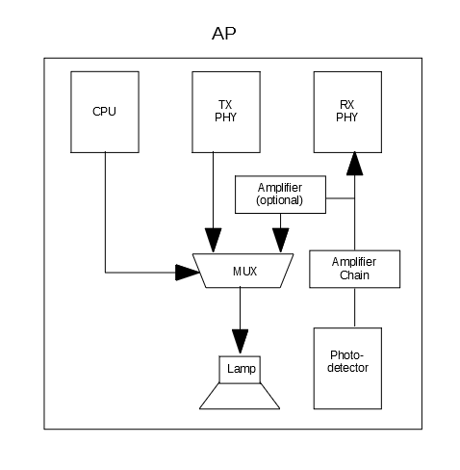
Relayed CCA on PHY
Due to the nature of light communications, the CCA mechanism will not work on STA side.
The relayed CCA mechanism relies on the AP that detects the transmission from any STA and inform all STAs.
CCA busy is disseminated via retrasmitting the received packet from a STA.
The retransmission happens on the analog stage, hence reduces latency.

Slide 3
Support on MAC
STA side: check transmission by AP
A STA checks if there is relayed CCA session on the DL channel all the time.
An ongoing relayed CCA session initiated by the AP means the medium is “CCA busy”.
The STA will stop backoff procedure when the relayed CCA session is valid and defer to the end of the relayed CCA session.
AP side: retransmission of received packet
Retransmit the received signal from the RX immediately, with a few nano seconds’ delay.

Slide 4
Channel access with virtual CCA
Delay (ns)
Delay (ns)
Delay (ns)
AP
Retransmission
Packet 1
Packet 2
Retransmission Packet 3
STA1
Packet 1
Relayed CCA Busy
STA2
Backoff
Relayed CCA Busy
Packet 3

