Slide 1
Tx FD Window Design for Secure LTF
Date: 2020-12-16
Authors:

Slide 2
Tx FD Window Design for Secure LTF
In this presentation, we evaluate performance of various Tx frequency-domain (FD) windows with OFDM for MMSE sample-by-sample attack [1] and Sphere Decoder + successive interference cancellation (SIC) attack [2]:
  Rectangular window [3]
  Raised-cosine (RC) window [4]
  Flat Top window

Slide 3
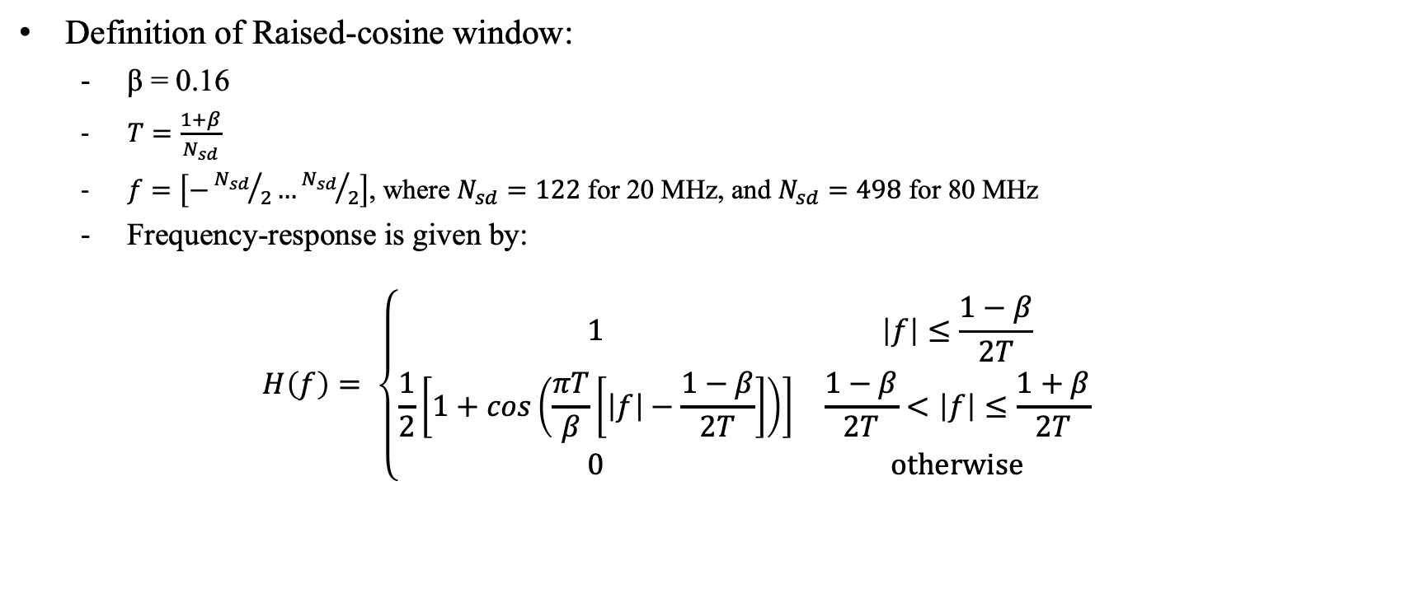
Tx Frequency-Domain Window: Raised-Cosine
Definition of Raised-cosine window:
  β = 0.16
  $T=\frac{1+β}{N_{sd}}$
  $f=\left[−{N_{sd}}/2…{N_{sd}}/2\right]$, where $N_{sd}=122$ for 20 MHz, and $N_{sd}=498$ for 80 MHz
  Frequency-response is given by:
  $$H\left(f\right)= \left\{\begin{matrix}1 & \left|f\right|≤\frac{1−β}{2T} \\ \frac{1}{2}\left[1+cos\left(\frac{πT}{β}\left[\left|f\right|−\frac{1−β}{2T}\right]\right)\right] & \frac{1−β}{2T}<\left|f\right|≤\frac{1+β}{2T} \\ 0 & \text{otherwise}\end{matrix}\right.$$

Slide 4
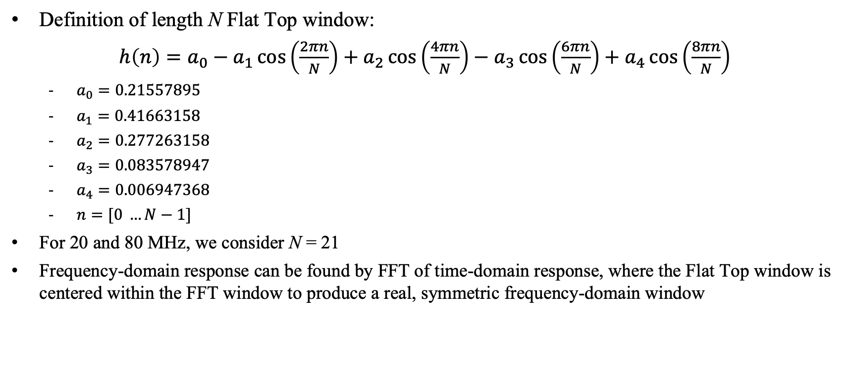
Tx Frequency-Domain Window: Flat Top
Definition of length N Flat Top window:
$h\left(n\right)=a_{0}−a_{1}\cos\left(\frac{2πn}{N}\right)+a_{2}\cos\left(\frac{4πn}{N}\right)−a_{3}\cos\left(\frac{6πn}{N}\right)+a_{4}\cos\left(\frac{8πn}{N}\right)$
  $a_{0}=0.21557895$
  $a_{1}=0.41663158$
  $a_{2}=0.277263158$
  $a_{3}=0.083578947$
  $a_{4}=0.006947368$
  $n=[0 …N−1]$
For 20 and 80 MHz, we consider N = 21
Frequency-domain response can be found by FFT of time-domain response, where the Flat Top window is centered within the FFT window to produce a real, symmetric frequency-domain window

Slide 5
Tx Frequency-Domain Window: Impulse Response
Time-domain response: 20 MHz
Time-domain response: 80 MHz

Slide 6
Tx Frequency-Domain Window: Frequency Response
Time-domain response: 20 MHz
Time-domain response: 80 MHz

Slide 7
Tx Frequency-Domain Window: Spectrum
Spectrum with window: 20 MHz
Spectrum with window: 80 MHz
A time-domain window (ex: RevMD D4.0 17-4) is applied to 6.4 us Secure LTF signal to shape spectrum

Slide 8
Tx Frequency-Domain Window: Bandwidth Comparison
Ranging accuracy is approximately proportional to inverse of signal BW (rule of thumb) ⇒ larger BW is better!
Tx FD Window | 20 MHz: BW (10 dB) | Relative BW to Rectangular | 80 MHz: BW (10 dB) | Relative BW to Rectangular
Rectangular | 19.4 MHz | 100% | 78.4 MHz | 100%
Raised-cosine | 17.1 MHz | 88.1% | 69.7 MHz | 88.9%
Flat Top | 19.1 MHz | 98.5% | 78.2 MHz | 99.7%

Slide 9
MMSE Sample-by-Sample Attack
Simulation assumptions:
  CBW = 20 MHz (N_{FFT} = 128, N_{sd} = 122), CBW = 80 MHz (N_{FFT} = 512, N_{sd} = 498)
  SNR = 40 dB
  i.i.d. AWGN noise
  Constellations: 4096QAM
  Tx FD windows: Rectangular, Raised Cosine, Flat Top – all windows are normalized to same RMS value
  Correlation over entire LTF symbol
  Time advance of signal: Ta = 2, 3, 4

Slide 10
MMSE Sample-by-Sample Attack: SNR=40 dB, Ta=2
Flat top window has much better performance than either Rectangular or RC windows

Slide 11
MMSE Sample-by-Sample Attack: SNR=40 dB, Ta=3
Flat top window has much better performance than either Rectangular or RC windows

Slide 12
MMSE Sample-by-Sample Attack: SNR=40 dB, Ta=4
Flat top window has much better performance than either Rectangular or RC windows

Slide 13
Sphere Decoder + SIC Attack
Simulation assumptions:
  CBW = 20 MHz (NFFT = 128, Nsd = 122+DC)
  SNR = 40 dB
  i.i.d. AWGN noise
  Constellations: 64QAM
  Attacker uses OSR = 2 and applies Hamming window
  Sphere decoder based on Matlab toolbox with infinite radius (R = ∞)
  Observation window: To = 75% (M = 96)
  Sphere decoder sizes: 4×4
  Correlation over entire LTF symbol

Slide 14
Sphere Decoder + SIC Attack: SNR=40 dB
Flat top window has better performance than either Rectangular or RC windows

Slide 15
Summary
Simulation results show that Tx FD windows (Raised-cosine and Flat Top) improve cross-correlation against both MMSE-based sample-by-sample and Sphere Decoder + SIC attacks when compared to Rectangular window
Flat Top window shows the best security performance of three windows
Flat Top window also maintain large transmission BW (~98-99% of bandwidth of rectangular window ⟹ results in excellent ranging accuracy
Finally, Flat Top window is well-known and easy to implement

Slide 16
Proposal
ISTA/RSTA shall support frequency domain windowing of Rectangular window and Flat Top window
  Rectangular window is default
Use of Flat Top window:
  Optional and determined by transmitter
  Receiver may recommend transmitter to use Flat Top window
  Future-proofs device in case lower correlation is needed to provide improved security
Transmit system components may have impact on FD windowing:
  Suggest to have no compliance testing for ISTA/RSTA Tx window ⇒ honor system
Side note: for Flat Top window, ISTA/RSTA receiver processing may ignore effects of window with very minimal performance loss; thus, no additional complexity required to support Flat Top window at ISTA/RSTA Rx

Slide 17
References
[1] 802.11-20/1373r0 Attacks to Fully Random OFDM Sounding Signal
[2] 802.11-20/0964r0 Attacks to Fully Random 64QAM Sounding Signal
[3] 802.11-20/0836r0 11az Secure LTF Design
[4] 802.11-20/1855r0 Further Updated on 11az Secure LTF Design

