Slide 1
Limiting BA Bitmap Subfield Length
Date: 2020-11-09
Authors:

Slide 2
Introduction
BlockAck in 802.11be
  Negotiated BA buffer size to be smaller than or equal to 1024
  512-bits and 1024-bits BA bitmap in R1
Potential airtime inefficiency in 802.11be
  Originator sets a large duration field covering the largest BA bitmap length according to the negotiated buffer size
We propose BA Bitmap Subfield Length limitation to alleviate inefficiency caused by “reserved” but “not used” airtime

Slide 3
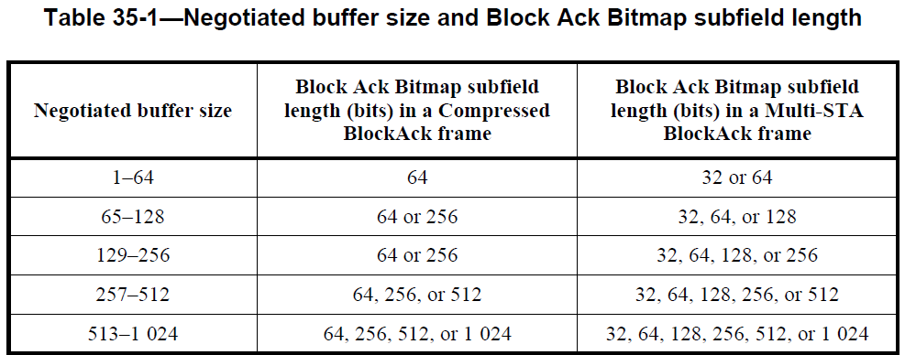
Motivation
  11ax D8.0
  The originator of a A-MPDU that includes QoS Data frames that solicits an immediate BlockAck frame response that solicits acknowledgment shall set the Duration field accounting for the largest BlockAck Bitmap length based on negotiated buffer size.
11be D0.1

Slide 4
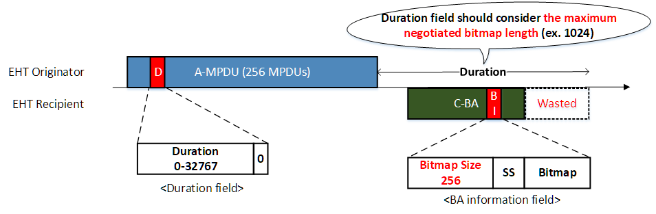
Motivation
Example
  Negotiated buffer size = 1024
  Originator transmits A-MPDU with 256 MPDUs
  Originator shall set the duration field considering 1024 BA bitmap
  Recipient can choose its BA bitmap length as 256 bitmap
The mismatch of the largest BA bitmap length based on the negotiated buffer size and the actual BA bitmap length selected by the recipient causes airtime waste
Notes:
문제: 몇 개를 보내는가에 상관이 없이 duration field가 결정됨.

Slide 5
Wasted Airtime
The amount of wasted airtime comes from the discrepancy of the largest BA bitmap length based on the negotiated buffer size and the actual BA bitmap length selected by the recipient
Wasted airtime
  Non-HT duplicate PPDU, 6Mbps or 24Mbps
  Negotiated buffer size = 1024

Slide 6
Proposal
Let the originator set the duration field based on the upper bound of BA bitmap length required for the recipient
Upper bound of BA bitmap length
  In 11ax, the upper bound of BA bitmap length is determined based on the negotiated buffer size
  In 11be, we can allow the originator to limit the upper bound of BA bitmap length of the recipient
We propose two options
  [Option1] BA bitmap length upper bound per BA negotiation
    Originator sets “Max BA bitmap length” field
    For example, the field can be included in ADDBA request
    Cons
      Originator cannot aggregate MPDUs more than the “Max BA bitmap length”
  [Option2] BA bitmap length upper bound per BA (preferred)
    The number of aggregated MPDUs can vary

Slide 7
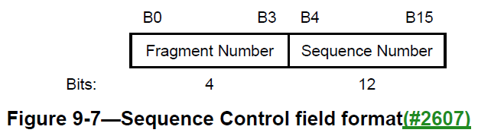
BA Bitmap Length Upper Bound per BA
[Option2a] Explicit way
  The originator includes an indication of upper bound of BA bitmap length
  The recipient follows the indication
  Example: Upper bound of BA bitmap length in Sequence Control field
    (26.3.2.4 Level 3 dynamic fragmentation in 802.11ax D8.0) The originator shall set the Fragment Number subfield of each MPDU to a value less than 4
    We can use MSB 2-bit to indicate upper bound of BA bitmap subfield length
Fragment Number |  |  |  | Upper Bound of BA bitmap length
B3 | B2 | B1 | B0
0 | 0 | Any |  | 64
0 | 1 |  |  | 256
1 | 0 |  |  | 512
1 | 1 |  |  | 1024

Slide 8
BA Bitmap Length Upper Bound per BA
[Option2a] Explicit way
  Another example
    Using HT control field to indicate BA bitmap length upper bound

Slide 9
BA Bitmap Length Upper Bound per BA
[Option2b] Implicit way
  The originator sets the duration field considering the upper bound of BA bitmap length without explicit indication
  The recipient determines its BA bitmap length while satisfying the duration field set by the originator

Slide 10
Summary
We point out the airtime inefficiency problem caused by the discrepancy of the largest BlockAck Bitmap length based on negotiated buffer size and the actual BA bitmap length selected by the recipient
We propose two options for BA bitmap length limitation

Slide 11
SP1
  Do you support in 11be we need a mechanism for alleviating the inefficiency caused by the “reserved by the originator but not used by recipient” time?

Slide 12
SP2
  Do you support in 11be the originator of a A-MPDU that includes QoS Data frames that solicits an immediate BlockAck frame response that solicits acknowledgment to set Fragment Number subfield based on the following table to limit the upper bound of BlockAck bitmap subfield length?
    Upper bound of BA bitmap length shall be less than or equal to the largest BlockAck Bitmap length based on negotiated buffer size
    The recipient shall follow the upper bound of BA bitmap length set by the originator
Fragment Number |  |  |  | Upper Bound of BA bitmap length
B3 | B2 | B1 | B0
0 | 0 | Any |  | 64
0 | 1 |  |  | 256
1 | 0 |  |  | 512
1 | 1 |  |  | 1024

Slide 13
SP3
  Do you support in 11be the originator of a A-MPDU that includes QoS Data frames that solicits an immediate BlockAck frame response that solicits acknowledgment to set Duration field accounting for the Upper Bound of BA bitmap length set by itself?

