Slide 1
UL BW subfield design in Trigger frame

Slide 2
Introduction
There are several contributions about Trigger frame design in 11be [1-3].
We think that Trigger frame in 11be is designed with the consideration of A-PPDU of HE TB PPDU(s) and EHT TB PPDU(s).
That means, the Trigger frame can trigger HE STA(s) and EHT STA(s) at the same time if present.
HE STA receives the Trigger frame as HE Trigger frame. It means the Trigger frame shall be designed with backward compatibility.
EHT STA receives the Trigger frame aligned with 11be spec, for example, supporting larger BW than 160MHz, 16 spatial streams, and 11be RU/MRU allocation that cannot be understood by HE STA.
Based on the assumption, here we focus on UL BW subfield design of Trigger frame in 11be.

Slide 3
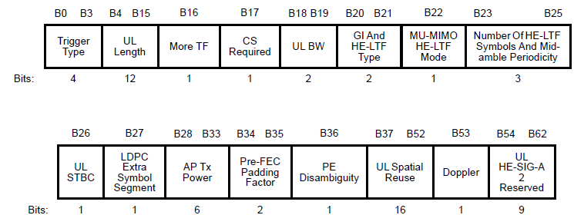
Common info field
Common Info field of Trigger frame in 11ax
UL BW subfield is included in B18-19 of Common Info field.
Common Info field of Trigger frame in 11be
It can be used for HE STA. So we can’t revise the used subfields for HE STA. We only can touch the reserved bits (B54~B63).
For EHT STA, Trigger frame has to indicate over 160MHz UL BW.

Slide 4
UL BW subfield design (1/2)
HE STA reads UL BW subfield (B18-19) to transmit HE TB PPDU as in HE Trigger frame.
And there are two ways to indicate UL BW for EHT STA
Option1: use the same UL BW subfield except 320MHz
In case of UL BW of TB A-PPDU <=160MHz
Set ‘Wide UL BW Indication’ subfield (e.g. B63) to ‘0’
B18~19 indicates the total UL BW of TB A-PPDU
AP can’t point out each UL BW for HE STA and EHT STA. But there may be no problem because each TB PPDU is transmitted according to the each RU Allocation in User Info field.
In case of UL BW of TB A-PPDU = 320MHz
Set ‘Wide UL BW Indication’ subfield (e.g. B63) to ‘1’
B18~B19 is used for HE STA as in HE Trigger frame
‘Wide UL BW Indication’ subfield is needed. It consists of 1 bit (for 320MHz) or 2 bits (for 320MHz and the future extension).

Slide 5
UL BW subfield design (2/2)
There are two ways to indicate UL BW for EHT STA (Cont’d)
Option2: use two separate UL BW subfields
B18~19 only indicates ‘HE’ UL BW for HE TB PPDU(s)
New ‘EHT UL BW’ subfield are defined for EHT TB PPDU(s).
It indicates BW of EHT TB PPDU or BW of total TB A-PPDU. If the former, it may need the variable size’s BW indication (e.g. (300MHz EHT TB PPDU and 20MHz HE TB PPDU, for total 320MHz TB A-PPDU)
The EHT UL BW subfield are defined in some reserved bits. We can use B54~62 (UL HE-SIG-A2 reserved) or Extended Common Info field by setting Special AID in User Info field [3].
AP can announce each own BW for HE STA and EHT STA. But the arrangement rule is needed between HE’s BW and EHT’s BW in total TB A-PPDU’s BW, for example, BW for HE PPDU is primary located and then BW for EHT PPDU is followed.
It needs two UL BW subfields for HE TB PPDU and EHT TB PPDU, separately, but looks simple to each HE STA and EHT STA.

Slide 6
Conclusion
In this contribution, we discuss how the UL BW of HE/EHT TB PPDU is indicated in Trigger frame in 11be.
We think that the Trigger frame can trigger both of HE TB PPDU and EHT TB PPDU simultaneously.
For that, UL BW subfield of Common Info field shall be defined for HE STA and/or EHT STA.
We slightly prefer option1 to set ‘Wide BW Indication’ subfield for 320MHz BW and reuse the existed UL BW subfield for both of HE TB PPDU(s) and EHT TB PPDU(s).

Slide 7
Reference
[1] IEEE802.11-20/0831r2, “Trigger frame for frequency-domain A-PPDU support”, Jonghun Han
[2] IEEE802.11-20-0840r3, “Backward compatible EHT Trigger frame”, Ming Gan
[3] IEEE802.11-20-1429r2, “Enhanced Trigger frame for EHT support”, Steve Shellhammer

Slide 8
Straw poll 1
Do you agree to add the following text to the TGbe SFD?
A Trigger frame can trigger both of HE TB PPDU and EHT TB PPDU at the same time.
Y/N/A

Slide 9
Straw poll 2
Do you agree to add the following text to the TGbe SFD?
A Trigger frame indicates UL BW for HE TB PPDU and/or EHT TB PPDU?
Y/N/A

Slide 10
Straw poll 3
Do you agree to add the following text to the TGbe SFD?
UL BW subfield (B18~B19) in Common Info field of the Trigger frame indicates total UL BW of HE TB PPDU and/or EHT TB PPDU when the BW is 20/40/80/160MHz?
Y/N/A

Slide 11
Straw poll 4
Do you agree to add the following text to the TGbe SFD?
‘Wide UL BW Indication’ subfield is defined in Common Info field of the Trigger frame to indicate whether UL BW is equal to or larger than 320MHz or not.
This subfield is for EHT STA and reserved for HE STA.
Y/N/A

Slide 12
Straw poll 5
Do you agree to add the following text to the TGbe SFD?
‘EHT UL BW’ subfield is newly defined in Trigger frame, separately with ‘(HE) UL BW’ subfield (B18-19). It consists of 3bits and indicates 20/40/80/160/320MHz BW for EHT TB PPDU.
Y/N/A

