Slide 1
Random Access for 11be
Date: 2020-11-30
Authors:

Slide 2
Outline
Key Points on Random Access
Proposal: Random-Access NFRP (RA-NFRP) for 802.11be
  RA-NFRP Principle
  Illustration
  RA-NFRP Efficiency versus UORA
  Scalability towards 802.11 technologies or services
Annex
  Legacy 802.11ax UORA procedure
  Legacy 802.11ax NFRP procedure
  Details on RA-NFRP (advantages, example format)

Slide 3
Key points
UORA provides low efficiency [1]:
  empty RUs 37%, collision 26%, efficiency 37%
  lost random RUs (either unused or collided) occur on large transmission durations
Random Access still required for 11be !
  Many contributions about 11be design TF report that random-access support becomes now difficult : 11/831r1, 11/840r0, 11/1192r0…
Build a RA based on NFRP:
  “Triggered PPDU” is universal (only energy in RU Tone set)
  By offering greater efficiency

Slide 4
Proposal: Random-Access NFRP (RA-NFRP)
RA-NFRP Principle: (details in Annex slide 13)
  Based on 802.11ax NFRP with following modifications :
  RA-NFRP TF identified by predefined Starting_AID value
    Typically value 0
    Optionally: 2047 (all stations), or a BSSID index (stations belonging to a BSS)…
  Random Access to access a RU Tone, by a STA :
    1st random phase: STA randomly selects a RU Tone Set Index
    2nd random phase: STA randomly selects a Feedback Status
  Easy Collision detection
    AP considers as correct a feedback where only one RU tone is used (single feedback)
  Next, UL Data transmission:
    AP can schedule (in Basic TF) the responding STAs by the index of RU Tone Set , corresponding to RU Tone Set with a single feedback

Slide 5
RA-NFRP Illustration
Random access:
- select random RU Tone Set index (e.g. using backoff)
- FEEDBACK_STATUS is random
RA-NFRP identification :
starting AID = 0, 2047, …
Basic TF scheduling:
AP schedules STAs using RU Tone Set index
AP
AP
AP
NFRP Trigger
Frame
(starting AID = 0)
NDP (sent by STA₁)
A
Basic Trigger
Frame
(schedule RUs by using RU_TONE_SET_INDEX )
Data frame (sent by STA₁)
Multi-STA BA
26 tone RU
B
Primary 20MHz
channel
(242 tones)
collided
C
Collided Data frame
(sent by at least 2 STAs)
26 tone RU
NDP (sent by STA₂₀)
D
NDP (sent by STA₂)
SIFS
SIFS
SIFS
SIFS
Case | NDP Feedback detection by AP | Comment
A | correct (single feedback) | One single STA transmits a TB NDP Feedback
B | Not used (no feedback) | No further RU scheduled
C | correct !! (2 STAs use same feedback value) | RA-NFRP can not detect the error ! : collided data will not be acknowledged
D | Error (two feedbacks) | 2 tone sets used as Feedback (tones for 0 and 1, so feedback=3)

Slide 6
RA-NFRP Efficiency
RA-NFRP is a very efficient RA mechanism :
  Early Collision detection:
    performed on NDP feedback (not during Data transmission) : reduce wasted data RUs
  Enhanced collision detection:
    half of collisions are detected (e.g. when RU Tone Sets made of two groups of tones)”
  Detection of Empty NDP RU will avoid having empty data RU
 |  |  | Efficiency for RA scheme
 | Empty NDP RUs | Collided NDP RUs | Empty data RUs | Collided data RUs | Global efficiency
UORA | - | - | 37% | 26% | 37%
RA-NFRP + Basic TF | 37% | 26% | 0 | 26% / 2 = 13% | 74%
The 37% of empty NDP Tones are not scheduled for data
26% of Aloha collision, halfed by 2-bit feedback
= 37 / (37 + 26/2)

Slide 7
RA-NFRP scalability
As only energy is received as NFRP feedback, AP needs to know what kind of station it will address.
There is room in ‘User Info’ field of NFRP format to signal the technologies to schedule/trigger subsequent transmissions:
  9 bits in the reserved field (see examples in Annex slide 16)
  Could be used to signal a given technology …
    Basic 11ax TF, Basic 11be TF, future version, …
    or given service or usage :
    multi-AP TF…

Slide 8
Summary
This document presented a Random Access procedure for 11be, on top of NFRP mechanism.
Efficiency is close to 74%, extremely greater than the legacy UORA (37%).
Scalable to future versions of the 802.11 standard
We think 802.11be would largely benefit from such mechanism.

Slide 9
Straw Poll #1
Do you support that 802.11be shall define a more efficient Random-Access mechanism ?
  NFRP-based solution is one candidate.
Results: Y/N/A

Slide 10
Annex

Slide 11
Recall: UL OFDMA-based Random Access (UORA)
UORA allows a non-AP HE STA to access one of a number of resource units designated for random access by the HE AP [1].
UORA provides low efficiency:
  theoretical probability for random access distributions (Slotted-Aloha type):
    empty RUs 37%, collision 26%, efficiency 37%
  lost random RUs (either unused or collided) occur on large transmission durations !
  802.11be needs a more efficient RA mechanism !

Slide 12
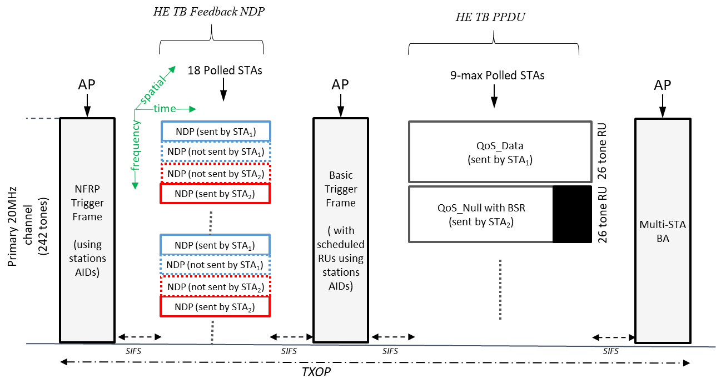
Recall : 802.11ax NFRP procedure
NDP Feedback Report Poll (NFRP) TF is used to collect feedback from a range of associated STAs [1]:
  STAs are identified by a range of AIDs, starting from value of ‘Starting_AID’ field
  Scheduled STAs select a tone set according to STA’s RU_TONE_SET_INDEX ([1] table 27-32), and modulate tones of the tone set according to the FEEDBACK_STATUS (0/1) to emit.
Later, based on received NDP feedbacks, AP may solicit (e.g. via Basic TF for UL MU) some responding STAs
Illustration:
e.g. Feedback is 0
e.g. Feedback is 1

Slide 13
NFRP TF format (802.11ax)
340

Slide 14
RA-NFRP Advantages
Fully compliant with legacy 802.11ax format :
  Keep 11ax design format
    ‘Starting AID’ field takes value 0 (optionally 2047…), any predefined AID value outside the range of AID assigned by AP to associated stations
Very efficient random-access mechanism
  random access is moved to the short time NDP Feedback report procedure
  AP schedules only used RU Tone Set:
    no empty data RUs are met in the subsequent UL MU operation
    Possibly still collisions on UL data RU, but half of the collisions compared to UORA(case C of previous slide)
Tips:
  AP later determines the STA AID (at final stage upon receiving HE TB data PPDU), but this is not an issue.

Slide 15
RA-NFRP TF format
TF Techno bitmap
This field tells
the inquired technology.
Value | Description
0 | Resource request
1 | Universal request
2-15 | Reserved
B0 B5 | B6 | B7 | B8
Reserved | … | EHT | HE
Bits: 6 | 1 | 1 | 1
  Keeping conventional Feedback Type (0) or this new value (1) is TBD

Slide 16
Reference
[1]. Draft P802.11ax_D8.0
[2].

