Slide 1
UORA Enhancements to address RTA
Date: 2020-12
Authors:
Name | Affiliations | Address | Email
Oren Kedem | Huawei | Israel | oren.kedem@huawei.com
Boyce Bo Yang |  | Nanjing, China | yangbo59@huawei.com
Lily Yunping Lyu |  | Nanjing, China | lvyunping@huawei.com
Wayne Qiuwei |  | Nanjing, China | wayne.qiuwei@huawei.com
Notes:
September 2012

Slide 2
Introduction
11be PAR is targeting to address Real Time Application (RTA)
Targeted RTA (e.g. URLLC) require 1-10ms E2E latency [1].
RTA traffic is characterized also with non-periodic data (e.g. Human Safety, Sensors Alerts, Machine Control etc) .
Current methods to send RTA non-periodic data are :
  EDCA Link access
  UL/DL Scheduling
EDCA and Scheduling doesn’t address RTA non-periodic traffic effectively and efficiently.
Contribution proposes enhancements to address the above.

Slide 3
Impairments of UL/DL Scheduling
Allocating “Protected Service Periods” for RTA traffic is useful in case traffic characteristics (i.e. arrival time) is known in advance.
In case the RTA traffic is non-periodic and with non-anticipated time arrival, scheduling become very non efficient as many of the allocations might not being used by the allocated STA.
Sending RTA traffic in OFDMA UL transmission require sending BSR in advance and waiting for the UL allocation, hence it is time consuming and doesn’t address the stringent RTA latency requirements.

Slide 4
Enabling the RTA STA a Continues Opportunity Transmissions
In case of low E2E Latency (1-2ms), STA must reduce Contention Awaiting time [2] and gain transmit opportunity immediately after data is in queue.
However, if Wireless Medium is occupied, at least full TXOP should pass before RTA STA could contend the medium again.
Low Latency is addressed only if RTA STA could be able to transmit its RTA data immediately when medium is free or busy.

Slide 5
TXOP Initiation and Ownership
In EDCA TXOP operated by the STA, only the initiating STA is served hence is non-efficient and bad for RTA compared to AP TXOP where several STAs can be served.
Nevertheless, EDCA STA TXOP cannot be totally avoided since:
  STA initiated TXOP is the only way STA can initiate transmission.
  AP cannot continuously hold the wireless medium with AP TXOPs
➔ Suggested Solution:
  TXOPs obtained by STAs should be granted to AP ownership.
  Granted TXOPs serve the initiating STA BSR as well as other STAs traffic.

Slide 6
MU RDG (11ax)
RDG Protocol allow RDG responder AP to use HE MU PPDU and Trigger based UL PPDU with multiple STAs while including the RD initiator.
Throughput gain at AP side (without reducing the initiator’s bandwidth could be more then doubled.
IEEE P802.11ax™/D8.0
“If the RD initiator is an HE STA and the RD responder is an HE AP, the RD response burst may contain one or more Basic Trigger frames. The Basic Trigger frames shall trigger the RD initiator and at least one other STA in a full bandwidth UL MU-MIMO transmission.”
“An RD responder that transmits a Basic Trigger frame …. and shall allocate a number of streams for the RD initiator that is not smaller than the number of streams of the RD initiator's last PPDU.”
“The RD responder shall not transmit any PPDUs with a CH_BANDWIDTH that is wider than the CH_BANDWIDTH of the PPDU containing the frame(s) that delivered the RD grant. “
MU RDG can be used as the TXOP Granting mechanism

Slide 7
UORA Group Allocations
11ax UL OFDMA-based random access (UORA) allow multiple STAs to randomly access the medium in a joint TB PPDU transmission.
UORA is effectively used when AP doesn’t know all station BSR. In this case RA-RU is allocated for STAs to contend.
However, 11ax UORA can be allocated only to all “Associated” or all “Unassociated” group STAs.
UORA should provide a Group Allocation mechanism to prioritize RTA STAs.
AP could use UORA Group Allocations in every its obtained/granted TXOP

Slide 8
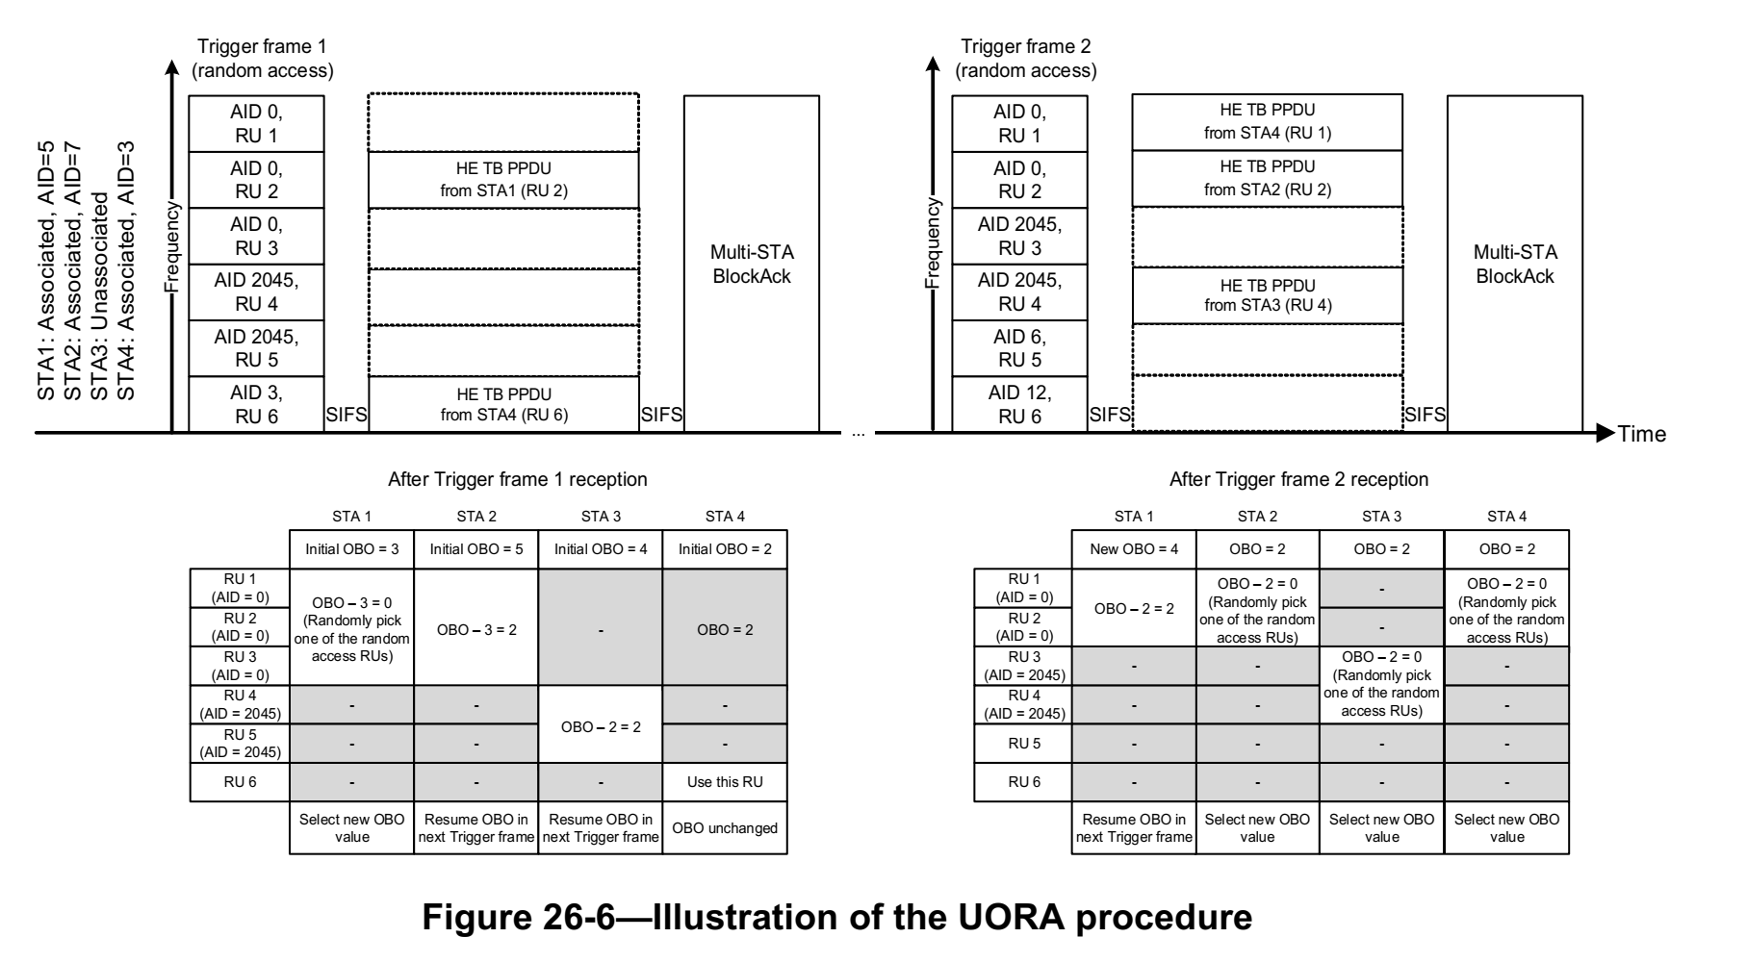
UORA Mechanism (11ax)
Under UORA, STA manages OBO random backoff counter on received RA-RU and transmit its data.
Utilizing UORA reduce EDCA Contention Time.

Slide 9
Suggested EHT improvements for UORA
Define Group-AID values intended for RA-RU allocated for RTA STA. RA-RU with Group-AID could be contended only by stations members of that group.
HE UORA doesn’t differentiate traffic types nor Access Categories.
Allow Group-AID allocation to serve Access Categories (AC) as in EDCA
Define different and dynamic EOCWmin and EOCWmax values for multiple ACs.

Slide 10
Enhanced UORA – Allocating RA-RU Group AID
QoS STA is getting served per allocated G-AID
Note: In this example, STA has separate OBOs for each RA-RU type and group-AID

Slide 11
Setup
During Association and per QoS agreement, AP exchange with STA its requirements and the G-AIDs it is admitted to contend.

Slide 12
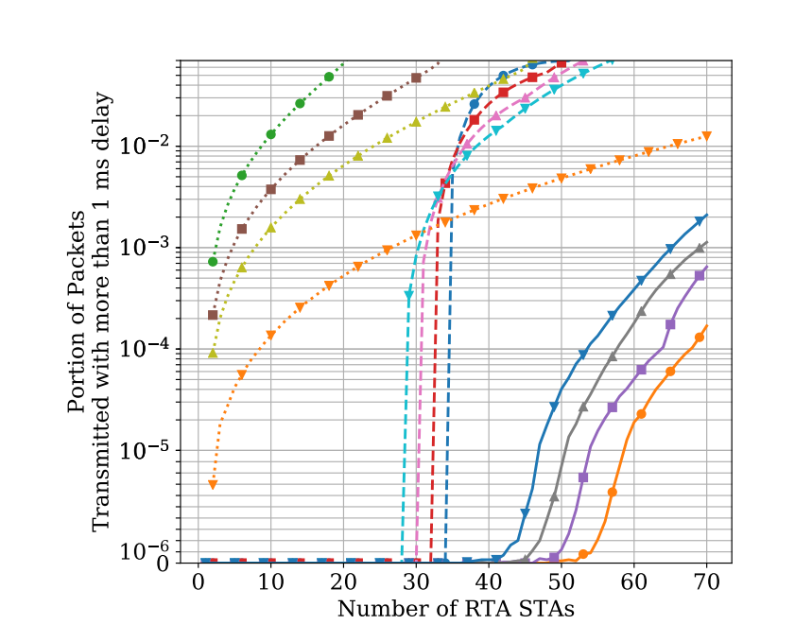
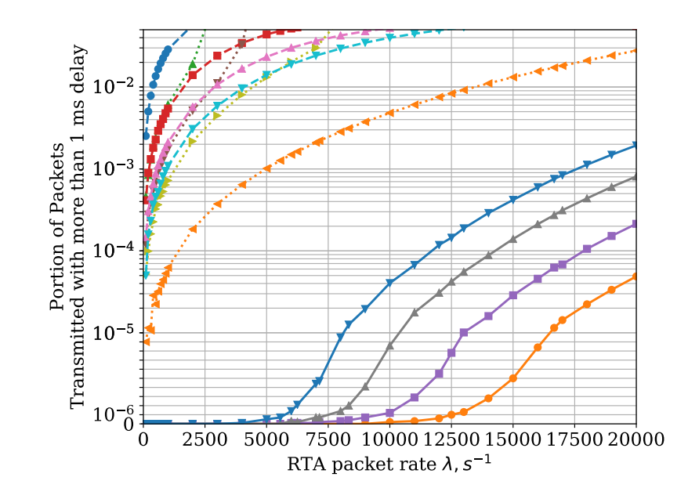
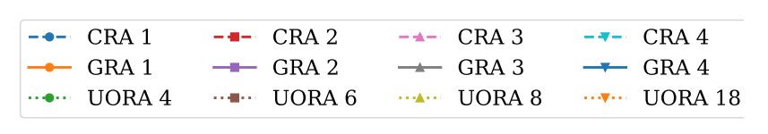
Performance with UORA Group-AID
UORA is based on ALOHA with maximum efficiency of about 35% (1/e).
Utilizing Group-AID allocations increase the number of RTA STA could be supported and improve performance in terms of both the probability of latency.
[3] shows major performance improvements in case OFDMA UORA incorporates Group-AID allocations.
11ax based UORA Resource allocation
Improved algorithm based on 11ax UORA unicast allocations
UORA Resource allocation incorporating Group RA-RU

Slide 13
Conclusion
EDCA Link access is the only method for STA to initiate traffic transmission.
Performance are increased if STA TXOPs is granted to AP that utilize DL MU PPDU and Trigger Based UL MU PPDU.
To meet RTA requirements and per network configuration, TXOPs obtained by STA should be granted to AP while initiator BSR request are being kept.
11ax UORA functionality could be enhanced for RTA by the following:
  Define “Group AID” values for RA-RU allocated for QoS stations, RA-RU with Group AID could be contended only for stations included in that group.
  Define the support for data transmission in all Access Categories.
  Define different set values of EOCWmin and EOCWmax to priorities various ACs.

Slide 14
Straw Poll 1
Do you agree that 11be SFD will include network configuration option in which STA obtained TXOP is granted to AP while keeping the RDG Initiator throughput performance ?
Yes
No
Abstain

Slide 15
Straw Poll 2
Do you agree that 11be SFD will include UORA enhancements for RTA STA by allowing Group-AID allocations and supporting Access Categories ?
Yes
No
Abstain

Slide 16
References
[1] 11-19-1207-04-00be-Views on Latency and Jitter Features in TGbe
[2] 11-19-0762-01-00be- Latency analysis for EHT
[3] [IEEE Publications] Enabling Massive Real-Time Applications in TGbe

