Slide 1
Two LOs for 320 MHz Transmission
Date: 2020-11-24
Authors:
Name | Affiliations | Address | Phone | email
Ross Jian Yu | Huawei |  |  | ross.yujian@huawei.com
Ming Gan | Huawei
Mengshi Hu | Huawei
Guogang Huang | Huawei
Mei Huang | Huawei
Wei Ruan | Huawei
Wook Bong Lee | Samsung |  |  | wookbong.lee@samsung.com

Slide 2
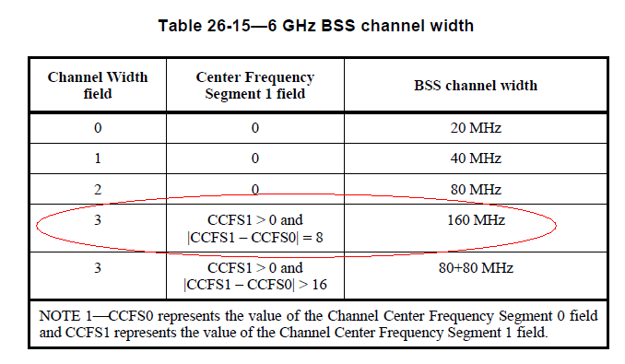
One or Two LOs in 11ac/ax
  In 11ac and 11ax, both 80+80 (two RF local oscillators (LO)) and 160 MHz (one or two RF LOs) are supported [3]:
      Transmit signals with TXVECTOR parameter CH_BANDWIDTH set to CBW160 or CBW80+80 may be generated using two separate RF LOs, one for each of the lower and upper 80 MHz frequency portions.
      NOTE—The signal phase of the two 80 MHz frequency portions might not be correlated
  There are some implementations in the market which fulfills 160 MHz (contiguous) transmission using two LOs.
    BSS channel width 160 MHz
    The Tx procedure still follows the 160 MHz (single segment) case.

Slide 3
One or Two LOs in 11ac/ax
  At the Rx side, if the Rx applies a single CFO tracker, it suffers SNR degradation compared with either:
    Two LOs at the Tx side, two CFO tracker at the Rx side, or
    Single LO at the Tx side, single LO tracker at the Rx side
Delta CFO between two LOs | SNR loss at the Rx
50Hz | Max 3dB
200Hz | >8dB
400Hz | >10dB

Slide 4
One or Two LOs for 320MHz Transmission in 11be
  Similar things happen for 11be regarding 320MHz transmission, one LO case or two LO case. Now in the PDT [2], the following paragraph is TBD.
    Transmit signals with TXVECTOR parameter CH_BANDWIDTH set to CBW320 may be generated using two separate RF LOs, one for each of the lower and upper 160 MHz frequency portions.
    NOTE 2—The signal phase of the two 160 MHz frequency portions might not be correlated.
  Fulfill 320MHz using two LOs has the following benefits:
    Low complexity and low cost regarding RF designs
    Enable flexible change of the mode regarding two 160MHz Multi-link operation, single 160MHz larger size MIMO (e.g., 4 SS) and two LO 320MHz (e.g., 2SS) depending on the specific country/region and scenarios.
    LPI transmit power limitation can be higher in 320MHz compared to 160MHz.

Slide 5
One or Two LOs for 320MHz Transmission in 11be
  Similar SNR loss at the Rx side if the Rx applies single CFO tracker whilst the Tx transmits over 320MHz using two LOs. It is better to clearly define how many LOs the Tx implement if the Tx supports 320MHz transmission, so that the Rx can choose to implement one or two CFO trackers:
    e.g., Add NumberofLO indication:
      Set to 0 to indicate one LO 320MHz
      Set to 1 to indicate two LO 320MHz
    Or use CCFS0 and CCFS1 to differentiate one LO or two LO case for the AP.

Slide 6
Straw Poll #1
  Do you agree to add the following into the 11be SFD:
    Transmit signals with TXVECTOR parameter CH_BANDWIDTH set to CBW320 may be generated using two separate RF LOs, one for each of the lower and upper 160 MHz frequency portions.
    NOTE 2—The signal phase of the two 160 MHz frequency portions might not be correlated.
  Y
  N
  A

Slide 7
Straw Poll #1a
  Do you agree to remove TBD (make the color black) of the following paragraph in 36.3.18.3 in P802.11be D0.2?
    Transmit signals with TXVECTOR parameter CH_BANDWIDTH set to CBW320 may be generated using two separate RF LOs, one for each of the lower and upper 160 MHz frequency portions.
    NOTE 2—The signal phase of the two 160 MHz frequency portions might not be correlated.
  Y
  N
  A

Slide 8
References
[1] IEEE P802.11be D0.1
[2] https://mentor.ieee.org/802.11/dcn/20/11-20-1792-00-00be-pdt-tbd-phy-frequency-tolerance.docx, Wook Bong Lee, Samsung
[3] IEEE P802.11ax D8.0

