Slide 1
Reconsideration on STA MAC Address of Non-AP MLD
Date: 2020-09-02
Authors:
Name | Affiliations | Address | Phone | Email
Guogang Huang | Huawei | Shenzhen, China |  | huangguogang1@huawei.com
Yuchen Guo
Yunbo Li
Yiqing Li
Ming Gan
Mengyao Ma
Wei Lin
Notes:
September 2012

Slide 2
Introduction
The following motion is passed
  802.11be supports that if different affiliated APs of an AP MLD have different MAC addresses, then different affiliated non-AP STAs of a non-AP MLD with more than one affiliated STA have different MAC addresses.
  [Motion 112, #SP38, [13] and [99]]
In this contribution, we will point out that different affiliated non-AP STAs of a non-AP MLD with more than one affiliated STA can use the same MAC address as the non-AP MLD MAC address

Slide 3
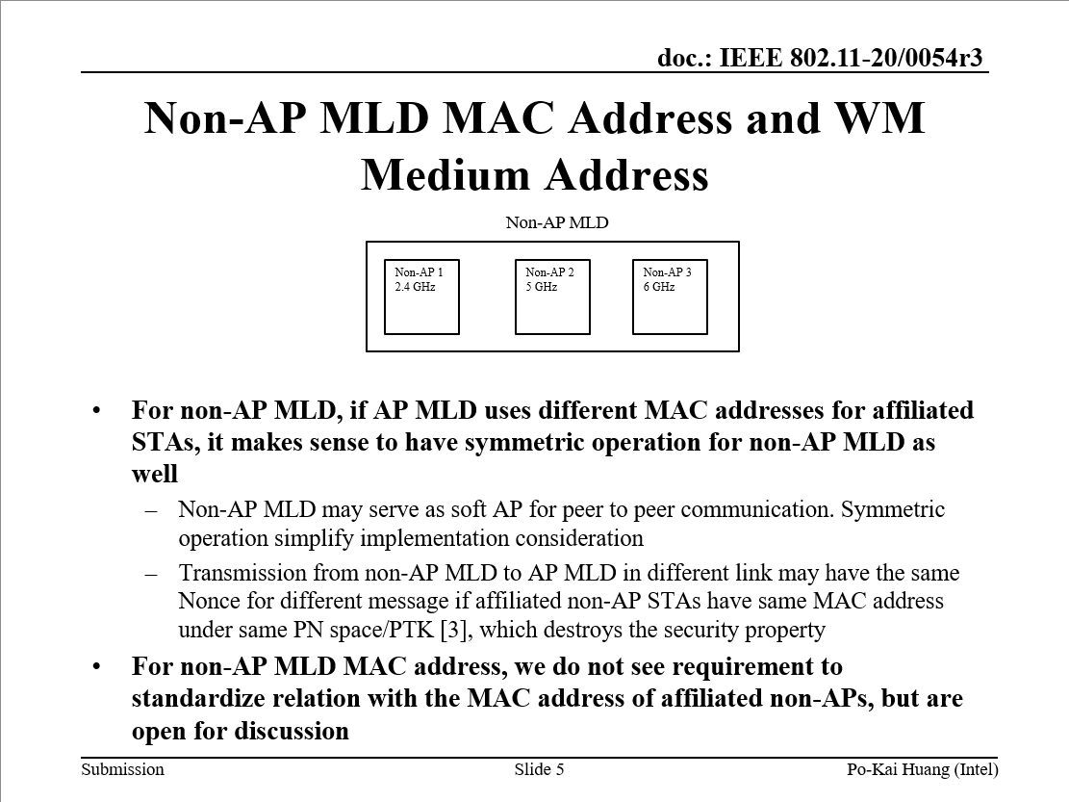
Recap

Slide 4
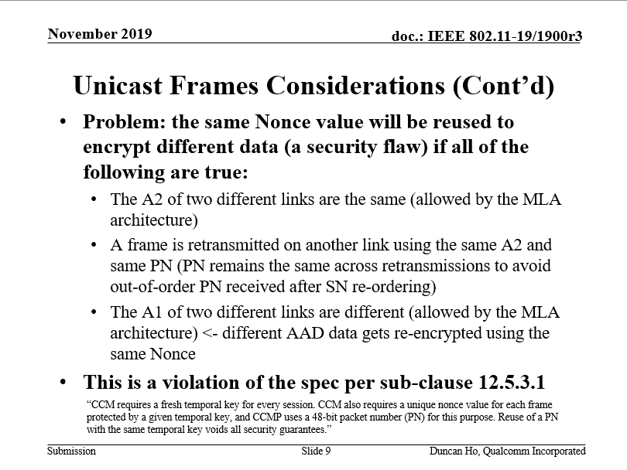
Recap (Cont.)

Slide 5
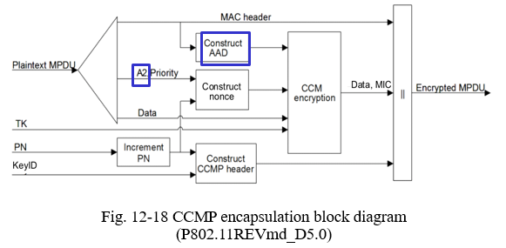
Discussion
Replacing with MLD MAC Address
This logic is not correct. Because the contribution [3] proposes that the same AAD is used

Slide 6
Discussion (Cont.)
“CCM requires a fresh temporal key for every session. CCM also requires a unique nonce value for each frame protected by a given temporal key, and CCMP uses a 48-bit packet number (PN) for this purpose. Reuse of a PN with the same temporal key voids all security guarantees.”
The above text just clarifies that a fresh PN is used to guarantee that a unique nonce value for each frame protected by a given temporal key
But there is an exception
  For the retransmitted MPDU, the PN is not modified. So the same nonce is used for retransmitted MPDU.

Slide 7
Discussion (Cont.)
When affiliated non-AP STAs of a non-AP MLD can use the same MAC address as the MLD MAC address, it makes sense to still use the same nonce for the retransmitted MPDU with the same AAD [3] through another link
It doesn’t violate the security guarantee if the same nonce is applied to the retransmitted MPDU with the same AAD

Slide 8
Benefits
If non-AP STAs affiliated with a non-AP MLD are allowed to use the same MAC address as the non-AP MLD MAC address, it will simplify the following operations
  There is no need to carry STA MAC address info during the authentication, (re-)association and 4-way handshake [4]
  No addressing issue, e.g.
    It can simplify the non-AP MLD’s roaming between a legacy AP and an AP MLD [5].
    It can simplify the TDLS addressing proposed in [6]

Slide 9
Proposal
Option 1. The spec. supports the following two modes:
  Mode 1 (Transparent mode). Non-AP STAs affiliated with a non-AP MLD use the same MAC address as the MLD MAC address
  Mode 2 (Nontransparent mode). Non-AP STAs affiliated with a non-AP MLD use the different MAC address
Option 2. The spec. only supports that non-AP STAs affiliated with a non-AP MLD use the same MAC address as the MLD MAC address

Slide 10
Proposal (Cont.)
For Option 1, we can use a bit within the Multi-link Control field of Multi-link element to indicate which mode (transparent/nontransparent) is used
  0: Transparent
  1: Nontransparent. Then the MAC Address field for the corresponding STA is present in Per-STA Control field of Basic-variant ML element

Slide 11
Conclusions
It is not necessary to require that non-AP STAs affiliated with a non-AP MLD must use the different MAC address.
In other words, non-AP STAs affiliated with a non-AP MLD can use the same address as the MLD address, which has the following benefits
  Simple, i.e. no addressing issue
  Low signaling overhead

Slide 12
Reference
[1] 11-20-0054-03-00be-mld-mac-address-and-wm-address
[2] 11-19-1900-03-00be-mla-security-considerations
[3] 11-20-1545-00-00be-mld-security-considerations.pptx
[4] 11-20-0727-00-00be-mla-link-mac-addresses-security
[5] 11-20-0669-04-00be-mld-transition
[6] 11-20-1692-01-00be-tdls-handling-in-mlo.pptx

Slide 13
SP 1
Do you support that different affiliated non-AP STAs of a non-AP MLD with more than one affiliated STA can use the same MAC address as the non-AP MLD MAC address?
  Y
  N
  A

Slide 14
SP 2
Which option do you support?
  Option 1. The spec. supports the following two modes:
    Mode 1. STAs affiliated the non-AP MLD use the same MAC address as the MLD MAC address
    Mode 2. STAs affiliated the non-AP MLD use the different MAC address
  Option 2. The spec. only supports that STAs affiliated the non-AP MLD use the same MAC address as the MLD MAC address
  Option 1.
  Option 2.
  Abstain

Slide 15
SP 3
Do you agree to use a bit within the Multi-link Control field of the Multi-link element to indicate which mode (transparent/nontransparent) is used
  0: Transparent mode. Then the STA MAC Address field for the corresponding STA affiliated with a non-AP MLD is not present in Per-STA Control field of Basic-variant ML element
  1: Nontransparent mode. Then the STA MAC Address field for the corresponding STA affiliated with a non-AP MLD is present in Per-STA Control field of Basic-variant ML element
  Y
  N
  A

