Slide 1
Further Updates on 11az Secure LTF Design
Date: 2020-12-02
Authors:

Slide 2
Outline
Background
Updates on 64QAM proposal
Security performance analysis of secure LTF modulation scheme:
  Per tone (slicer) detection
  Sequential detection using Viterbi algorithm
  Sphere decoder
  Multi-stage: sample-by-sample attack with time advance
Summary

Slide 3
Background
A joint contribution 20/0836r0 [1] proposed the following changes to secure LTF:
  Secure PN Generation at PHY using AES-128 CTR
  New modulation 64QAM to increase signal entropy
  Per stream phase rotation updated every secure LTF repetition
  Per stream phase rotation angles are the same for all the tones and all the LTFs in one repetition
Simulation results show 64QAM provides good security performance against per tone (slicer) attack and sequential Viterbi attack
Since the proposal was presented, additional attacks have been proposed:
  Frequency-domain sphere decoder attack 20/0964r0 [2]
  MMSE based multi-stage and sample-by-sample attack [3]

Slide 4
Multi-stream Secure LTF Generation
Proposed to change constellation from 64QAM to 64QAM+4PSK:

Slide 5
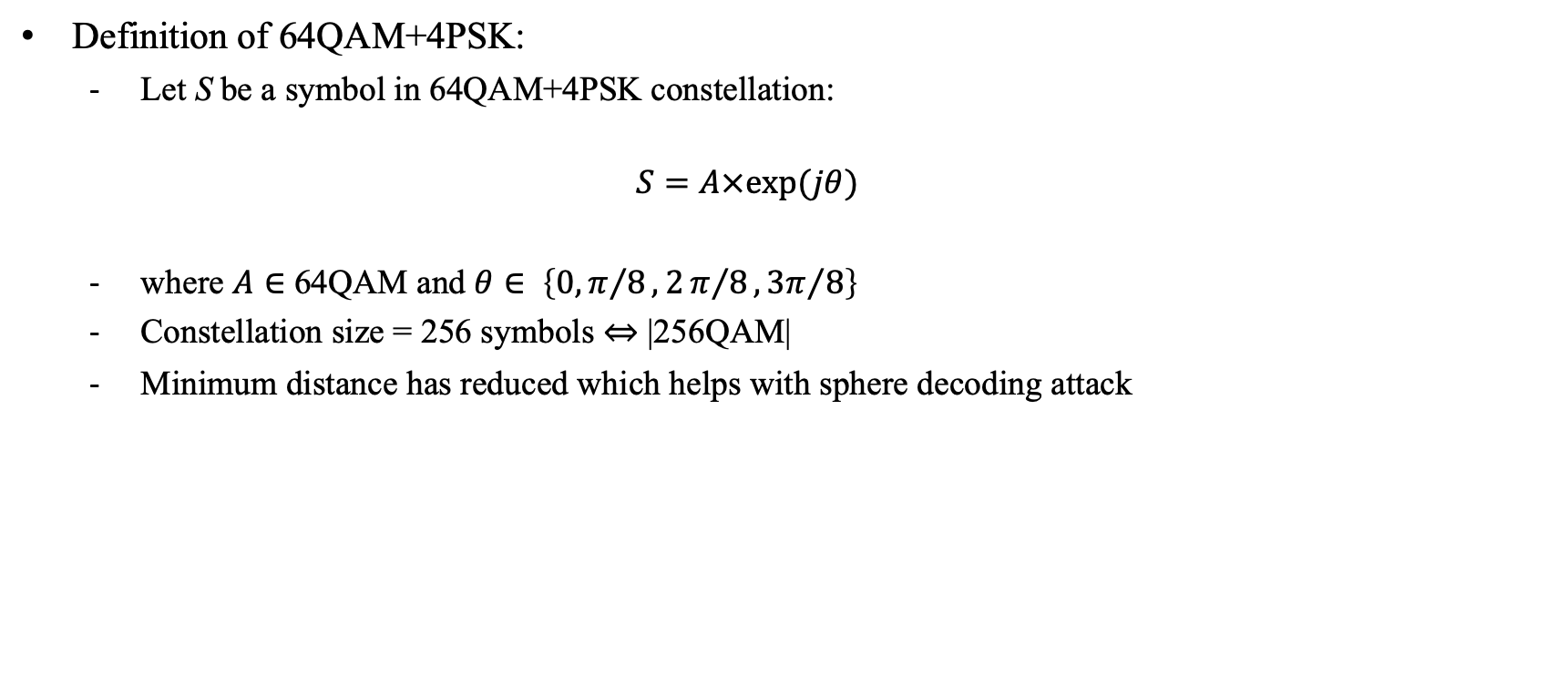
64QAM + 4PSK Constellation (1)
Definition of 64QAM+4PSK:
  Let S be a symbol in 64QAM+4PSK constellation:
  $$S=A×exp⁡(jθ)$$
  where $A∈$ 64QAM and $θ∈ \left\{0,π/8,2π/8,{3π}/8\right\}$
  Constellation size = 256 symbols ⇔ |256QAM|
  Minimum distance has reduced which helps with sphere decoding attack

Slide 6
64QAM + 4PSK Constellation (2)
Constellation:

Slide 7
Per Tone (Slicer) Attack

Slide 8
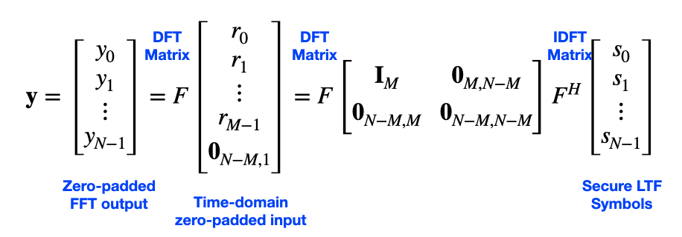
Overview of Per Tone Slicer Attack
Estimation of Secure LTF is based on a partial observation of transmitted signal:
Attacker slices output (map to closest constellation point) of zero-padded FFT
Sliced symbols are then used to generate an attack signal
Lowest complexity attack

Slide 9
Per-tone (Slicing) Attack
Simulation assumptions:
  CBW = 20 MHz (NFFT = 128, Nsd = 122)
  CBW = 80 MHz (NFFT = 512, Nsd = 498)
  SNR = 40 dB
  i.i.d. AWGN noise
  Constellations: 64QAM, 64QAM+4PSK
  ML slicer
  Correlation over entire LTF symbol
  Observation window: To = 25%, 37.5%, 50%, 62.5%, 75%, 87.5%

Slide 10
Per-tone (Slicing) Attack Results: 20 MHz
64QAM+4PSK has slightly better performance than 64QAM

Slide 11
Per-tone (Slicing) Attack Results: 80 MHz
64QAM+4PSK has slightly better performance than 64QAM

Slide 12
Sequential Detection Attack

Slide 13
Overview of Sequential Detection Attack
Maximum likelihood sequence detection (MLSD) is an algorithm that determines the most-likeliest sequence of transmitted symbols
  Solution to MLSD requires a brute-force approach, but it is prohibitively complex (256^{NFFT})
  Near-ML performance can be achieved by using a Viterbi algorithm, which has much lower complexity
Near-ML approach:
  Observe a limited number of time-domain samples over the observation window
  Apply a Hamming window (instead of rectangular window) to limit the spread of ICI
  Calculate zero-padded FFT output
  Calculate ICI impulse response, which are a function of the observation window
  Implement the MLSD using a Viterbi algorithm

Slide 14
Complexity: 64QAM vs. 64QAM+4PSK
Constellation | To | Number of States
64QAM | 75% | 2²⁴
 | 50% | 2³⁶
 | 25% | 2⁷²
64QAM+4PSK | 75% | 2³²
 | 50% | 2⁴⁸
 | 25% | 2⁹⁶
For ICI < -20 dB:

Slide 15
Sequential Detection Attack
Simulation assumptions:
  CBW = 20 MHz (NFFT = 128, Nsd = 122, States = 2¹²)
  CBW = 80 MHz (NFFT = 512, Nsd = 498 , States = 2¹⁶)
  SNR = 40 dB
  i.i.d. AWGN noise
  Constellations: 64QAM, 64QAM+4PSK
  Correlation over entire LTF symbol

Slide 16
Sequential Detection Attack Results: 20 MHz
64QAM+4PSK has better performance than 64QAM

Slide 17
Sequential Detection Attack Results: 80 MHz
64QAM+4PSK has better performance than 64QAM

Slide 18
Sphere Decoder Attack

Slide 19
Overview of Sphere Decoder Attack
Attacker observes a portion of transmitted Secure LTF, passes the received signal through a window (ex: Hamming) to reduce the ICI, and then passes it through a zero-padded FFT
Attacker applies a sphere decoder over consecutive tones to sequentially decode a single tone:
  Sphere decoder attacker assumes that consecutive tones can be model as an equivalent MIMO channel
Attacker then cancels the interference, using successive interference cancellation (SIC), from the decode tone to the remaining tones before applying the sphere decoder to the next set of consecutive tones

Slide 20
Sphere Decoder Attack
Simulation assumptions:
  CBW = 20 MHz (NFFT = 128, Nsd = 122+DC)
  SNR = 40 dB
  i.i.d. AWGN noise
  Constellations: 64QAM, 64QAM+4PSK
  Attacker uses OSR = 2 and applies Hamming window
  Sphere decoder based on Matlab toolbox with infinite radius (R = ∞)
  Observation window: To = 75%, 50%, 25% (M = 96, 64, 32)
  Sphere decoder sizes: 4×4, 6×6
  Correlation over entire LTF symbol

Slide 21
Sphere Decoder Attack Results: 20 MHz (1)
For large observation period like M=96 (To = 75%), 64QAM+4PSK has significantly better results than 64QAM. For short observation period, both modulation schemes leads to good security performance, comparable low correlation of attack signal

Slide 22
Sphere Decoder Attack Results: 20 MHz (2)
For large observation period like M=96 (To = 75%), 64QAM+4PSK has significantly better results than 64QAM. For short observation period, both modulation schemes leads to good security performance, comparable low correlation of attack signal

Slide 23
Sample-by-Sample Attack

Slide 24
Overview of Sample-by-Sample Attack
Attacker oversamples the Secure LTF signal and observes it sample-by-sample
As each sample is received, the attacker exploits the correlation between these samples to predict samples in the future via an MMSE filter
Future samples are then used to generate an attack with a time advanced signal
Time advancement serves multiple purposes:
  Accounts for Rx/Tx RF/analog latencies
  Accounts for time required to digitally estimate the future samples (i.e., attack signal)
  Accounts for time advancement of attack signal to introduce an earlier, false peak

Slide 25
Sample-by-Sample Attack
Simulation assumptions:
  CBW = 20 MHz (NFFT = 128, Nsd = 122)
  CBW = 80 MHz (NFFT = 512, Nsd = 498)
  SNR = 40 dB
  i.i.d. AWGN noise
  Constellations: 64QAM+4PSK, 4096QAM
  Tx FD windows: Rectangular, Raised Cosine [4]
    Both Tx FD windows are normalized to have same RMS value
  Correlation over entire LTF symbol
  Time advance of signal: Ta = 2 samples at OSR=1, Ta = 3 and Ta = 4

Slide 26
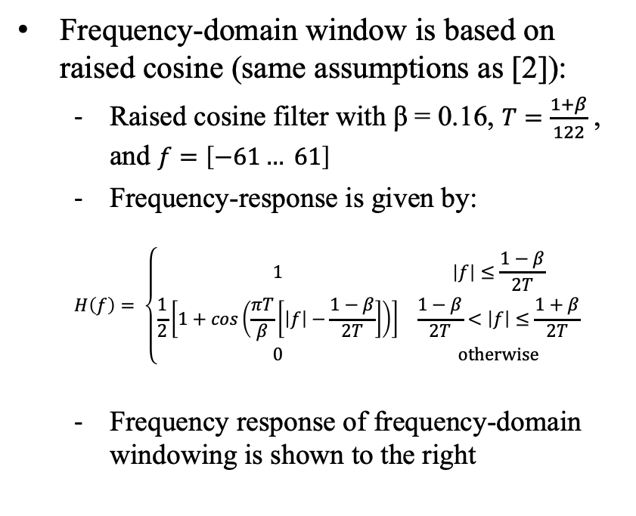
Tx Frequency-Domain Window: Raised Cosine
Frequency-domain window is based on raised cosine (same assumptions as [2]):
  Raised cosine filter with β = 0.16, $T=\frac{1+β}{122}$ , and $f=\left[−61… 61\right]$
  Frequency-response is given by:
  $$H\left(f\right)= \left\{\begin{matrix}1 & \left|f\right|≤\frac{1−β}{2T} \\ \frac{1}{2}\left[1+cos\left(\frac{πT}{β}\left[\left|f\right|−\frac{1−β}{2T}\right]\right)\right] & \frac{1−β}{2T}<\left|f\right|≤\frac{1+β}{2T} \\ 0 & \text{otherwise}\end{matrix}\right.$$
  Frequency response of frequency-domain windowing is shown to the right

Slide 27
Sample-by-Sample Attack Results: 20 MHz, Ta=2
64QAM+4PSK has same performance as 4096QAM

Slide 28
Sample-by-Sample Attack Results: 20 MHz, Ta=3
64QAM+4PSK has same performance as 4096QAM

Slide 29
Sample-by-Sample Attack Results: 20 MHz, Ta=4
64QAM+4PSK has same performance as 4096QAM

Slide 30
Sample-by-Sample Attack Results: 80 MHz, Ta=2
64QAM+4PSK has same performance as 4096QAM

Slide 31
Sample-by-Sample Attack Results: 80 MHz, Ta=3
64QAM+4PSK has same performance as 4096QAM

Slide 32
Sample-by-Sample Attack Results: 80 MHz, Ta=4
64QAM+4PSK has same performance as 4096QAM

Slide 33
Sample-by-Sample Attack:
OFDM vs. DFT Precoded OFDM

Slide 34
OFDM vs. DFT Precoded OFDM
Simulation assumptions:
  CBW = 20 MHz (NFFT = 128, Nsd = 122)
  CBW = 80 MHz (NFFT = 512, Nsd = 498)
  SNR = 40 dB
  i.i.d. AWGN noise
  Constellations: (1) OFDM: 64QAM+4PSK, (2) DFT Precoded OFDM: 4QAM is precoded using NFFT-point DFT and output is mapped onto Nsd data tones without quantization [4]
  Attacker oversamples LTF by OSR = 4
  Tx FD windows: Rectangular, Raised Cosine [4]
    Both Tx FD windows are normalized to have same RMS value
  Correlation over entire LTF symbol

Slide 35
Comparison of 64QAM+4PSK and DFT Precoded OFDM: Ta = 2
20 MHz
80 MHz
64QAM+4PSK OFDM has nearly identical performance as 4QAM DFT Precoded OFDM

Slide 36
Comparison of 64QAM+4PSK and DFT Precoded OFDM: Ta = 3
20 MHz
80 MHz
64QAM+4PSK OFDM has nearly identical performance as 4QAM DFT Precoded OFDM

Slide 37
Comparison of 64QAM+4PSK and DFT Precoded OFDM: Ta = 4
20 MHz
80 MHz
64QAM+4PSK OFDM has nearly identical performance as 4QAM DFT Precoded OFDM

Slide 38
Summary
Proposed to modify constellation from 64QAM (see [1]) to 64QAM+4PSK:
  Increases constellation size from 64 to 256 points
  Significantly reduces minimum distance, which improves performance against sphere decoder attack
Simulation results show that 64QAM+4PSK is better than or comparable to 64QAM for:
  Per-tone slice attack
  Sequential detection using Viterbi algorithm
  Sphere decoder
  Sample-by-sample attack (4096QAM, instead of 64QAM)
Simulation results also show that OFDM (i.e., frequency-domain approach) and DFT Precoded OFDM (i.e., time-domain approach) have nearly identical performance for sample-by-sample attack
64QAM+4PSK OFDM is a good proposal that balances security, ranging accuracy and implementation complexity

Slide 39
References
[1] 802.11-20/0836r0 11az Secure LTF Design
[2] 802.11-20/0964r0 Attacks to Fully Random 64QAM Sounding Signal
[3] 802.11-20/1373r0 Attacks to Fully Random OFDM Sounding Signal
[4] 802.11-20/1097r1 Secure LTF using DFT Precoded OFDM

