Slide 1
Performance Evaluation of Various MLO TID Mapping Configurations
Date: 2020-11-20
Name | Affiliations | Address | Phone | email
Morteza Mehrnoush | Facebook |  |  | mmehrnoush@fb.com
Chunyu Hu
M. Kumail Haider
Payam Torab

Slide 2
Introduction
MLO supports various TID-to-Link mapping options
Conducted a simulation study on various configurations and discuss solution for reducing latency

Slide 3
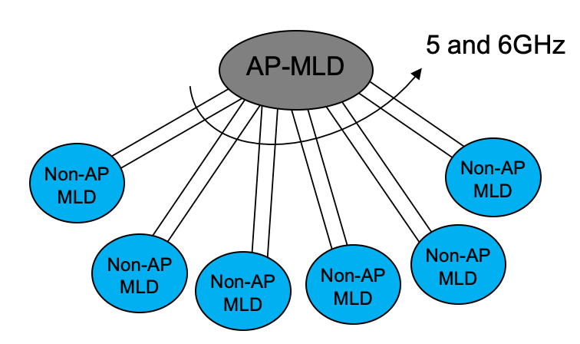
MLO Default TID Mapping: Config-1
MLO Config-1: all TIDs to all links.
Assumed default configuration
BA agreement established for each TID is shared over all links
Increase throughput, however requires larger BA window to show effect
Increase the channel access opportunity ➔ expect latency improvement
MLO: MLD can use either of the links for transmission

Slide 4
Simulation Study on MLO Default
Focus on evaluating the latency improvement in MLO default configuration
STR, asynchronous mode
Set-1.a: full buffered UL traffic, all BE, BA win 64
Set-1.b: DL/UL = 80/20 Mbps VI traffic, BA win 64
A 2-link MLO: increase number of non-AP MLDs, 2N
Single link: increase number of non-AP STAs, N
MAC/PHY parameters:
Fixed PHY rate: mcs9/nss2/bw80MHz
MAC: 2 MSDUs/A-MSDU, rts/cts ON.
Evaluate latency by measuring
Total delay: queueing delay + medium contention + transmission delay (including retransmission and response/ack rx time, also include rts/cts and its retrx)

Slide 5
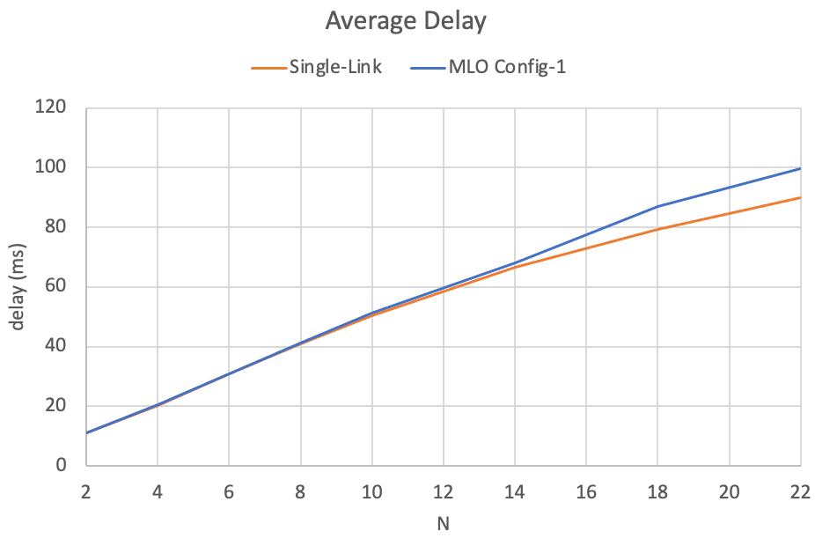
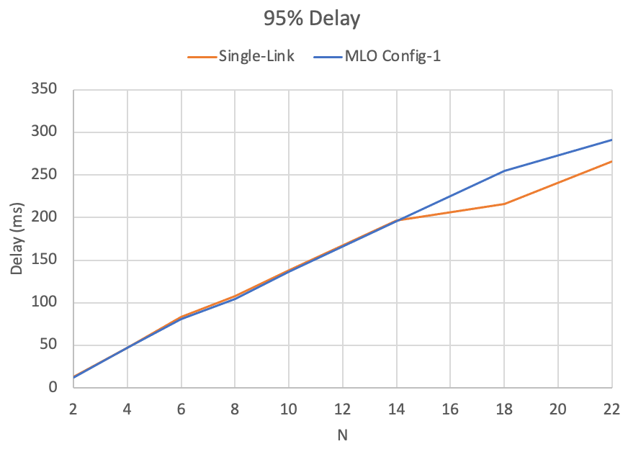
Simulation Results: Set-1.A
MLO default has worse latency compared to single link:
Both average and 95% latency are worse and the delta grows as N increases
Throughput results are similar

Slide 6
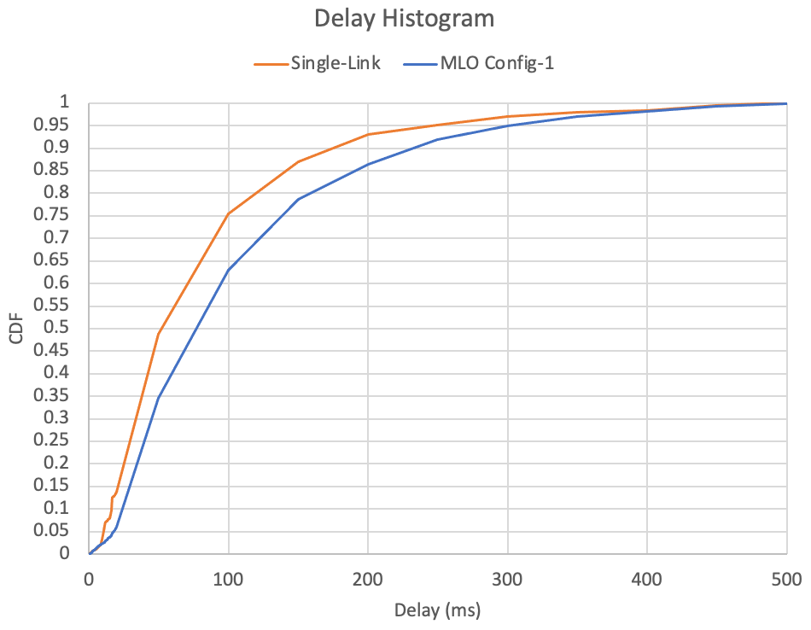
Simulation Results: Set-1.A, Delay CDF
A closer examination of the delay distribution
MLO: 22 non-AP MLDs
Single link: 11 non-AP STAs
80MHz | Single-Link | MLO Config-1
Tput / user | 57.75 Mbps | 60 Mbps
Avg Delay | 89.9 ms | 99.62 ms
95% Delay | 265.3 ms | 291.3 ms

Slide 7
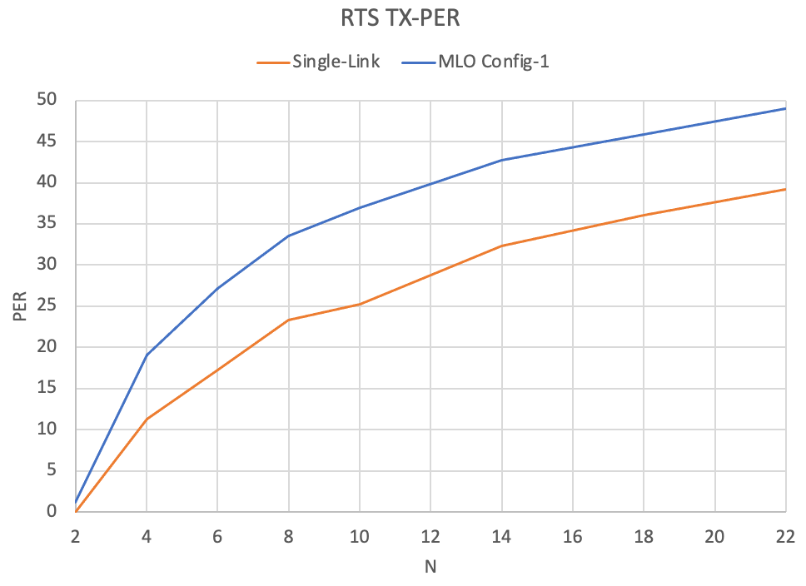
Simulation Results: Set-1.A, RTS TX-PER
MLO default has worse RTS PER compared to single link
The reason for higher PER in MLO is that N STAs are contenting over each link in MLO while N/2 STAs are contending in Single-Link
This results in the higher collision and higher PER
RTS TX-PER = (CTS RX) / (RTS TX)

Slide 8
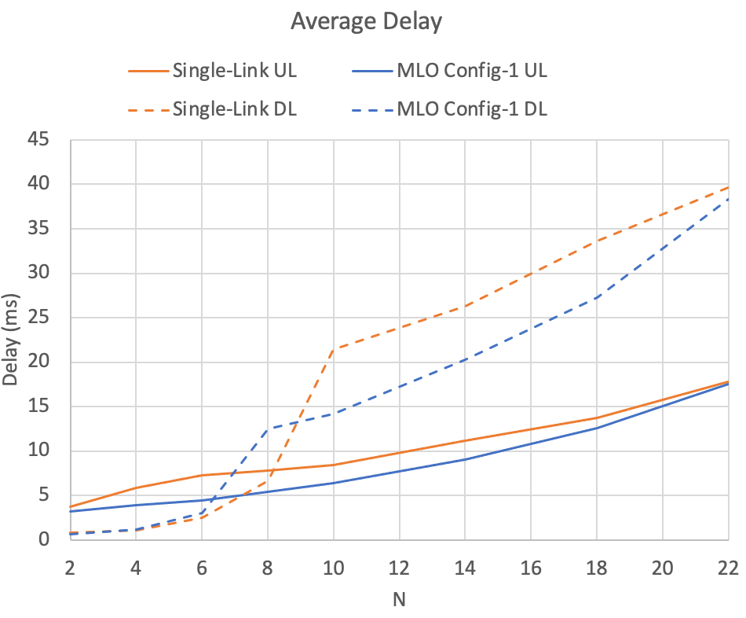
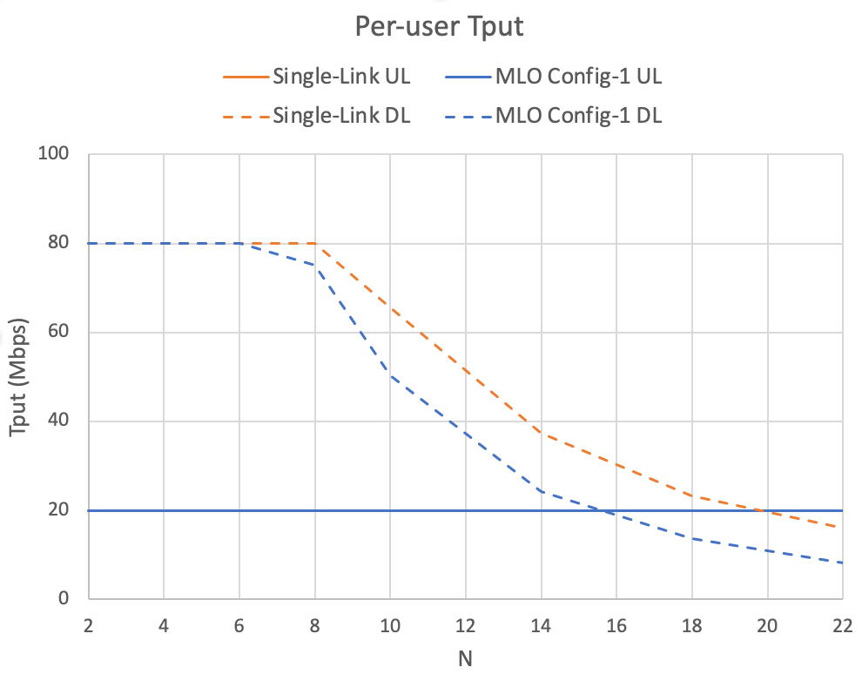
Simulation Results: Set-1.B
Both Single-Link and MLO achieve the desired UL 20Mbps throughput
Observation on latency performance:
MLO has very close UL delay compared to Single Link
MLO has lower DL delay, due to lower transmission delay corresponding to shorter A-MPDU length: avg agg MPDUs / A-MPDU: 24 / MLO versus 41 / single link.
Observations on throughput:
Single Link and MLO achieves the same UL target throughputs
Single Link achieves higher DL throughput as # of contending nodes increases
Link load starts to saturate at N=8 for MLO, and at N=10 for Single Link
This is the reason for the bump in the DL delay curves at N=8 and N=10

Slide 9
Key Observations
Default MLO TID mapping with two links doubles the channel access opportunity, however, by doing so it incurs higher collision probability and hence can worsen the latency performance (both average and 95%)
As the number of non-AP MLDs increases, average and 95% latency performance gap between the MLO Config-1 and Single Link increases. This shows higher latency in a more congested environment
Default MLO TID mapping improves latency when:
The network has lighter traffic load, and/or
Competing with single link operation STAs (unfairness)
MLO default can saturate the network load with fewer devices competing the medium
Next, we study two other possible MLO TID mapping configuration and seek a better solution for latency improvement
Notes:
For the observation “Default MLO TID mapping improves latency when, competing with single link operation STAs”, we have a set of OBSS simulation results, but not included in this deck of slides.

Slide 10
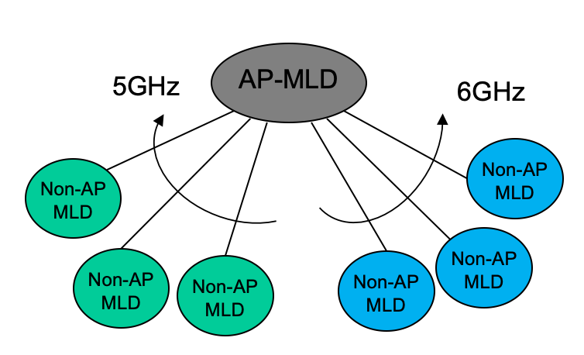
MLO Load-Balancing: Config-2
MLO config-2: all TIDs to a subset of links.
Partition links at MLD level: load balancing
E.g. a group of non-AP MLDs operate over 5GHz link; and the others on 6GHz link
MLO for load-balancing: the non-AP MLDs use the assigned subset of link(s)

Slide 11
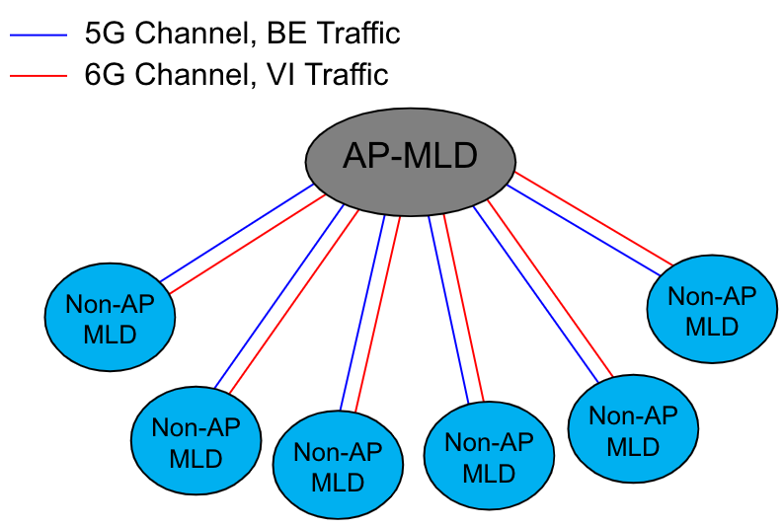
MLO Tid-to-Link Mapping: Config-3
MLO config-3: a subset of TIDs to a subset of links.
Partition links at TID level
E.g. map all BE/BK traffic over the 5GHz link; and the VI/VO traffic on 6GHz link
MLO TID/link partition: Traffic is split over the links based on TIDs; MLD tx/rx traffic of subset of TID(s) over a subset of link(s)
E.g.

Slide 12
Simulation Study: Set-2
MLO Config-1: MLO Default / all TIDs to all links
1 AP-MLD with N non-AP MLDs operating on both link 1 and 2
N/2 MLDs have UL BE saturated traffic;
N/2 MLDs have DL/UL=80/20 Mbps VI traffic
MLO Config-2: MLD/link partition
Both links have mixed BE and VI traffic
N/2 non-AP MLDs on link 1, and N/2 non-AP MLDs on link 2
Half of them have UL BE saturated traffic; half have DL/UL=80/20 Mbps VI traffic
MLO Config-3: TID/link partition
N/2 non-AP MLDs on link 1: have UL BE saturated traffic
N/2 non-AP MLDs on link 2: have DL/UL=80/20 Mbps VI traffic
MAC/PHY parameters: same as previous set

Slide 13
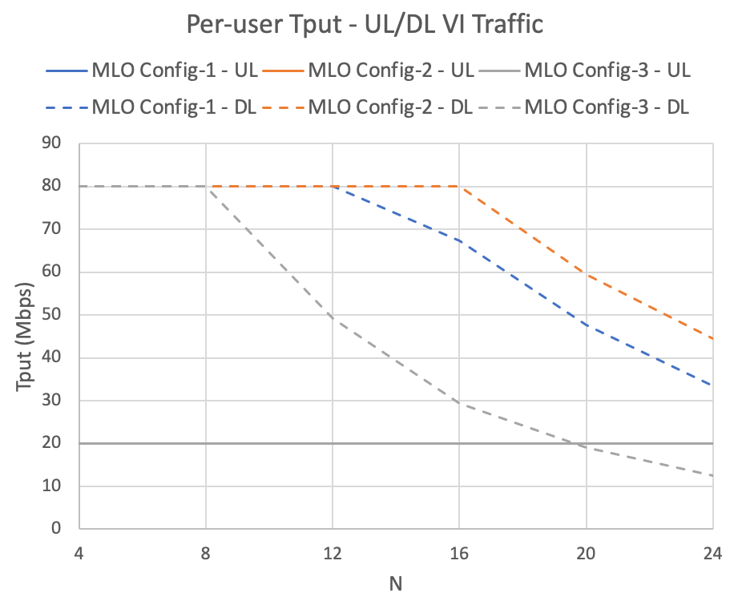
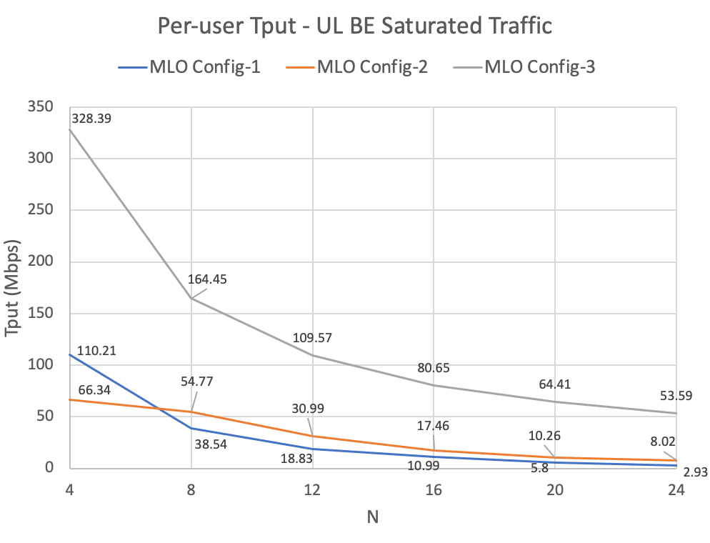
Simulation Set-2: Throughput
MLO Config-3 (TID/Link partition) has highest BE throughput, but lowest VI throughput
High BE throughput due to best medium utilization due to large A-MPDU size
MLO Config-2 (MLD/Link partition) has highest VI throughput
In all Configs, UL achieves the desired 20Mbps throughput

Slide 14
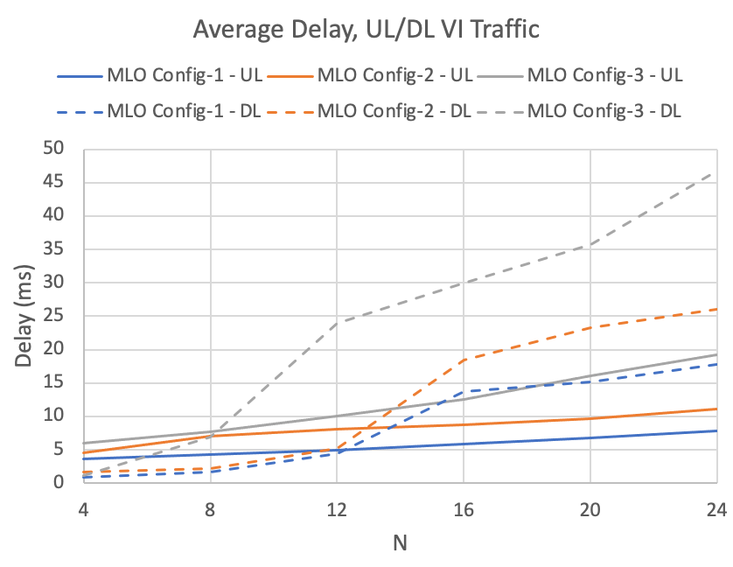
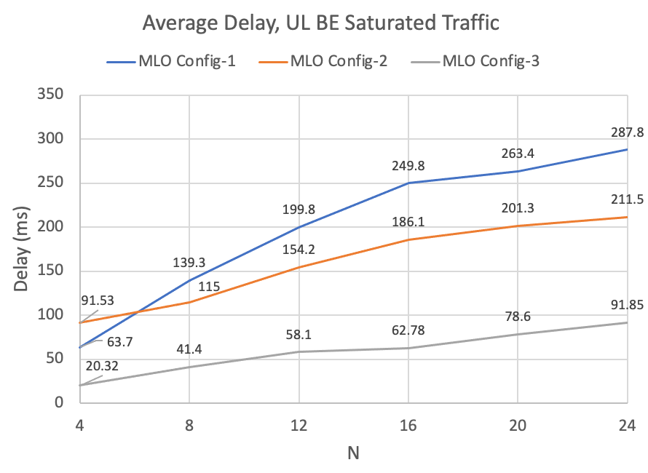
Simulation Set-2: Average Delay
MLO Config-1 has highest delay for BE, however lowest delay for VI traffic
MLO Config-3 has lowest delay for BE, but highest delay for VI
Performance gets penalized by concentrating aggressive traffic over one link

Slide 15
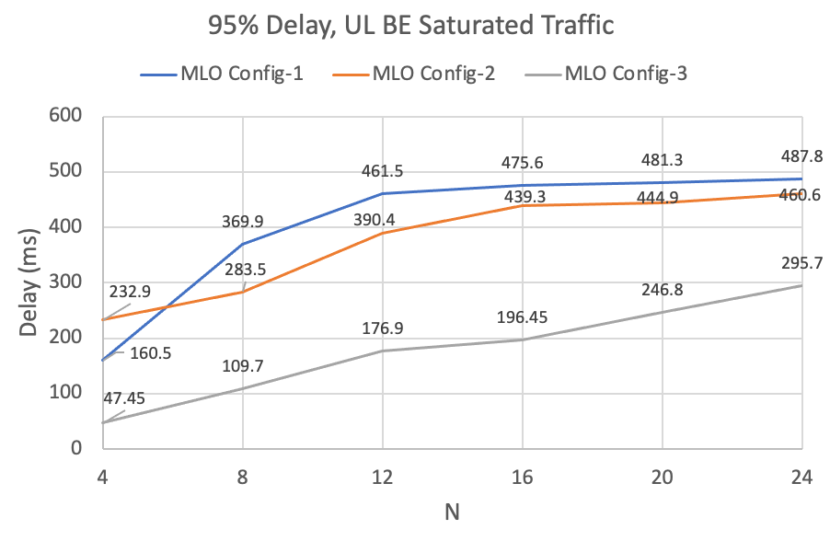
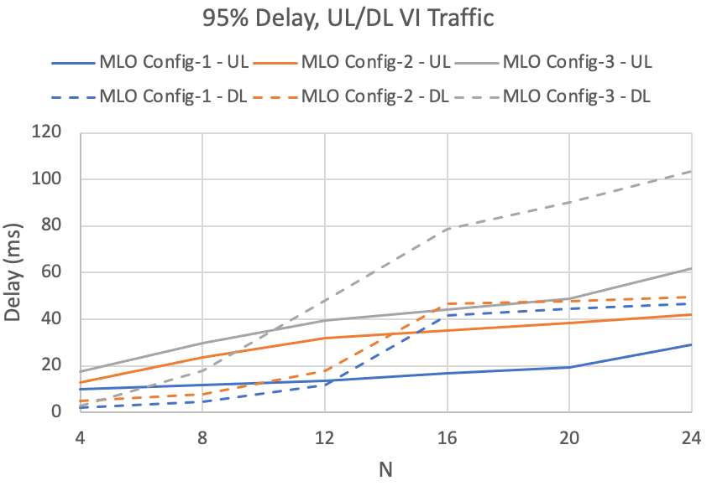
Simulation Set-2: 95% Delay
Similar observation as average delay

Slide 16
Analysis (1)
Config-3 (TID/link partition) has best BE performance compared with the Config-1 and Config-2, however worst performance for VI traffic
Over link-1 with uniform BE traffic, Config-3 has highest medium utilization: more payloads per frame exchange
Over link 2 with all VI traffic in Config-3, the aggressive EDCA parameters cause more collision and penalize VI performance
In Config-1 (MLO default) and Config-2 (MLD/link partition), BE and VI traffic are mixed over the same link, VI traffic has higher priority over BE and overall
Config-2 (MLD/link partition) has a better BE traffic performance compared with Config-1
Because of fewer VI traffic STAs per-link and less collision in general in Config-2
Similar observation made in set-1
Config-2 has a better VI traffic throughput but worse delay compared with Config-1
Throughput: fewer STAs are contending per-link in Config-2, so it results in a lower collision and higher throughput
Delay: since the VI traffic is not a saturated traffic, the STAs in Config-1 can access either of the two links for their transmission so the delay for transmission decreases

Slide 17
Analysis (2)
Discussion on better BE traffic performance in Config-3 compared to Config-1
In Config-1, STAs with BE and VI traffic are contending over both links, so STAs with VI traffic gets priority over the STAs with BE traffic; however, in Config-3, the STAs with VI traffic are contending on one link and STAs with BE traffic on the other link, so the contention is among the same type of traffic and no priority to the VI STAs.
In Config-1 the VI STAs are sending more frames, but since we have a low data-rate traffic of UL=20Mbps and DL=80Mbps, it leads to shorter data frames per tx.
This leads to frequent access of VI STAs and lower medium utilization, so BE STAs gets less channel access opportunities and hence lower throughput
Below is the per STA statistics for N=4 case. In Config-1, we can see more VI tx per second, but each tx has lower aggregation number
Config-1
Config-3
traffic | #A-MPDUs / second | #MPDUs / A-MPDU
DL-VI | 2640 | 2
UL-VI | 500 | 3
BE | 84 | 64
traffic | #A-MPDUs / second | #MPDUs/ A-MPDU
DL-VI | 1040 | 4
UL-VI | 303 | 4
BE | 320 | 51

Slide 18
Summary
MLO TID mapping provides flexibility and opportunity to improve latency and also throughput, however the default all TIDs to all link mapping achieve this gain/goal in limited network traffic scenarios. When the network is more congested, default MLO TID mapping has more contention and incurs higher collision which worsens latency and network capacity.
MLD/link and/or TID/link partitioning methods are necessary means to reduce this penalty
TID/link partitioning method is promising in providing better QoS over each link by grouping traffic of similar requirements/characteristics together, but need additional mechanism to distribute aggressive medium access ➔ need scheduling / reserved SPs as necessary compliment mechanism

Slide 19
Backup Slides

Slide 20
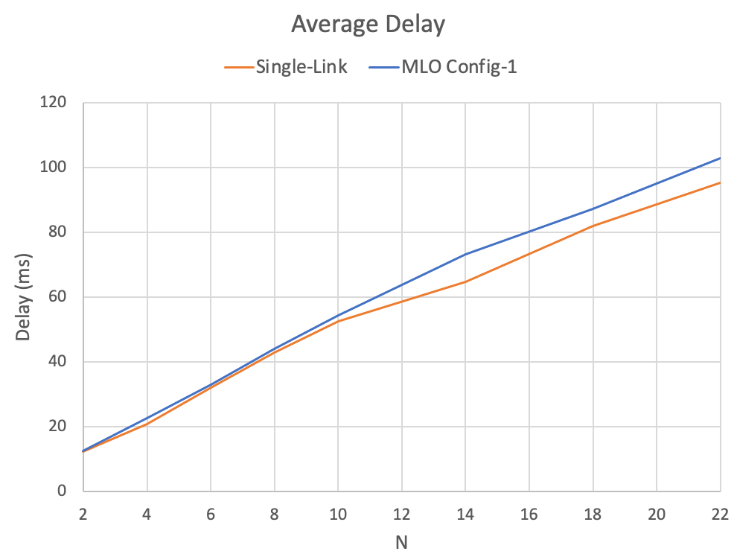
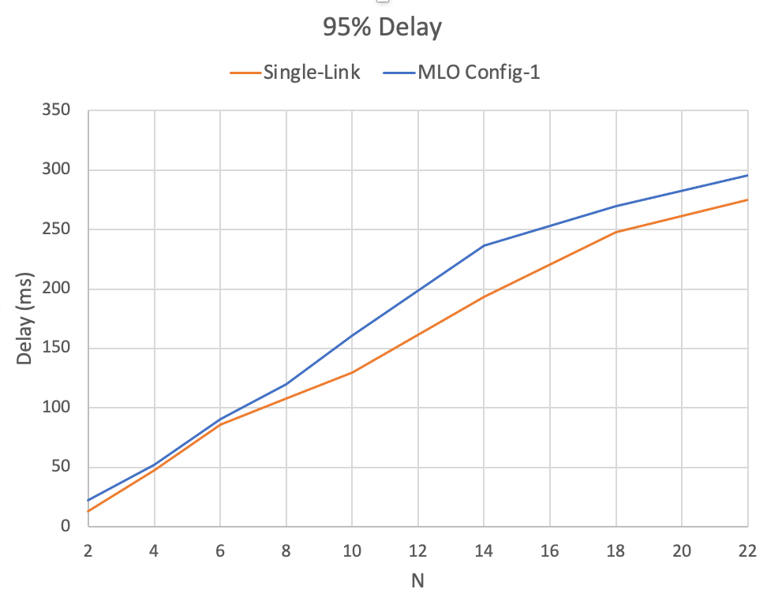
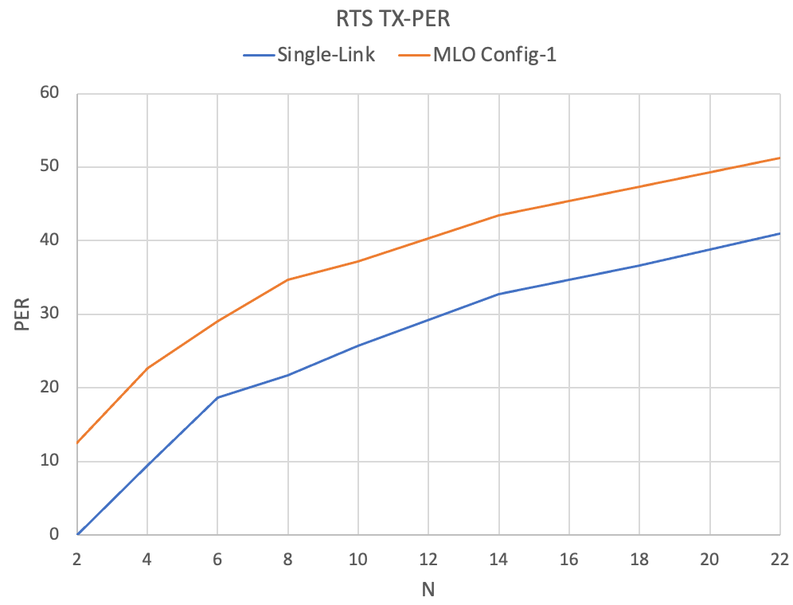
Set 1.C
Set-1.c: full buffered UL traffic, all BE, BA win 256
Rest is same as Set-1.A
Higher BA window is to make sure MLD always have packets to contend for accessing over both links
MLO default has higher average and 95% latency compared to single link
Consistent with the observation that RTS TX-PER is higher in MLO default case
Throughput results are similar

