Slide 1
6 GHz in CEPT update
Date: 2020-11-02
Authors:

Slide 2
Abstract
This presentation provides updates for the 802.11 Coex SC, on recent activities on 6 GHz at CEPT

Slide 3
Summary: CEPT / Europe 6 GHz (5925-6425 MHz) Regulatory and Standardization Status
ECC SE45 published coexistence studies (fixed service, fixed satellite service, and urban rail)
Sharing generally possible (low power indoor, very low power portable)
Higher power outdoor (aka USA “standard power”) not studied; therefore not currently allowed
ECC FM57 developed draft CEPT Report and draft ECC Decision
Public Consultation completed
Resolution meeting was inconclusive on how to protect urban rail
Issues passed to ECC WGFM to approve CEPT Report and ECC Decision
ECC WGFM 22nd October 2020 approved CEPT Report 75 and ECC Decision 20(01)
UK planning to open the lower 6 GHz (5925-6425 MHz) – statement published
European Commission to agree an EC Decision – likely March 2021
Administrations to enable access to lower 6 GHz Q2/2021 onwards once rules transposed into National Law
ETSI standard EN 303 687 being developed – waiting on the regulations
7th March 2022 is earliest date for EN 303 687 citation in European Union Official Journal (EUOJ)
Ability to self declare compliance against EN 303 687 possible when EN included in EUOJ
BNetzA Spectrum Compass 2020 deadline to respond was 23rd October 2020

Slide 4
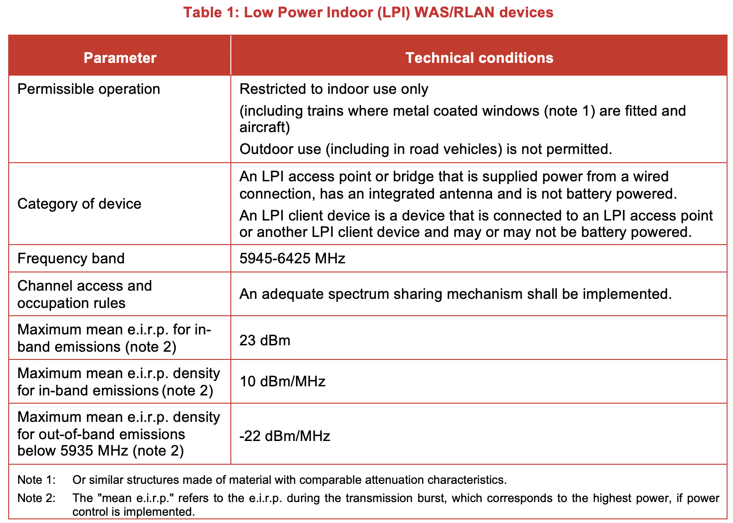
ECC Decision (20)01: Low Power Indoor (LPI) Devices 5945-6425 MHz
Notes:
No CDC
No 2-stage implementation
No database

Slide 5
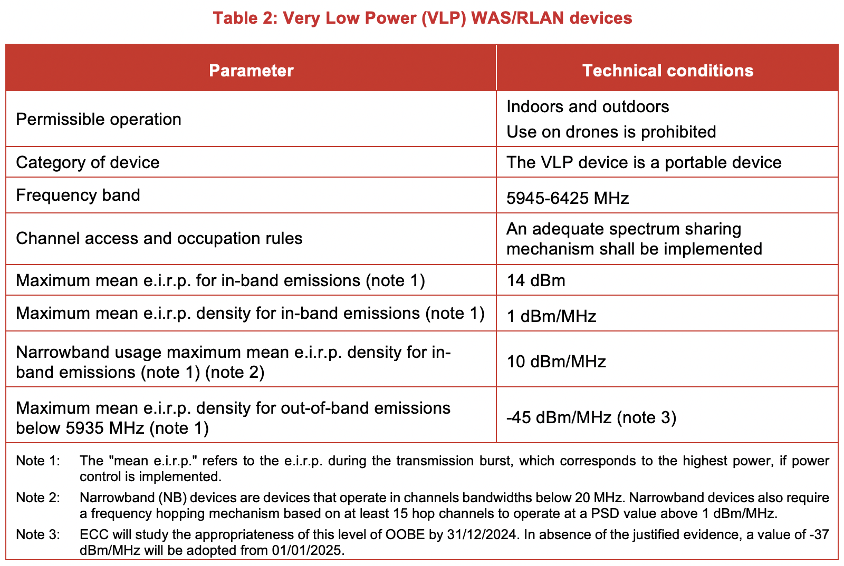
ECC Decision (20)01: Very Low Power (VLP) Devices 5945-6425 MHz
Notes:
No CDC
No Cat A/Cat B implementation
Full band usage
Narrowband usage rules
See next slide on OOB

Slide 6
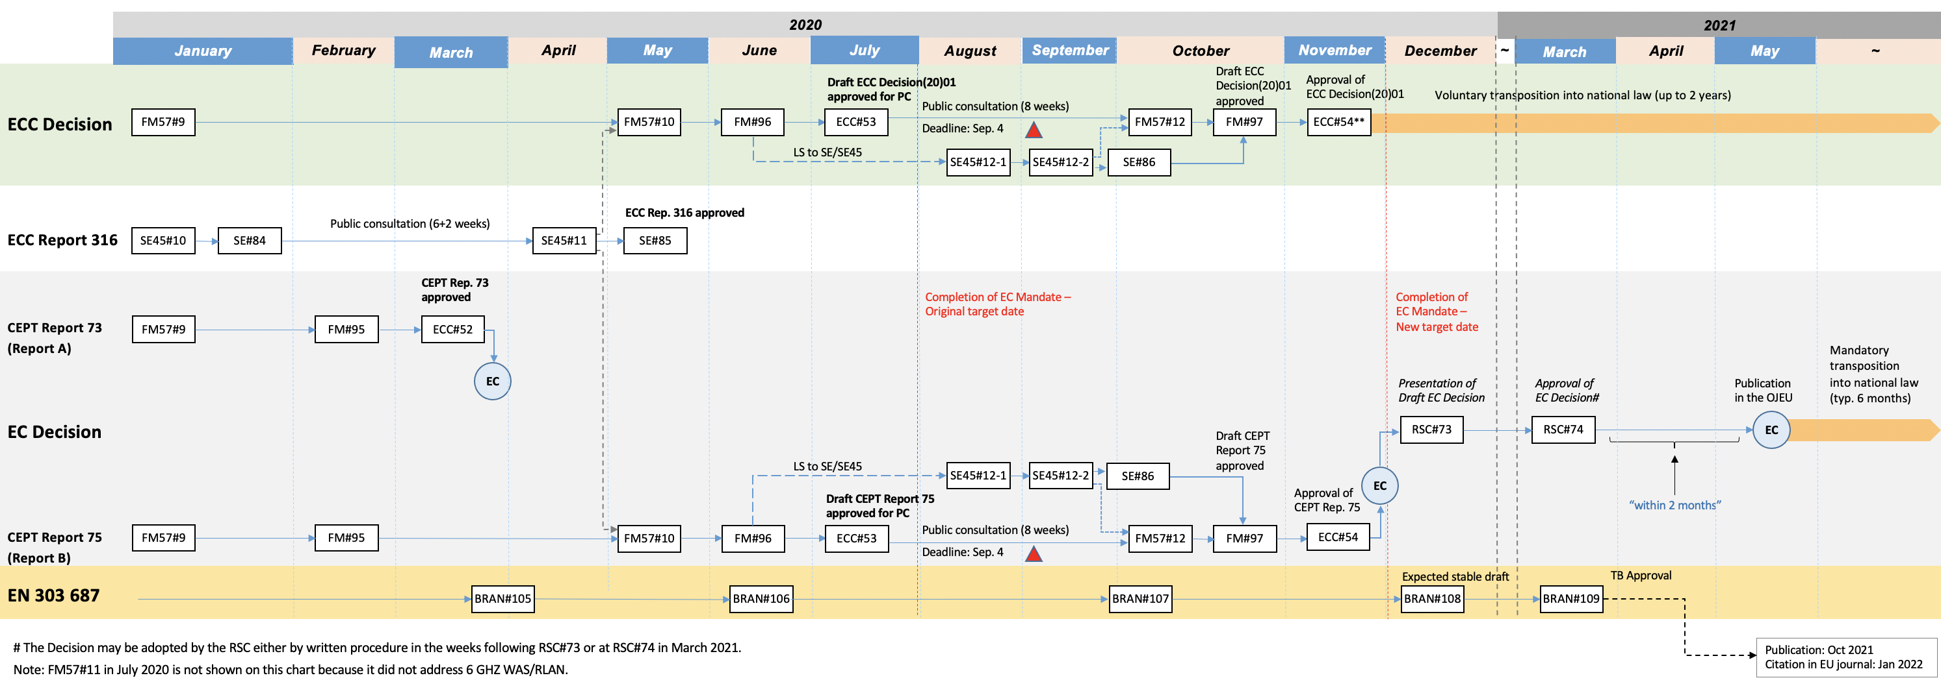
CEPT/EC/ETSI 6 GHz (5925-6425 MHz) Timeline

Slide 7
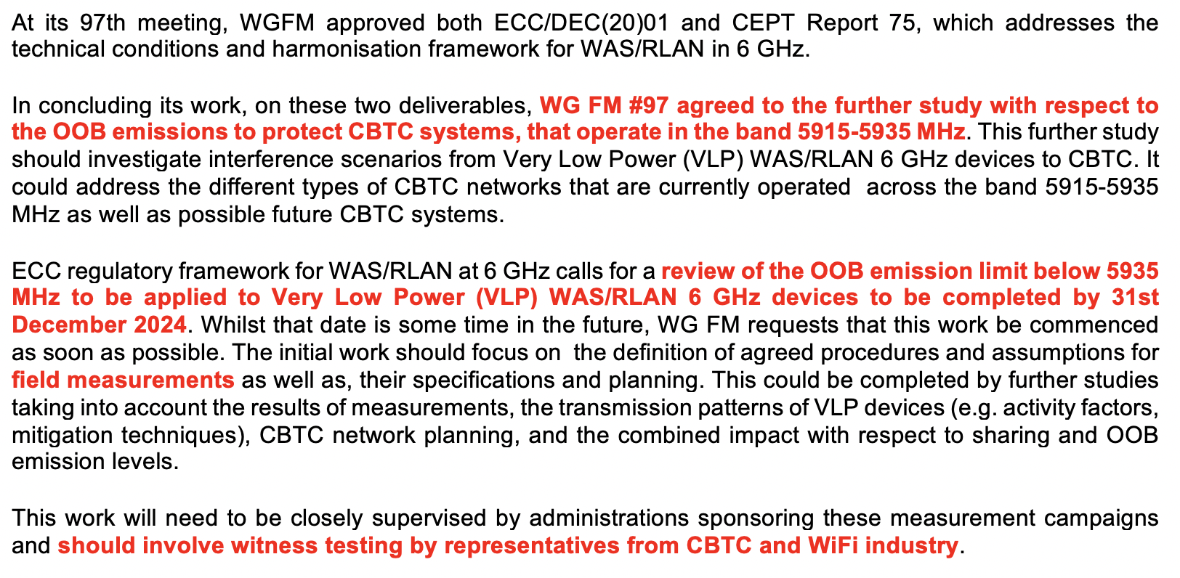
Further study on protection requirements for CBTC in adjacent bands

Slide 8
Further study on protection requirements for CBTC in adjacent bands
New ECC WG FM Work Item on RLAN VLP OOB emission limit below 5935 MHz:
FM_54
“RLAN OOB emission limit to protect CBTC”
“Review the RLAN VLP OOB emission limit below 5935 MHz with regard to an opportunity to relax it, and review and revise ECC/DEC/(20)01 as appropriate.”
Nov 2020 – June 2024
Comments: “In ECC/DEC/(20)01, the -45 dBm/MHz OOB limit below 5935 MHz for VLP would allow VLP initial market to takeup. CEPT agreed that this OOB limit should be valid in time only until 31 December 2024 and be re-examined with regard to an opportunity to relax it based on the real IEEE and DSSS Urban Rail interference situation. In absence of the justified evidence, a value of -37 dBm/MHz, for the OOB limit below 5935 MHz, will be adopted from 01/01/2025.”

