Slide 1
A Study on the Impact of Radar Range Resolution in Different Use Cases
Date: 2020-11-06
Authors:

Slide 2
Abstract
In multiple previous contributions, the different authors presented some requirements (including the range resolution) for different use cases [1, 2, 3]
In this contribution, we present practical results using FMCW based radar instead of OFDM based waveform for sensing. With appropriate parametrization, both waveforms could perform the same as presented in [4].
Multiple use cases were studied using two radar modules in mmWave and sub-6GHz frequency bands with two different range resolutions

Slide 3
Outline
Introduction
Human activity detection use case study in both sub-6GHz and mmWave bands
Results
Conclusion
Focus on other use cases using sub-6GHz
Gestures recognition
Vital sign recognition
Conclusions

Slide 4
Introduction
In the usage model Excel document [1], some of the use cases are only valid in the 60GHz mmWave band (e.g. Gesture recognition - medium range)
We then wanted to compare the results with two radar modules operating in mmWave (79GHz) and sub-6GHz (5.8GHz) frequency bands, respectively.
After capturing real time radar signatures and data processing, we observe that the sub-6GHz band can provide accurate results for several use cases.
We finally concluded that, our current demonstrations show promising results for sub-6GHz band, which motivates further studies on the capabilities of sub-6GHz band in additional use cases.

Slide 5
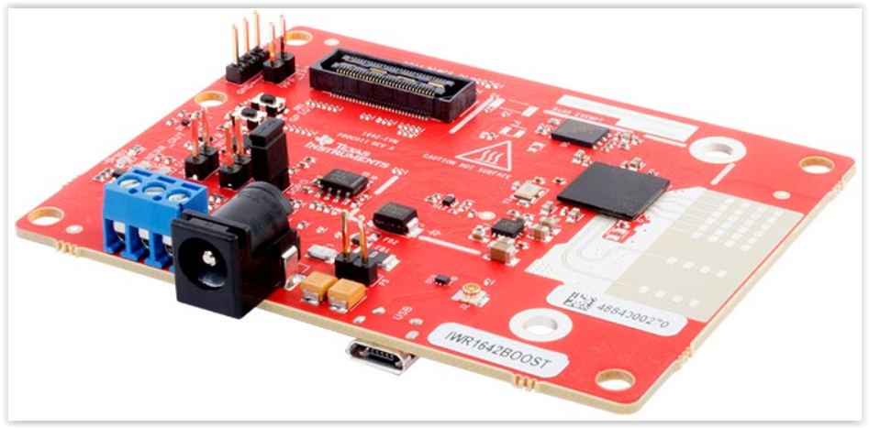
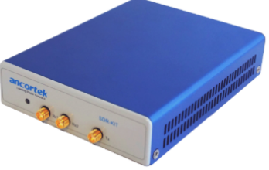
Human Activity Detection 1/5 – Radar modules
Two Commercial Off-The-Shelf (COTS) FMCW radar transceivers, one for sub-6GHz and one for mmWave are mounted on a room’s ceiling to detect the signatures of people performing different activities inside the room: walking, sitting and falling
Range resolution in sub-6GHz is 37.5cm and resolution in mmWave is 3.75cm
mmWave reference design
2 Tx and 4 Rx antennas
Fc=79GHz – Pow=12.5dBm
Bw=4GHz – Res=3.75cm
Sub-6GHz reference design
1 Tx and 2 Rx antennas
Fc=5.8GHz – Pow=20dBm
Bw=400MHz – Res=37.5cm

Slide 6
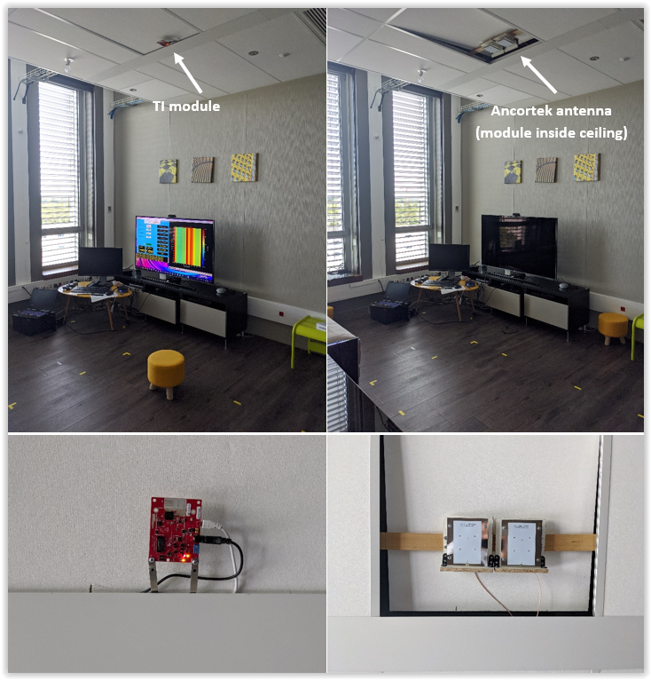
Human Activity Detection 2/5 – Scene setup
(a) Showroom for real testing environment
(b) Modules are mounted on the ceiling (Tx and Rx collocated)

Slide 7
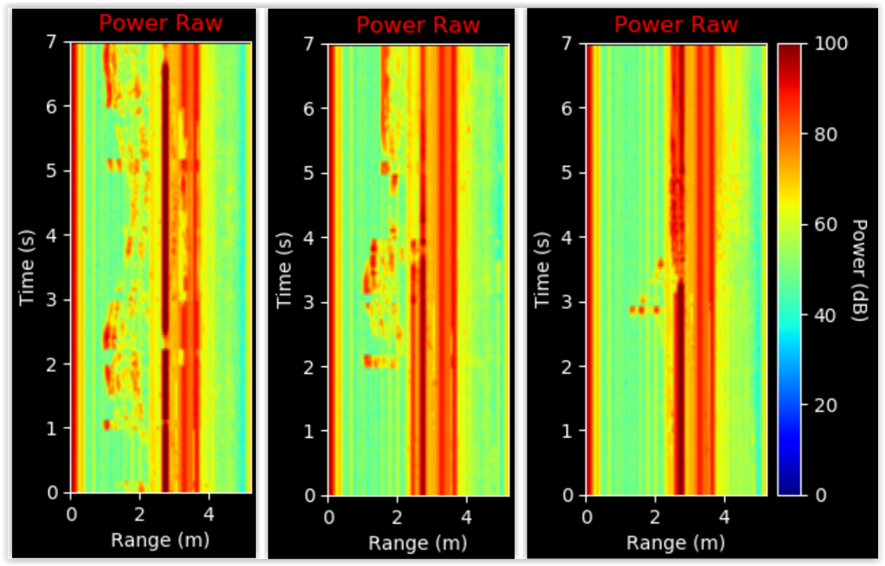
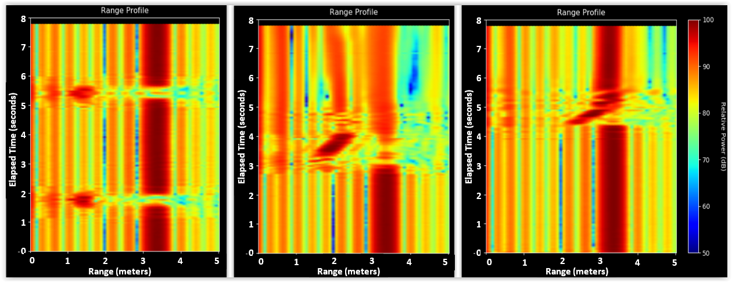
Human Activity Detection 3/5 - Presentation
Range-time-power captured signatures for the three indoor human activities: (a) walking, (b) sitting and (c) falling
Relative
(a)
(c)
(a)
(b)
(c)
(a)
(b)
(c)
(b)
Heatmaps of activities for mmWave band
Heatmaps of activities for sub-6GHz band
→ Signatures in between the events are clearly different and are both visible in the mmWave and Sub-6GHz bands

Slide 8
Human Activity Detection 4/5 - Results
Classification results of respective signatures, after background subtraction, and using Machine Learning (ML) / Support Vector Machine (SVM) classifier (*)
Reference to our accepted paper for IEEE ICCE 2021 [5]
Detected activity Ground truth | Background | Walking | Sitting | Falling
Background | 98% | 0% | 2% | 0%
Walking | 0% | 97% | 0% | 3%
Sitting | 0% | 13% | 78% | 10%
Falling | 2% | 10% | 2% | 86%
Detected activity Ground truth | Background | Walking | Sitting | Falling
Background | 100% | 0% | 0% | 0%
Walking | 0% | 100% | 0% | 0%
Sitting | 0% | 0% | 90% | 10%
Falling | 0% | 7% | 10% | 83%
Confusion matrix in mmWave band
Average result = 89.8%
Confusion matrix in sub-6GHz band
Average result = 93.3%
(*) Using commercially available toolbox

Slide 9
Human Activity Detection 5/5 - Conclusions
Human activity detection performs well in both sub-6GHz and mmWave bands using two COTS radar modules with different configurations.
The measurement results in the given configurations demonstrate that sub-6GHz band is able to classify human activities with reasonable accuracies.

Slide 10
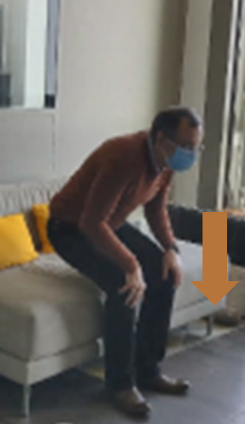
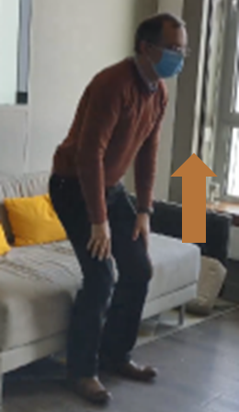
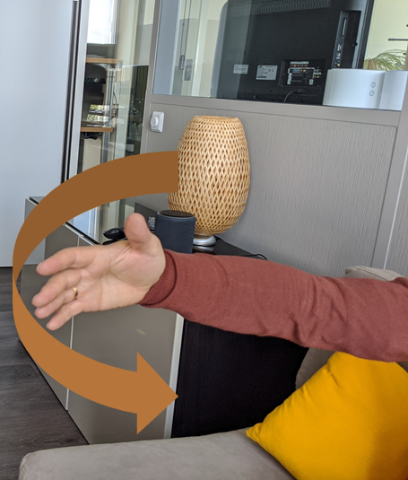
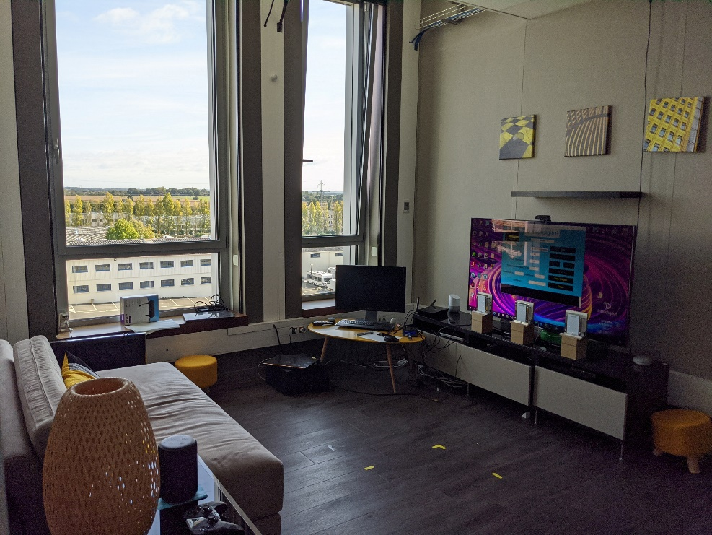
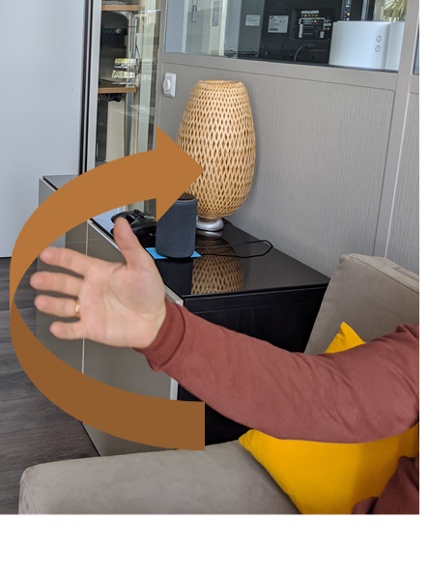
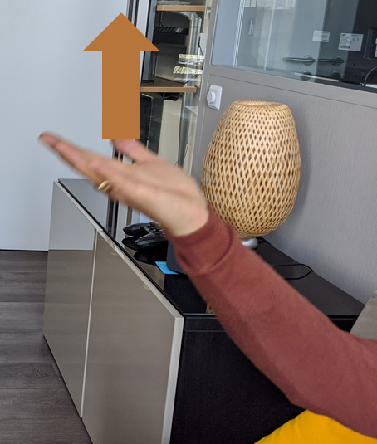
Gestures recognition 1/3 – Scene setup and gestures
Using same sub-6GHz module equipped with three antennas: one Tx antenna in the middle and two Rx antennas on both sides (for spatial diversity)
Sitting down
Standing up
Sweep left
Rx1
Tx
Rx2
3.5m
Sweep right
Hand up
Hand down
TV scenario application
List of gestures

Slide 11
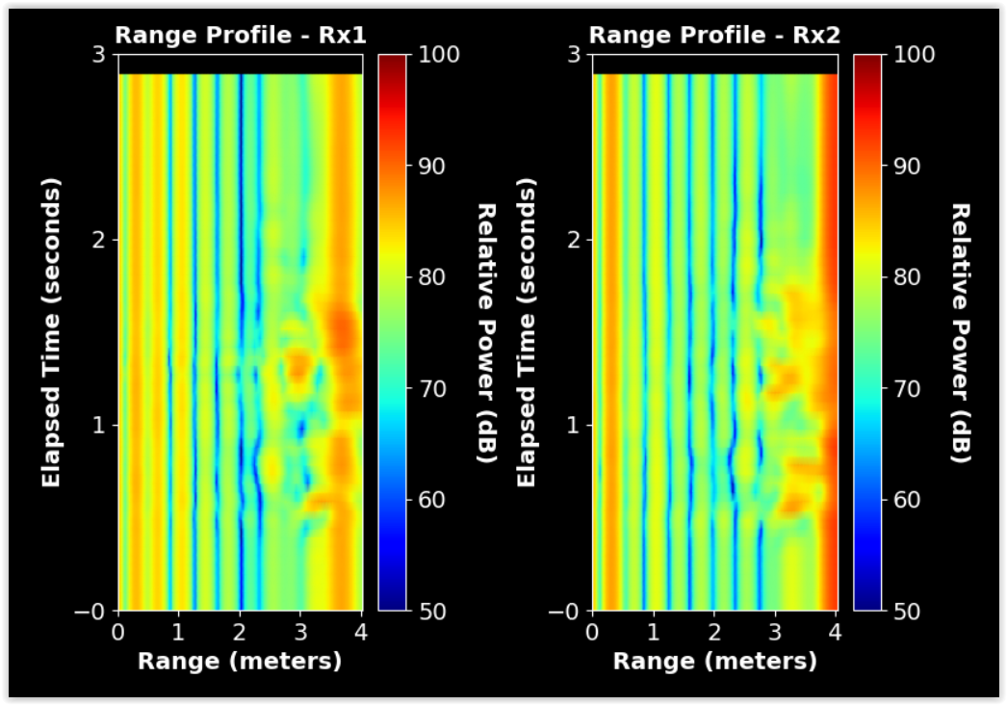
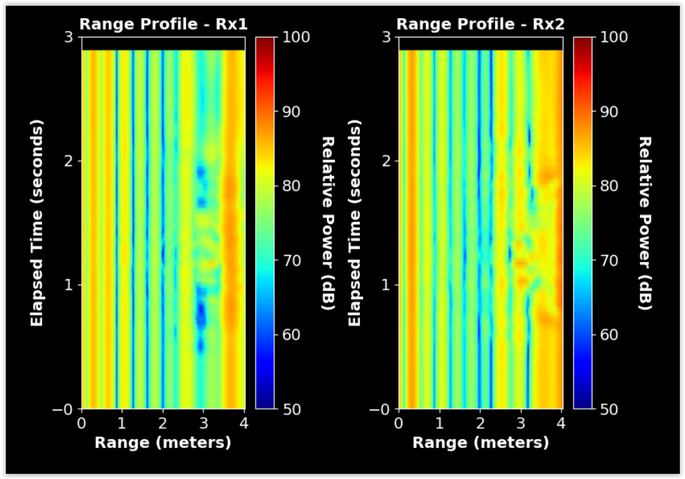
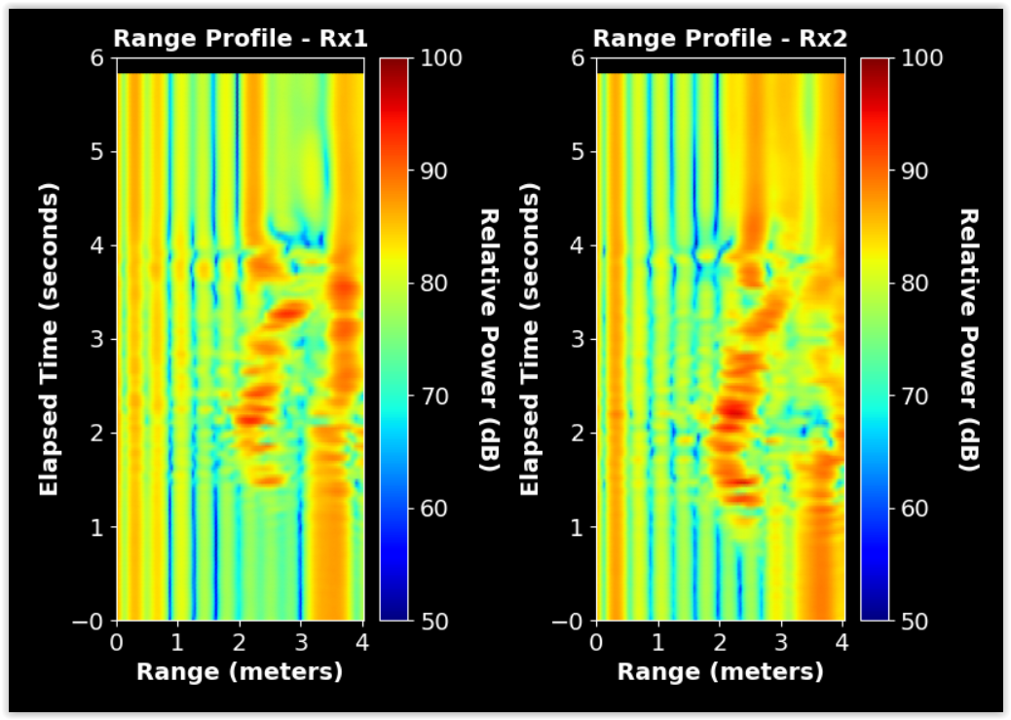
Gestures recognition 2/3 – Examples of captured signatures
Range-time-power heatmaps
of sweep-left gesture
Range-time-power heatmaps
of hand-up gesture
Range-time-power heatmaps
of sitting-down event
The different gestures signatures are visually different and can then be discriminated through post-processing

Slide 12
Gestures recognition 3/3 – Classification Results
After background subtraction, and cross-correlation applied as a post-processing:
Detected activity Ground truth | Hand-Down | Hand-Up | Sitting-Down | Standing-Up | Sweep-Left | Sweep-Right
Hand-Down | 86.25% | 3.75% | 0% | 0% | 10% | 0%
Hand-Up | 7.5% | 92.5% | 0% | 0% | 0% | 0%
Sitting-Down | 0% | 0% | 100% | 0% | 0% | 0%
Standing-Up | 0% | 0% | 0% | 100% | 0% | 0%
Sweep-Left | 25% | 7.5% | 0% | 0% | 61.25% | 6.25%
Sweep-Right | 28.75% | 0% | 0% | 0% | 31.25% | 40%
Confusion matrix in sub-6GHz band
Average result = 80%

Slide 13
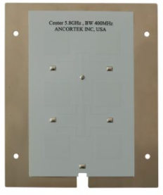
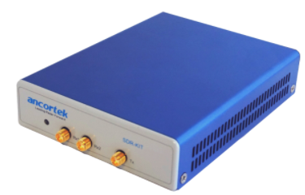
Vital sign recognition 1/4 - Scene setup
Another use case with same sub-6GHz radar module monitoring a stream of live human heart beating and breathing data is demonstrated
Similar studies were conducted by others, including the work in [6]
People is sitting in front of radar module at a distance of 1m
T_{x}
1m
R_{x}

Slide 14
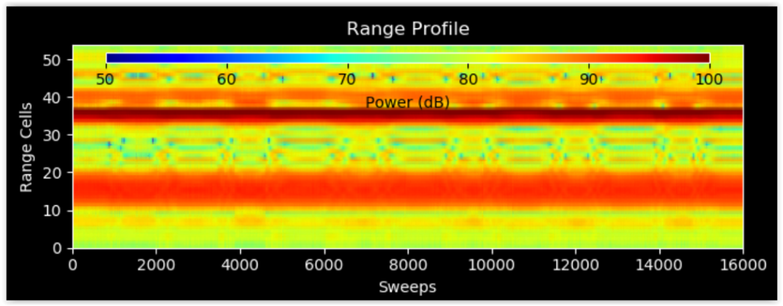
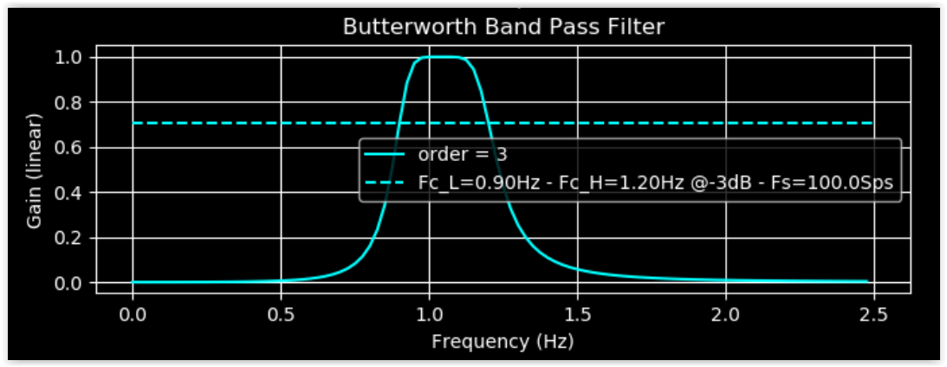
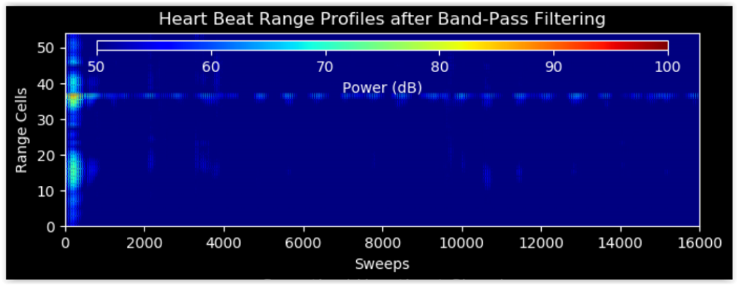
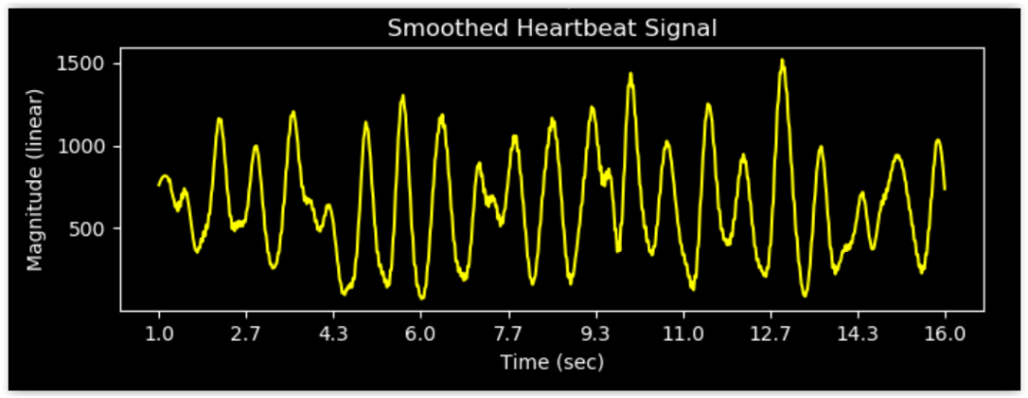
Vital sign recognition 2/4 – Heart beating
Useful signal is extracted from the range where the target is detected (max power)
Example of range-time-power heatmap
of heart beating/breathing event in the sub-6GHz band
Band Pass filter [0.9Hz – 1.2Hz]
Heatmap of heart beating event after filtering
Heart beating event after Band Pass filtering

Slide 15
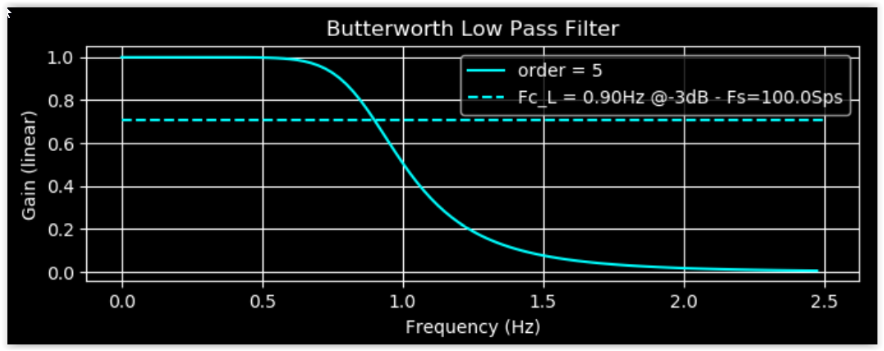
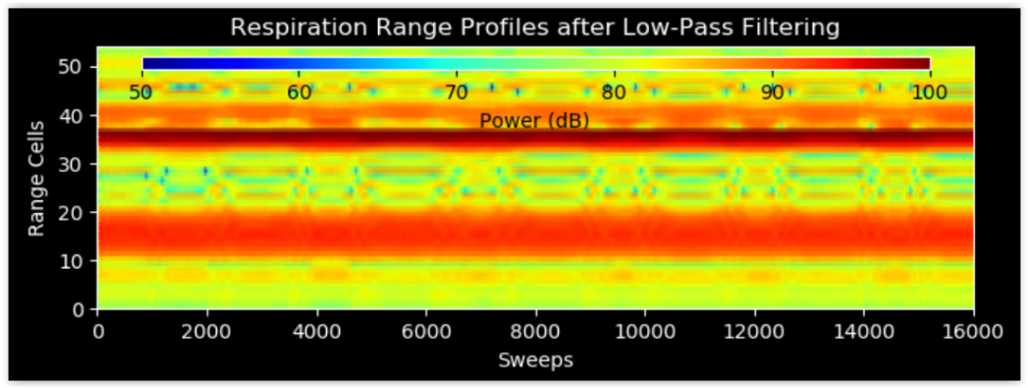
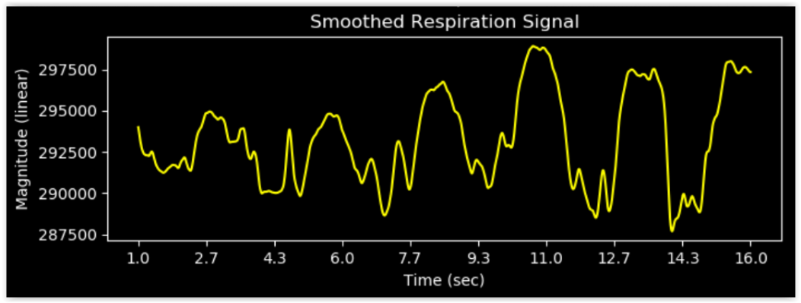
Vital sign recognition 3/4 - Breathing
Useful signal is extracted from the range where the target is detected (max power)
Same example of range-time-power heatmap
of heart beating/breathing event in the sub-6GHz band
Low Pass filter [0.9Hz]
Heatmap of Breathing event after filtering
Breathing event after Low Pass filtering

Slide 16
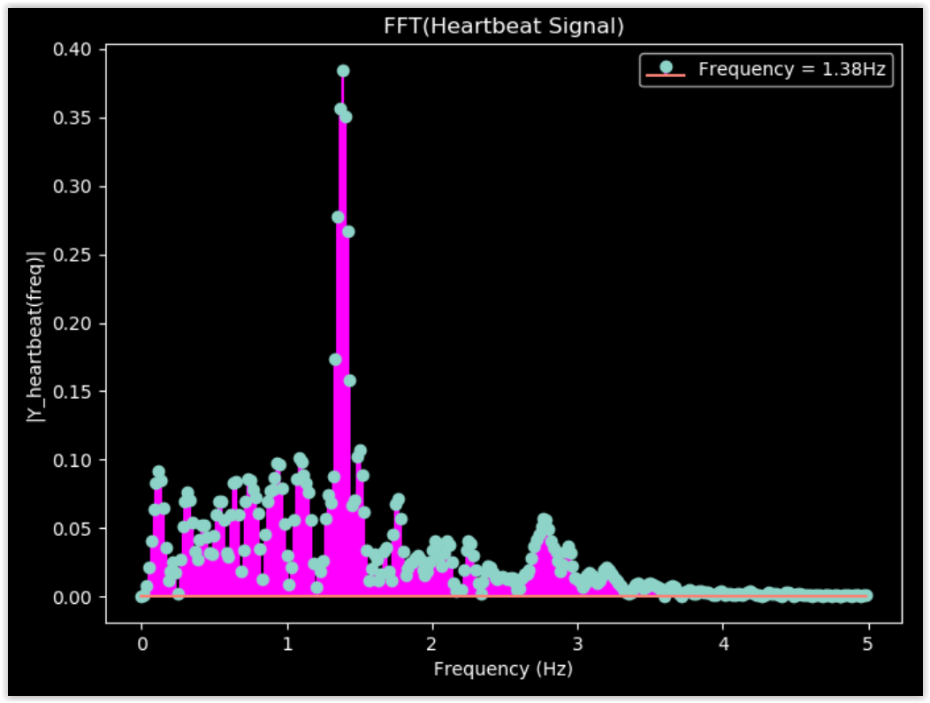
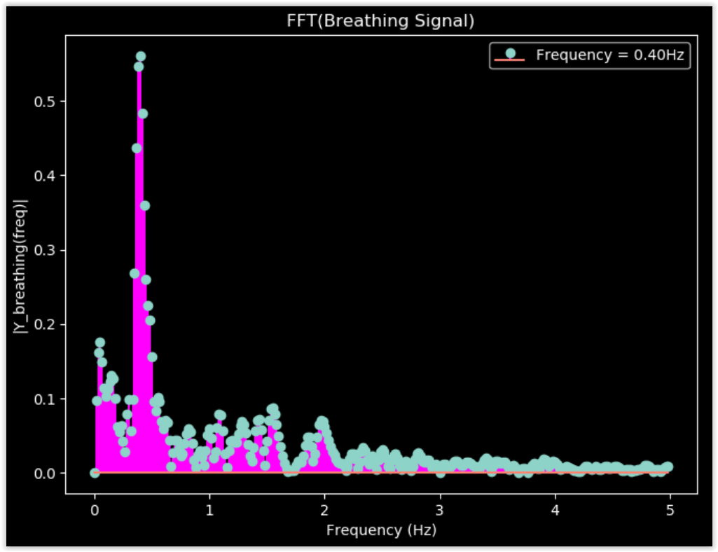
Vital sign recognition 4/4 - Results
Results after processing to get the pace of the two heart beating and breathing events
Measured frequency corresponds to the max frequency in the spectrogram
Heart beating signal in frequency domain
Frequency = 1.38Hz (~ 83 beats per minute)
Breathing signal in frequency domain
Frequency = 0.40Hz (24 breaths per minute)

Slide 17
Conclusions
Wireless sensing of human activity were performed using radar modules operating in sub-6GHz and mmWave bands.
Promising results were obtained in sub-6GHz band, with detection performances similar to mmWave band.
Other use cases in the sub-6GHz band have been demonstrated like gestures recognition for TV scenarios and vital sign recognition like heart beating and breathing detection for which we also had promising results.
All these use cases, which are very common in our daily life, lead to the conclusion that the lower range resolution provided by the sub-6GHz band could be sufficient to achieve promising classification results.
Some other use cases may require a high resolution where mmWave band is needed, for example short range gesture recognition (finger movement), face/body recognition, autonomous robotics or automotive safety applications.
Therefore, we think that lower cost and narrower bandwidth sub-6GHz band radar is well suited in numerous sensing applications for which high range resolution is not paramount.

Slide 18
Backup slide
Pros & Cons of Sub-6GHz vs mmWave bands
 | Sub-6GHz band | mmWave band
Pros | Low path-loss (long range/large coverage) | High bandwidth (high range resolution)
 | Low penetration loss through non-metallic obstacles (Non Line Of Sight possible) [7] | Small size of high gain/beamforming antenna arrays (high angular resolution)
 | Low power consumption (high power efficient components, lower rate ADCs) | A lot of COTS mmWave radar modules with relatively small form factor available on the market
 | Low cost (proven high volume, mass-market technology)
Cons | Narrow bandwidth (low range resolution) | High path-loss (short range/small coverage) [8, 9]
 | High risk of interferences with existing products in the crowded Sub-6GHz bands (WiFi, Cellular, etc…) | Severe penetration loss (through walls, ceiling, furniture, people, product cases, hands, etc… almost Line Of Sight mandatory)
 | Large size of high gain/beamforming antenna arrays | High power consumption (poor efficiency of mmWave Power Amplifier [10], high rate ADCs)
 | Not so much COTS complete radar solutions on the market | High cost (expensive high rate ADCs, mmWave technology cost on components and manufacturing)

Slide 19
References
[1] 20/0936r0, SENS usage model document
[2] 20/0937r0, SENS Introduction to usage model document
[3] 20/1239r0, SENS Use Cases for Wireless LAN Sensing
[4] J. Fink, F. Jondral, "Comparison of OFDM Radar and Chirp Sequence Radar“, Communications Engineering Lab, Karlsruhe Institute of Technology Germany, 2015.
[5] A. Pesin, A.Louzir, A. Haskou, "A Novel Approach for Radar-Based Human Activity Detection and Classification", accepted paper in IEEE International Conference on Consumer Electronics, 2021.
[6] F. Adib, H. Mao, Z. Kabelac, D. Katabi, R. C. Miller, "Smart Homes that Monitor Breathing and Heart Rate", Massachusetts Institute of Technology, 2015
[7] Z. Zhong, J. Zhao, and Chao Li, "Outdoor-to-Indoor Channel Measurement and Coverage Analysis for 5G Typical Spectrums", International Journal of Antennas and Propagation, 2019.
[8] N. Al-Falahy and O. Y. Alani, "Millimetre wave frequency band as a candidate spectrum for 5g network architecture: A survey," ELSEVIER Physical Communication, pp. 120–144, November 2018.
[9] 3GPP TR 38.901 v15.0.0, "5G; Study on Channel Model for Frequencies from 0.5 to 100 GHz (Release 15)," July 2018.
[10] Y. Chang, Y. Wang, C. Chen, Y. Wu and H. Wang, "A V-Band Power Amplifier With 23.7-dBm Output Power, 22.1% PAE, and 29.7-dB Gain in 65-nm CMOS Technology," in IEEE Transactions on Microwave Theory and Techniques, vol. 67, no. 11, pp. 4418-4426, Nov. 2019.

Slide 20
SP
Do you agree to include “range resolution” as part of design metrics for 802.11bf?
Y:
N:
A:

