Slide 1
Signaling of Beacon Interval for AP MLD
Date: 2020-11-12
Authors:
Name | Affiliation | Address | Phone | Email
Insun Jang | LG Electronics | 19, Yangjae-daero 11gil, Seocho-gu, Seoul 137-130, Korea |  | insun.jang@lge.com
Jinsoo Choi |  |  |  | js.choi@lge.com
Jeongki Kim |  |  |  | jeongki.kim@lge.com
Namyeong Kim |  |  |  | namyeong.kim@lge.com
Sunhee Baek |  |  |  | sunhee.baek@lge.com

Slide 2
Introduction
We have agreed that
“The value of the Listen Interval field sent by the non-AP MLD is in units of the maximum value of beacon intervals corresponding to the links that the non-AP MLD intends to setup in R1 [1]”
To this end, an STA of non-AP MLD shall know beacon intervals (BI) corresponding to the links that the non-AP MLD intends to setup
In this contribution, we discuss how to indicate the beacon intervals of other APs

Slide 3
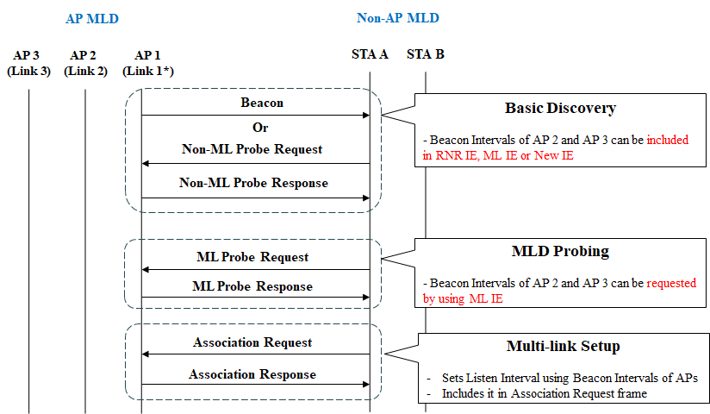
Overview of Signaling of Beacon Intervals
STA A discovers AP 1 (as reporting AP) and obtains Beacon Intervals of AP 2, 3 (as reported APs)

Slide 4
BI Signaling During Basic Discovery
A reporting AP can provide BIs of reported APs, as follows
Option 1: RNR element
Based on D0.1, the partial information of reported APs shall be provided by RNR IE (i.e., MLD ID, Link ID, Change Sequence)
Therefore, the RNR element can be a proper candidate
E.g., adding to MLD Parameters subfield of TBTT Information field (e.g., 2 octets)
However, except other APs in the same MLD, BIs of some APs (such as non-transmitted BSSIDs in the same MBSSID set and APs of the same AP MLD as each non-transmitted BSSID) may be unnecessary

Slide 5
BI Signaling During Basic Discovery (Cont’d)
Option 2: ML element
By default, ML IE needs to include BIs of reported APs
Based on D0.1
An AP within an AP MLD “should” include in the Beacon and non-ML Probe Response frames only the MLD-level/common information carried in the field(s) of ML IE
Whether the multi-link element is always present in the Beacon and non-ML Probe Response frames or is optionally present is TBD
Therefore, if ML IE includes BIs of reported APs, it should be in the Common part not Per-STA profile
However, that is not common information and it requires ML IE is always present in Beacon and Probe Response frames
Order of Link ID

Slide 6
BI Signaling During Basic Discovery (Cont’d)
Option 3: New element
We can define a new element carried in Beacon or Probe Response frame
The new element should be for reported APs in the same AP MLD as reporting AP
If an STA is not affiliated with an MLD, it does not need to include the new element in Beacon or Probe Response frame
However, since we already have RNR element and ML element to signal the information regarding Multi-link, we may not need a new element to signal a specific ML information
Order of Link ID

Slide 7
Discussion on BI Signaling during MLD Probing
An STA can request BIs of reported APs of the same AP MLD as the reporting AP using ML IE
For example, through Request IE in Per-STA Profile of ML IE (assuming BI can be made as an element)
The reporting AP can provide the requested BIs using ML IE
However, if the STA perform MLD probing to obtain BIs of reported APs, MLD probing should be mandatory
We believe MLD Probing is an optional mechanism

Slide 8
Summary
In this contribution, we discussed how to indicate the beacon intervals of other APs
In terms of Basic Discovery, reporting AP can provide BIs of reported APs
In terms of MLD Probing, if the STA perform MLD probing to obtain BIs of reported APs, MLD probing should be mandatory
We believe MLD Probing is an optional mechanism
IE | Location | Issues
RNR | MLD Parameters subfield* (in TBTT Information field) | Consideration for APs (e.g., non-transmitted BSSID) (except for APs in the same AP MLD as reporting AP)
Multi-link | Common Part | Validation of including in Common Part Whether ML IE is always present in Beacon
New | Body of Beacon/Probe Response | Necessity of another IE for ML information
*Another (new) subfield could be used

Slide 9
References
[1] 802.11-19/1262r20 Specification Framework for TGbe
[2] IEEE P802.11be/D0.1, September 2020

