Slide 1
Solicited method for critical update in multi-link
Date: 2020-10-26
Authors:
Name | Affiliations | Address | Email
Namyeong Kim | LG Electronics | LG Seocho R&D Campus, Korea | namyeong.kim@lge.com
Jeongki Kim |  |  | jeongki.kim@lge.com
Insun Jang |  |  | insun.jang@lge.com
Sunhee Baek |  |  | sunhee.baek@lge.com
Jinsoo Choi |  |  | js.choi@lge.com

Slide 2
Overview
Previously, we had discussed about the method for providing the Change Sequence fields for other APs.
We agreed that [1] :
802.11be supports that an AP within an AP MLD shall include in the Beacon and Probe Response frames it transmits the Change Sequence fields that indicate changes of system information for other APs within the same AP MLD, where the change sequence field value for the reported AP is initialized to 0, that increments as the critical update of the reported AP is occurred.
In 11be, a STA of non-AP MLD can obtain the Change Sequence number for other APs from Beacon or Probe Response frame.

Slide 3
Motivation
When a STA of a non-AP MLD confirms that the Change Sequence field for another link has changed,
In the STA of the same non-AP MLD is in awake state, the another STA can try to listen the next Beacon of another link to obtained the updated parameters.
In the STA of the same non-AP MLD is in doze state, the another STA need to awake from doze to listen the next Beacon of the another link to obtain the updated parameters.
As a result, the STA shall awake to gather the updated parameters from its Beacon and this may be inefficient when the STA is in doze state.

Slide 4
Recap: the method for critical update in 11ah
In 11ah spec., it provides some methods for the STA to retrieve the critical update information.
The S1G STA shall either be awake to receive the next S1G Beacon frame that is transmitted at a TBTT or shall queue for transmission a Probe Request frame when it receives a Change Sequence field that contains a value that is different from the previously received Change Sequence field.
When an S1G STA transmits a Probe Request frame to obtain the updated system information, it may include the Change Sequence element in the Probe Request frame to request a compressed Probe Response frame.
When an S1G AP receives a Probe Request frame that contains a Change Sequence element from an S1G STA associated with the S1G AP, it compares the value of the received Change Sequence field with the value of its current Change Sequence field. If the value of the received Change Sequence field is not equal to the value of the current Change Sequence field, the S1G AP should send a compressed Probe Response frame, which is a Probe Response frame that includes the Change Sequence element and only the elements that need be updated by the STA.

Slide 5
Proposal
11be allows a STA of a non-AP MLD to request a part of complete information of other APs of the same AP MLD [2].
We can adopt this method for a STA of a non-AP MLD to request the critical update information of other APs.
Especially, the method can be useful for a non-AP MLD in power save mode because it can obtain the updated information of the another AP without awakening the another link.
In this contribution, we propose the solicited method to obtain critical update information for other APs of same AP MLD.

Slide 6
Proposal: The solicited method for critical update
A STA may request a critical update information for one or more APs.
For example, the STA may send an ML Probe Request frame including the change sequence information of the other APs to retrieve the critical update information for other APs.
An AP sends a ML Probe Response frame containing the Change Sequence element and only the elements regarding critical update that need to be updated by the STA.
We provide two options for a signaling to indicate the request of critical update information for other APs.
Option 1: Reuse of Change Sequence element
Option 2: Define a control field + Change Sequence field

Slide 7
Option 1: Reuse of Change sequence element
We can reuse existing Change Sequence element to indicate the request of critical update information for other APs.
A STA may request critical update information of other APs by sending a Request message including a Change Sequence element.
For this, the STA may use a ML Probe Request.
On receiving the Request frame, an AP sends a Response frame containing the Change Sequence element and only the elements regarding critical update that need be updated by the STA.

Slide 8
Example: ML IE format for Option 1
A STA can request only updated critical update information of a specific link, containing a Change Sequence element in Per-STA Profile (x) of ML IE.
ML Probe Request

Slide 9
Option 2: Define a control field + Change Sequence field (1/2)
We can define a new control field to indicate the request of critical update information for other APs.
“Critical update Request” field: this field is an indication to request the elements regarding critical update.
For example, if the STA indicates a request for critical update information, this field is set to 1 and the Change Sequence field is present in Per-STA profile, otherwise, the value is 0.
To obtain only updated parameters from the AP, the STA shall include the most recently received change sequence field value in the ML Probe Request.
This can reduce overhead for duplicated information already obtained by the STA.

Slide 10
Option 2: Define a control field + Change Sequence field (2/2)
A STA may request critical update information of other APs by sending a request message including a Change Sequence field with a “Critical update Request” field.
For this, the STA may use a ML Probe Request.
On receiving the Request frame, an AP sends a ML Probe Response frame containing the Change Sequence field and only the elements regarding critical update that need to be updated by the STA.

Slide 11
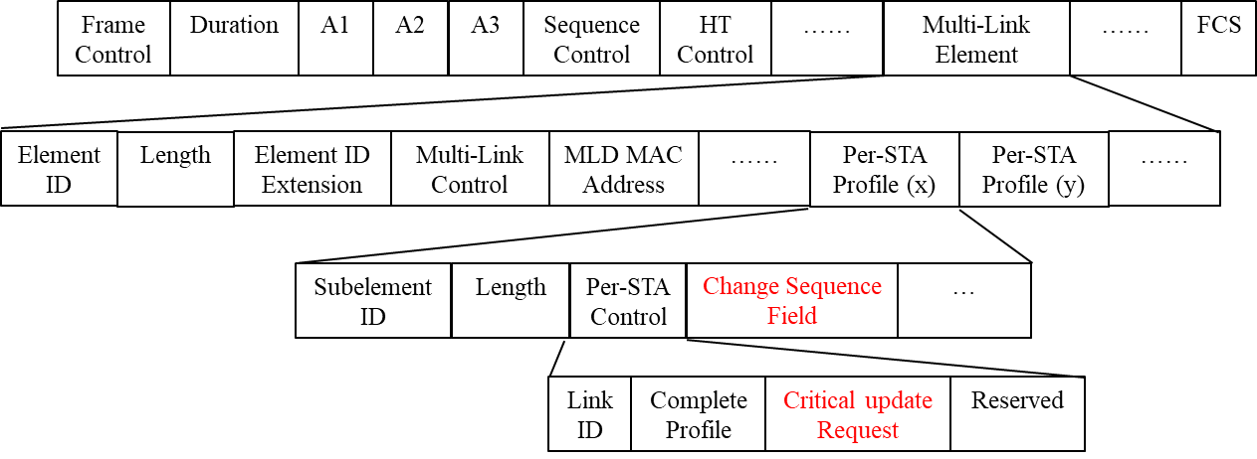
Example: ML IE format for Option 2
A STA can request only updated critical update information of a specific link, containing a Change Sequence field with a “Critical update Request” field in Per-STA Profile (x) of ML IE.
ML Probe Request

Slide 12
Option 1 vs Option 2
Option 1
This option is simple using existing Change Sequence element.
We don’t need to define a new field or element.
But, the overhead for default field (e.g. element ID, length field) may occur each Per-STA Profile.
When the STA requests information on multiple APs, this overhead may increase further.
Option 2 (preferred)
This option requires a new field.
However, the new field is just 1bit (e.g. “Critical update Request” field)
But, the overhead for default field can be reduced by using the change sequence field (not element).
As a result, we prefer the Option 2 to avoid duplicated information transmission and reduce overhead.
We may use ML IE format to indicate request of critical update information of specific link(s).

Slide 13
Conclusion
In this contribution, we propose the solicited method to retrieve the critical update information for one or more AP(s).
Using this method, a STA may obtain only critical update information for other APs.
In particular, this method may be useful for non-AP MLD in power save mode because it can retrieve other AP's information regardless of the doze state.
In this regard, we provide 2 options for the signaling to request the critical update information.
We slightly prefer Option 2 for the solicited method because it has lower overhead than Option 1.

Slide 14
SP #1
Do you agree to add the following to 11be SFD:
A STA of a non-AP MLD may send a Probe Request frame to the peer AP to obtain updated BSS parameters of another AP of the AP MLD with which the non-AP MLD has setup.
The Probe Request frame is ML Probe Request.

Slide 15
SP #2
Do you agree to add the following to 11be SFD:
When a STA of a non-AP MLD sends ML Probe Request to the peer AP to obtain updated BSS parameters of another AP of the AP MLD with which the non-AP MLD has setup, it shall include the value of the most recently received change sequence field of the another AP in the ML Probe Request.
The exact name of change sequence field is TBD.

Slide 16
SP #3
Do you agree to add the following to 11be SFD:
When a STA of a non-AP MLD sends a ML Probe Request to the peer AP to obtain updated BSS parameter(s) of another AP of the AP MLD with which the non-AP MLD has setup, it shall include the value of the most recently received change sequence field in Per-STA Profile of ML IE carried in the ML Probe Request.
The exact name of change sequence field is TBD.

Slide 17
SP #4
Do you agree to add the following to 11be SFD:
When a STA of a non-AP MLD sends a ML Probe Request containing a ML IE with change sequence field to the peer AP, the “Complete Profile” subfield in Per-STA Profile subelement of ML IE is set to 0.
The exact name of change sequence field is TBD.

Slide 18
SP #5
Which option do you prefer as a signaling to retrieve the updated BSS parameter(s) for another AP of AP MLD with which the non-AP MLD has setup?
Option 1: Reuse Change Sequence element
Option 2: Define a control field + Change sequence field
Abstain

Slide 19
References
[1] 11-20/0586: MLO Signaling of critical updates (Abhishek Patil, Qualcomm)
[2] 11-20/0411: MLO Information exchange for Link switching (Namyeong Kim, LG Electronics)

