Slide 1
TGba CRC Telco Agenda and Motions
Date: 2020-10-12
Authors:

Slide 2
Abstract
This document contains
Agenda for TGba CRC call [October 12]
Call information
Join the Webex meeting here:
https://ieeesa.webex.com/ieeesa/j.php?MTID=m81e91f557723fddd71af8dc47473b30a
Meeting number: 173 229 1137
Meeting password: wireless (94735377 from phones and video systems)
Join by phone:
Tap to call in from a mobile device (attendees only)
+1-408-418-9388 USA Toll
Global call-in numbers
Access code: 173 229 1137
Motions on comment resolutions (from motion# 8000)

Slide 3
Agenda [October 12]
Call meeting to order
Agenda setting
Patent policy (links in the next slide)
Attendance:
Use IMAT to register your attendance
SA ballot result review
Presentations
11-20/1596r2 - CR for CID 8001, Po-Kai Huang (Intel)
11-20/1597r0 - CR for misc. CIDs, Minyoung Park (Intel)
Timeline
Adjourn

Slide 4
Teleconferences are subject to applicable policies and procedures
• IEEE Code of Ethics – https://www.ieee.org/about/corporate/governance/p7-8.html • IEEE Standards Association (IEEE-SA) Affiliation FAQ – https://standards.ieee.org/faqs/affiliation.html • Antitrust and Competition Policy – https://standards.ieee.org/content/dam/ieee-standards/standards/web/documents/other/antitrust.pdf • IEEE-SA Patent Policy – http://standards.ieee.org/develop/policies/bylaws/sect6-7.html – https://standards.ieee.org/about/sasb/patcom/ • IEEE 802 Working Group Policies &Procedures (29 Jul 2016) – http://www.ieee802.org/PNP/approved/IEEE_802_WG_PandP_v19.pdf • IEEE 802 LMSC Chair's Guidelines (Approved 13 Jul 2018) – https://mentor.ieee.org/802-ec/dcn/17/ec-17-0120-27-0PNP-ieee-802-lmsc-chairs-guidelines.pdf • Participation in IEEE 802 Meetings – https://mentor.ieee.org/802-ec/dcn/16/ec-16-0180-05-00EC-ieee-802-participation-slide.pptx • IEEE 802.11 WG OM: (Approved 10 Nov 2017) – https://mentor.ieee.org/802.11/dcn/14/11-14-0629-22-0000-802-11-operations-manual.docx

Slide 5
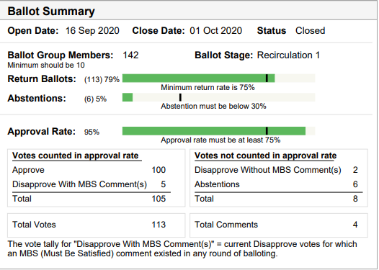
SA Ballot Summary
Approval rate: 95%
100 approve, 5 disapprove
4 comments received

Slide 6
Timeline – [Depends on 11ax and 11ay]
2020
October: comment resolution on D7.0
October-November: D8.0 Recirc/Unchanged recirc
November 13 – 802 EC Approval
Next opportunity is December 1st EC telco
December 11 – Draft to RevCom
2021
January: RevCom/SASB approval

Slide 7
Motion# 8000
Move to accept the comment resolution in [11-20/1596r2] for CIDs listed below:
8001
Move:
Second:
Result:

Slide 8
Motion# 8001
Move to accept the comment resolution in [11-20/1597r0] for CIDs listed below:
8002, 8003, 8004
Move:
Second:
Result:

