Slide 1
MU-RTS to SST-STAs
Date: 2020-10-07
Authors:

Slide 2
Abstract
This submission provides means to Sub-Channel Selective (SST) STAs to receive MU-RTS and transmit CTS as a response.

Slide 3
Recap, SST STA in 802.11ax
A STA and AP may setup an individual trigger-enabled TWT agreement to schedule the times when the STA operates in SST mode
20 MHz SST STA may operate in any secondary channel
  The PPDU reception rules are similar to the primary 20 channel
The 80 MHz SST STA may operate in the secondary 80 MHz channel
  The 80 MHz SST STA does not have a primary channel:
    STA receives HE MU and non-HT Duplicate PPDUs that are transmitted over the whole 80 MHz channel

Slide 4
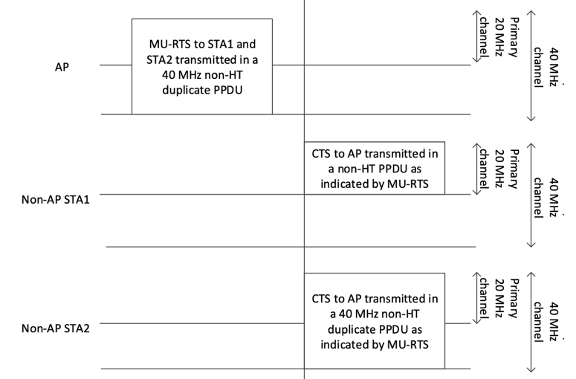
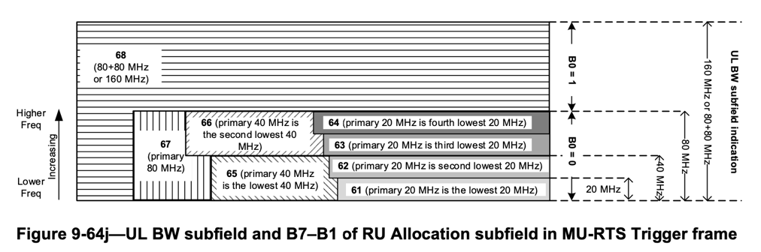
Recap, MU-RTS and CTS
MU-RTS may trigger CTS frame transmission from one or more STAs
The MU-RTS signals the channels in which the responding STAs transmit CTS if the channel(s) are IDLE
The CTS is always transmitted to the primary channel

Slide 5
Proposal: MU-RTS and CTS exchange with EHT SST STA
1. CCA and NAV are obtained from the STA that receives DL transmission.
2. CTS protects the proximity of the STA that receives transmission
3. EHT SST STAs may operate outside the operating BW of the non-SST STAs.
SIFS, CCA is done at the same time in all STAs

Slide 6

Proposal: MU-RTS and CTS exchange with EHT SST STA
The AP may receive CTS only on secondary channels
The AP may transmit to other STA, if the AP senses the primary channel IDLE
  Associated STAs detect the primary channel busy
SIFS

Slide 7
Proposal: MU-RTS and CTS exchange with EHT SST STA
If the AP does not receive CTS and senses primary channel BUSY, then the AP may:
  Send PPDU to the SST STAs from which it received CTS on the secondary channels
  Cancel the TXOP by sending CF-End frame on the secondary channels in which it received a CTS frame
SIFS

Slide 8
Packet Reception Channel
1. SST-STA Receives MU-RTS on Packet Detection channel [2]
2. The UL BW field in the MU-RTS signals the channels to which SST-STA transmits CTS. SST STAs may have similar signaling as STAs in primary channel, except the channels are counted from the Packet Detection channel.
SIFS
[2] 20/736r2 EHT SST Operation, Mediatek

Slide 9
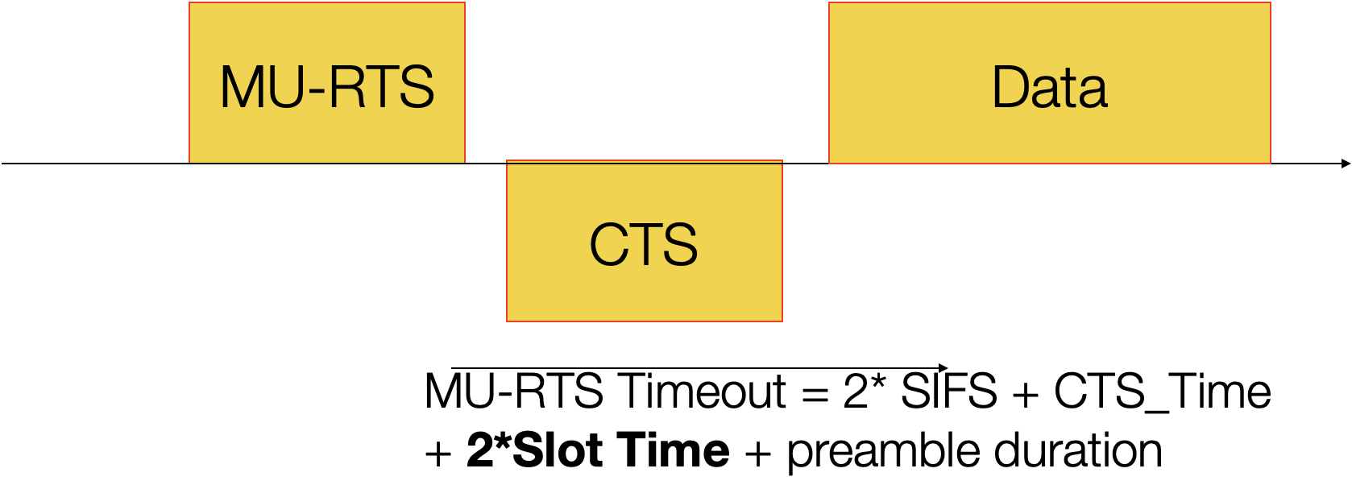
TX protection during TX to SST-STA(s)
The AP may transmit only to the SST-STAs, because:
  Legacy 802.11ac, etc. STAs set NAV when they receive MU-RTS frame. These STAs cannot reset the NAV
  The 802.11ax and EHT STAs may be configured to initiate UL EDCA transmissions with RTS CTS signaling by setting the TXOP Duration Threshold subfield in HE Operation Parameters element to 1
    The RTS CTS protects the STAs from gaining to the media, if the AP is transmitting to SST-STAs

Slide 10
Shorter MU-RTS frame
Hidden STAs may not receive MU-RTS
  Short MU-RTS allows better chances to transmit CTS before hidden STAs can transmit
The MU-RTS frame is transmitted in low TX Rate
  Packet size increases transmission duration
  @6 Mbit/s TX rate only 26 bits fit in one ~4µs symbol

Slide 11
MU-RTS frame transmission per 80 MHz
MU-RTS frame is transmitted as non-HT Duplicate PPDU
802.11be allows PPDUs to carry a different payload in each 80 MHz channel
  The MU-RTS frame on secondary, tertiary or quaternary 80 MHz channel may contain User Info fields only to the EHT SST STAs
  The MU-RTS frame transmission to SST-STAs may not increase the transmission duration of the MU-RTS frame

Slide 12
Partial response to MU-RTS
The MU-RTS may allow SST-STA to reserve a subset of the requested channels
  The SST-STA may send CTS on channels in which the AP is capable to transmit punctured PPDU
If channels is reserved by a single (SST-)STA, the CTS frame may signal the reserved channels
SIFS

Slide 13
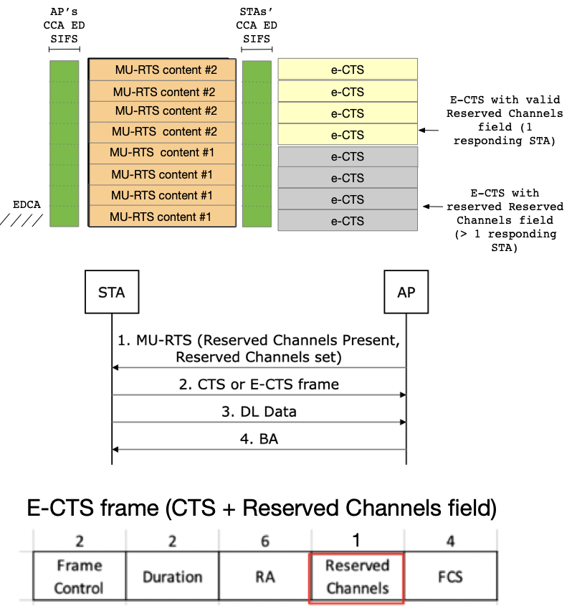
Proposal - CTS frame size and content
A receiver cannot know whether it is the only responder of the MU-RTS frame
The MU-RTS signals the response frame type (CTS or e-CTS):
  CTS frame format is specified in 802.11ax
  E-CTS frame signals the channels in which channel the E-CTS was transmitted
  AP can command a STA to set Reserved Channels field to value 0

Slide 14
Summary
The submission proposed MU-RTS CTS signalling for SST-STAs
  The DL transmissions to SST-STAs can have hidden terminal protection

Slide 15
SP 1
Do you support that 802.11be allows AP to send an MU-RTS frame that is addressed to an EHT SST-STA?
- EHT SST-STA responds with CTS if all requested channels are IDLE

Slide 16
SP 2
Do you support that 802.11be allows non-HT duplicate transmission that contains different payload for different 80 MHz channels?

Slide 17
SP 3
Do you support that 802.11be R2 SST-STA has optional capability to respond on subset of the channels to the MU-RTS frame addressed to the STA?

