Slide 1
ML Reconfiguration
Date: 2021-01-20
Authors:
Name | Affiliations | Address | Phone | E-mail
Payam Torab | Facebook | 1 Hacker way Menlo Park, CA |  | torab@ieee.org
Chunyu Hu |  |  |  | chunyuhu@fb.com
Pooya Monajemi | Cisco |  |  | pmonajem@cisco.com
Malcolm Smith |  |  |  | mmsmith@cisco.com
Rojan Chitrakar | Panasonic |  |  | rojan.chitrakar@sg.panasonic.com
Yoshio Urabe |  |  |  | urabe.yoshio@jp.panasonic.com
Gaurav Patwardhan | HPE |  |  | gaurav.patwardhan@hpe.com
Eldad Perahia |  |  |  | eldad.perahia@hpe.com
Zhiqiang Han | ZTE |  |  | han.zhiqiang1@zte.com.cn
Insun Jang | LGE |  |  | insun.jang@lge.com
Namyeong Kim |  |  |  | namyeong.kim@lge.com

Slide 2
Introduction
Multi-link operation (MLO) is an established feature of 11be
STA* entities within Multi Link Devices (MLDs) forming connections referred to as links
A link is a pairing of one AP STA* of an AP MLD and one non-AP STA* of an associated non-AP MLD
We refer to the mapping between AP and non-AP STA* entities of two associated MLDs as the “Multi-Link (ML) Configuration”
There are MLO scenarios that require changing the ML configuration established at association time – see [20/0810] for discussion
Radio | processing core becoming available/unavailable (device centric)
Reachability | range changes (environment, mobility) …
Furthermore, details of deciding the ML configuration at association time are not clear
* We prefer a different name for these entities in the the 802.11 architecture (e.g., “endpoints”), but have kept the term STA to stay consistent with contributions to this point.

Slide 3
Introduction
We discuss ML Reconfiguration, an umbrella term for a set of procedures (information dissemination, signaling) aimed at changing the mapping of STA entities within MLDs (the “ML configuration”) post association
Multiple links (paths) improves robustness of both data and management planes
Robust management: Making changes to configuration without having to disassociate
Change to the mapping can include changes in number of links
ML reconfiguration example
Note: Some changes to ML configuration may require multiple steps (e.g., adding a new AP to an AP MLD, deleting a link terminating on an AP within the AP MLD, adding a new link terminating on a different AP within the AP MLD …)
AP 1
STA 1
AP 1
STA 1
AP 2
STA 2
AP 2
STA 2
AP 3
STA 3
AP 3
STA 3
ML
Reconfiguration
AP 4
AP 4
AP MLD
Associated
Non-AP MLD
AP MLD
Associated
Non-AP MLD

Slide 4
Why ML reconfiguration
Some MLO scenarios require changing the ML configuration
Radio becoming available/unavailable post association (changes in device)
Maintenance, hardware additions, hardware failure, upgrades ...
New reachability/range with mobility (changes in environment)
New traffic conditions (static/permanent increase/decrease in traffic)
See [20/0810] for discussion
Changing ML configuration does not require disassociation
As long as there are unaffected links through the process to carry out the signaling

Slide 5
More on ML configuration (1) Deciding the ML configuration at association time
References
[20/0389]
[20/0390]
[20/0865]
AP
MLD
Beacon,
Probe Response
Elements: RNR, ML
AP STA capabilities
Probe Request,
Association Request
Elements: ML
Non-AP STA capabilities
Non-AP
MLD-
References
[20/0389]
[20/0390]
[20/0741]
[20/1274]
[20/1592]
AP1
STA1
AP2
STA2
AP3
STA3
AP4
ML configuration (= mapping between AP and non-AP STAs)
decided by non-AP MLD
AP
MLD
2.4 GHz channel
Non-AP
MLD-
AP1
STA1
AP2
STA2
AP3
6 GHz channel
STA3
AP4
Non-AP MLD decides the STAs and mapping to APs, based on many factors including capabilities (e.g., channels, number of spatial streams)
ML element in Association Request declares a mapping by indicating the Link ID (better name is AP ID) corresponding to each non-AP STA [20/1274]
The choice (including number) of non-AP STAs to connect to AP STAs and the mapping to AP STAs belongs to non-AP MLD
That is, non-AP MLD decides the number and endpoints of the links, which is accepted or rejected by the AP MLD

Slide 6
More on ML configuration (2) Deciding the ML configuration at association time
Desired ML configuration (mapping between non-AP and AP STAs of MLDs) is specified through the ML IE in Association Request
AP MLD can reject a requested ML configuration for a variety of reasons
Association Response must include proper error code and possibly a recommended ML reconfiguration in case of rejection

Slide 7
ML reconfiguration scenarios (1) Requiring a change in the AP endpoint of a link
Scenario: AP MLD associated with 3 MLDs, decides to move the 5 GHz operation of MLD2 and MLD3 to 6 GHz
STA1
Non-AP MLD with 3 STAs
(no change in configuration)
2.4 GHz
Non-AP
MLD1-
AP1
STA2
AP
MLD
5 GHz
AP2
STA3
Move 5 GHz
endpoint …
AP3
Non-AP
MLD2-
Non-AP MLD with 2 STAs (connected to 2 APs of the AP MLD; this MLD needs ML reconfiguration)
... to 6 GHz
STA1
STA2
MLD1 (3 STAs) on 2.4, 5 and 6 GHz
MLD2 (2 STAs) on 2.4 and 5 GHz
MLD3 (2 STAs) using 2.4, 5 and 6 GHz
5 GHz congestion or link loss,
or just traffic engineering
6 GHz
Non-AP
MLD3-
Non-AP MLD with 3 STAs
(connected to 3 APs of the AP MLD; this MLD can simply disable the 5 GHz link)
STA1
MLD1 (3 STAs) on 2.4, 5 and 6 GHz
MLD2 (2 STAs) on 2.4 and 6 GHz
MLD3 (2 STAs) using 2.4 and 6 GHz
STA2
STA3
ML reconfiguration to change the AP endpoint of a link; common scenarios
Fewer non-AP STAs than AP STAs within associated MLDs (no 1:1 mapping), or
AP STAs tied to certain bands/channels (switching constraints, or radio in use)
Potential steps (separate, or possibly combined)
(Non-AP MLD2) remove the STA2 – AP2 link
(Non-AP MLD2) add the STA2 – AP3 link
Notes:
AP2 will stay on 5 GHz for its connection to STA2 in MLD1. STA2 in MLD2 needs to switch to a new AP (AP3) for operation on 6 GHz.

Slide 8
ML reconfiguration scenarios (2) Requiring a change in the non-AP endpoint of a link
Scenario: AP MLD associated with 3 MLDs, decides to move the 5 GHz operation of all MLDs to 6 GHz
STA1
2.4 GHz
Non-AP
MLD1-
Non-AP MLD with 2 STAs
(one of the STAs performs a channel switch from 5 to 6GHz)
AP2 switching from 5 GHz to 6 GHz; needs to connect to different non-AP STAs affiliated with non-AP MLDs
AP1
STA2
AP
MLD
Channel switch from 5 to 6 GHz
AP2
5 GHz
switching
to 6 GHz
5 GHz
Non-AP
MLD2-
Non-AP MLD with 3 STAs
(STA2: Only 5 GHz capable,
STA3: Only 6 GHz capable,
new link on a new STA set up)
Move 5 GHz
endpoint …
STA1
STA2
MLD1 (2 STAs) on 2.4 and 5 GHz
MLD2 (3 STAs) on 2.4 and 5 GHz
MLD3 (2 STAs) on 2.4 and 5 GHz
STA3
6 GHz
... to 6 GHz
5 GHz congestion or link loss,
or just traffic engineering
Non-AP
MLD3-
Non-AP MLD with 2 STAs
(one of the STAs performs a channel switch from 5 to 6GHz)
STA1
MLD1 (2 STAs) on 2.4 and 6 GHz
MLD2 (3 STAs) on 2.4 and 6 GHz (through a new STA)
MLD3 (2 STAs) on 2.4 and 6 GHz
Channel switch from 5 to 6 GHz
STA2
ML reconfiguration to change the non-AP endpoint of a link; common scenarios
Fewer AP STAs than non-AP STAs within associated MLDs (no 1:1 mapping)
Non-AP STAs within an MLD tied to certain bands/channels (switching constraints)
Potential steps (some may be optional)
(AP MLD) request MLD2 to remove STA2 – AP2 link
(Non-AP MLD2) remove STA2 – AP2 link (5 GHz)
(AP MLD) switch AP2 channel from 5 GHz to 6 GHz
(Non-AP MLD2) add STA3 – AP2 link (6 GHz)
Notes:
STA2 in MLD1, and STA2 in MLD 3 are capable of both 5 and 6 GHz operation and will perform a channel switch. STA2 in MLD2 is capable of only 5 GHz, so moving the operation to 6 GHz requires using the new STA3.

Slide 9
ML reconfiguration scenarios (3) Other scenarios (similar in nature)
Adding a link
Traffic load increase
Channel condition (range, reachability..) changes
New application starts to run, requiring new radio purposed for the type of application, e.g., activating a new 6 GHz radio in response to VR application request
Removing a link
Operating on all available links may not always be the best option due to:
Efficiency, power save
Less management overhead
Sticking with the dominant traffic component (e.g., keeping a TID with 5% of the traffic together with the only other TID carrying 95% of the traffic, in one link)
Note: There should be no reason for AP to reject a non-AP request to remove a link
See [20/810] (Dynamic Link Set) for more discussion

Slide 10
ML reconfiguration | Summary
ML reconfiguration: A set of procedures to change the AP/non-AP STA mapping within the associated MLDs
Reconfiguration components (absent in the current framework – early discussion [19/1943], [20/0741]),
Adding | removing an AP (within MLD)
Adding | removing non-AP (within MLD)
Adding | removing a link
Changing AP end or non-AP end of a link
Note: Changing one end of the link can be achieved through link removal and addition; listed separately to leave open the possibility of a one-step solution
Reconfiguration initiated by non-AP or AP (details subject of straw polls)
AP
MLD
Non-AP
MLD
Non-AP connecting to new AP
Fewer non-AP STAs than AP STAs within MLDs, or
AP STAs having band/channel switching constraints
AP
MLD
Non-AP
MLD
AP connecting to a new non-AP
Fewer affiliated AP STAs than affiliated non-AP STAs, or
affiliated non-AP STAs having band/channel switch constraints
AP
MLD
Non-AP
MLD
Adding | removing a link
New link was not set up at association time (adding a link),
or link removed permanently from protocol standpoint

Slide 11
Operations that are not ML reconfiguration
TID switch
Change of TID-to-link mapping
Channel switch
Change of link-to-channel mapping
Changes to link power save state
None of these operations changes the mapping of AP/non-AP STAs decided at association time
AP
MLD
Non-AP
MLD
TID 1
(split between
two links)
TID switch
Links remain the same, mapping between TIDs and links changes
AP
MLD
Non-AP
MLD
Channel switch
No change from MLO perspective;
same link operating on a different channel
AP
MLD
Non-AP
MLD
Changes to link power save or TIDs
Links still set up at association time

Slide 12
Discussion (1) Fit into the architecture
ML reconfiguration is part of ML management
It complements other ML management functions such as TID-to-link mapping
Reconfiguration sets the stable (longer term) link set
TID-to-link mapping for more dynamic adjustments over a given link set (still needed)
ML reconfiguration is a basic part of the architecture
There are many use cases, but in general it is not even a question of why
Framework should provide mechanisms to add links, remove links, and possibly modify links (the equivalent of removing a link and adding another, but as one operation) post association, without having to disassociate
The case of non-AP connecting to a different AP within the MLDs is remotely similar to BTM, but there is really no network wide transition
For example, a BTM-like signaling can be used, but there is no re-association
Assuming same PTK for all ML links, PTK can stay the same, and new GTK set up on new links

Slide 13
Discussion (2) Symmetry, traffic hit
ML reconfiguration is generally a symmetric operation
There is little difference between AP and non-AP STAs within two associated MLDs in terms of reasons to initiate a link switch
Need to add/remove/replace a link can arise on any side – AP or non-AP
Reconfiguration does not change the MLD-level network roles
Reconfiguration can be initiated by the AP MLD however
Non-AP can trigger the operation, similar to sending a Query frame in BTM
Traffic loss during the reconfiguration must be minimized
This is a common goal (with potentially common solutions) for all switching scenarios, TID-level or link-level
Design elements from Fast Session Transfer (FST) can be borrowed
Data plane ownership during reconfiguration, making sure MPDUs are received on new link(s) before declaring the operation successful

Slide 14
Discussion (3) Disabled links at association time
A non-AP MLD that does not match the AP MLD in terms of number of affiliated STAs can create “ghost” disabled links at association time
For example, non-AP MLD introducing a STA for each AP of the AP MLD
Some links started in a non-active state - indefinite state of power save, “TID-free zone” (but presumably still allowing groupcast and management frames?), or other variations
This is a scenario-dependent choice at association time, requiring
Additional resources (unique MAC addresses, Link/AP IDs, information blocks …)
Additional MAC features (e.g., power save)
Creating these links neither replaces nor is precluded by ML reconfiguration
Not a substitute for general link addition (when new links are unavailable or not set up for any reason at association time), link removal (absent from all subsequent signaling), or modifying the link endpoints post association
In some cases, these do not even look similar, e.g., fewer AP STAs than non-AP STAs of different capabilities (see reconfiguration scenario #2)
Matter of operation vs. configuration
Notes:
Regarding ghost/disabled links: Association time ML configuration can be decided with or without extra links. ML reconfiguration is a fundamentally different problem – changing the configuration post association for any reason that was not present or clear at the time of association. With regards to implementation, and by way of example, if a non-AP MLD with two basebands associates with an AP MLD with 3

Slide 15
Discussion (4) State preservation across ML reconfiguration
MLD-level states/parameters preserved across ML reconfiguration
BlockAck operation, TIDs (TSs, TCs)
Security (authentication, possibly PTK)
Link-level states/parameters initialized for new/modified links
Power save states, TWT sessions
Per-link security attributes (e.g., GTK)
ML reconfiguration is generally not a substitute for frequent switching between links (as in enhanced multi-link single radio for example)
Logic should be simple and straightforward
For example, no change to existing TID-to-link mappings (hierarchical view of TIDs on top of link “topology”), plus, some straightforward rules on affected TIDs
TIDs mapped exclusively to a link deleted during ML reconfiguration to stop (which means they should be mapped to other links before link deletion if interested in TID continuity)
No change in operation state (power save etc.) to unaffected links

Slide 16
Straw Poll 1 Link addition/removal initiated by non-AP MLD
Do you agree to add to TGbe SFD in R1, a mechanism for a non-AP MLD to add or remove links to an associated AP MLD, subject to the following,
The AP MLD may reject a request to add a link
The AP MLD shall not reject a request to remove a link
Note: In case of adding a link, additional AP STAs within the AP MLD can be known prior to association (e.g., ML IE received from AP MLD during discovery), or can be added by the AP MLD post association through updated beacon contents or similar TBD procedure, to be specified as part of defining the mechanism.
Yes
No
Abstain

Slide 17
Straw Poll 2 Link addition at the request of AP MLD
Do you agree to add to TGbe SFD in R1, a mechanism for an AP MLD to request an associated non-AP MLD to add a link to the AP MLD, subject to the following,
The non-AP MLD may reject a request to add a link
Note: Additional non-AP STAs within the non-AP MLD can be known during association (e.g., from the ML IE received from the non-AP MLD in the Association Request frame) or can be added by the non-AP MLD post association through updated ML IE contents or similar TBD procedure, to be specified as part of defining the mechanism.
Yes
No
Abstain

Slide 18
Straw Poll 3 Link removal at the request of AP MLD
Do you agree to add to TGbe SFD in R1, a mechanism for an AP MLD to request an associated non-AP MLD to remove a link to the AP MLD, subject to the following,
Request in the form of a recommendation, which the non-AP MLD may reject, or a mandate (notification, pointing to a future removal time), which the non-AP MLD cannot reject
Note: AP MLD practically can stop serving a non-AP MLD on a given MLO link; the mandate option (notification pointing to future removal time) aims to make the transition smooth by making the non-AP MLD aware of the impending link removal. This is similar in nature to the “Disassociation Imminent” indication in the BTM Request frame.
Yes, with request as recommendation (non-AP can decline) or notification (non-AP cannot decline)
Yes, with request as recommendation only (non-AP can decline)
No (AP may not send a request to remove a link)
Abstain

Slide 19
Straw Poll 4 AP MLD indication of AP STA removal
Do you agree to add to TGbe SFD in R1, an announcement-based mechanism for an AP MLD to remove an affiliated AP STA?
Note: Announcement mechanism is similar in nature to Extended Channel Switch Announcement, indicating the number of TBTTs left to the moment the affiliated AP STA will become unavailable. The AP MLD should give sufficient advance notice to non-AP MLDs before removing the affiliated AP STA. Definition and mechanisms for “sufficient advance notice” is TBD.
Yes
No
Abstain

Slide 20
Straw Poll 5 Use of Robust Action frames
Do you agree to use Robust Action frames for any post-association link add, remove or modify operation that has been approved in the TGbe SFD in R1?
Note: ML reconfiguration operations, subject to approval in TGbe SFD in R1, include link add, remove and modify (i.e., remove plus an add), initiated by non-AP independently, or at the request of AP MLD.
Yes
No
Abstain

Slide 21
Straw Poll 6 Combined/multiple link addition/removal initiated by non-AP MLD
Do you agree to add to TGbe SFD in R1, a mechanism for a non-AP MLD to add and remove multiple links to an associated AP MLD through a single request/response exchange?
Note 1: Assuming MLD-level association is maintained through one or more links that are not removed throughout the procedure.
Note 2: Mechanism details are TBD, but the same mechanisms used by non-AP MLD to add or remove links to the AP MLD post association (e.g., through communicating a modified ML IE) can be extended to signal multiple changes in the ML configuration.
Yes
No
Abstain

Slide 22
References
[19/1943] 11-19-1943-09-00be-multi-link-management.pptx
[20/0389] 11-20-0389-03-00be-multi-link-discovery-part-1.pptx
[20/0390] 11-20-0390-03-00be-multi-link-discovery-part-2.pptx
[20/0412] 11-20-0412-01-00be-mlo-link-switching-method.pptx
[20/0669] 11-20-0669-00-00be-mld-transition.pptx
[20/0741] 11-20-0741-02-00be-indication-of-multi-link-information-follow-up.pptx [20/0751] 11-20-0751-01-00be-multi-link-setup-clarifications.pptx [20/0810] 11-20-0810-01-00be-dynamic-link-set.pptx [20/0908] 11-20-0908-00-00be-multilink-ts-operation.pptx
[20/1187] 11-20-1187-00-00be-multilink-setup-discussion.pptx
[20/1274] 11-20-1274-09-00be-mac-pdt-mlo-ml-ie-structure.docx
[20/1592] 11-20-1592-00-00be-ml-ie-in-authentication-frame.docx

Slide 23
Backup slides

Slide 24
Mechanisms with potential design reuse (1) BSS Transition Management (BTM)
AP recommending or requiring non-AP to transition to a new AP
Query, Request and Response frames
Neighbor Report element

Slide 25
Mechanisms with potential design reuse (2) Fast Session Transfer (FST) overview
FST is designed to transfer a session (defined as one or more TSs) from one band/channel to another band/channel
TCs should be able to use FST too; TS constraint is probably unnecessary
Equivalent of an MLO link is an independent association between the FST endpoints in each band/channel
For example, the endpoints network roles (AP | non-AP relationship) can be different in the new band/channel
Operating parameters of each FST association are generally unavailable across BSSs in the FST framework, which means they need to be signaled at transition (through the Multi-band element)
Architecturally, the two endpoints of an FST session do not manage their multiple MAC sublayers through a multiple MAC SME (MM-SME)
FST can switch one TID from one BSS to another BSS between two given multi-band devices
Multi-band definitions are general enough to apply to two channels in the same band.

Slide 26
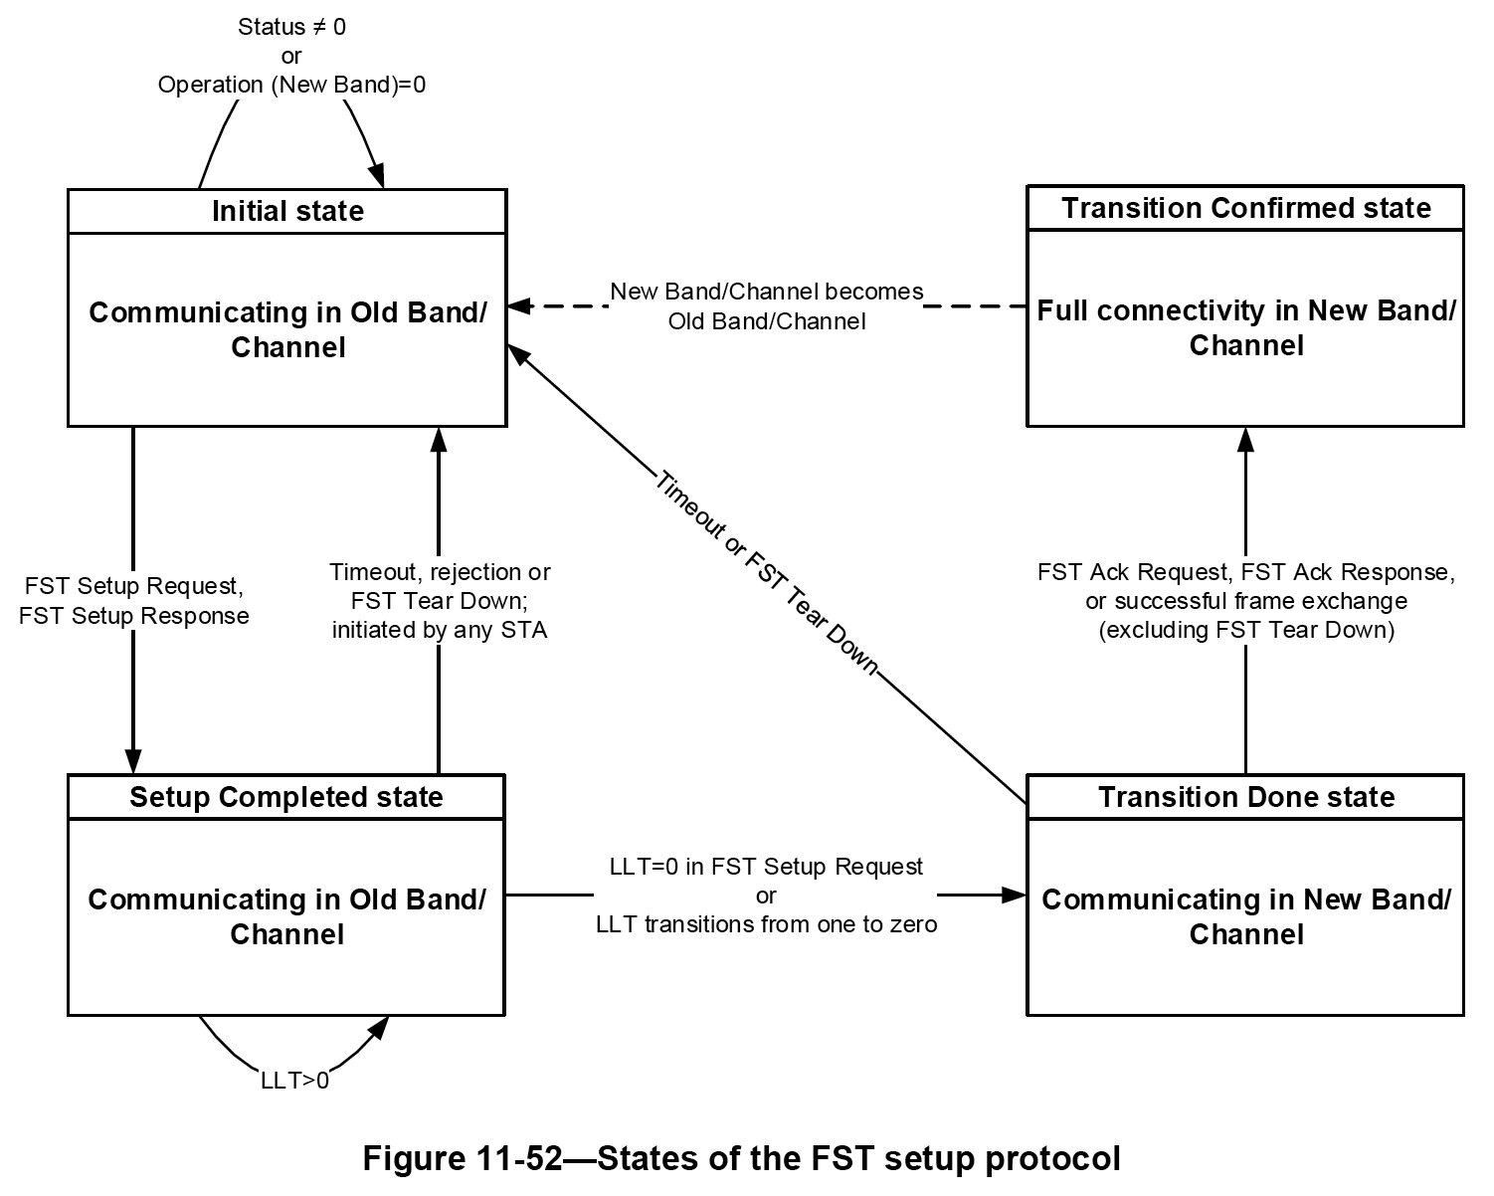
Mechanisms with potential design reuse (3) FST session transfer protocol
Session transfer can be initiated by either end (initiator end, the other end called responder)
State machine with 4 states (Initial, Setup Completed, Transition Done, and Transition Confirmed), and the following state transition logic,
“Initial” to “Setup Completed”: Successful exchange of FST Setup Request and FST Setup Response Action Ack frame; no timeout, retries left to initiator, MAC address-based arbitration between racing requests
“Setup Completed” to “Transition Done”: After a STA-based or stream-based (TS-based) countdown to 0; counter initially loaded to LLT ×32 μs, where link loss timeout (LLT) is specified in the FST Setup Request frame; counter reset to initial value every time an individually addressed frame for the STA or for the specific TS in the STA is received from the peer STA
“Transition Done” to “Transition Confirmed”: Successful exchange of FST Ack Request and FST Ack Response (both Action Ack frames) or other MPDUs in the new band/channel

