Slide 1
Discussion on Multi-link Setup
Date: 2020-09-02
Authors:
Name | Affiliations | Address | Phone | Email
Guogang Huang | Huawei |  |  | huangguogang1@huawei.com
Ming Gan
Yuchen Guo
Yunbo Li
Yiqing Li
Mengyao Ma
Notes:
September 2012

Slide 2
Introduction
The following consensus has been reached
  Enable/disable is govern by TID-to-link mapping. In other words, enable/disable is the result of TID-to-link mapping
    Note that frame exchange on a link is subject to the power state of the corresponding non-AP STA.
  An AP MLD can recommend a non-AP MLD to use one or more enabled links.
In this contribution, we seek to clarify how to signal the multi-link setup and link recommendation

Slide 3
Recap Multi-link element (MLE)
The format of MLE is shown as the following [1]

Slide 4
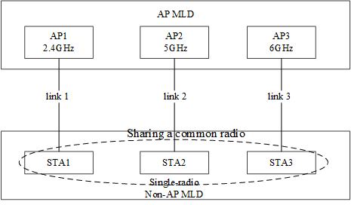
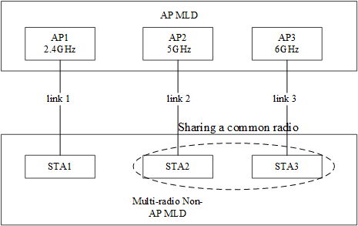
Scenario considered
Scenario 1. Single-radio non-AP MLD, shown as the left Figure
Scenario 2. Multi-radio non-AP MLD with fewer radios than AP MLD, shown as the right Figure.
Figure Single-radio non-AP MLD
Figure Multi--radio non-AP MLD

Slide 5
Related Signaling
For each requested setup link, the corresponding Per-STA profile subelement shall be carried in the MLE in an (Re-)Association Request frame.
In the (Re-)Association Request frame, the information on STA-AP association relationship needs to be carried in the Per-STA profile
So the proposed format of Per-STA Profile subelement carried in (Re-)Association Request frame is shown as follows

Slide 6
Radio ID
When a non-AP MLD has multiple affiliated physical STAs, a Radio ID subfield is carried
  The Radio ID of STA transmitted (Re-)Association Request frame is 0 by default.
If multiple Per-STA profiles have the same value of Radio ID, that means these links share a common physical STA.
This information is helpful to the following operation
  At the AP side, this info is needed for making some recommendation
  Decide a proper TID-to-link mapping
  Signalling on antennas sharing between two radios

Slide 7
Power Management and Capability Information
The non-AP MLD can explicitly indicate the power management of each non-transmitting link after the multi-link setup [2-5]
  Active mode
  Power save mode and its power state is doze by default
This is helpful to reduce the latency of the delay-sensitive traffic when the non-AP MLD is roaming to a new AP MLD
There are two options for the Capability Information indication
  Option 1. Capability Information is MLD-level
  Option 2. Capability Information is link-level
    But the values of some subfields in Capability Information field must keep consistent, e.g. ESS, IBSS, APSD subfields

Slide 8
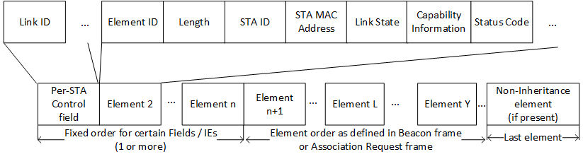
Status Code
In the (Re-)Association Response frame, the AP MLD maybe reject some requested links.
  For example, the AP MLD can reject the establishment of one link which belongs to a non-STR link pair.
Then the AP MLD needs to respectively indicate whether the requested link is set up successfully through the Status Code subfield
  If the transmitting link is rejected, then the association is considered failed
  If the transmitting link is accepted and all of non-transmitting links are rejected, then the STA-level association is considered successful
  If the transmitting link is accepted and at least one of non-transmitting links is accepted, then the MLD-level association is considered successful

Slide 9
Link Recommendation
AP MLD can send a Link Recommendation notification to the non-AP MLD through one link, which includes the following info
  Recommended link ID
  Change Sequence of the recommended link ID
  (optional) Reason code
    e.g. overload, low RSSI, traffic steering and so on
When the Change Sequence value is different from the locally stored Change Sequence value of the recommended link, the non-AP MLD may send a Probe Request frame with the locally stored Change Sequence in the recommended link
Then AP MLD may reply a Probe Response frame with the corresponding elements whose contents are changed

Slide 10
Conclusion
We discussed how to signal the Multi-link setup and enable fast link transition. We prefer the links to be setup to be explicitly indicated by inclusion the corresponding Per-STA Profile subelement.
We also proposed that the non-AP includes information of Radio ID in the Per-STA Profile subelement to help the indication of which links sharing a common STA
We also proposed that the non-AP/AP MLD indicates the Power Management for the non-transmitting link in the Per-STA Profile subelement
We also proposed that the AP MLD decides whether or not to accept the setup of each non-transmitting link through Status Code in the Per-STA Profile subelement

Slide 11
SP 1
Do you support that
  an AP MLD separately signals whether to accept each request link through a Status Code field in the corresponding Per-STA profile?

Slide 12
SP 2
Do you support to indicate the power management of each non-transmitting link after the multi-link setup as following?
  Active mode
  Power save mode and its power state is doze by default

Slide 13
SP 3
Do you support that
  A non-AP MLD with more than one affiliated STA includes a Radio ID field in the Per-STA Profile subelement of a multi-link element included in Association Request frame?

Slide 14
Reference
[1] 11-20-1274-02-00be-mac-pdt-mlo-ml-ie-structure.docx

