Slide 1
Discussion on Multi-link Setup
Date: 2020-09-02
Authors:
Name | Affiliations | Address | Phone | Email
Guogang Huang | Huawei |  |  | huangguogang1@huawei.com
Ming Gan
Yuchen Guo
Yunbo Li
Yiqing Li
Mengyao Ma
Notes:
September 2012

Slide 2
Introduction
Many contributions have mentioned the fast link transition, which has the following benefits
  When a link is unreachable or congested, the non-AP MLD can quickly switch the corresponding STA to anther link.
  It can avoid the time-consuming multi-link re-setup and GTK derivation
In this contribution, we seek to clarify how to signal the multi-link setup and enable the fast link transition

Slide 3
Recap Multi-link element (MLE)
The format of MLE is shown as the following [1]

Slide 4
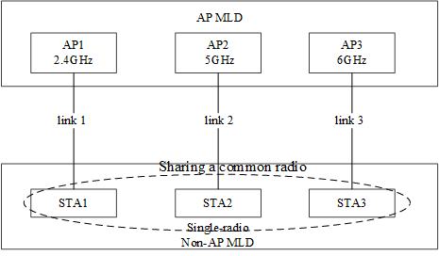
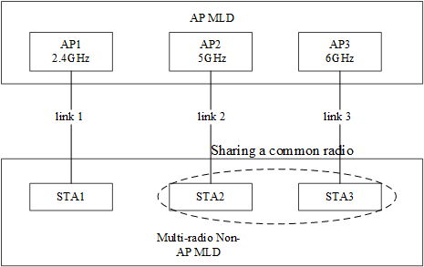
Scenario considered
Scenario 1. Single-radio non-AP MLD, shown as the left Figure
Scenario 2. Multi-radio non-AP MLD with fewer radios than AP MLD, shown as the right Figure.
Figure Single-radio non-AP MLD
Figure Multi--radio non-AP MLD

Slide 5
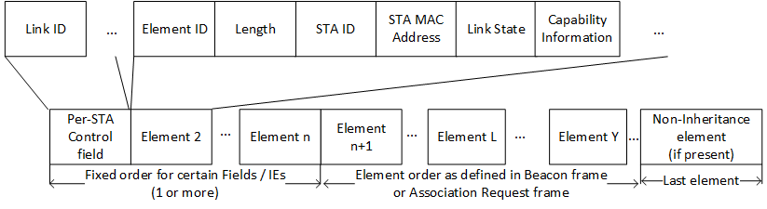
Related Signaling
For each requested setup link, the corresponding Per-STA profile subelement shall be carried in the MLE in an (Re-)Association Request frame.
In the (Re-)Association Request frame, the information on STA-AP association relationship needs to be carried in the Per-STA profile
So the proposed format of Per-STA Profile subelement carried in (Re-)Association Request frame is shown as follows

Slide 6
Radio ID
When a non-AP MLD has multiple affiliated physical STAs, a Radio ID subfield is carried
  The Radio ID of STA transmitted (Re-)Association Request frame is 0 by default.
If multiple Per-STA profiles have the same value of Radio ID, that means these links share a common physical STA. Hence, only one of them can be in the enable state.
This information will help to prevent that the AP MLD requests to enable multiple links which are sharing a common physical STA
The Radio ID also can be used to indicate that the STA-AP association relationship and which physical STAs are sharing antennas
The AP MLD may change the STA-AP association relationship in the (Re-)Association Response frame by changing the tuple <Link ID, Radio ID>

Slide 7
Link State and Capability Information
The non-AP MLD can explicitly indicate the initial state of each non-transmitted link through the Link State subfield after the multi-link setup [2-5]
  E.g. enable (i.e. active), disable or doze
  A link can be disabled by AP MLD or non-AP MLD for some reason (See backups slides).
  Different from the doze state, any TID cannot be mapped to a disabled link
There are two options for the Capability Information indication
  Option 1. Capability Information is MLD-level
  Option 2. Capability Information is link-level
    But the values of some subfields in Capability Information field must keep consistent, e.g. ESS, IBSS, APSD subfields

Slide 8
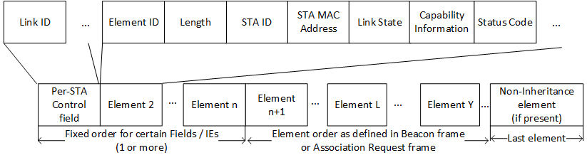
Status Code
In the (Re-)Association Response frame, the AP MLD maybe reject some requested links through the Status Code subfield
  If the transmitted link is rejected, then the association is considered failed
  If the transmitted link is accepted and all of non-transmitted links are rejected, then the STA-level association is considered successful
  If the transmitted link is accepted and at least one of non-transmitted links is accepted, then the MLD-level association is considered successful

Slide 9
Fast Link Transition
Case 1. Fast link transition initiated by non-AP MLD
  The non-AP MLD sends a Link Transition Request frame to the AP MLD through one link, which includes the following info
    Reason code
      e.g. link unreachable, bad QoS and so on
    Target link ID
    Locally stored Change Sequence of the target link ID
  The AP MLD replies a Link Transition Response frame to the non-AP MLD through the current link, which includes the following info
    Status code
    Target link ID
    Current Change Sequence of the target link ID
      Alternatively, the AP MLD directly includes the updated information in the frame
  Then the non-AP MLD will send a Probe Request frame in the target link to get the updated information

Slide 10
Fast Link Transition
Case 2. Fast link transition initiated by AP MLD
  AP MLD also can send a link transition notification to the non-AP MLD through one link, which includes the following info
    Reason code
      e.g. overload, low RSSI, traffic steering and so on
    Target link ID
    Change Sequence of the target link ID
  When the Change Sequence value is different from the locally stored Change Sequence of the target link, the non-AP MLD may send a Probe Request frame with the locally stored Change Sequence in the target link
  Then AP MLD may reply a Probe Response frame with the corresponding elements whose contents are changed

Slide 11
Conclusion
We discussed how to signal the Multi-link setup and enable fast link transition. We prefer the links to be setup to be explicitly indicated by inclusion the corresponding Per-STA Profile subelement.
We also proposed that the non-AP includes information of Radio ID in the Per-STA Profile subelement to help the indication of which links sharing a common STA
We also proposed that the non-AP/AP MLD explicitly indicates the Link State in the Per-STA Profile subelement
We also proposed that the AP MLD decides whether or not to accept the setup of non-transmitted links through Status Code in the Per-STA Profile subelement

Slide 12
SP 1
Do you support that an AP MLD separately signals whether to accept each request link through a Status Code field in the corresponding Per-STA profile?

Slide 13
SP 2
Do you support to explicitly indicate the link state of each setup link after the multi-link setup as following?
  Enable
  Disable
  Doze

Slide 14
SP 3
Do you support that a non-AP MLD with more than one affiliated STA includes a Radio ID field in Per-STA Profile subelement of a multi-link element included in Association Request frame?

Slide 15
Backup slides

Slide 16
Link Enable/Disable (1)
A link can be disabled due to the following reasons
  Power save in a special low power mode, which is different from the doze state [2]
  Link unreachability/ poor connection [3]
  Radio may be turned into a “monitor-only” role for measurement purposes or turned back into client-serving mode [3]
  Multiple setup links sharing a common physical STA[4]

Slide 17
Link Enable/Disable (2)
What’s the difference between doze and disable state?
  Since both AP MLD and non-AP MLD can initiate the TID-to-link mapping negotiation, the AP MLD can actively request the non-AP MLD to enable a disabled link.
    But according to the current Spec., the AP cannot actively request the non-AP MLD to wake up a STA in the doze state. It is totally up to the STA in the doze state whether it will wake up to retrieve data from the AP side
  When a link is disabled due to link failure, the AP cannot map any TID to this link, especially when a TID is only mapped to this link.
    But when a link is in the doze state, the AP is still allowed to map some TIDs to this link

Slide 18
Reference
[1] 11-20-1274-02-00be-mac-pdt-mlo-ml-ie-structure.docx
[2] 11-20-0924-03-00be-all-tids-mapped-to-all-links.pptx
[3] 11-20-0810-01-00be-dynamic-link-set.pptx
[4] 11-20-1049-02-00be-mld-link-transition-management.pptx
[5] 11-20-1187-00-00be-multi-link-setup-discussion.pptx

