Slide 1
Collaborative WLAN Sensing
September, 2020
Date: 2020-09-29
Authors:
Name | Affiliation | Address | Phone | Email
Sang Kim | LG Electronics | 19, Yangjae-daero 11gil, Seocho-gu, Seoul 137-130, Korea |  | sanggook.kim@lge.com
Dongguk Lim |  |  |  | dongguk.lim@lge.com
Insun Jang |  |  |  | insun.jang@lge.com
Jeongki Kim |  |  |  | jeongki.kim@lge.com
Jinsoo Choi |  |  |  | js.choi@lge.com

Slide 2
Introduction
September, 2020
WLAN sensing has drawn increasing attention due to its potential enormous opportunities to create many applications such as in home security, health care, enterprise, and building automation/management markets, etc. [1- 2]
Due to the proliferation of Wi-Fi devices in potential sensing applications, it is desirable to consider sensing opportunity in the context of multitude of Wi-Fi devices and their possible collaboration.
It can enhance the accuracy on sensing measurements over certain area of interest and can be tailored to applications in terms of the number of Wi-Fi devices involved and their locations.
In this contribution, we consider the WLAN sensing in which multitude of Wi-Fi devices are involved and collaborated.

Slide 3
Observations
September, 2020
Various WLAN sensing applications under consideration require different key performance indices (KPIs) .
Measurement rate
Measurement accuracy
Coverage area of interest
Etc.
In addition, various WLAN sensing-capable devices may have different capabilities:
Power from outlet vs. Battery-powered.
Computing power to extract useful information from sensing measurements.
Etc.

Slide 4
Example – Home Security
September, 2020
Intruder will use the entrances to home such as main entrance, windows, etc.
Central entity (e.g., AP) can detect the presence of someone in the area of interest using sensing measurements.
It may inform it to responsible person (e.g., home owner) to check.
It may alert to responsible person if unusual pattern is detected, e.g., unusual gait pattern.
Wi-Fi devices with limited capabilities in terms of computation, power, etc. can be located around those areas for other purposes. For example, IoT devices can be used to control the curtain or blind for the window.
Devices (IoT devices, home appliances, etc.) around certain area of interest can be grouped and coordinated for home security.

Slide 5
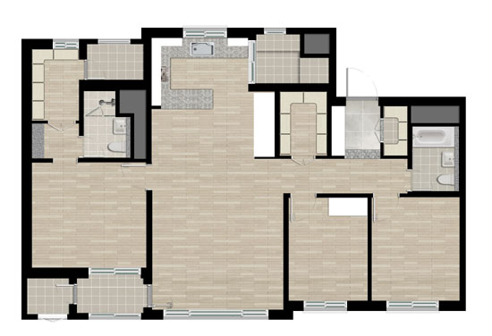
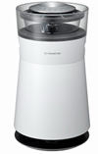
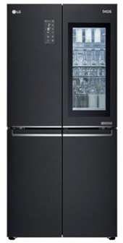
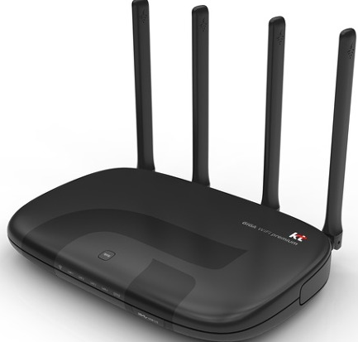
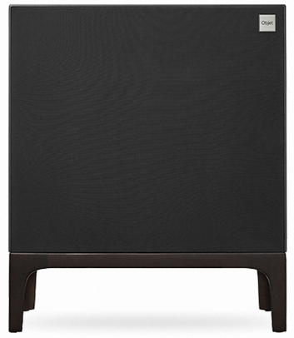
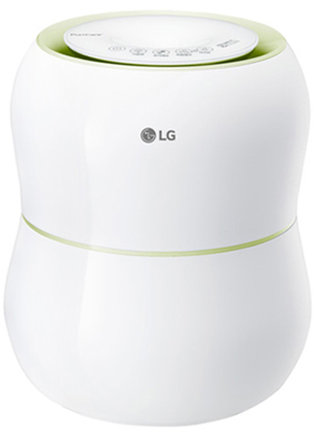
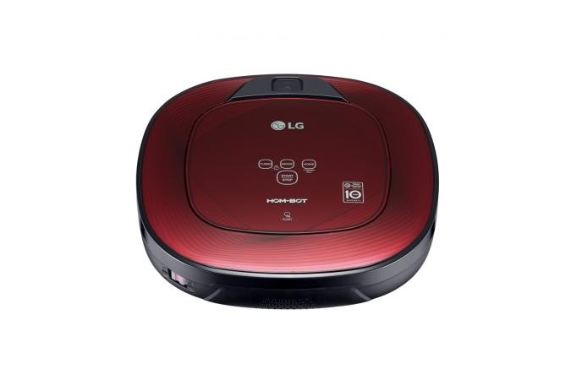
Example – Home Security (Cont’d)
September, 2020
Case 1: Managed by AP and Controlled by AP
AP can detect the presence of someone in the area of interest. It may simply inform to home owner the presence or may inform when unusual pattern is detected. In this example, sensing agent is located in AP, i.e., AP determines the presence based on the measurements by itself and from other STAs in the group.
Example illustration:
Case 2: Managed by AP and Controlled
by TV
“Alert”
Intruder

Slide 6
Example – Home Security (Cont’d)
September, 2020
Configurations:
Sensing
Initiator (AP)
Example configuration: One initiator (AP) and two responders.
Sensing transmission and feedback may be burst-based [3] when a session consists of multiple bursts.
Sensing transmission and feedback may be done over multiple TXOPs.
Illustration is based on burst-based.
Sensing
Responder 1
Sensing
Responder 2

Slide 7
Example – Home Security (Cont’d)
September, 2020
Configurations:
Sensing
Initiator (AP)
Sensing
Transmitter
Sensing
Initiator (AP)
Feedback
Receiver
Sensing
Responder 1
Sensing
Responder 2
Sensing
Responder 1
Sensing
Responder 2
Sensing
Receiver
Sensing
Receiver
Feedback
Transmitter
Feedback
Transmitter
1st Burst: Transmission
Initiator transmits and two responders receive.
Available channel information: Initiator to responder 1 and
initiator to responder 2
1st Burst: Feedback
Two responders feedback the measurements to initiator.

Slide 8
Example – Home Security (Cont’d)
September, 2020
Configurations:
Sensing
Initiator (AP)
Sensing
Receiver
Sensing
Initiator (AP)
Feedback
Receiver
Sensing
Responder 1
Sensing
Responder 2
Sensing
Responder 1
Sensing
Responder 2
Sensing
Transmitter
Sensing
Receiver
Feedback
Transmitter
2nd Burst: Transmission
Responder 1 transmits, initiator and responder 2 receive.
Available channel information: Responder 1 to initiator and
responder 1 to responder 2.
2nd Burst: Feedback
Responder 2 feedbacks channel measurement between
responder 1 and itself..

Slide 9
Benefits
September, 2020
Accurate sensing over the area of interest can be achievable:
Multitude of Wi-Fi capable devices and their collaboration as a group can provide additional information.
Without grouping and collaboration, sensing can be considered as the one between one-to-one device or among one-to-many devices.
With grouping and collaboration, sensing can be considered as the one among many-to-many devices. More location information (diversity gain) can be achieved, thus leading to accurate sensing.
Note that grouping concept is logical on top of existing architecture.
Sensing requirements for different use cases can be tailored:
Presence detection vs. Health monitoring.
Less frequent sensing measurements using home appliances in the living room (presence detection).
More frequent sensing measurements using the home appliances and IoT devices in the bedroom (health monitoring).
Less number of devices for presence detection than for accurate health monitoring.

Slide 10
Benefits (Cont’d)
September, 2020
Computational benefit can be exploited by devices with less computational capability and power constraint:
Sensing measurements can be delivered to AP for useful information extract over the area of interest.
Computation to extract useful information may be done in AP or Cloud.
Aforementioned benefits, of course, entails increased overhead:
For example, channel measurement gathering may require additional signaling and time allocation.
We need to consider the trade-off depending on the applications, and etc.

Slide 11
Things to Consider
September, 2020
Determination on which devices to be included (“Grouping”) .
Can be static or dynamic.
For static grouping, AP can predetermine the devices to be included depending on the locations, capabilities, sensing applications, etc. This information may be delivered to the devices in beacon, Trigger frame, or etc.
If AP is not in the group, then it may deliver information on group to group owner (initiator).
For dynamic grouping, the device may initiate the grouping process. For example, it may broadcast its intention to form the group. The devices that are willing to join the group may respond to the initiation.
Selection of the devices into the group can be based on application(s), location of interest, etc.
The device(s) that is not included into the group can do what it is supposed to do, e.g., data transmission, staying in power save mode, etc.
When multiple APs are considered and a group is managed by an AP, the device(s) associated with other APs can be considered as a member of the group because the measurement result can be more accurate. Then, how to support it?

Slide 12
Summary
September, 2020
WLAN sensing has drawn increasing attention due to its possible and potential opportunities to create many applications such as in home security, health care, enterprise, and building automation/management markets, etc.
In this contribution, we considered the group-based WLAN sensing in which multitude of Wi-Fi devices are involved and collaborated.
Possible benefits are also addressed in addition to overhead to achieve them.

Slide 13
Reference
September, 2020
[1] Wi-Fi Sensing – A New Technology Emerges. v1.0, October 2019, Wireless Broadband Alliance (https://wballiance.com/wba-wi-fi-sensing/_
[2] 11-20/1239r0, Use Cases for Wireless LAN Sensing
[3] 11-20/1232r0, Overview of WLAN sensing protocol

