Slide 1
WG11 30th Anniversary
Date: 2020-09-18
Authors:

Slide 2
Abstract
This document includes materials presented 2020-09-18 marking the 30th Anniversary of the IEEE 802.111 Working Group
Remarks and materials from:
Vic Hayes, Stuart Kerry, Bruce Kraemer, Adrian Stephens, Dorothy Stanley
802.11 members

Slide 3
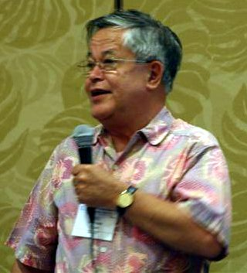
Remarks: Vic Hayes
Vic served as the first WG11 chair: 1990-2000

Slide 4
Congratulations
Notes:
Congratulations with 30 years of
Perseverance in constant improvement of the standard
Amazing what you have reached and have in your plans
Kudos to the management and members of this working group to continue working in the harsh circumstances of the current pandemic
Fortunately the technology is at the level that on-line conferencing is possible and that the capacity of global Internet appears to be fine
At least in my country I can not see a degradation of the Internet with massive homeworking workforce and students receiving on-line tuition
But it is still a drawback that you have to miss the face-to-face experience.

Slide 5
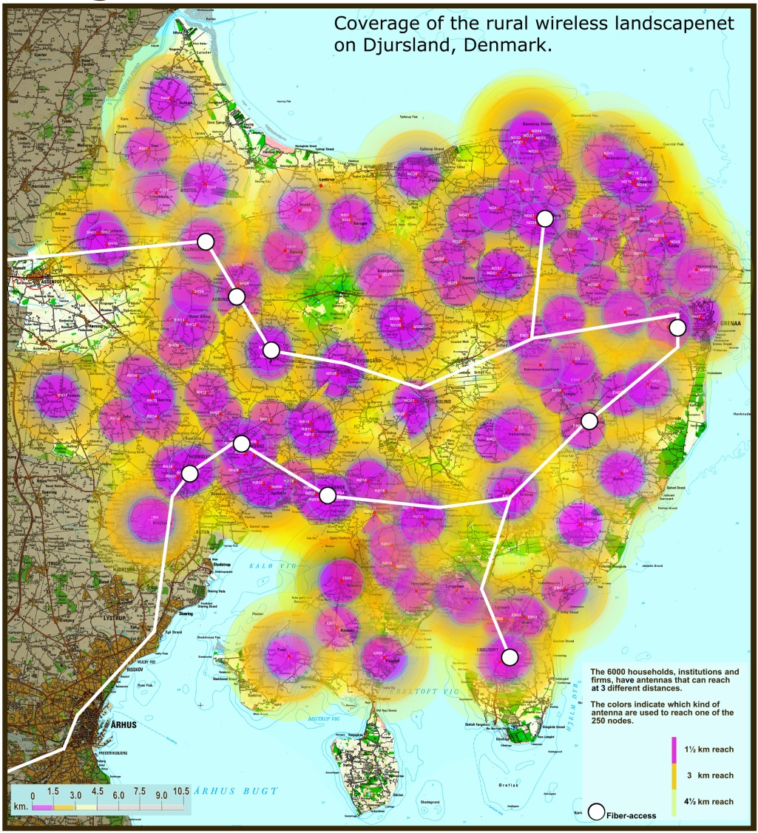
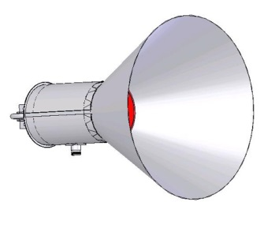
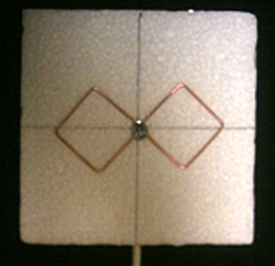
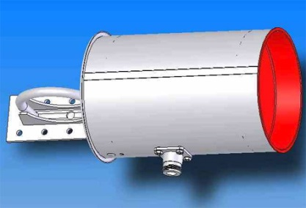
Social and economic impact
Rural area in Denmark
With user innovation
Notes:
Again the IEEE 802.11 standard is of tremendous assistance to humankind
In this pandemic I have heard how students deprived from Internet at Home are getting access for remote tuition
- through libraries offering Wi-Fi access to Internet at a wider area
- Through Schoolbuses with Wi-Fi being parked at places where many students live
In the 2000-2010 era Wi-Fi helped people in rural areas to get high-speed internet access by community initiatives setting-up Wi-Fi networks bringing social and economic benefits to them
In this rural area in Denmark a network was built under the charismatic leadership of @@ that gave rural people the same quality of Internet access for one third of the price in urban area

Slide 6
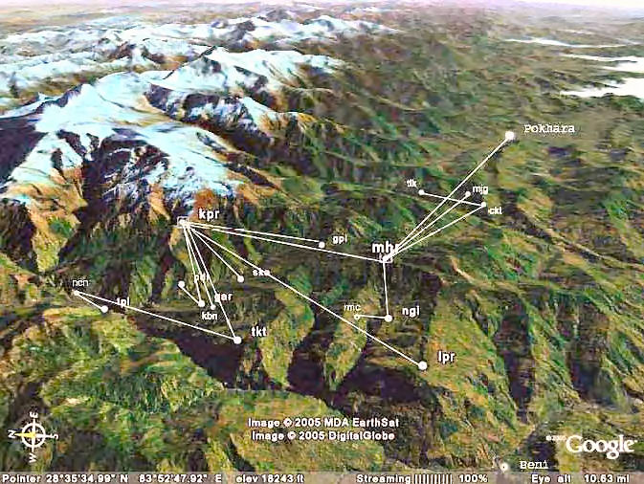
Social and economic benefit
Mountain area in Nepal
Notes:
This example is from a development country in the Himalayas, Nepal.
Internet access is provided in the town Pokhara.
In the rural area there is no power grid, no telephone nor mobile phone network. Farmers sell their crop to traders
A teacher lives in the area where the node called “gar” is situated. Distance to the town is 40 km as the crow flies, but it takes 4 hours to walk to the closest bus stop and then 4 hours to drive to town. He was tired to have to travel 8 hours to do his e-mail.
So he deployed the network with the help of many oversees sponsors.

Slide 7
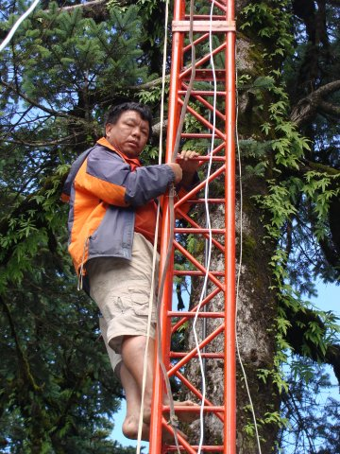
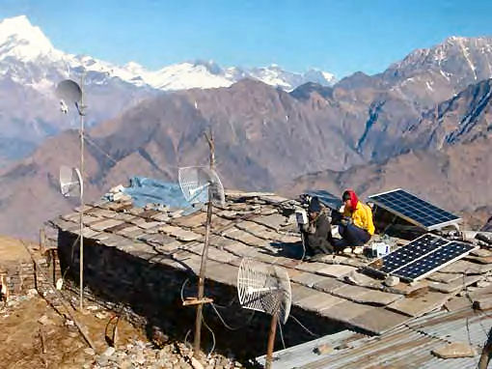
Mahabir Pun and node in Nepal
Notes:
On the left is the teacher, Mahabir Pun, later called a social entrepreneur because after he funded the school and deployed the network, he continued to create jobs for the inhabitants.
On the right is a node with 3 links. Note the solar cells for power.

Slide 8
Please continue your good work
And it is my wish that the standard is used only to the benefit of mankind!
Thank you for your attention

Slide 9

Remarks: Stuart Kerry
Stuart served as WG11 chair: 2000-2008
and remains an active participant in WG11

Slide 10
Remarks: Bruce Kraemer
Bruce served as WG11 chair: 2008-2014 and continues to
serve in leadership roles in IEEE and IEEE-SA

Slide 11
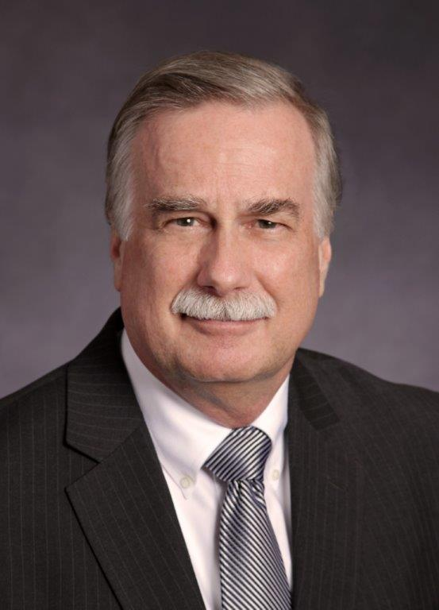
30 years of 802.11
802.11 Participant
802.11n Chair
802.11 WG Chair
IEEE Standards Association President
– Eternally Grateful

Slide 12
Since my absence is forcing Dorothy to recite this text I’ll be very brief.
The first order of business is to congratulate everyone gathered for 30 successful years of developing a standard that has truly become a benefit to and recognized by the entire world.
Sorry I can’t be with you today (even virtually) to celebrate.
I guess you could say that the experiences from 802.11 have proven valuable in many other related domains and especially within IEEE where I continue to lead or participate in, a variety of governance and technical activities.

Slide 13
Vic Hayes published a book in 2011 titled “The Innovation Journey of Wi-Fi”.
I will not attempt to recite it’s contents – but I do encourage you to read it.
I will call to your attention that the first introductory chapter is titled
“Wi-Fi: an unexpected success story”.
Even today, this theme highlights the fact that many individuals encountered and creatively mastered events to create solutions the world truly desires as evidenced by about 3 billion devices per year being shipped.
I was one of those individuals lucky enough to have contributed to and benefited from 802.11.

Slide 14
I recognize that day-to-day creation of a standard is challenging and often frustrating work. The process of invention presentation peer review can become quite difficult.
I hope that Vic, Stuart, Adrian and Dorothy as well as the thousand other contributing engineers agree that taking a few minutes every ten years, or so, to look back at the cumulative accomplishments helps motivate continuing the effort for yet another 10 years.
Best wishes moving forward
Regards,
Bruce Kraemer

Slide 15
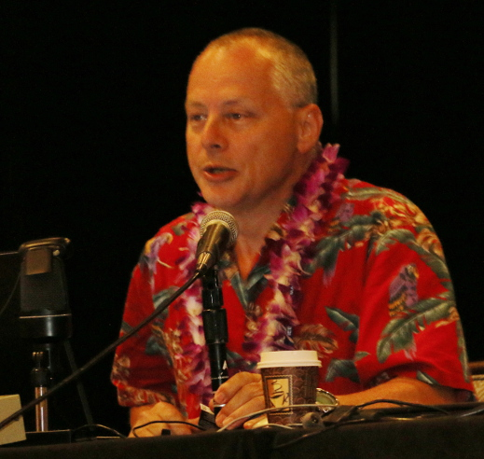
Remarks: Adrian Stephens
Adrian served as WG11 chair: 2014-2018

Slide 16
We have made a significant impact on society
Continuous publication of market-relevant standards since 1999 (802.11b)
Value to world economy (~$2E12 in 2018, WiFi Alliance)
Expectations of connectedness

Slide 17
How we did it
Following IEEE rules, any interested person can contribute (“platform”)
Exploited “free” spectrum
“No one is in control”
  Technically – distributed algorithms
  Procedurally – when the process works, we are all equals

Slide 18
Where do we go from here?
Is there a limit on getting more out of the same spectrum?
Law of diminishing returns for complexity
How do we share spectrum with others?
How can we maintain a standard that is 5,000 pages long?
Is the future move about non-data services?
If we started from scratch, could we really do better than we have?

Slide 19

Where do we go from here – personal?
A “meeting standard” 125 mm cookie weighs about 125 g (~4.5 oz)
In March 2018, Adrian weighed 635 cookies (175 lb, 79.4 kg)
Now, Adrian weighs 584 cookies (161 lb, 73 kg)
Weight lost since being denied 802.11 cookies is 50 cookies.
802.11 Cookies missed: ~12 * 5 = ~60
Conclusion: missing 802.11 meetings has unexpected consequences

Slide 20

Remarks: Dorothy Stanley
Dorothy is the current 802.11 WG Chair

Slide 21
I offer my sincere congratulations to all WG11 participants on the milestone of 30 years.
I am grateful for the opportunity that I have had to contribute in 802.11 for over 20 years. It is an honor to serve as Chair and I am looking forward to continued work and success for the 802.11 WG.
Please see the photographs and the honor roll, which includes information on editors, secretaries and vice chairs.
Slides below (in References) were presented during the Monday 2020 Sept WG11 Opening Plenary.

Slide 22
Comments from members present

Slide 23
References

Slide 24
M6.2 WG11 30th Anniversary
Congratulations
to all WG
participants!
September 2020 – Recognize 30 Years!
First meeting of WG11: September 1990
Celebrating 20 years in 2010
Celebrating 25 years in 2015
Celebrating 30 years in 2020
Also Friday Closing Plenary agenda item
Notes:
The original standard was published in 1997, revised in 1999 with MIB changes, and reaffirmed in 2003.
A revision was published in 2007, which incorporated into the 1999 edition the following amendments:
— IEEE Std 802.11a™-1999: High-speed Physical Layer in the 5 GHz Band (Amendment 1)
— IEEE Std 802.11b™-1999: Higher-Speed Physical Layer Extension in the 2.4 GHz Band
(Amendment 2)
— IEEE Std 802.11b-1999/Corrigendum 1-2001: Higher-speed Physical Layer (PHY) extension in the
2.4 GHz band (Corrigendum 1 to Amendment 2)

Slide 25
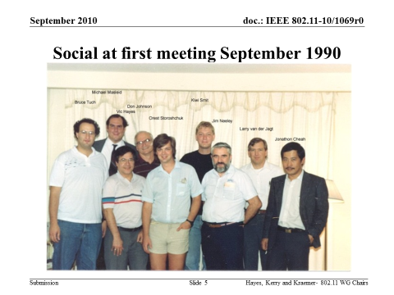
The first meeting of the IEEE 802.11 Working Group was 10th – 14th Sept 1990
1990s
The original standard was published in 1997, revised in 1999 with MIB changes
IEEE Std 802.11a™-1999: High-speed Physical Layer in the 5 GHz Band
IEEE Std 802.11b™-1999: Higher-Speed Physical Layer Extension in the 2.4 GHz Band
IEEE Std 802.11b-1999/Corrigendum 1-2001: Higher-speed Physical Layer (PHY) extension in the 2.4 GHz band
Notes:
The original standard was published in 1997, revised in 1999 with MIB changes, and reaffirmed in 2003.
A revision was published in 2007, which incorporated into the 1999 edition the following amendments:
— IEEE Std 802.11a™-1999: High-speed Physical Layer in the 5 GHz Band (Amendment 1)
— IEEE Std 802.11b™-1999: Higher-Speed Physical Layer Extension in the 2.4 GHz Band
(Amendment 2)
— IEEE Std 802.11b-1999/Corrigendum 1-2001: Higher-speed Physical Layer (PHY) extension in the
2.4 GHz band (Corrigendum 1 to Amendment 2)

Slide 26
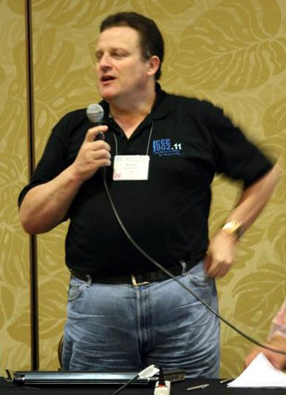
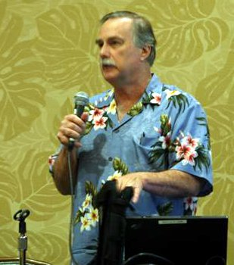
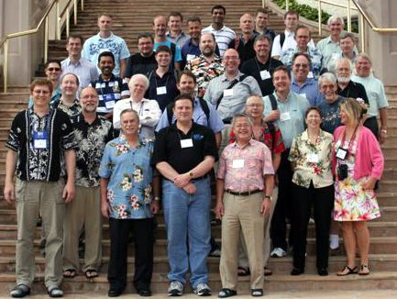
September 2010 - 20th Anniversary: 2nd decade
1990s
IEEE Std 802.11d™-2001: Specification for operation in additional regulatory domains
IEEE Std 802.11g™-2003: Further Higher Data Rate Extension in the 2.4 GHz Band
IEEE Std 802.11h™-2003: Spectrum and Transmit Power Management Extensions in the 5 GHz band in Europe
IEEE Std 802.11i™-2004: Medium Access Control (MAC) Security Enhancements
IEEE Std 802.11j™-2004: 4.9 GHz–5 GHz Operation in Japan
IEEE Std 802.11e™-2005: Medium Access Control (MAC) Quality of Service Enhancements
IEEE Std 802.11™ -2007
IEEE Std 802.11k™-2008: Radio Resource Measurement of Wireless LANs
IEEE Std 802.11r™-2008: Fast Basic Service Set (BSS) Transition
IEEE Std 802.11y™-2008: 3650–3700 MHz Operation in USA
IEEE Std 802.11w™-2009: Protected Management Frames
IEEE Std 802.11n™-2009: Enhancements for Higher Throughput
Notes:
— IEEE Std 802.11d™-2001: Specification for operation in additional regulatory domains
(Amendment 3)
— IEEE Std 802.11g™-2003: Further Higher Data Rate Extension in the 2.4 GHz Band (Amendment
4)
— IEEE Std 802.11h™-2003: Spectrum and Transmit Power Management Extensions in the 5 GHz
band in Europe (Amendment 5)
— IEEE Std 802.11i™-2004: Medium Access Control (MAC) Security Enhancements (Amendment 6)
— IEEE Std 802.11j™-2004: 4.9 GHz–5 GHz Operation in Japan (Amendment 7)
— IEEE Std 802.11e™-2005: Medium Access Control (MAC) Quality of Service Enhancements
(Amendment 8)
A revision was published in 2012, which incorporated into the 2007 revision the following amendments:
— IEEE Std 802.11k™-2008: Radio Resource Measurement of Wireless LANs (Amendment 1)
— IEEE Std 802.11r™-2008: Fast Basic Service Set (BSS) Transition (Amendment 2)
— IEEE Std 802.11y™-2008: 3650–3700 MHz Operation in USA (Amendment 3)
— IEEE Std 802.11w™-2009: Protected Management Frames (Amendment 4)
— IEEE Std 802.11n™-2009: Enhancements for Higher Throughput (Amendment 5)

Slide 27
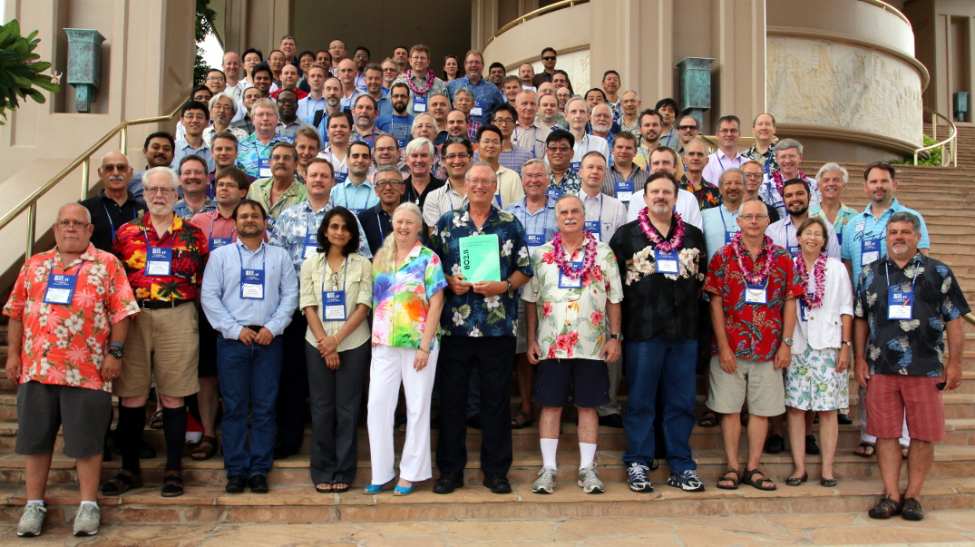
July 2015 - 25th Anniversary: Next 5 years
1990s
IEEE Std 802.11p™-2010: Wireless Access in Vehicular Environments
IEEE Std 802.11z™-2010: Extensions to Direct-Link Setup (DLS)
IEEE Std 802.11v™-2011: Wireless Network Management
IEEE Std 802.11u™-2011: Interworking with External Networks
IEEE Std 802.11s™-2011: Mesh Networking
IEEE Std 802.11™ -2012
IEEE Std 802.11ae™-2012: Prioritization of Management Frames (Amendment 1)
IEEE Std 802.11aa™-2012: MAC Enhancements for Robust Audio Video Streaming
IEEE Std 802.11ad™-2012: Enhancements for Very High Throughput in the 60 GHz Band
IEEE Std 802.11ac™-2013: Enhancements for Very High Throughput for Operation in Bands
below 6 GHz
IEEE Std 802.11af™-2013: Television White Spaces (TVWS) Operation
Notes:
IEEE Std 802.11p™-2010: Wireless Access in Vehicular Environments (Amendment 6)
— IEEE Std 802.11z™-2010: Extensions to Direct-Link Setup (DLS) (Amendment 7)
— IEEE Std 802.11v™-2011: Wireless Network Management (Amendment 8)
— IEEE Std 802.11u™-2011: Interworking with External Networks (Amendment 9)
— IEEE Std 802.11s™-2011: Mesh Networking (Amendment 10)
— IEEE Std 802.11ae™-2012: Prioritization of Management Frames (Amendment 1)
— IEEE Std 802.11aa™-2012: MAC Enhancements for Robust Audio Video Streaming
(Amendment 2)
—IEEE Std 802.11ad™-2012: Enhancements for Very High Throughput in the 60 GHz Band
(Amendment 3)
— IEEE Std 802.11ac™-2013: Enhancements for Very High Throughput for Operation in Bands
below 6 GHz (Amendment 4)
— IEEE Std 802.11af™-2013: Television White Spaces (TVWS) Operation (Amendment 5)

Slide 28
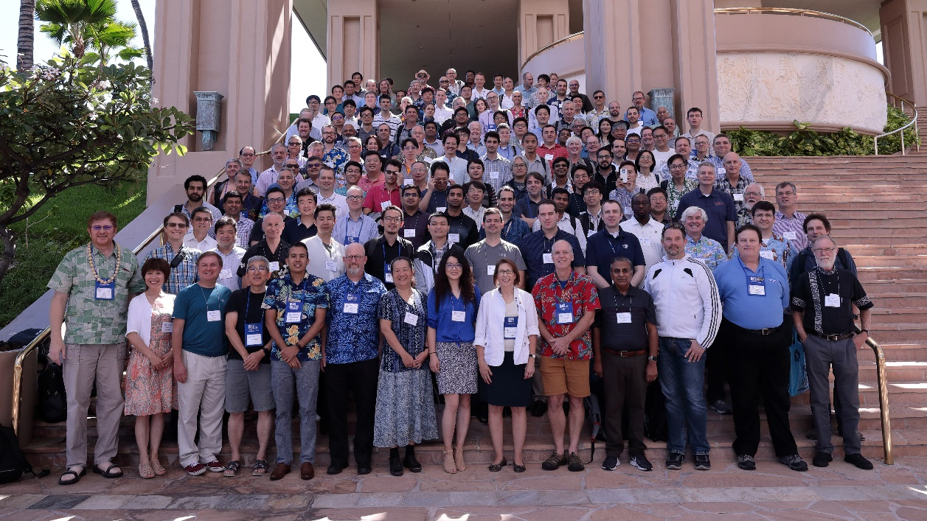
September 2020- 30th Anniversary: Next 5 years
IEEE Std 802.11™ -2016
IEEE Std 802.11ai™-2016 (second printing): Fast Initial Link Setup
IEEE Std 802.11ah™-2016: Sub 1 GHz License Exempt Operation
IEEE Std 802.11aj™-2018: Enhancements for Very High Throughput to Support Chinese Millimeter Wave Frequency Bands (60 GHz and 45 GHz)
IEEE Std 802.11ak™-2018: Enhancements for Transit Links Within Bridged Networks
IEEE Std 802.11aq™-2018: Preassociation Discovery
Group Photo form 2019:
Looking forward to REVmd,
11ax, 11ay, 11az, 11ba, 11bb,
11bc, 11bd,11be, 11bf……

