Slide 1
BW Indication of >160MHz for non-HT and non-HT Duplicated Frames
Date: 2020-08-10
Authors:
Name | Affiliations | Address | Phone | Email
Yunbo Li | Huawei | Shenzhen, China |  | liyunbo@Huawei.com
Yiqing Li
Yuchen Guo
Ming Gan
Guogang Huang
Rob Sun
Chenchen Liu
Wei Lin
Jia Jia
Notes:
September 2012

Slide 2
Background
Indicate a bandwidth larger than 160MHz in non-HT or non-HT duplicated frames passed motion [1];
  802.11be supports indicating BW larger than 160 MHz through scrambler sequence in non-HT or non-HT duplicated frames. [Motion 115, #SP102, [10] and [87]]
When a new bandwidth is indicated, we need to guarantee the receiver side can clear know whether the new bandwidth information is carried;
Current CH_BANDWIDTH_IN_NON_HT is indicated through Individual/Group bit in TA, but it can not be used to indicate new larger bandwidth.
  Otherwise, receiver STA doesn’t know only 20, 40, 80 or 160MHz are indicated through B5B6 in scrambling sequence or new bandwidth is indicated.
Two main points will be discussed in this presentation:
  1) how to indicate the new bandwidth is carried, we call it EHT BW indication in following slides;
  2) which new bandwidth(s) can be carried.

Slide 3
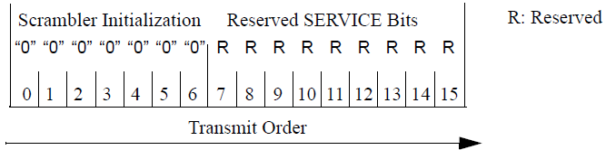
Explicit Solutions for EHT BW Indication
There are several subfields are reserved and set to 0 in Frame Control field of Control frame, but some chip vendors have concerns to reuse these subfields due to vendor specific implementation reasons;
Reserved SERVICE field is another potential place to carry the indication, it should be fine in 6GHz, for but there are similar concerns in 5GHz;
So a unify solution for both 5GHz and 6GHz can not be supported through Reserved SERVICED field.

Slide 4
Implicit Solution for EHT BW Indication
The receiver STA will know whether the new BW modes are carried based on the category of the TX STA
  If the TX STA is an EHT STA, and TA field is a bandwidth signaling TA, then new BW may be carried
  If the TX STA is an non-EHT STA, and TA field is a bandwidth signaling TA, then B5B6 in service field are used to indicate 20, 40, 80, or 160MHz.
Control response (e.g. CTS) usually implemented in low MAC layer, it means that a EHT STA needs to distinguish whether a TX STA is EHT STA or not in low MAC;
Base on the feedback from product line, it is implementable, and the complexity is acceptable;
Implicit indication can be an unified solution for both 5GHz and 6GHz bands;
Base on above analysis, implicit indication is preferred.

Slide 5
New BW Modes Indication
Preamble puncture modes is suggest to discussed later
  Supported modes are TBD;
  Can not be signaled through first 7 bits of scrambler sequence, needs more discussion about the container of signaling (e.g. Reserved SERVICE field).
320MHz bandwidth is supported in R1, it can be signaled through scramble seed (the first 7 bits of scrambler sequence), which could be an unified solution for both 5GHz and 6GHz;
Suggest to use B3 as BANDWIDTH EXTENSION bit
  B3=0, and B5B6 = 0~3 to indicate 20, 40, 80, and 160(80+80)MHz respectively
  B3=1, and B5B6 = 0 to indicate 320MHz;
  B3=1, and B5B6 = 1~3 are reserved for future use.
B3 | B5 B6 | BW
0 | 0 | 20MHz
0 | 1 | 40MHz
0 | 2 | 80MHz
0 | 3 | 160MHz or 80+80MHz
1 | 0 | 320MHz
1 | 1-3 | reserved
Pseudo random integer
BANDWIDTH EXTENSION
DYN_BANDWIDTH_IN_NON_HT
CH_BANDWIDTH_IN_NON_HT
B0 B2 B3 B4 B5 B6

Slide 6
The affect of B3 for PAPR
Some simulation are done to verify the affect of B3 for PAPR;
Length of RTS = (16 service bits+20Bytes*8)/24 = 8 OFDM symbols;
Length of CTS = (16 service bits+14Bytes*8)/24 = 6 OFDM symbols;
In baseline: first 7 scrambler sequence bits are random, except all 0 state;
In the proposed solution
  [B3, B5, B6] = [1, 0, 0];
  B4 (Dynamic bit in the simulation results) is set to 0 or 1;
  B0-B2 are random;
No. of simulations = 100k;
  All 8 states are select for each simulation, and 8 states are randomly selected from 127 states in baseline;
  PAPR of each OFDM symbol is counted in each simulation;

Slide 7
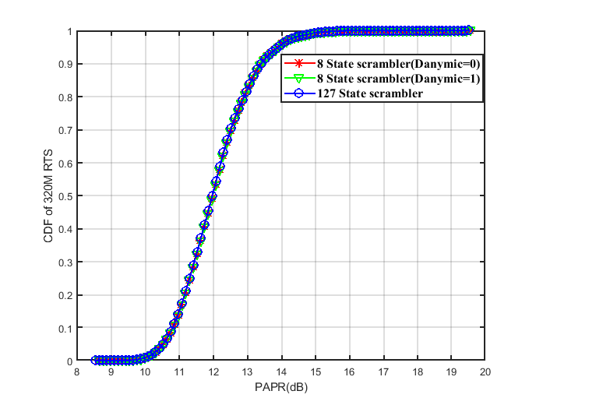
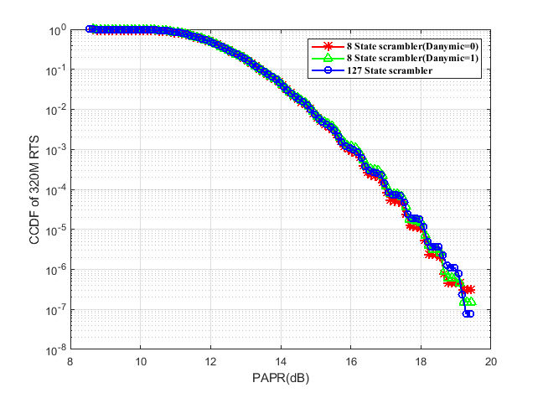
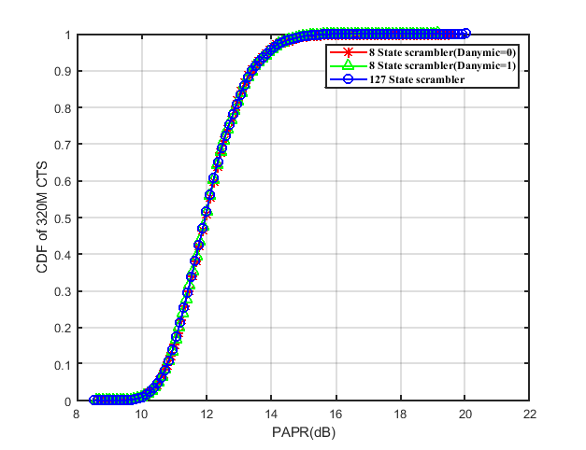
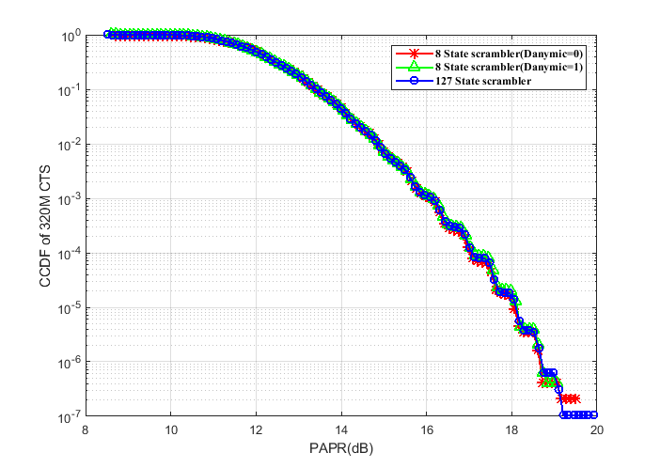
The affect of B3 for PAPR
Almost no difference from baseline for CDF curves;
Only minor difference in high PAPR region for CCDF curves.

Slide 8
Summary
Indicate a bandwidth larger than 160MHz in non-HT or non-HT duplicated frames passed motion;
Hard to do explicit EHT BW indication in 5GHz, and implicit indication is suggested;
Preamble puncture modes are TBD, and cannot find a good place for the BW modes signaling in 5GHz. Suggest to discuss it later;
Suggest to use B3 of scrambler sequence to indicate 320MHz in R1.

Slide 9
Straw Poll 1
Do you support to add the following in TGbe spec in R1?
  B3 of scrambler sequence is used to indicate 320MHz BW mode for non-HT or non-HT duplicated frames as below:
    B3=0, and B5B6 = 0~3 to indicate 20, 40, 80, and 160(80+80)MHz respectively
    B3=1, and B5B6 = 0 to indicate 320MHz;
    B3=1, and B5B6 = 1~3 are reserved for future use.

Slide 10
Straw Poll 2
Do you support to add the following in TGbe spec in R1?
  If the TX STA is an EHT STA, and TA field is a bandwidth signaling TA, then three bits (B3, B5 and B6) of scrambler sequence are used to indicate the bandwidth of the non-HT or non-HT duplicated frame.

Slide 11
Reference
[1] 11-20-0616-00-00be-bandwidth-indication-of-320mhz-for-non-ht-and-non-ht-duplicate-frames

Slide 12
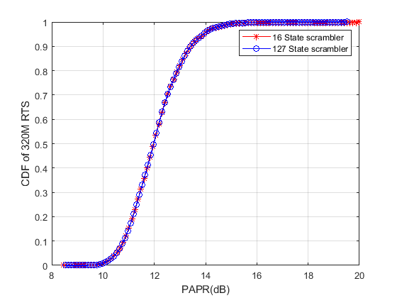
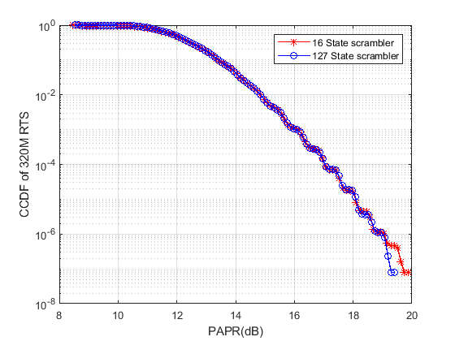
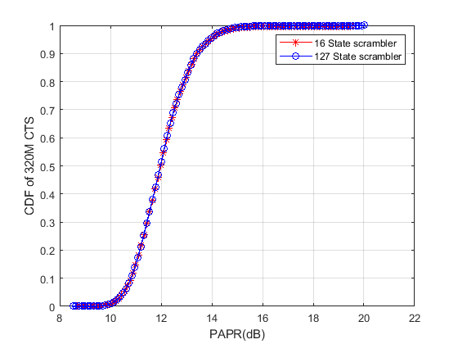
The affect of B3 for PAPR
The simulation results for 16 states
  B4 (DYN_BANDWIDTH_IN_NON_HT) is random.

