Slide 1
Attacks to Fully Random OFDM Sounding Signal
Date: 2020-12-2

Slide 2
11az LB249 CID 3911
CID | Page/Line | Clause | Comment | Proposed resolution
3911 | 153.00 | 11.22.6.4.6 | The Secure LTF mechanism for TB and NTB ranging needs to be improved. A submission will be provided. | As in comment.

Slide 3
Outline
.
Recap of frequency-domain attack
Complexity of frequency-domain attack
Limitation of frequency-domain attack
Introduction of time-domain attack
Simulations
Summary

Slide 4
Background
.
Two proposals are on the table, OFDM-based [5] and time-domain pulse-based [4], which mainly differ by one FFT in implementation
In [1-2], we showed that OFDM-based signal [5] is vulnerable to various frequency-domain attacks
In [4], time-domain pulse signal was proposed, which is similar to UWB and immune to FD attacks
In this contribution, we present a time-domain attack applicable to both TD pulse signal and OFDM signal. In addition, the protection scheme against TD attacks is proposed

Slide 5
Attack Model
Attacker listens to the beginning part, predicts the future part, and sends time-shifted signal of the future part
Delay
Fake
Genuine signal
Time
Attack signal
Time
Time advancement
Slide 5

Slide 6
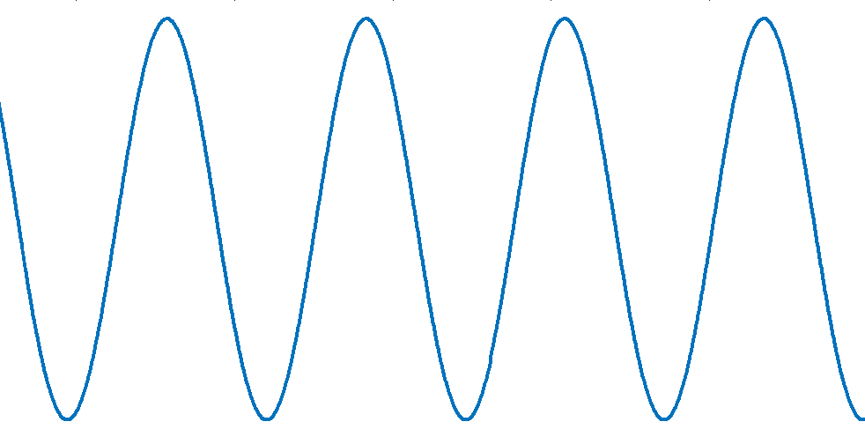
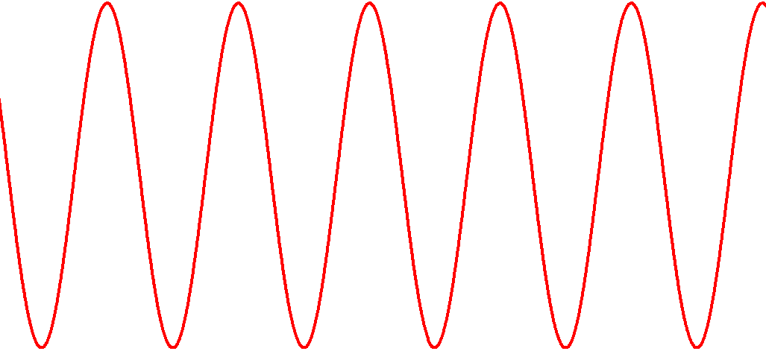
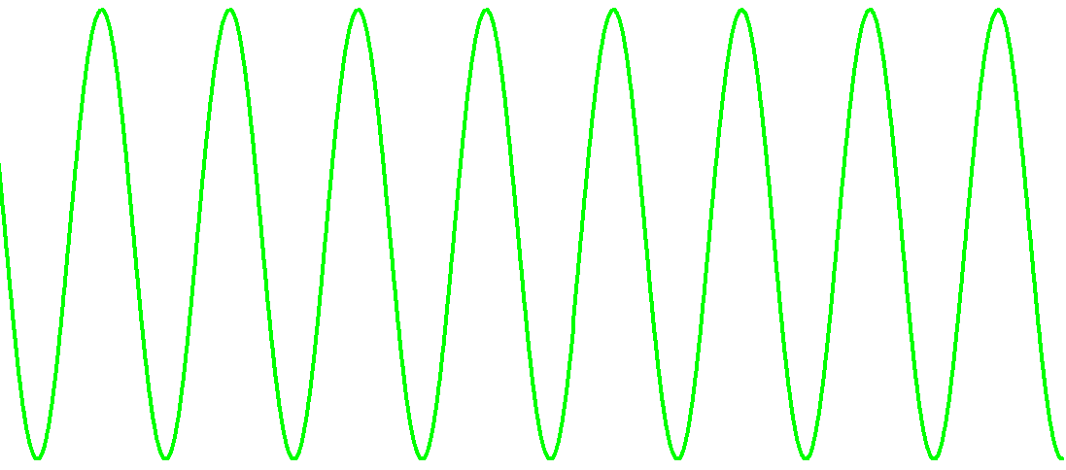
Observation Window
Attacker observes the beginning portion and detects the phases of the sinusoids for generating shifted attack signals
…
Observation window
Attack window
Slide 6

Slide 7
Windowed FFT (1/2)
Time-domain window is applied to weight the input signal and then FFT is performed on the weighted signal

Slide 8
Windowed FFT (2/2)
The longer the window in time, the fewer the significant taps in frequency

Slide 9
Windowing in Time, ICI in Frequency
The time-domain windowing introduces inter-carrier interferences in frequency domain

Slide 10
Windowing in Time, ICI in Frequency
The time-domain windowing introduces inter-carrier interferences in frequency domain

Slide 11
Linear Filter
The time-domain windowing introduces inter-carrier interferences in frequency domain
QAM symbols the attacker wants to know
q_{n+1}
q_{n}
q_{n-1}
q_{n-2}
q_{n-3}
q_{n-4}
q_{n-5}
w₁
w₂
w₃
w₀
w₄
Significant taps in Hamming spectrum
+
noise
r_{n-4}
Signals observed by the attacker

Slide 12
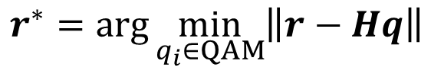
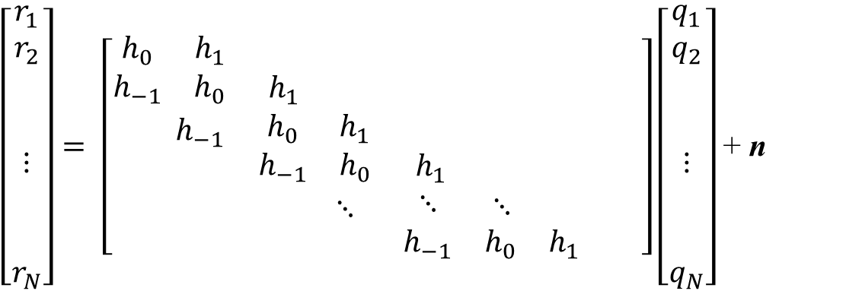
Linear Signal Model
.
Each received FD sample is a linear mixture of adjacent QAM symbols
Maximum-likelihood solution exists, and near-optimal solutions were well studied and deployed
Sparse matrix
$\left[\begin{matrix}\begin{matrix}r_{1} \\ r_{2}\end{matrix} \\ \begin{matrix} \\ \\ ⋮\end{matrix} \\ \begin{matrix} \\ \\ r_{N}\end{matrix}\end{matrix}\right]= \left[\begin{matrix}\begin{matrix}h_{0} & h_{1} \\ h_{−1} & h_{0}\end{matrix} & \begin{matrix} & \\ h_{1} & \end{matrix} & \begin{matrix} & \begin{matrix} & & \end{matrix} \\ & \begin{matrix} & & \end{matrix}\end{matrix} \\ \begin{matrix} & h_{−1} \\ & \end{matrix} & \begin{matrix}h_{0} & h_{1} \\ h_{−1} & h_{0}\end{matrix} & \begin{matrix} & \begin{matrix} & & \end{matrix} \\ h_{1} & \begin{matrix} & & \end{matrix}\end{matrix} \\ \begin{matrix} & \\ & \end{matrix} & \begin{matrix} & ⋱ \\ & \end{matrix} & \begin{matrix}⋱ & \begin{matrix}⋱ & & \end{matrix} \\ h_{−1} & \begin{matrix}h_{0} & h_{1} & \end{matrix}\end{matrix}\end{matrix}\right]\left[\begin{matrix}\begin{matrix}q_{1} \\ q_{2}\end{matrix} \\ \begin{matrix} \\ \\ ⋮\end{matrix} \\ \begin{matrix} \\ \\ q_{N}\end{matrix}\end{matrix}\right]$ + n
$$r^{∗}=arg\min_{q_{i}∈QAM}\left\|r−Hq\right\|$$

Slide 13
Vulnerability of OFDM Sounding Signal
.
Estimating the QAM symbols of OFDM using partially observed signal is equivalent to equalizing an inter-symbol interference (ISI) channel [1], where a large family of solutions exist [1][2]
Not secure
ISI
F
F
Secure?
ISI
F
F

Slide 14
Frequency Domain Attack
.
The numbers of taps in the equivalent ISI channel are
In [2], decision-feedback equalizer is used, where 4x4 and 5x5 sphere decoders successfully estimated the input 64 and 256-QAM symbols by observing 2/3 and ¾ of the symbol, respectively
For massive MIMO deployment, low-complexity decoding of 16x16 64QAM is developed [3], where K-best algorithm collaborated with SD and reduced the number of visited nodes by an order of magnitude, e.g., only ~10 nodes
Observed portion of sounding symbol | 3/4 | 1/2 | 1/3
No. of taps | 5-7 | 8-10 | 11-15
Notes:
Complexity scaling, sphere decoder grid

Slide 15
Complexity doesn’t go up exponentially
The complexity doesn’t increase with the QAM size exponentially
The number of visited nodes depends on the SNR and should be less than 10 for 40dB SNR [3]
It is even possible for the attacker to attack 2/3 of symbol
y
log₂N
All constellation points except a handful in a large constellation, e.g., 4kQAM are not visited

Slide 16
Limitation of FD Attack
No attack signal is sent during the observation window
Attack efficiency can be improved by sending attack signal in the observation window
Genuine signal
Time
Attack signal
Time
No attack signal sent

Slide 17
Time Domain Attack
Attacker receives one signal sample and sends out one attack sample
Relay on a different band
Slide 17

Slide 18
Exploiting Correlation in Sounding Signal
Nov 2020
Wiener filter predicts the future signal by exploiting the correlation between the signal previously received and the future signal unreceived
Correlation
Received signal
Future signal
Time advancement of attack signal, e.g., 3, 4, 5 samples
Slide 18

Slide 19

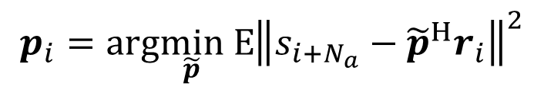


Linear MMSE Estimator
Nov 2020
Wiener filter predicts the future signal by exploiting the correlation between the signal previously received and the future signal unreceived
Wiener filter is of low complexity, O(N²),
$$t_{i+N_{a}}=p_{i}^{H}r_{i}$$
, where
$$p_{i}=arg\min_{\tilde{p}} E{{\left\|s_{i+N_{a}}−{\tilde{p}}^{H}r_{i}\right\|}^{2}}$$
p₁
p₂
p_{i}
Bank of filters
×
$$t_{i+N_{a}}$$
…
$$r_{i}$$
p₁₂₆
Slide 19

Slide 20

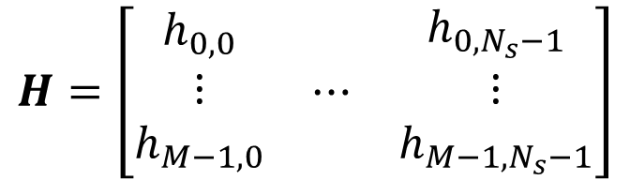
Nov 2020
Derivation of LMMSE predictor
The received signal can be written as
Symbols sent sequentially
$$r=H_{0:n, :} s+n$$
Equations are determined after oversampling
where
$$H=\left[\begin{matrix}\begin{matrix}h_{0,0} \\ ⋮ \\ h_{M−1,0}\end{matrix} & ⋯ & \begin{matrix}h_{0,N_{s}−1} \\ ⋮ \\ h_{M−1,N_{s}−1}\end{matrix}\end{matrix}\right]$$
Time-domain signal vector for the 1st pulse
Time-domain signal vector for the last pulse
Slide 20

Slide 21
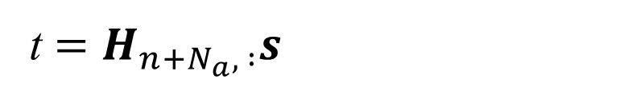
Nov 2020
The Signal under Prediction
The signal under prediction can be written as
t $=H_{n+N_{a}, :}s$
The row of H corresponding to the predicted signal t
Slide 21

Slide 22


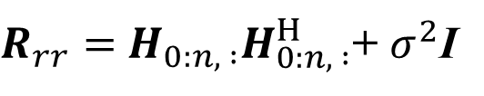


Linear MMSE Solution
Nov 2020
Linear MMSE solution of $t$ is given by
$$\hat{t}=p^{H} r$$
where
$$p =R_{tr}R_{rr}^{−1}$$
$R_{rr}=$ $H_{0:n, :}H_{0:n, :}^{H}$+ $σ^{2}$I
$$R_{tr}={H_{n+N_{a}, :}H}_{0:n, :}^{H}$$
Slide 22

Slide 23
Pulse Representation of OFDM Signal
.
OFDM signal can be viewed as a sequence of correlated, Gaussian distributed pulses sent in time, whose pulse shape is determined by frequency domain window
QAM
Gaussian
IFFT
F
T
F
T

Slide 24
Pulse shape determines the correlation
.
The time-domain correlation is determined by the pulse shape (or frequency-domain window) not the modulation, i.e., OFDM or pulse modulation

Slide 25
What does secure pulse look like?
Information is confined within the pulse width
No information is leaked before the interval
No signal for the attack to change after the pulse interval
Phase and amplitude info
No info about the pulse
No signal to change
Time
Pulse width
Slide 25

Slide 26
Meeting Spectrum Requirement
Zero power at DC subcarrier
Freq
DC
Slide 26

Slide 27
Windows and Pulse Shapes
Rectangular, Raised-Cosine (β=0.15), and differential Blackman
Slide 27

Slide 28
Tail Truncated Pulse (1/2)
The truncated, differential, Hamming pulse with two opposite Hamming sub-pulses has no DC power
Set the tails to zero for full security
Slide 28

Slide 29
Trail Truncated Pulse (2/2)
The mask weights consist of purely imaginary numbers. No complex multiplication is needed.
Rx doesn’t have to over-sample the received signal, the degradation due to aliasing is negligible, i.e., -34.1dB,

Slide 30
Simulation Setting
20 MHz bandwidth, 40 dB SNR
Wiener filters generate each attack signal sample
4x oversampling, i.i.d. noise
4kQAM OFDM and BPSK time-domain pulse
FD windows: Rectangular, Raised-Cosine β=0.15, differential Blackman, truncated differential Hamming
Time advancement: 2, 3, 4 Ts, where Ts = 1 / Bandwidth
Correlation
Received signal
Future signal
Time advancement of attack signal, e.g., 3, 4, 5 samples

Slide 31
Correlation CDF for Time Domain Pulse

Slide 32
Rectangular and Raised-Cosine
Gap
Raised-Cosine is better than Rectangular

Slide 33
Diff Blackman and Truncated Diff Hamming
Approach ideal

Slide 34
Correlation CDF for OFDM

Slide 35
Rectangular and Raised-Cosine
Gap
Raised-Cosine is better than Rectangular

Slide 36
Diff Blackman and Diff Hamming
Gap

Slide 37
Remarks
Without FD windowing or TD pulse shaping, the residual correlation is above 0.3, whose attack signal quality is better than CP replay attack
FD windowing or TD pulse shaping is essentially to reduce the attack signal quality
The FD windowing or TD pulse shaping improves both OFDM and TD pulse signals in similar ways
Ideal performance can be achieved for time advancement of 4+ (and even 3+) samples with proper TD pulse shaping

Slide 38
Compound Attack to OFDM Signal
Within the observation window of the FD attack, TD attack, e.g., linear MMSE attack can continuously send attack signal such that the attack quality is substantially improved
Genuine signal
Time
TD attack
FD attack
Attack signal
Time

Slide 39
Summary
 |  | OFDM | TD Pulse
Implementation complexity |  | About the same as OFDM | One more FFT operation than OFDM
Security | FD attack O(N²) | No | Yes
 | TD attack O(N²) | Yes
 | Overall | No | Yes

Slide 40
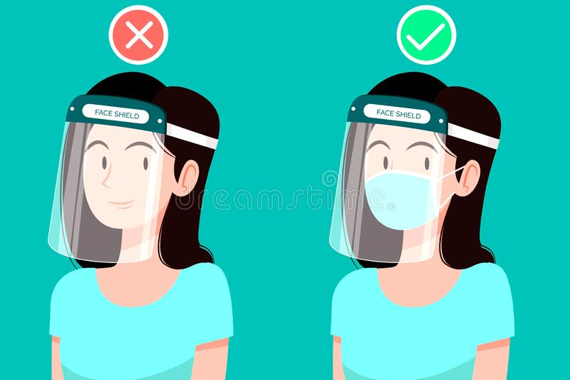
Face Mask and Face Shield
Face shield is like the TD pulse shaping to prevent TD attacks
Face mask is like the FFT to prevent FD attacks
We need both protections!
FD attacks

Slide 41
Conclusions
Time-domain attack is developed
TD attack such as linear MMSE filter is of low implementation complexity
TD attack has similar performances in attacking OFDM and TD pulse
Sounding signal without FD windowing or TD pulse shaping is vulnerable to TD attack
TD attack can work together with FD attack to attack OFDM signal

Slide 42
Reference
        [1] Q. Li, F. Jiang, X. Chen, and R. Stacey, “Attacks to Fully Random QPSK Sounding Signal,” doc: IEEE 802.11-20-0710r1.
        [2] F. Jiang, Q. Li, X. Chen, and R. Stacey, “Attacks to Fully Random 64QAM Sounding Signal,” doc: IEEE 802.11-20-0964r0.
        [3] A. Dabah, et al., “Performance / Complexity Trade-os of the Sphere Decoder Algorithm for Massive MIMO Systems,” https://arxiv.org/pdf/2002.09561.pdf.
        [4] C. Berger, “Secure LTF using DFT Precdoded OFDM,” doc: IEEE 802.11-20-1097r1.
        [5] B. Tian, et al., “11az Secure LTF Design,” doc: IEEE 802.11-20-836r0.

Slide 43
Backup

Slide 44


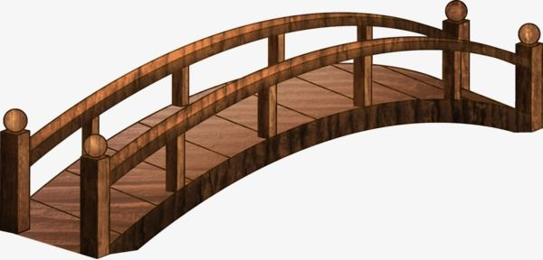
Cardboard vs. Metal
FD attacks
TD
FD attacks
FD attacks
FFT
FD attacks
OFDM
FD attacks
FD attacks

Slide 45
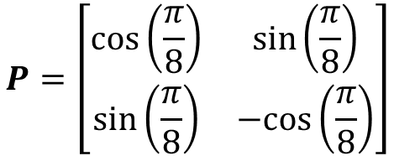
Illustration of Correlation among OFDM Samples (1/2)
.
PAM with constellation {-3, -1, +1, +3}
Two samples of 4-PAM in “frequency domain” and are converted to “time domain” by “FFT matrix”
$$P=\left[\begin{matrix}cos\left(\frac{π}{8}\right) & sin\left(\frac{π}{8}\right) \\ sin\left(\frac{π}{8}\right) & −cos\left(\frac{π}{8}\right)\end{matrix}\right]$$
4-PAM
P
F
T

Slide 46
Illustration of Correlation among OFDM Samples (2/2)
.
Just observing the 1st time-domain sample, the attacker can determine both 4-PAM symbols in “frequency-domain” uniquely
Namely, the 2nd TD sample is not secure because it is exposed ahead of time and can be determined from the 1st sample
(3,3)
(3,1)
(-3, -1)
(-3,-3)

Slide 47

Reducing Out-of-Band Emission by Pulse Removal
Removing the first and last 4 pulses, i.e., adding 0s to the +/-1 sequence, easily eliminates the out-of-band emission. No TD window is needed.
Out-ofband emission
0 0 +1 +1 …
Zero-power GI
…
T
Time
Symbol duration
This Photo by Unknown Author is licensed under CC BY-NC
Slide 47

Slide 48
Easy Compliance with Spectrum Mask
Easily meet IEEE spectrum mask without additional time-domain windowing
Slide 48

Slide 49
MatLab Code for Truncated Differential Hamming Pulse (1/2)

Slide 50
MatLab Code for Truncated Differential Hamming Pulse (2/2)

