Slide 1
Enhancements for QoS and low latency in 802.11be R1
Date: 2020-10-12
Authors:

Slide 2
Introduction
802.11be is expected to provide low latency/QoS management solutions catering to new and upcoming applications like AR/VR/TSN/Cloud/Gaming/IoT.
QoS negotiation allows an MLD to be aware of the QoS needs at an associated AP/non-AP STA MLD. This in turn allows an MLD to
  determine if it has enough resources to admit the stream and provide the expected QoS if an AP MLD,
  handle frames corresponding to each of the admitted streams as characterized and deliver the corresponding QoS.
Main QoS negotiation in current spec is ADDTS Request/Response (TS Setup). The protocol was designed based on video and voice applications 15 years ago and is bit outdated.
In this presentation therefore we propose enhancing the existing QoS signaling mechanism for 11be.
The concepts in this contribution are aligned with Doc#1046r5, 418r4.

Slide 3
Recap: current related proposals in IEEE
Some contributions such as 1355r5, 1046r7 propose to create specific SPs for low latency applications.
Some contributions focus on the signaling from STA to improve UL scheduling:
  1067r4 proposes signaling in A-Ctrl field for STA to inform AP about periodic traffic.
  1006r3 proposes signaling in a Mgt frame for STA to inform AP about the min and max intervals between successive triggers.
    Also proposes establishment of scheduling session through exchange of those frames.
Some contributions focus on signaling of traffic characteristics and classification:
  908r1 proposes MLD-level TS setup.
  418r4 proposes MLD-level QoS signaling of both layer-2 traffic and higher layer classification parameters.

Slide 4
Proposal overview
We propose to have a common signaling framework to specify both the traffic characteristics and the traffic classification parameters.
To meet R1 timeline, reuse SCS Request/Response framework with minor changes to capture below functionalities:
  The signaling could be at MLD level for STAs that are associated as part of MLD setup/association.
  Add some new parameters for next gen low latency services (TSN, AR/VR) similar to 5G URLLC.
  Allow exchange of P2P specific parameters.
  Allow AP to modify a setup SCS stream parameters based on network conditions (e.g., inform change UP for DL flow, scheduling etc.).
Notes:
Add how to tie to the restricted SP prop

Slide 5
What do we need to signal ?
Reuse TCLAS for packet classification.
For describing traffic characteristics signal the following (in red are the new parameters):
  UP for the flow
  Inactivity Interval
  Max Service Interval
  Max MSDU size: Maximum size of MSDU
  Latency Bound: Maximum time required for successful delivery of the MSDU/A-MPDU (from MAC-SAP to MAC-SAP)
  Min Service Interval: requested minimal periodicity of service or min MSDU interarrival time
  Jitter: variation in latency (RTA)
  Burst Size: Max aggregate size MSDUs that arrive within a period
  Packet delivery ratio: Expected packet delivery ratio within the latency bound.
  More TSN Parameters in R2.
Notes:
How does the paameters connect to TWT ? Show an example..
Multiple TIDs ?
TWT use cases:
a. laptop/PC : do want to prioritize some applications.. “identify TID”
b. wearables.. Only run one type of applications.. Several components microphone, camera serving same application.. Each having different flows (identified by DSCP vals).
map the flow to different TIDs. All flows served in same SP. For example, 16ms periodicity. Specify traffic load (DL and UL, assymetric).
Check how to signal that multiple flows map with unknwon traffic characteristics ….
Want a way to ask AP to drop a packet if we cant meet the latency bound.. Add clarification that latency bound means STA shall drop it if we cant meet the delay requirement.

Slide 6
Signaling changes to SCS
Require SCS Request/Response frame to be valid at MLD-level similar to ADDBA Req/Response.
The parameters described in slide 5 can be signaled in a TSPEC element or/and a new IE (TSPEC-lite) and included in the SCS Request/Response frames.
  Note: The parameters can be signaled outside SCS Req/Response frames (e.g., with TWT).
Allow AP to transmit an unsolicited SCS Response frame signaling an update to existing session.
Notes:
The new frames can be differentiated from Basic and DMG ADDTS either via
new QoS Action field if using Option 1 in previous slide or
by presence of the new element if using Option 2 in previous slide.

Slide 7
Example of STA initiated QoS Setup
Network
Controller
STA
AP
STA initiates SCS Req with a description of the QoS Traffic
AP responds with SCS Resp accepting the request
QoS Traffic flows between the STA and the AP using the QoS setup for the flow(s)
AP determines that the current QoS needs to be amended due to
  Network policy/conditions
  QoS flow policing decisions
AP sends an SCS Resp modifying the QoS Setup
QoS Traffic flows between the STA and the AP with the amended QoS Setup
Network Policy/ condition
SCS Req
SCS Resp
Traffic from/to the application with the setup QoS
Network Policy/ condition/ policing
SCS Resp
(modify)
Traffic from/to the application with modified QoS/scheduling

Slide 8
QoS signaling enabling Restricted TWT Service Periods for low latency flows
EHT QoS signaling
SCS Req + TSPEC-lite (IE)
SCS Resp
SCS Resp
Example restricted SP schedule
AP and STAs set up Restricted Service Periods
AP advertises restricted SPs
Low latency flow experience low/deterministic low latency with higher reliability
EHT APs and STAs supporting and participating in the restricted SPs follow the access rules

Slide 9
Summary
Proposed a unified framework for QoS signaling that requires minimal spec changes while satisfying critical low latency requirements.

Slide 10
SP #1
  Do you support modifying the TSPEC element to enable to signal the following traffic characteristics/parameters:
  - UP, Inactivity Interval, Max MSDU size, Latency Bound, Min Service Interval, Max Service Interval, Burst Size, Packet delivery ratio, Direction
  - After regular association (non-MLD association), this TSPEC element describes the traffic characteristics/parameters at the STA level
  - After MLD association, this TSPEC element describes the traffic characteristics/parameters at the MLD level.
    Parsing of this new TSPEC element is optional.

Slide 11
SP #2
  Do you support that SCS Request and SCS Response frames may contain a TSPEC element ?

Slide 12
SP# 3
Do you support that 11be R1 supports creation of MLD-level SCS stream ?

Slide 13
SP #4
  Do you support that 11be R1 defines a mechanism for an AP to modify a setup SCS stream by transmitting an unsolicited SCS Response frame ?

Slide 14
backup

Slide 15
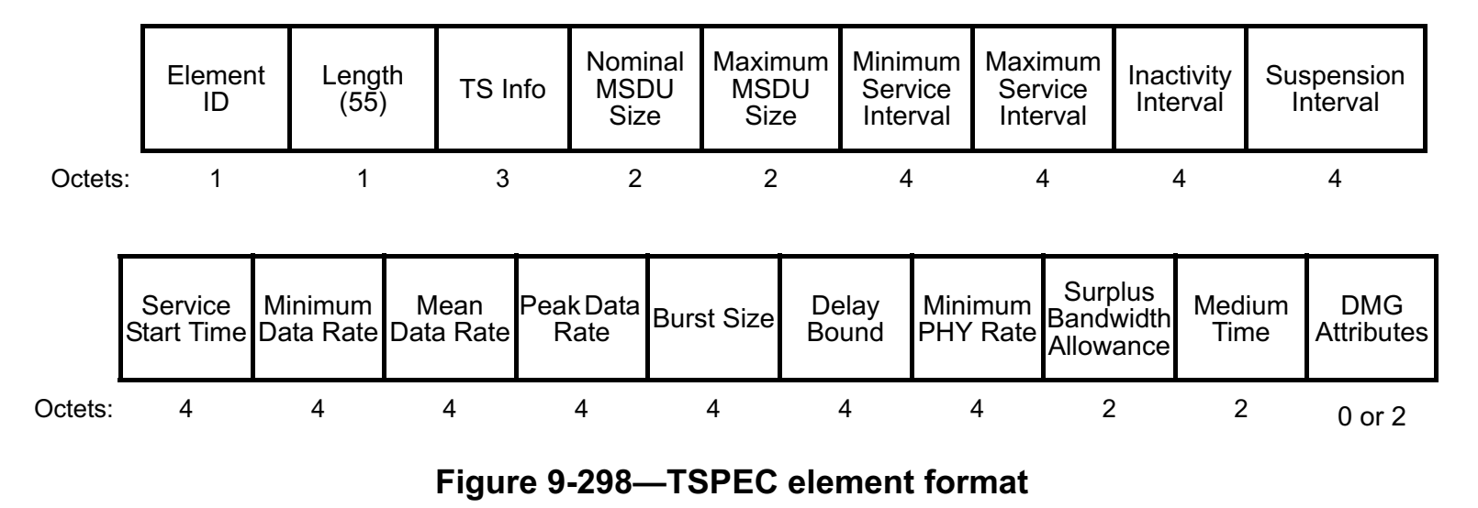
Signaling QoS characteristics via TSPEC
Current TSPEC is not extensible for non-DMG but allowed for DMG. May be we can propose to extend it for EHT or propose an EHT TSPEC similar to DMG TSPEC (discuss).
Below discussion assumes we will reuse TSPEC element.
Fields present but may require new interpretation: Inactivity interval (profile lifetime) , Max MSDU size, Latency Bound, Burst Size, Min Service Interval
Not present: Jitter, Packet delivery ratio (present in DMG Att but may have small size), Criticalilty, Tolerance to loss, Flow ID, Redundancy, whether TWT negotiation follows.
~30 bytes unused if we reuse TSPEC for existing parameters.
To simplify signaling the fields in TSPEC that are not part of bullet 1 may be considered Reserved or repurposed to fit fields signaled in bullet 2.
  One of the Reserved bits in TS Info may be reused to signal this.

