Slide 1
A brief description of the channel realization generation process
Date: 2020-09-01
Authors:
 | Affiliation | Address | Phone | Name
Meihong Zhang | Huawei Technologies Co. Ltd | F3, Huawei Base, Shenzhen, China |  | zhangmeihong@huawei.com
Xiaohui Peng
Rui Du
Chenchen Liu
Yingxiang Sun
Danny Kaipin Tan
Rui Wang | Southern University of Science and Technology
Shuai Wang
Xinrao Li

Slide 2
1. Abstract
In [1], a discussion of WLAN Sensing channel model was presented, including
The necessity and some initial thinking for WLAN Sensing channel modelling.
In this contribution, the following point will be further discussed:
A brief description of the channel realization generation process.

Slide 3
2. Scenario
We consider a scenario including,
AP (TX) and STA (RX) are located in the environment, like the living room, conference room;
fixed scatters (walls, chair, table,…) ;
a device free target is moving.
d for channel models covering, e.g.

Slide 4
3. Approach without considering second order reflections (Overall)
We first divide the rays into 2 types,
Target unrelated: rays reflected from fixed scatters, LOS ray without human shadowing;
Target related: rays reflected from targets.
Overall process of channel realization generation,

Slide 5
3. Approach without considering second order reflections (Step 1)
For target unrelated rays, steps for generating the channel parameters,
For sub 7GHz, approach is same as or based on 11ax [2] ,
For 60GHz, approach is same as or based on 11ay [3],

Slide 6
3. Approach without considering second order reflections (Step 2)
For the target related rays, we propose 3 types of generation methods,
Option 1: Execute ray tracing software for each snapshot.
For each snapshot (including new positions of TX/RX and new position of target), execute the ray tracing software once.
Advantages:
Deal with the scenarios case by case, more accurate result can be achieved.
Cover more scenarios (different TX/RX positions, target position, snapshot).
Disadvantages:
More complex and less practical.
execute
the software

Slide 7

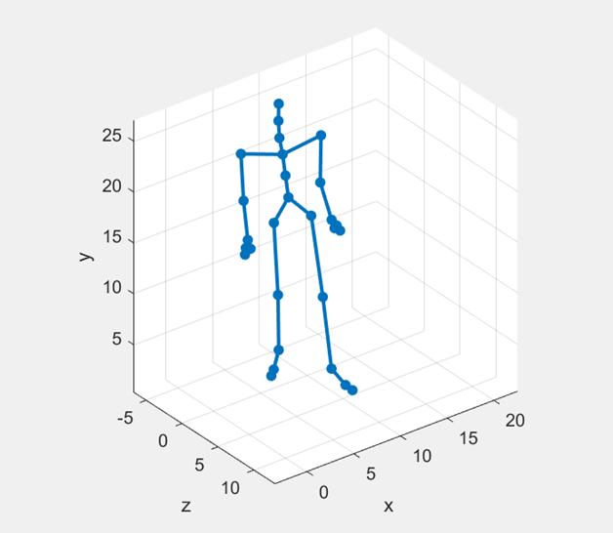
3. Approach without considering second order reflections (Step 2)
For the target related clusters, we propose 3 types of generation methods,
Option 2: Integrate an abstract target model into existing channel model.
We first establish an abstract model for target (set human as an example, and assume only one ray can be reflected from each part of target model).
TX/RX positions and snapshot (corresponding position of the target or each part of position) set as the inputs.
Advantages:
Cover more scenarios (different TX/RX positions, target trajectory);
Easily to be used in the simulation.
Disadvantages:
Less accurate due to the abstract model.
Integrated model

Slide 8
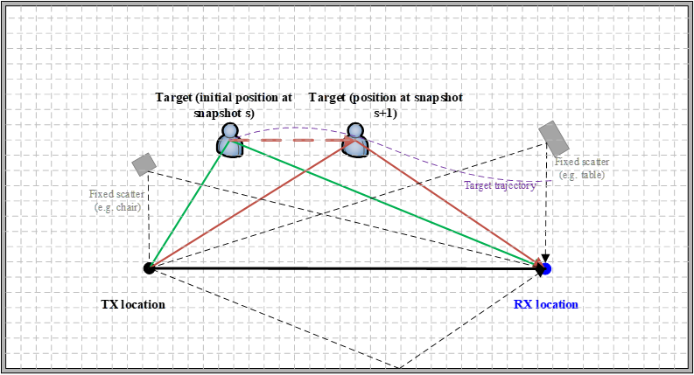

3. Approach without considering second order reflections (Step 2)
For the target related rays, we propose 3 types of generation methods,
Option 3: Establish a database which records the results for different scenarios (with corresponding snapshot) by ray tracing software.
We divide the whole environment into several grids ($N$), for a given target trajectory, the number of ray tracing results we need to record is
$N_{TX}×N_{RX}×N_{snapshot}$
- where $N_{TX}$ , $N_{RX}$ are the number of positions of TX
and RX respectively, which equal to $N$. $N_{snapshot}$ is
the number of snapshots.
Advantages:
More accurate result can be achieved;
Easily to be used in the simulation.
Disadvantages:
Cover limited scenarios;
The complexity increases with the number of grids.
extract the results
from the database

Slide 9
3. Approach without considering second order reflections (Step 3)
Some issues like the conflicts of the rays and the effect of other random objects may need to be considered in postprocessing and analysis before updating the channel coefficients.
Specific solutions are TBD.

Slide 10
4. Approach of considering second order reflections (Overall)
We do not divide the rays into 2 categories as previous, all the rays (LOS ray, reflections from target and fixed scatters) are considered together.
Two options we proposed above are adopted for generating all rays.
Overall process of channel realization generation,

Slide 11
4. Approach of considering second order reflections (Overall)
Brief descriptions of the channel realization generation process are shown as below.
1. Execute ray tracing software
2. Extract results from database

Slide 12
5. Conclusion
In this presentation, brief descriptions of the channel realization generation process for two conditions are proposed.

Slide 13
6. References
[1] 11-20-0906-00-SENS-discussion-of-channel-model-for-wlan-sensing.pptx
[2] 11-14-0882-04-00ax-tgax-channel-model-document.docx
[3] 11-15-1150-09-00ay-channel-models-for-ieee-802-11ay.docx

Slide 14
Appendix
The reason why second order reflections can not be considered in our first approach (divide the rays into target related and target unrelated),
Target unrelated rays (background environment)
+
Target related rays
Final model

Slide 15
Appendix
The reason why second order reflections can not be considered in our first approach (divide the rays into target related and target unrelated),
?
+
postprocessing
?

