Slide 1
Discussion on WLAN sensing sequence design
Date: 2020-09-01
Authors:
Name | Affiliation | Address | Phone | Email
Rui Du | Huawei Technologies Co. Ltd | F3, Huawei Base, Shenzhen, China |  | Ray.du@Huawei.com
Chenchen Liu
Meihong Zhang
Yingxiang Sun
Danny Kaipin Tan
Edward Au

Slide 2
Outline
Abstract
Sequence design of communication
Existing sequences
Analysis of existing sequences
Sequence design of WLAN sensing
Ambiguity function
Metrics for ambiguity function
Golay sequences
Analysis of Golay sequences
Summary
References
Rui Du (Huawei)

Slide 3
Abstract
New waveform/sequence is potentially needed for WLAN sensing [1].
Further information about a new sequence design property is provided in this presentation.
Rui Du (Huawei)

Slide 4
Sequence design of communications
The following properties have been adopted for sequence design of communications:
Peak to Average Power Ratio
Auto correlation
Cross correlation
Rui Du (Huawei)

Slide 5
Existing sequences
Frequency domain sequences
OFDM PHY.
STF/LTF/midamble/… at sub 7 GHz.
STF, CEF at 60 GHz (OFDM PHY in 11ay).
Time domain sequences
Single carrier PHY in 11ad and 11ay.
STF, CEF and TRN field at 60 GHz (11ad and SC PHY in 11ay).
Mainly used for synchronization, channel estimation and beam training.
Rui Du (Huawei)

Slide 6
Analysis of existing sequences
Frequency domain sequences
STF, LTF, midamble, EDMG-STF (OFDM PHY), EDMG-CEF (OFDM PHY)
Auto correlation (e.g. L-STF).
Cross correlation (e.g. MIMO EDMG-CEF).
PAPR (e.g. L-STF, L-LTF, HE-STF, HE-LTF, EHT-LTF, EDMG-STF, EDMG-CEF).
Time domain sequences
Golay sequences in DMG STF/CEF, EDMG STF/CEF (SC PHY), TRN field
Auto correlation (e.g. DMG-STF, DMG-CEF, EDMG-STF, EDMG-CEF)
Cross correlation (e.g. MIMO EDMG-CEF)
Rui Du (Huawei)

Slide 7
Sequence design of WLAN sensing
Potential property that could be adopted for WLAN sensing sequence design
Ambiguity function
Auto ambiguity function
Cross ambiguity function
Rui Du (Huawei)

Slide 8
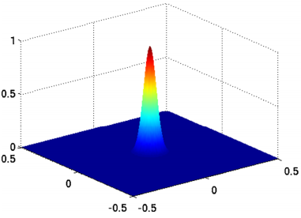
Ambiguity function
Ambiguity function is one of the most important tools for radar waveform analysis.
It is a two-dimensional function of time delay and Doppler shift, showing the output of the received signal through match filter, and is defined as
$$χ\left(τ,f_{d}\right)=\int_{−∞}^{∞}{s\left(t\right)s^{∗}\left(t−τ\right)}e^{j2πf_{d}t}dt$$
Doppler
Time
Rui Du (Huawei)

Slide 9

Metrics for ambiguity function
Peak to Sidelobe Level
$$PSL=\frac{1}{\left|χ\left(0,0\right)\right|}\max_{\begin{aligned}τ≠0 \\ f_{d}≠0\end{aligned}}\left|χ\left(τ,f_{d}\right)\right|$$
Integrated Sidelobe Level
$$ISL=\frac{1}{{\left|χ\left(0,0\right)\right|}^{2}}\sum_{τ≠0}{\sum_{f_{d}≠0}{{\left|χ\left(τ,f_{d}\right)\right|}^{2}}}$$
Rui Du (Huawei)

Slide 10
Golay sequences
Golay sequence is mentioned in [2][3] as a candidate for sensing at 60 GHz.
Is Golay sequence good enough for sensing ?
Rui Du (Huawei)

Slide 11
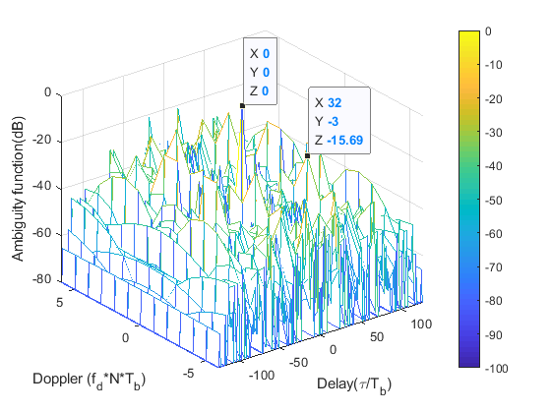
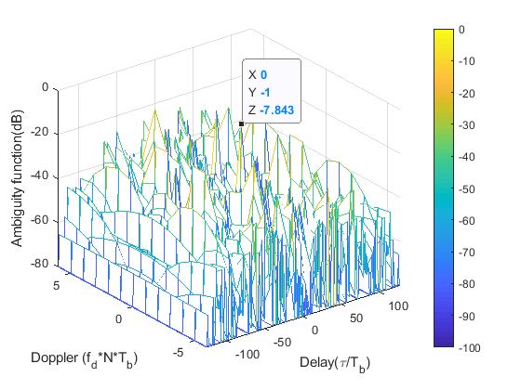
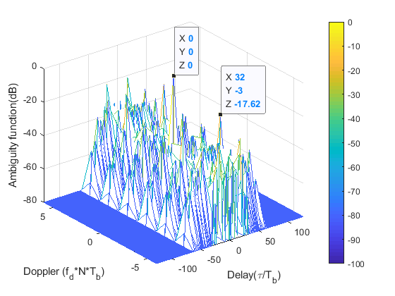
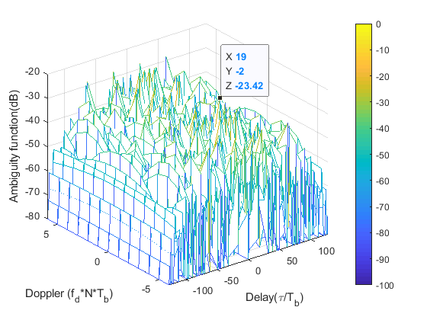
Analysis of Golay sequences
AAF of Ga128_1
CAF of Ga128_1 and Gb128_1
Sum of AAF of Ga128_1 and AAF Gb128_1
The analysis show that the ambiguity function of the Golay sequences is far from closely approximating the ideal “thumbtack” ambiguity function.
Sequences with better AAF/CAF properties could be potentially adopted for WLAN sensing.
CAF of Ga128_1 and Ga128_2
AAF of Gb128_1
Rui Du (Huawei)

Slide 12
Summary
In this presentation, ambiguity function for radar waveform analysis is introduced and discussed.
Initial analysis of existing sequences using the ambiguity function is also provided.
Rui Du (Huawei)

Slide 13
References
[1] 11-19-1500-00-0wng-wi-fi-sensing-follow-up.pptx
[2] 11-18-2094-00-00ay-wlan-radar.pptx
[3] 11-19-1854-00-SENS-wlan-based-radars-in-the-60ghz-band.pptx
Rui Du (Huawei)

Slide 14
SP
Do you agree to consider ambiguity function as a property for the WLAN sensing sequence design ?
Yes:
No:
Abstain:
Rui Du (Huawei)

