Slide 1
WLAN Sensing Procedures and Use Cases
Date: 2020-08-28
Authors:

Slide 2
Abstract
We first discuss WLAN sensing procedures in which the sensing initiator is an AP STA and review possible use cases.
We then review WLAN sensing use cases where the sensing initiator is a non-AP STA.
Potential procedures to enable sensing with multiple sensing responders for cases where the sensing initiator is a non-AP STA are discussed.

Slide 3
Outline
Abstract and outline
Sensing initiator is an AP STA
  Use cases
Sensing initiator is a non-AP STA
  Use cases
  Procedures to support multiple sensing responders
Conclusions

Slide 4
Sensing Initiator is an AP STA
Possible procedure: Sensing initiator (AP STA) obtains measurements using one or more sensing responders (clients/non-AP STAs) that are associated with it.
  WLAN sensing capabilities exchanged during the association process.
  AP obtains measurements dynamically or through a schedule.
  Sensing transmitter(s) could be the sensing initiator (feedback required) or sensing responders.
Note: We consider the “unassociated” case later in the contribution.
From [1]:
Sensing initiator: A STA that initiates a WLAN sensing session
Sensing responder: A STA that participates in a WLAN sensing session initiated by a sensing initiator
Sensing transmitter: A STA that transmits PPDUs used for sensing measurements in a sensing session
Sensing receiver: A STA that receives PPDUs sent by a sensing transmitter and performs sensing measurements
A sensing session is an instance of a sensing procedure with the associated scheduling if applicable, and operational parameters of that instance
Note: In this presentation, we consider multi-static architectures only.

Slide 5
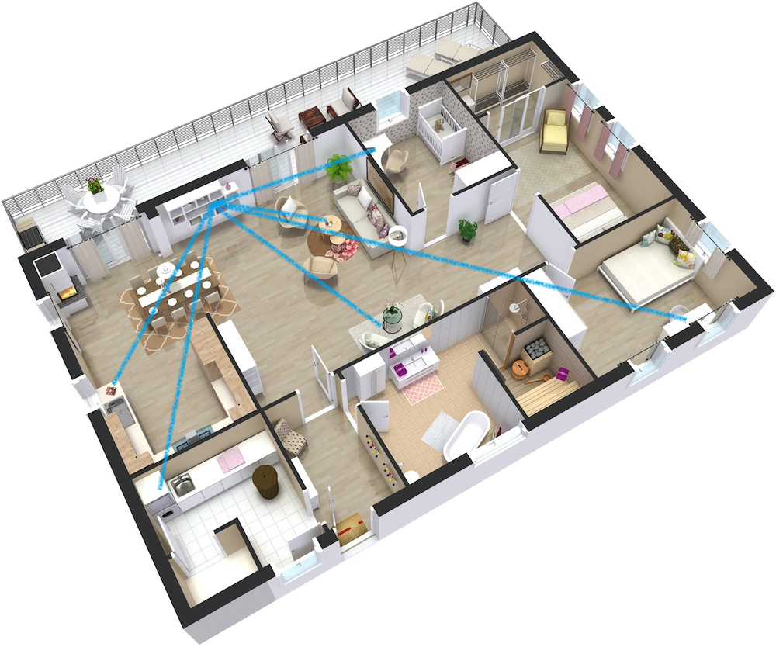
Sensing Initiator is an AP STA: Use cases 1/2
Set of use cases 1: Home environment.
Makes use of clients found in various locations inside the house.
  Measurements are taken with multiple clients, which could be used to characterize different rooms and floors.
  High level of device diversity.
  Wide coverage.
Sensing applications include:
  Security and safety.
    See, for example, [2].
  Energy management and control.
  Clientless positioning.

Slide 6
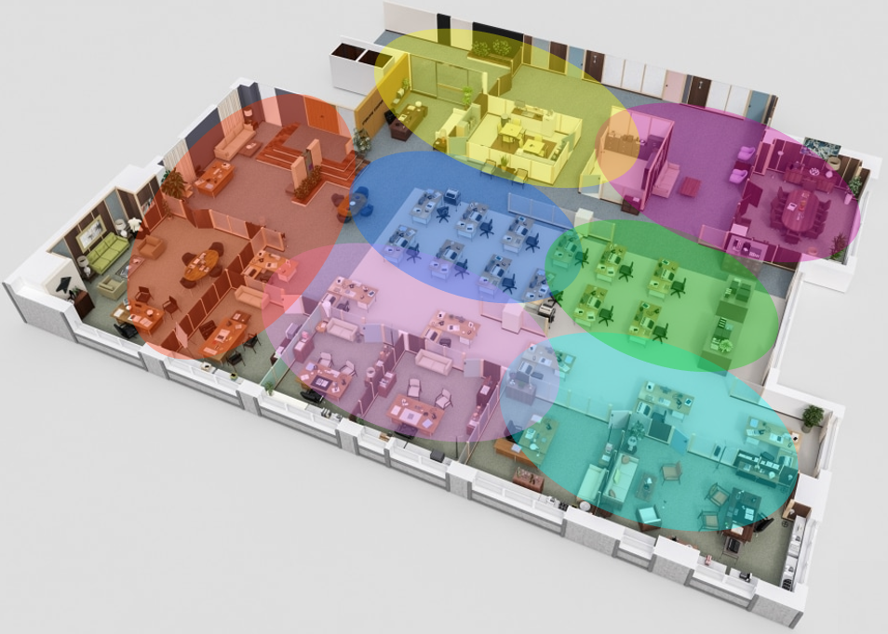
Sensing Initiator is an AP STA: Use cases 2/2
Set of use cases 2: Enterprise.
Example enterprise environment: Each color-coded area corresponds to the coverage/sensing area of an AP; measurements obtained by an AP roughly characterizes its coverage area.
Makes use of APs and clients found in various locations in the environment.
  High level of device diversity.
Sensing applications include:
  Security and safety; energy management and control; clientless positioning.
  Space-usage analytics.
  Smart housekeeping (hotels, for instance).

Slide 7
Outline
Abstract and outline
Sensing initiator is an AP STA
  Use cases
Sensing initiator is a non-AP STA
  Use cases
  Procedures to support multiple sensing responders
Conclusions

Slide 8

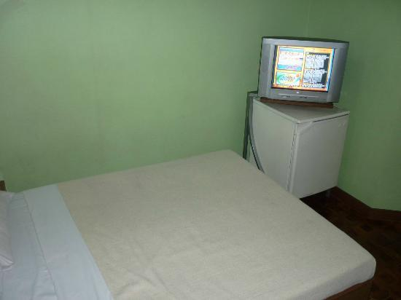
Sensing Initiator is a non-AP STA: Use-cases 1/2
Sensing initiator is a non-AP STA
  Sensing transmitter(s) could be the sensing initiator (feedback required) or sensing responders.
Use cases:
Proximity detection
  Wake-up: Detection of a user approaching the system, enhanced user experience.
  Security: Detection of a user walking away from the system, power save and security.
Presence detection
  Detection of a potential user in proximity to the device.
  Bandwidth management: Pause and/or lower resolution of streaming content based on the detection of presence/absence of a user.

Slide 9

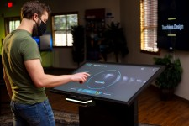
Sensing Initiator is a non-AP STA: Use-cases 2/2
https://www.newswire.com/news/touchless-design-initiative-will-create-touchless-kiosks-for-museums-21174838
Multi-user presence detection
  Example – Security: System identifies the presence of a user and tracks it over time. Presence of a second user is detected, and system notifies the user.
Touchless interaction
  Detection of gestures performed by a user in proximity to the device.
  Gestures could be as simple as left/right for page sweep or as complex as (touchless) handwriting.

Slide 10
Sensing Initiator is a non-AP STA: Single STA
Sensing initiator (non-AP STA) obtains measurements using the AP (sensing responder) that it is associated with.
  WLAN sensing capabilities could be exchanged during the association process.
  Client can trigger transmissions from sensing responders dynamically or through a schedule.
  Sensing transmitter could be the client (AP would be the sensing receiver, feedback required) or the AP (client would be the receiver).
Low level of device diversity.
  Only one sensing responder is used.
MIMO transmissions could be used, to a certain extent, to increase diversity.
Device diversity further enhance WLAN sensing and could be required to support certain applications.
Note: We consider the “unassociated” case later in the contribution.

Slide 11
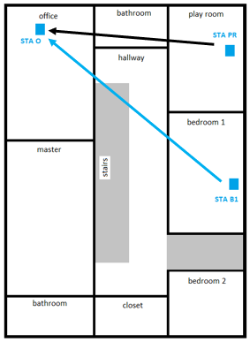
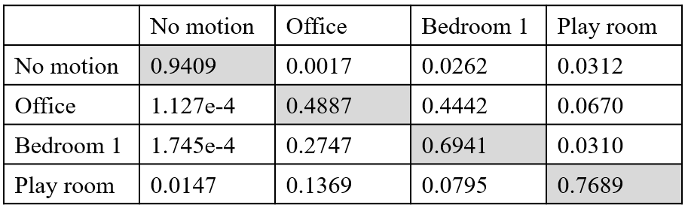
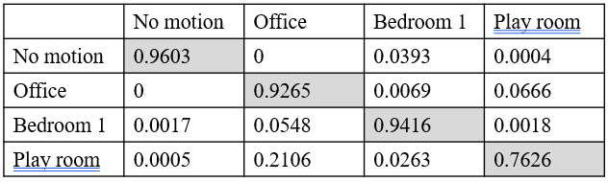
Experimental Results ([3] and [4])
As discussed in detail in [3] and [4], we performed experiments to evaluate the use of WLAN sensing to detect motion and identify where (e.g., in which room) it happens.
For ease of presentation and analysis, only three STAs are considered: STA O, STA PR, and STA B1.
predicted
Single sensing transmitter (STA B1)
actual
Two sensing transmitters (STA PR and STA B1)
Example – Confusion matrix: The system mistakes movement in the play room as movement in bedroom 1 with a probability equal to 0.0263.

Slide 12
Sensing Initiator is a non-AP STA: Multiple Responders
Scenario: Client establishes multiple sensing sessions with “other” APs (that is, APs other than the one to which the client is associated with).
  APs must have the appropriate capability/functionality and be able to support the request.
  Requires negotiation of parameters and scheduling, for example.
If MAC-level security is a requirement (e.g., use of protected management frames), a security context could be established by using PASN (pre-association security negotiation).
  Procedure defined by TGaz.

Slide 13
Sensing Initiator is a non-AP STA: Multiple Responders
control
802.11be is currently working on a multi-AP feature. Different models and functionalities are being considered.
WLAN sensing could re-use multi-AP procedures or, if needed, define modifications necessary to allow for a client to obtain measurements using multiple APs.
Note: The multi-AP feature can also be used to enhance WLAN sensing when the sensing initiator is an AP STA.
measurements

Slide 14
Sensing Initiator is a non-AP STA: Multiple Responders
802.11be is also currently working on enabling peer-to-peer (P2P) frame exchange.
  AP shares time resources obtained in a TXOP for P2P frame exchanges.
WLAN sensing could re-use P2P or, if needed, define modifications necessary to allow for a client to obtain measurements using PPDUs transmitted by other clients.
Note: WLAN sensing based on P2P-like procedures are particularly advantageous in scenarios where only one AP STA is present.
control
measurements

Slide 15
Outline
Abstract and outline
Sensing initiator is an AP STA
  Use cases
Sensing initiator is a non-AP STA
  Use cases
  Procedures to support multiple sensing responders
Conclusions

Slide 16
Conclusions
The “sensing initiator is an AP STA” and “sensing initiator is a non-AP STA” configurations have unique characteristics and standard requirements. Since there are use cases of value for both configurations, the WLAN Sensing amendment should support both.
The three procedures here discussed for client-based sensing are not the only/“best” procedures possible. More work is needed, and SENS SG members are encouraged to contribute to the discussion.
  Example: When looking into 11be features such as multi-AP and P2P, timelines and dependency between 11be and 11bf must be considered.

Slide 17
SP
Do you agree that support of both “sensing initiator is an AP STA” and “sensing initiator is a non-AP STA” applications should be a functional requirement of a WLAN sensing amendment?

Slide 18
References
[1] 20/0807r3, WLAN Sensing Definitions
[2] Wireless Broadband Alliance, Wi-Fi Sensing Group, whitepaper, Oct. 2019
[3] 19/1416r0, Wi-Fi Sensing: Cooperation and Standard Support
[4] 19/1772r0, Presence and Proximity Detection Using WLAN Sensing

