Slide 1
Overview of WLAN sensing protocol
Date: 2020-08-16
Authors:
Name | Affiliations | Address | Phone | Email
Cheng Chen | Intel |  |  | cheng.chen@intel.com
Claudio da Silva |  |  |  | claudio.da.silva@intel.com
Bahareh Sadeghi |  |  |  | bahareh.sadeghi@intel.com
Carlos Cordeiro |  |  |  | carlos.cordeiro@intel.com
Notes:
September 2012

Slide 2
Abstract
In this contribution, we propose a possible framework of a WLAN sensing protocol.
We divide a sensing session into different phases and go through them individually.

Slide 3
Assumptions
We use the terminologies defined in [1] to describe the different roles in a sensing session.
i.e., Sensing initiator/responder, Sensing transmitter/receiver.
Discovery of sensing capable STAs is already done during association.
i.e., AP and STAs exchange sensing related capabilities during association.
Therefore, in this contribution we assume all STAs involved in a sensing session are authenticated and associated.

Slide 4
Protocol Overview
Negotiation
Establishment of a sensing session
Identification of sensing transmitter(s) and sensing receiver(s)
Determination of associated parameters of sensing transmissions
Measurement
Sensing transmitters perform transmissions to sensing receivers for measurement
Reporting (Dependent on scenarios)
Feedback of the measurement results to Sensing Initiator
May be omitted if the sensing initiator is also the only sensing receiver [1]
Teardown (May be implicit)
Ending the sensing session
Sensing Initiator
Sensing Responder
Negotiation
Measurement and reporting
Teardown

Slide 5
Negotiation
We need to define a specific information element, say, Sensing Parameters element, to include related information that will be exchanged between the sensing initiator and sensing responder during negotiation. The information may include:
Identification of the roles of sensing transmitter and sensing receiver
Scheduling information of sensing periods/windows
Parameters of transmissions used for WLAN sensing, such as channel bandwidth and number of antennas.
Measurement feedback type
Other sensing parameters.
Sensing Initiator
Sensing Responder
Sensing Request
ACK
Note: The ACK may not be necessary depending
on how we define the Sensing Request/Response
frame.
Sensing Response
ACK

Slide 6
Measurement and Reporting
Sensing report is optional, depending on the roles of sensing transmitter and receiver.
When the sensing initiator is also the only sensing receiver, then there is no need to feedback the sensing measurement results.
Sensing Initiator
Sensing Responder
Sensing Initiator
Sensing Responder
Sensing transmissions
Sensing Measurement Feedback
Sensing transmissions
When sensing initiator is the
sensing transmitter
When sensing initiator is the
sensing receiver

Slide 7
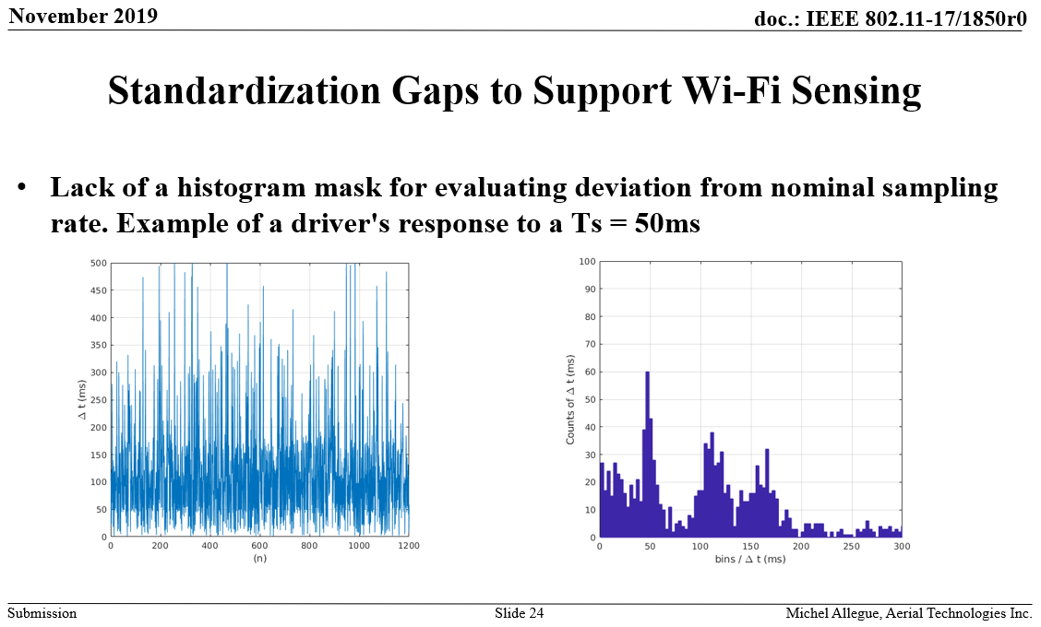
Measurement and Reporting
Scheduling of transmissions used for sensing measurement is key to obtain a more regular “sampling interval” of the channel and, therefore, improve WLAN sensing.
Example given in 19/1850r0 by Michel Allegue (Aerial) [2]:

Slide 8
Measurement and Reporting
Transmissions used for measurement within a sensing session may be defined to have certain characteristics.
Example: PHY configuration freeze/hold – PPDUs used for measurement shall be transmitted with same set of transmit parameters
Different scheduling options should be considered.
Example 1: Regular interval
Example 2: “Bursts”

Slide 9
Termination
Implicit sensing session termination
A sensing session automatically terminates at the end of the sensing session negotiated between the sensing initiator and sensing responder.
Explicit sensing session termination
A sensing session may also be terminated before the end of the sensing session through some message.
For example, by adding some specific indications in the Sensing PPDUs or Sensing Measurement Feedback to enable the sensing transmitter or receiver to terminate the sensing session.
Alternatively, define a separate Sensing Termination frame for either the sensing initiator or responder to terminate the sensing session.
Slide 9

Slide 10
Conclusions
In this contribution we proposed a high-level overview of the framework of a WLAN sensing protocol consisting of several phases.

Slide 11
References
[1] 11-20-0807-03-SENS-WLAN-Sensing-Definitions
[2] 11-19-1850-00-SENS-wi-fi-sensing-technical-feasibility-standardization-gaps

