Slide 1
DUP mode PAPR Reduction
Date: 2020-08-05
Authors:
Name | Affiliations | Address | Phone | email
Ron Porat | Broadcom |  |  | ron.porat@broadcom.com
Srinath Puducheri
Karim Nassiri-Toussi

Slide 2
Abstract
In [1], SP #1 passed for a new DUP mode for EHT with a TBD related to PAPR
[2] proposes a PAPR reduction schemes for the DUP mode
We have looked at various PAPR reduction schemes and propose our preferred scheme

Slide 3
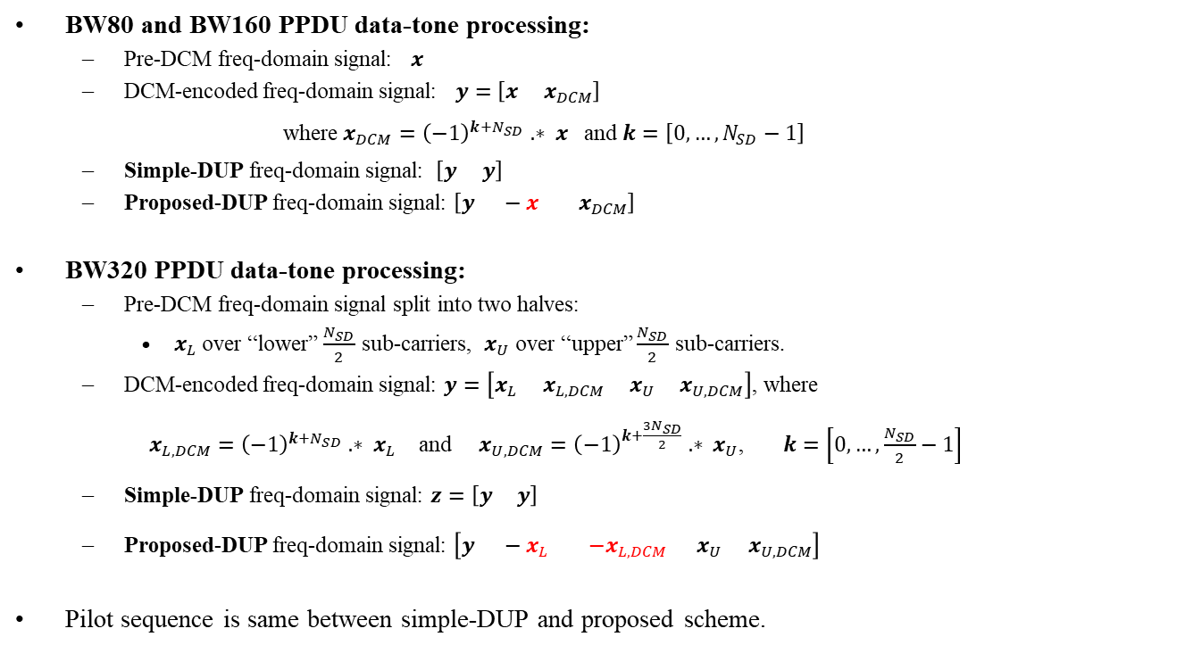
Proposed DUP mode for reducing PAPR
BW80 and BW160 PPDU data-tone processing:
  Pre-DCM freq-domain signal: $x$
  DCM-encoded freq-domain signal: $y=\left[x x_{DCM}\right]$
    where $x_{DCM}={\left(−1\right)}^{k+N_{SD}} .∗ x$ and $k=\left[0,…,N_{SD}−1\right]$
  Simple-DUP freq-domain signal: $\left[y y\right]$
  Proposed-DUP freq-domain signal: $\left[y −x x_{DCM}\right]$
BW320 PPDU data-tone processing:
  Pre-DCM freq-domain signal split into two halves:
    $x_{L}$over “lower” $\frac{N_{SD}}{2}$ sub-carriers, $x_{U}$ over “upper” $\frac{N_{SD}}{2}$ sub-carriers.
  DCM-encoded freq-domain signal: $y=\left[x_{L} x_{L,DCM} x_{U} x_{U,DCM}\right]$, where
    $x_{L,DCM}={\left(−1\right)}^{k+N_{SD}} .∗ x_{L}$ and $x_{U,DCM}={\left(−1\right)}^{k+\frac{3N_{SD}}{2}} .∗ x_{U}$, $k=\left[0,…,\frac{N_{SD}}{2}−1\right]$
  Simple-DUP freq-domain signal: $z=\left[y y\right]$
  Proposed-DUP freq-domain signal: $\left[y −x_{L} {−x}_{L,DCM} x_{U} x_{U,DCM}\right]$
Pilot sequence is same between simple-DUP and proposed scheme.

Slide 4
Simulation results – BW80
PAPR evaluated with oversampling factor = 4
Scheme | Mean PAPR (dB)
DCM | 8.38
Simple-DUP | 10.99
Proposed-DUP | 8.77

Slide 5
Simulation results – BW160
PAPR evaluated with oversampling factor = 4
Scheme | Mean PAPR (dB)
DCM | 8.76
Simple-DUP | 11.41
Proposed-DUP | 9.11

Slide 6
Simulation results – BW320
PAPR evaluated with oversampling factor = 4
Scheme | Mean PAPR (dB)
DCM | 9.19
Simple-DUP | 11.86
Proposed-DUP | 9.53

Slide 7
Conclusion
The proposed scheme flips the sign on the data tones in the third repeated group of data tones and provides low PAPR with simple complexity
  For 80 and 160 flipping the sign on the original non-DCM data tones

Slide 8
References
“6GHz LPI Range Extension,” IEEE 802.11-20/0965r4
“PAPR Issues for EHT ER SU PPDU” IEEE 802.11-20/1135

Slide 9
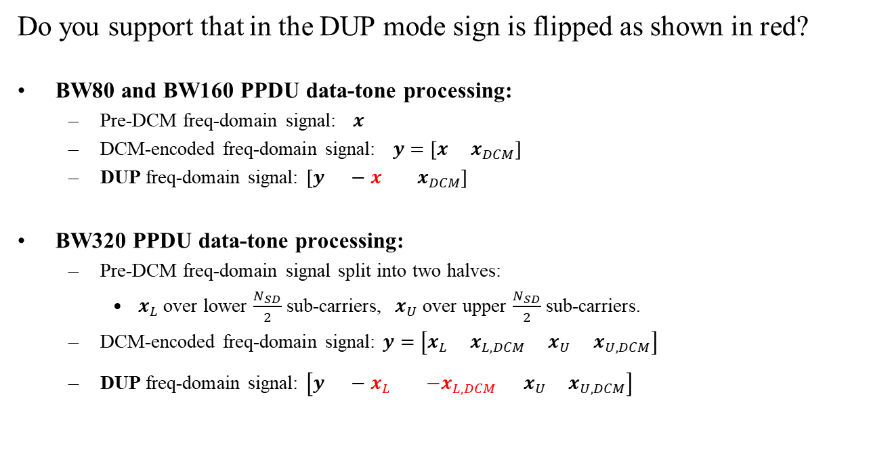
SP #1
Do you support that in the DUP mode sign is flipped as shown in red?
BW80 and BW160 PPDU data-tone processing:
  Pre-DCM freq-domain signal: $x$
  DCM-encoded freq-domain signal: $y=\left[x x_{DCM}\right]$
  DUP freq-domain signal: $\left[y −x x_{DCM}\right]$
BW320 PPDU data-tone processing:
  Pre-DCM freq-domain signal split into two halves:
    $x_{L}$over lower $\frac{N_{SD}}{2}$ sub-carriers, $x_{U}$ over upper $\frac{N_{SD}}{2}$ sub-carriers.
  DCM-encoded freq-domain signal: $y=\left[x_{L} x_{L,DCM} x_{U} x_{U,DCM}\right]$
  DUP freq-domain signal: $\left[y −x_{L} {−x}_{L,DCM} x_{U} x_{U,DCM}\right]$

