Slide 1
E-SIG Detection with Different Puncturing Patterns
Date: 2020-08-03
Authors:
Name | Affiliation | Address | Phone | Email
Junghoon Suh | Huawei |  |  | junghoon.suh@huawei.com
Yan Xin |  |  |  | yan.xin@huawei.com
Mengshi Hu |  |  |  | humengshi@huawei.com
Osama Aboul-Magd |  |  |  | osama.aboulmagd@huawei.com

Slide 2
Background
80 MHz Preamble Detection and 2 content channels in each 80 MHz of E-SIG are decided [1][2]
There shall be a variable MCS and variable length EHT-SIG, in an EHT PPDU sent to multiple users [3]
Since 40 MHz content channels are duplicated in each 80 MHz E-SIG, we may achieve combining gains for E-SIG detection in case of no preamble puncturing in the 80 MHz segment
We observed even further gain with different puncturing patterns applied to duplicated 40 MHz content channels
The overhead reduction in E-SIG is an imminent goal for our Release 1 progress
The additional gain with the different puncturing patterns applied to the duplicated 40 MHz may help increase the MCS, especially for those MCSs in the boundary

Slide 3
40 MHz Duplicated E-SIG in 80 MHz segment with MCS2/4/5 having different puncturing patterns in each 40 MHz
L-Preamble
/ RL-SIG
U-SIG
E-SIG - 1
with MCS2/4/5
L-Preamble
/ RL-SIG
U-SIG
E-SIG - 2
with MCS2/4/5
EHT-STF/LTF
and Payload
L-Preamble
/ RL-SIG
U-SIG
E-SIG - 1
with MCS2/4/5 - A
L-Preamble
/ RL-SIG
U-SIG
E-SIG - 2
with MCS2/4/5 - A
At the receiver side,
(1) We compute the LLR of E-SIG per content channel ← E-SIG is encoded per content channel
(2) Then, insert the zero bit at the punctured positions according to the Puncturing pattern designated to each content channel
(3) Combine the LLRs of primary 40 MHz with that of the secondary 40 MHz
(4) Run the BCC decoder per content channel based on the combined LLRs in Step 3

Slide 4
Puncturing Patterns for the rate of 3/4 (MCS2/MCS4)
* Puncturing Pattern of BCC code rate 3/4 in the current 802.11
* Puncturing Pattern for MCS2/4-A
X₀
X₁
X₂
X₃
X₄
X₅
X₆
X₇
X₈
Information Bits
X₀
X₁
X₂
X₃
X₄
X₅
X₆
X₇
X₈
A₀
A₁
A₂
A₃
A₄
A₅
A₆
A₇
A₈
Coded Bits
A₀
A₁
A₂
A₃
A₄
A₅
A₆
A₇
A₈
TX
B₀
B₁
B₂
B₃
B₄
B₅
B₆
B₇
B₈
Punctured Bit
B₀
B₁
B₂
B₃
B₄
B₅
B₆
B₇
B₈
A₀
B₀
A₁
B₂
A₃
B₃
A₄
B₅
A₆
B₆
A₇
B₈
Bit Punctured
Data
A₀
B₁
A₂
B₂
A₃
B₄
A₅
B₅
A₆
B₇
A₈
B₈
A₀
A₁
A₂
A₃
A₄
A₅
A₆
A₇
A₈
Inserted Zero Bit
A₀
A₁
A₂
A₃
A₄
A₅
A₆
A₇
A₈
B₀
B₁
B₂
B₃
B₄
B₅
B₆
B₇
B₈
Bit Inserted
Data
B₀
B₁
B₂
B₃
B₄
B₅
B₆
B₇
B₈
RX
Y₀
Y₁
Y₂
Y₃
Y₄
Y₅
Y₆
Y₇
Y₈
Decoded Bits
Y₀
Y₁
Y₂
Y₃
Y₄
Y₅
Y₆
Y₇
Y₈

Slide 5
Puncturing Patterns for the rate of 2/3 (MCS5)
* Puncturing Pattern of BCC code rate 2/3 in the current 802.11
* Puncturing Pattern for the rate 2/3 of MCS5-A
X₀
X₁
X₂
X₃
X₄
X₅
Information Bits
X₀
X₁
X₂
X₃
X₄
X₅
A₀
A₁
A₂
A₃
A₄
A₅
Coded Bits
A₀
A₁
A₂
A₃
A₄
A₅
TX
B₀
B₁
B₂
B₃
B₄
B₅
Punctured Bit
B₀
B₁
B₂
B₃
B₄
B₅
A₀
B₀
A₁
A₂
B₂
A₃
A₄
B₄
A₅
Bit Punctured
Data
A₀
A₁
B₁
A₂
A₃
B₃
A₄
A₅
B₅
A₀
A₁
A₂
A₃
A₄
A₅
Inserted Zero Bit
A₀
A₁
A₂
A₃
A₄
A₅
B₁
B₂
B₃
B₄
B₅
Bit Inserted
Data
B₀
B₁
B₂
B₃
B₄
B₅
B₀
RX
Y₀
Y₁
Y₂
Y₃
Y₄
Y₅
Decoded Bits
Y₀
Y₁
Y₂
Y₃
Y₄
Y₅

Slide 6
Simulation setting
SISO 80 MHz w/ 40 MHz duplication
Primary 20 and the secondary 20 MHz are separately encoded in the primary 40 MHz / secondary 40 MHz
MCS1~5 for Primary 40 MHz
MCS1/2A/3/4A/5A for Secondary 40 MHz
Actual channel estimation
BCC and Viterbi decoder
ChanD
Packet size – 10 bytes per content channel

Slide 7
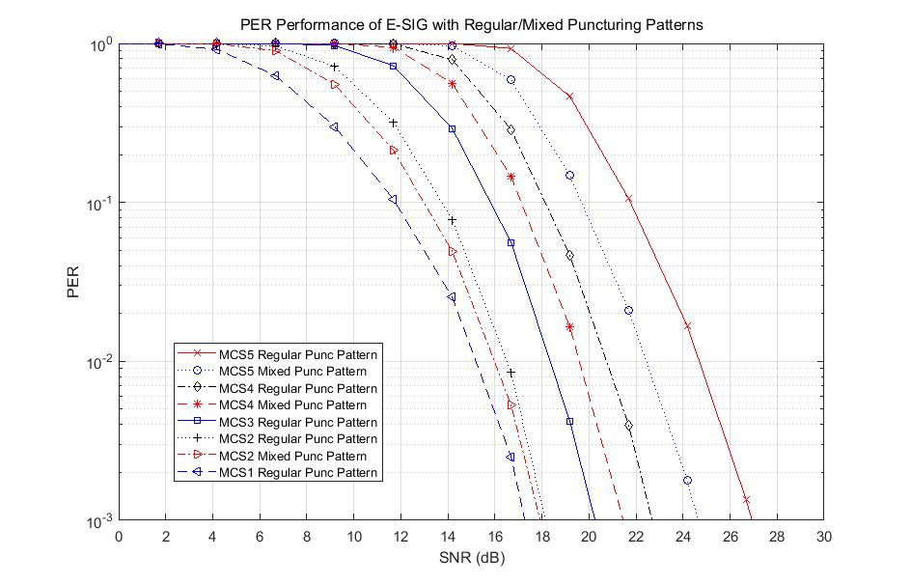
MCS3
MCS2
MCS5
MCS1
MCS4
Mixed Puncturing Pattern: Mixture of Puncturing Pattern between MCS2/4/5 and MCS2A/4A/5A, when combining

Slide 8
Summary
We proposed to apply different puncturing patterns to the duplicated secondary 40 MHz content channels in each 80 MHz segment
Combining gains boosted by 1~2 dB depending on the MCS with the mixed puncturing patterns
The MCS where corresponding SNRs are in the boundary may be upgraded to the higher MCS with the help of our proposal, which may eventually reduce the E-SIG overhead.
We propose MCS0~MCS5 for the E-SIG MCS
with the proposed puncturing patterns for the duplicated channels
DCM for MCS0/1/3/4 is supported for HE SIG-B in 802.11ax

Slide 9
SP1
Do you agree to have MCS0/1/2/3/4/5 available to be applied for the E-SIG field?
Support of DCM for MCS0/1/3/4 is TBD

Slide 10
SP2
For each 80 MHz segment of any EHT-PPDU larger than or equal to 80 MHz BW, do you agree to apply the different puncturing patterns for MCS2/4/5 to two content channels in the secondary 40 MHz of E-SIG?
Different Puncturing patterns are shown in slide 4&5, but not limited to the patterns

Slide 11
Reference
[1] S. Vermani, et. al., “U-SIG structure and preamble processing”, 802.11-20/0380r0, Mar. 2020
[2] D. Lim, et. al., “Consideration for E-SIG Transmission”, 802.11-20/0020r3, Apr. 2020
[3] S. Vermani, et. al., “Further ideas on EHT preamble design”, 802.11-19/1870r4, Nov. 2019

