Slide 1
Spectral Mask for puncturing
Date: 08/01/20
Authors | Email
Xiaogang Chen | Xiaogang.c.chen@intel.com
Qinghua Li
Xinrong Wang

Slide 2
Background
11ax defined spectral mask for preamble puncture but the mask was considered too relax;
ETSI is defining punctured mask in 5GHz[1], which is comprehensive and covered many puncturing cases.
  Although the puncturing in 6GHz has not been discussed, it will very likely reuse the 5GHz definition.
FCC doesn’t have a punctured mask definition in 6GHz
  Only has OOBE mask definition which is the same as the OOBE mask defined in 11ax[2].

Slide 3
11be puncturing mask
Punctured subchannels in 11be include: 20/40/80MHz either on the edge of the PPDU or within the PPDU.
All of the puncturing cases defined in 11be have been covered by the ETSI puncturing mask definition.
  ETSI punctured mask have been debated and harmonized in ETSI meeting with the participants from both WiFi and cellular sides.
  Reusing the puncturing mask defined in ETSI can avoid debating again in IEEE.
  Since it is ETSI mask, vendors need to meet the mask eventually.
Propose 11be puncturing mask reuses the puncturing mask defined in ETSI with necessary changes.

Slide 4
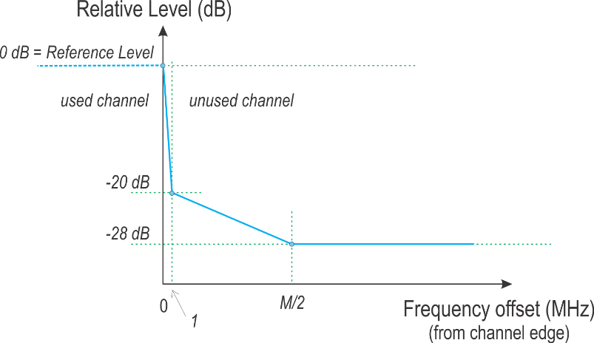
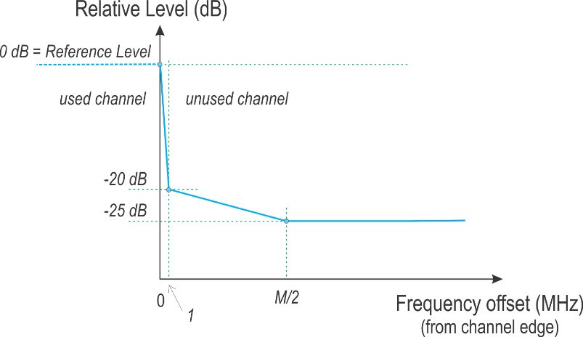
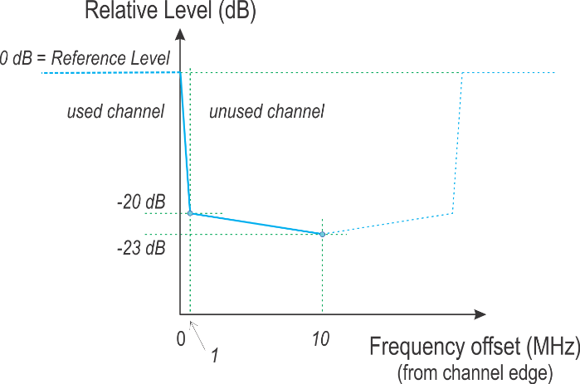
Recap of the ETSI puncturing mask
Edge puncturing:
  Linear interpolation (dB domain) from 0dBr to -20dBr, from 0 to 1MHz frequency offset;
  Linear interpolation (dB domain) from -20dBr to -28dBr, from 1 to M/2 MHz frequency offset.
Middle puncturing >=40MHz:
  Linear interpolation (dB domain) from 0dBr to -20dBr, from 0 to 1MHz frequency offset;
  Linear interpolation (dB domain) from -20dBr to -25dBr, from 1 to M/2 MHz frequency offset.
Middle puncturing 20MHz:
  Linear interpolation (dB domain) from 0dBr to -20dBr, from 0 to 1MHz frequency offset;
  Linear interpolation (dB domain) from -20dBr to -23dBr, from 1 to 10 MHz frequency offset.

Slide 5
Example of 11be edge puncturing
M = 60MHz in this example.
  Yellow dashed line is the 80MHz SEM (for comparison)

Slide 6
Example of the 11be middle puncturing
(40MHz punctured)
M = 40MHz for the left half of the mask;
M = 80Hz for the right half of the mask;
  Yellow dashed line is the 160MHz SEM (for comparison).

Slide 7
Example of the middle puncturing
(20MHz punctured)
Yellow dashed line is the 80MHz SEM (for comparison)

Slide 8
Summary
ETSI defined comprehensive puncturing rules in 5GHz band already;
Propose 11be reuse the rules of subchannel puncturing defined by ETSI with necessary changes.

Slide 9
SP1
Do you agree with the rule of edge channel puncturing below?
When the lowest and/or the highest subchannel(s) is/are punctured in a EHT PPDU, an additional subchannel edge mask as in figure below shall be applied at the lower edge of the lowest occupied subchannel and at the higher edge of the highest occupied subchannel.
  M is the separation in MHz between the lower edge of the lowest occupied subchannel and the higher edge of the highest occupied subchannel in the EHT PPDU.

Slide 10
SP2
Do you agree with the rule of middle subchannel (>=40MHz) puncturing below?
When there are two or more contiguous 20MHz subchannels are punctured in a EHT PPDU, an additional subchannel edge mask as in figure below shall be applied at the lower edge of the lowest punctured subchannel(s) and at the higher edge of the highest punctured subchannel(s).
  M is the contiguous occupied bandwidth adjacent to the punctured subchannel(s).
  The lower edge and higher edge each has its own M which can be different.
  Note: For a frequency that both subchannel edge mask have value greater than -25dBr and less than -20dBr, the higher value of the two subchannel edge mask shall be taken as the overall mask value.

Slide 11
SP3
Do you agree with the rule of middle 20MHz channel puncturing below?
When the puncturing only includes one 20MHz subchannel and the punctured 20MHz subchannel is not at the edge of the EHT PPDU, an additional mask as in figure below shall be applied at the punctured 20MHz subchannel.

Slide 12
Reference
[1] ETSI EN 301 893 V2.1.3519 (202019-0410)
[2] Unlicensed Use of the 6 GHz Band - Report and Order and Further Notice of Proposed Rulemaking.

